Slide 1
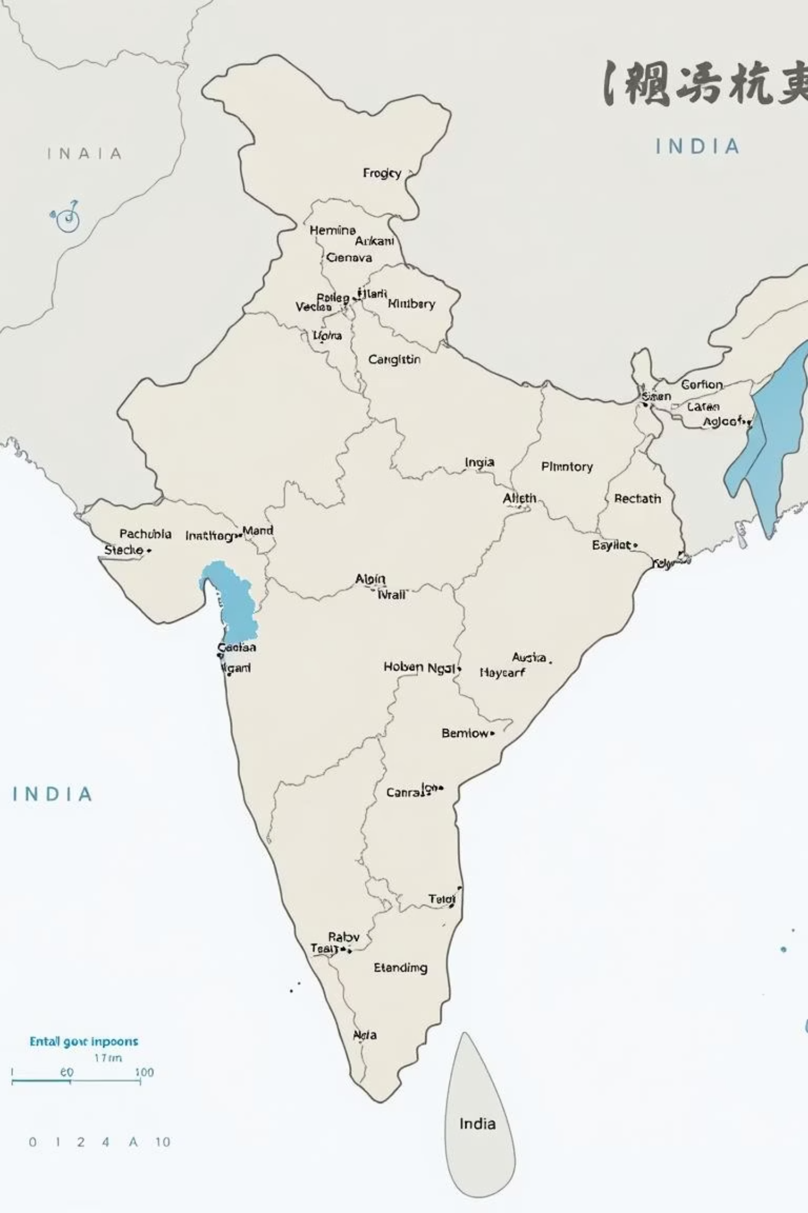
Regional Kingdoms: The Rise of New Powers in Medieval India
Explore the dynamic period in medieval Indian history when powerful regional kingdoms emerged, shaping the subcontinent's political, cultural, and social fabric.

Slide 2
The Emergence of Regional Kingdoms
From Subordination to Sovereignty
The Rise of the Rashtrakutas
New Royal Titles
A prime example is the Rashtrakutas, who were originally subordinate to the Chalukyas but rose to prominence under the leadership of Dantidurga, marking a significant shift in regional power dynamics.
The newly emergent kings adopted grand, ambitious titles such as Maharaja-Adhiraja (Great King, Overlord of Kings) and Tribhuvana-Chakravartin (Lord of the Three Worlds), symbolising their newfound authority and expansive ambitions.
By the 7th century, influential local chiefs, known as samantas, began to assert their independence from larger empires, establishing new power centres across India.

Slide 3
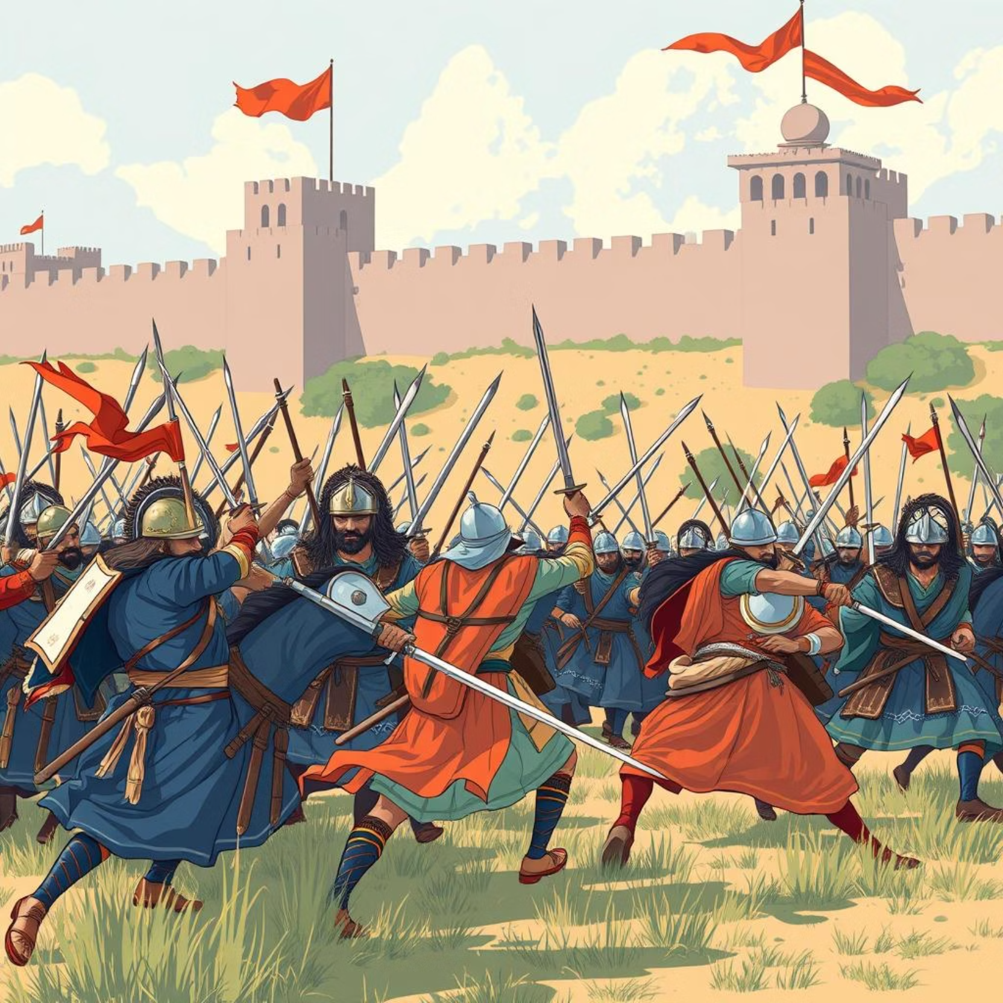
The Tripartite Struggle for Kanauj
The city of Kanauj became the focal point of a prolonged and intense conflict among three major regional powers: the Gurjara-Pratiharas, the Rashtrakutas, and the Palas.
This struggle for control endured for over two centuries, dramatically shaping the political landscape of North India.
Kanauj's strategic location in the fertile Ganga Valley offered unparalleled control over vast agricultural and trade resources, making it a highly coveted prize.
The protracted conflict significantly influenced the early medieval period, leading to shifting alliances and the consolidation of regional identities.

Slide 4
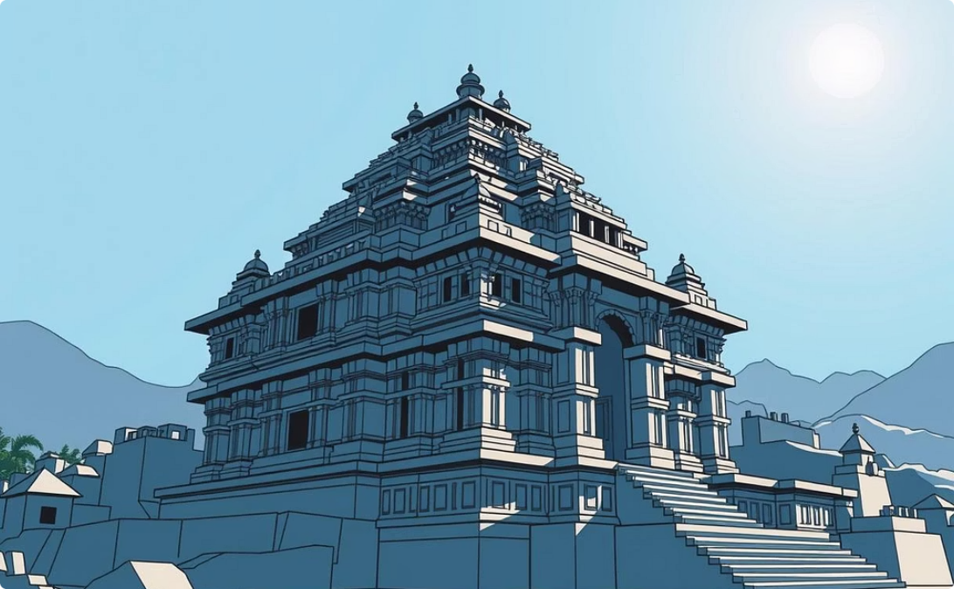
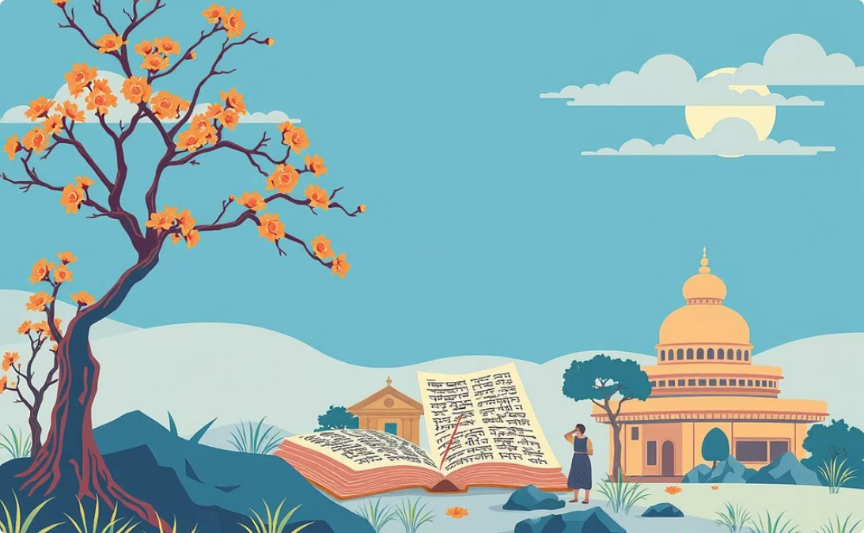
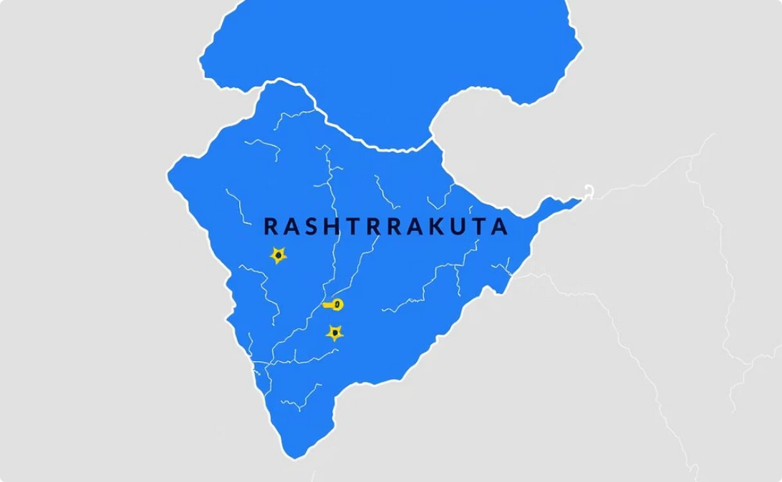
The Rashtrakutas: Patrons of Art and Power
Architectural Marvels
Cultural Development
Regional Dominance
The Rashtrakuta kings were renowned for their patronage of the arts, most notably commissioning the awe-inspiring Kailasa Temple at Ellora, a monolithic structure carved from a single rock, demonstrating remarkable engineering and artistic skill.
Beyond architecture, they actively promoted the Kannada language and its rich literary tradition, fostering a period of significant cultural growth and intellectual advancement within their dominion.
The Rashtrakuta Empire's influence extended prominently across the Maharashtra and Deccan regions, establishing them as a formidable power in central and southern India during their reign.

Slide 5
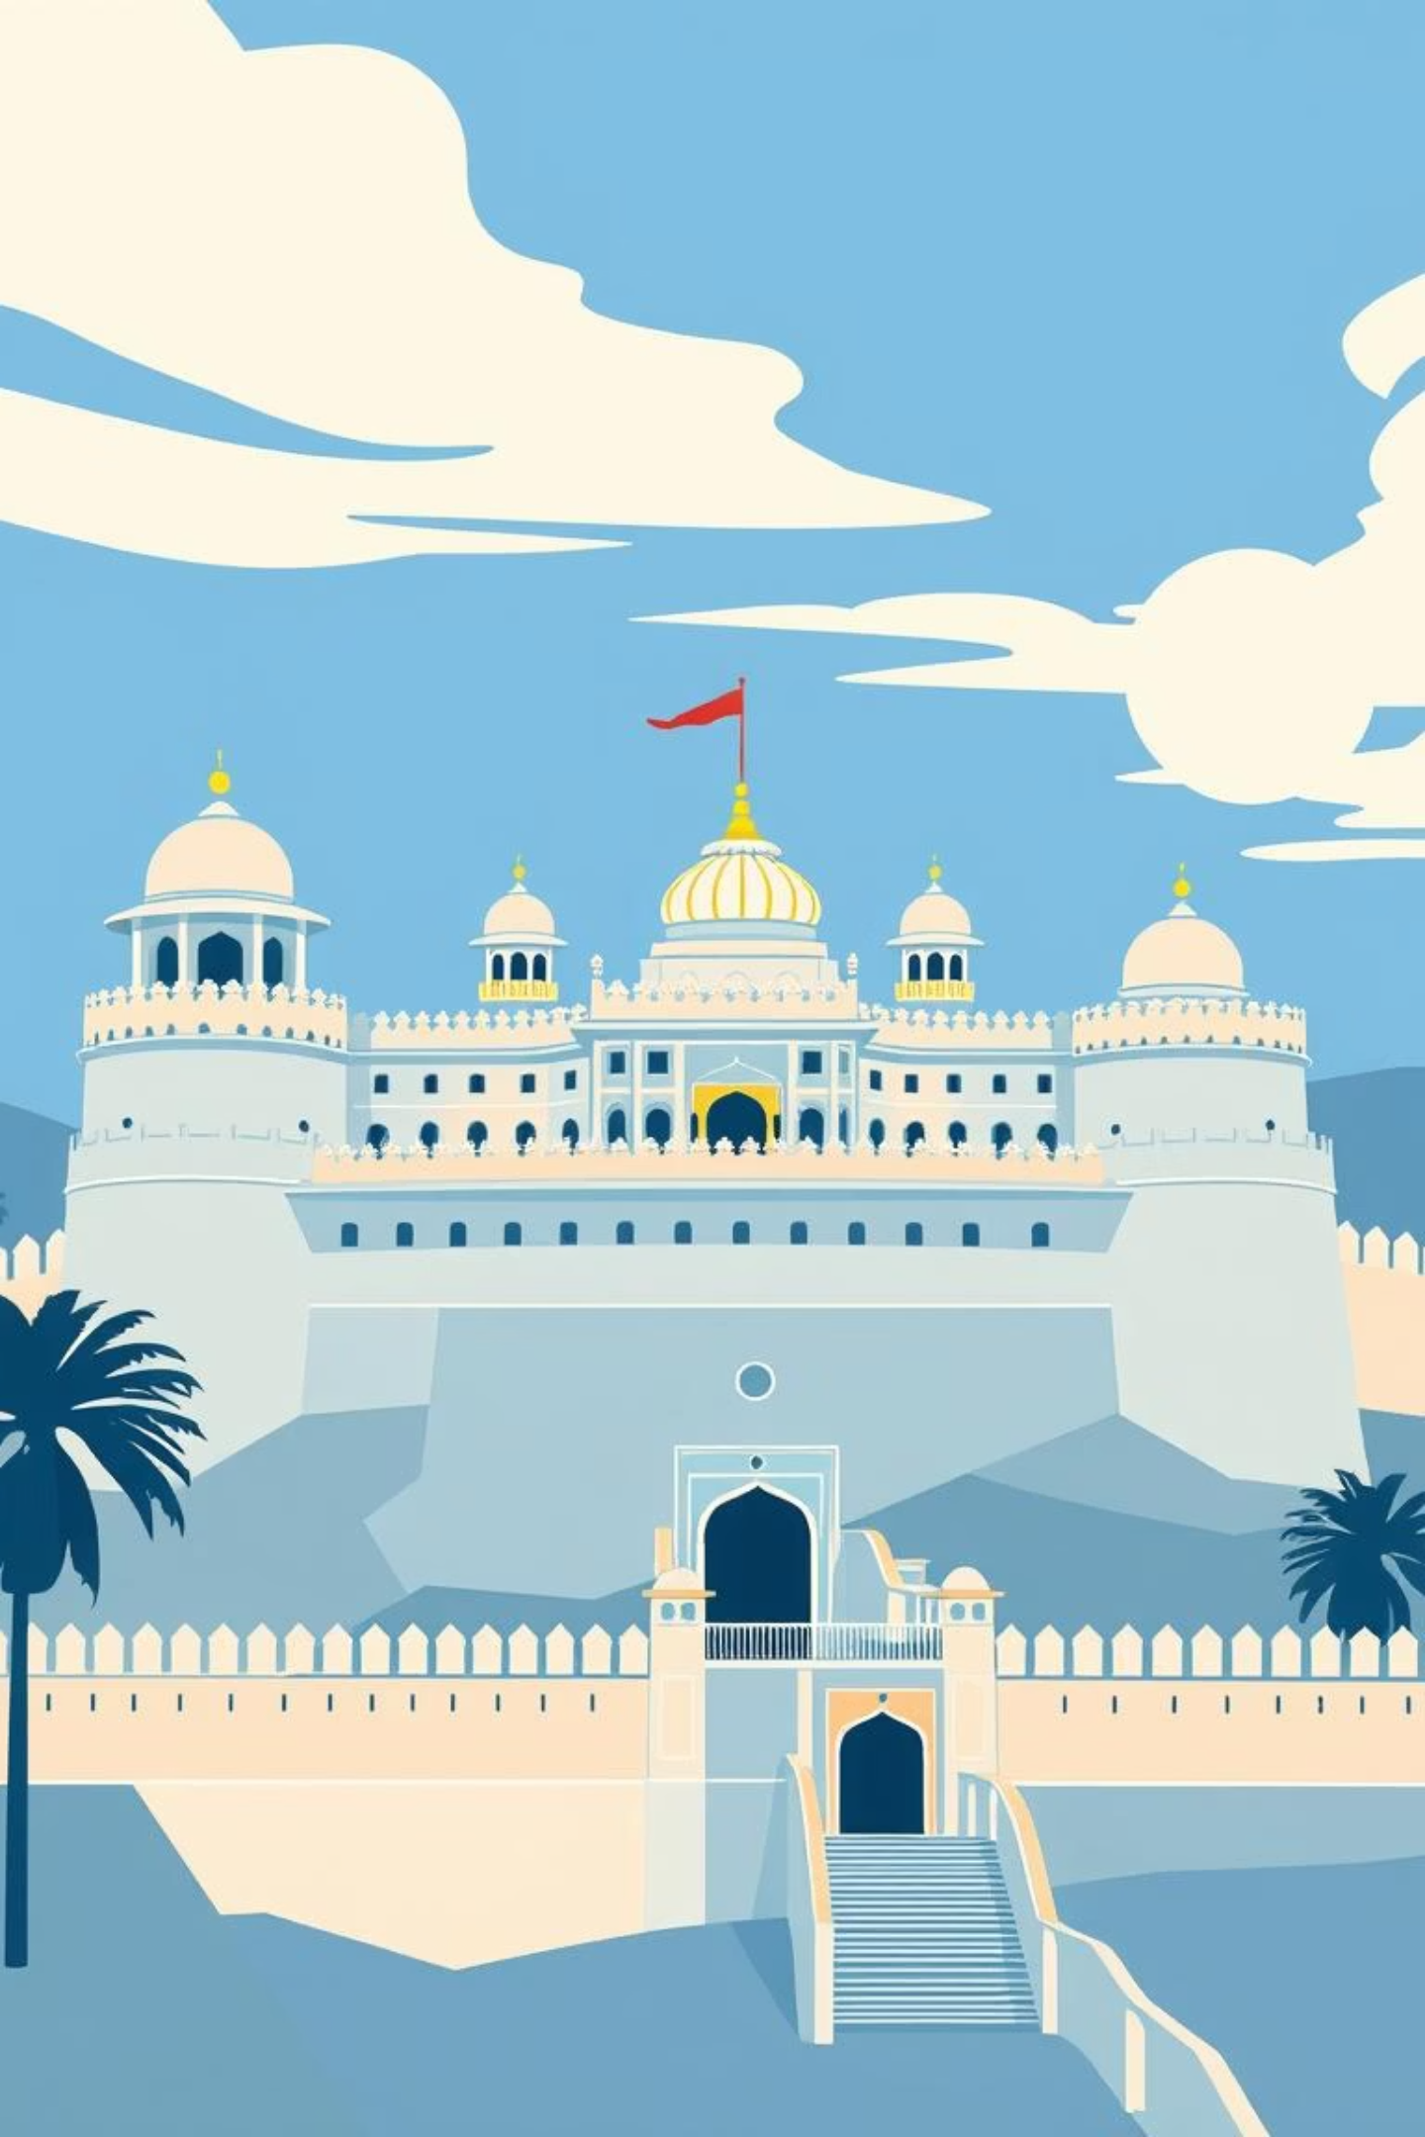
The Rajputs: Warriors of Rajasthan
The valour and legacy of the Rajput clans played a pivotal role in shaping the history and cultural identity of medieval India.
The Rajputs, a collection of valorous clans, claimed noble descent from the ancient Vedic Kshatriyas, identifying proudly as Surya-vanshi (descendants of the Sun God) or Chandra-vanshi (descendants of the Moon God), thereby solidifying their martial heritage.
Key Rajput kingdoms such as Mewar and Marwar emerged as significant centres of power in the Rajasthan region, known for their strong fortifications and fierce independence.
A notable figure, Rana Sanga of Mewar, distinguished himself by expanding his kingdom and valiantly resisting numerous invasions, embodying the enduring Rajput spirit of defiance and honour.

Slide 6






The Chola Empire: Southern Maritime Power
Imperial Expansion
Rajendra Chola further expanded the empire, leading successful expeditions to Bengal and Southeast Asia, earning the title Gangaikondachola (Conqueror of the Ganga).
Naval Supremacy
Rajaraja Chola established a powerful navy, defeating the Pandyas and Cheras, and gaining control over Sri Lanka and the Maldives, asserting Chola dominance in maritime trade routes.
Organised Administration
The Chola administration was highly organised, structured into Mandalams (provinces), Nadus (districts), and efficient village assemblies known as Ur and Sabha, ensuring effective local governance.

Slide 7
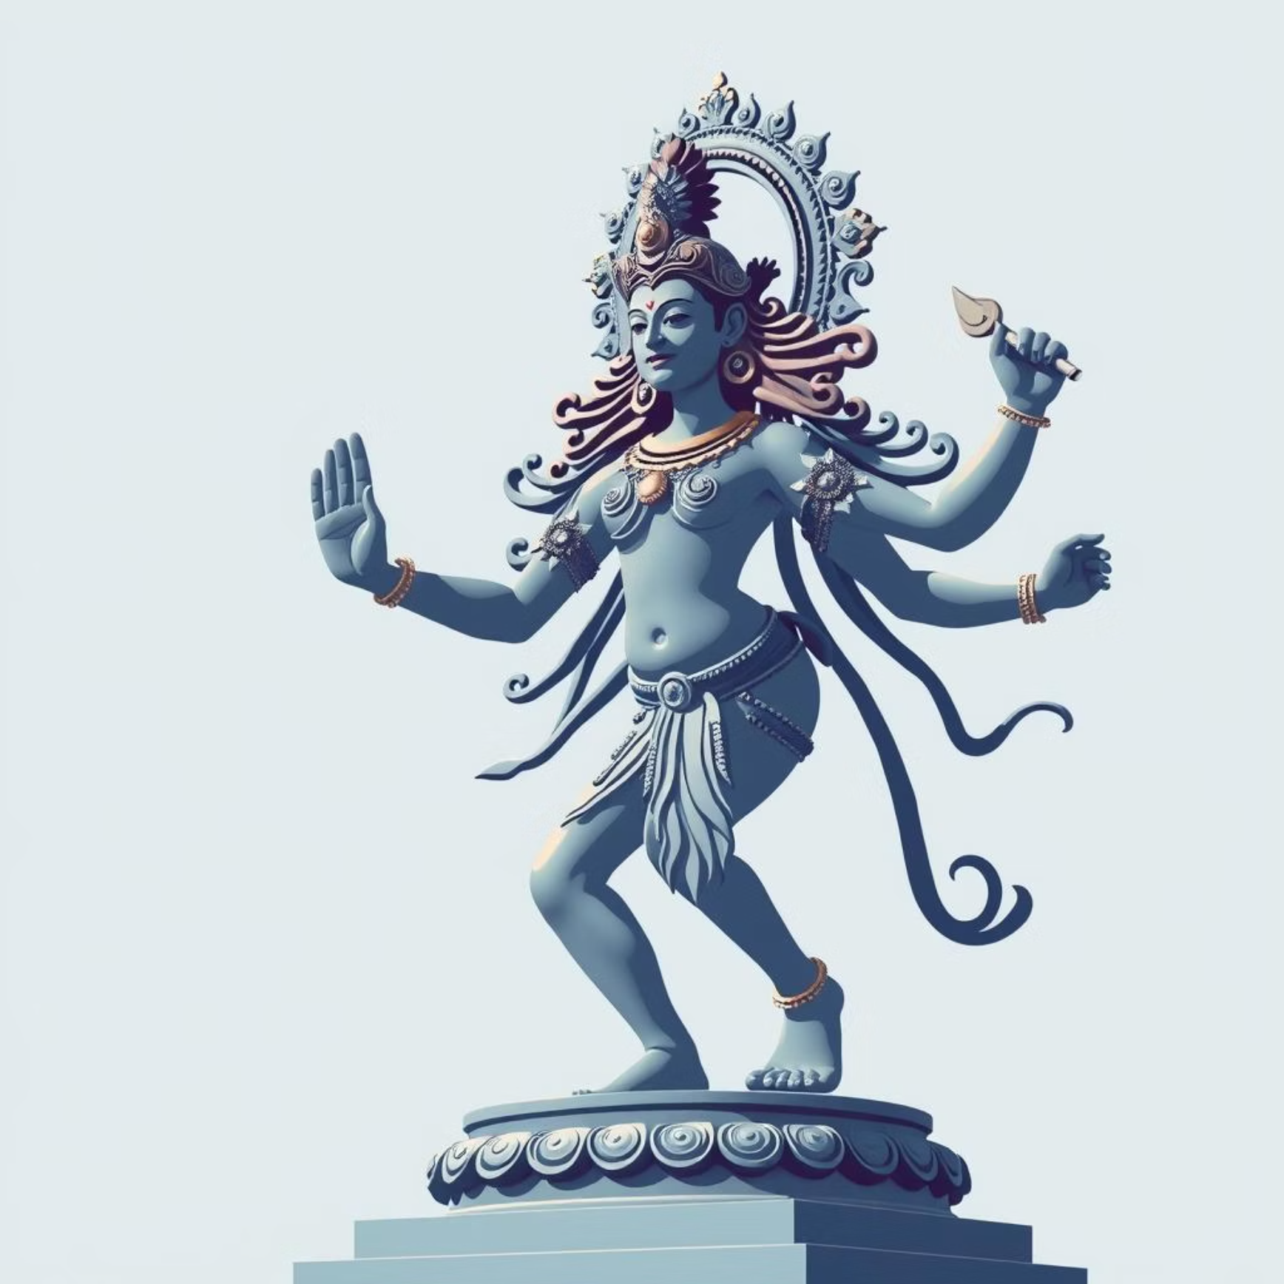
Cultural Flourishing: Art, Architecture, and Language
Artistic Masterpieces
Architectural Legacy
The Chola bronze sculptures, particularly those depicting Lord Shiva as Nataraja (the cosmic dancer), stand as unparalleled masterpieces, showcasing exquisite craftsmanship and deep religious symbolism.
The Vijayanagar Empire left an indelible mark through its extensive promotion of magnificent temple building, alongside pioneering irrigation projects that supported thriving agricultural practices and economic prosperity.
Linguistic Advancement
The Kakatiyas of Warangal were significant patrons of both Sanskrit and Telugu languages, fostering a vibrant literary environment. Meanwhile, the Yadavas of Devagiri thrived through extensive trade networks.

Slide 8



Clash of Kings: Prithviraj Chauhan vs Muhammad Ghori
The battles between Prithviraj Chauhan and Muhammad Ghori marked a pivotal turning point in Indian history, altering the subcontinent's political trajectory for centuries to come.
First Battle of Tarain (1191)
In a decisive confrontation, Prithviraj Chauhan, supported by a confederation of Rajput allies, achieved a significant victory over Muhammad Ghori, showcasing Rajput strength and unity.
Second Battle of Tarain (1192)
Ghori returned with a larger, more formidable army. Facing Ghori's renewed assault largely alone, Prithviraj Chauhan suffered a devastating defeat.
The Dawn of a New Era
This critical battle signalled the beginning of sustained Muslim rule in Northern India, fundamentally reshaping the political and cultural landscape of the region for generations.

Slide 9
Administration and Society in Regional Kingdoms
Revenue Collection
Kings financed their armies and grand temple constructions by collecting diverse revenues from peasants, artisans, and traders, forming the economic backbone of their states.
Official Appointments
Positions of power and authority were frequently granted to influential family members, and these roles often became hereditary, consolidating power within elite lineages.
Village Autonomy
Village assemblies, particularly prominent in the Chola empire, enjoyed considerable autonomy in managing local affairs, demonstrating a decentralised approach to governance.
These administrative structures ensured stability and facilitated the growth of these regional powers.

Slide 10
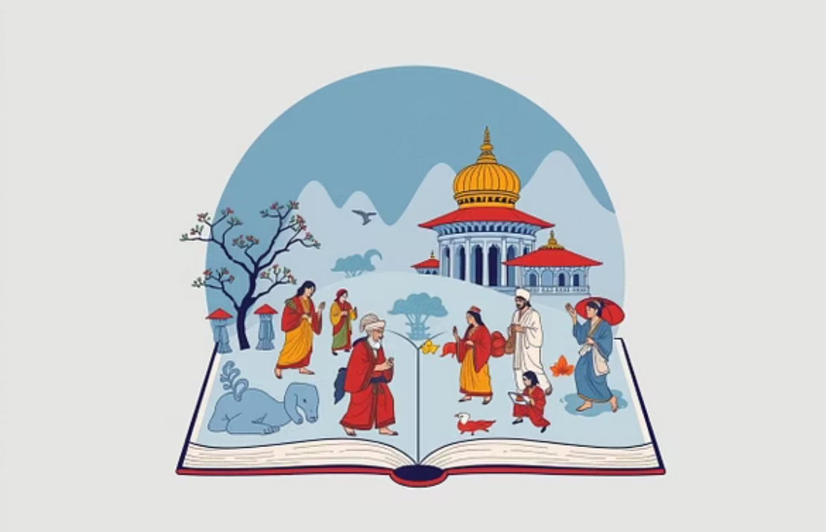
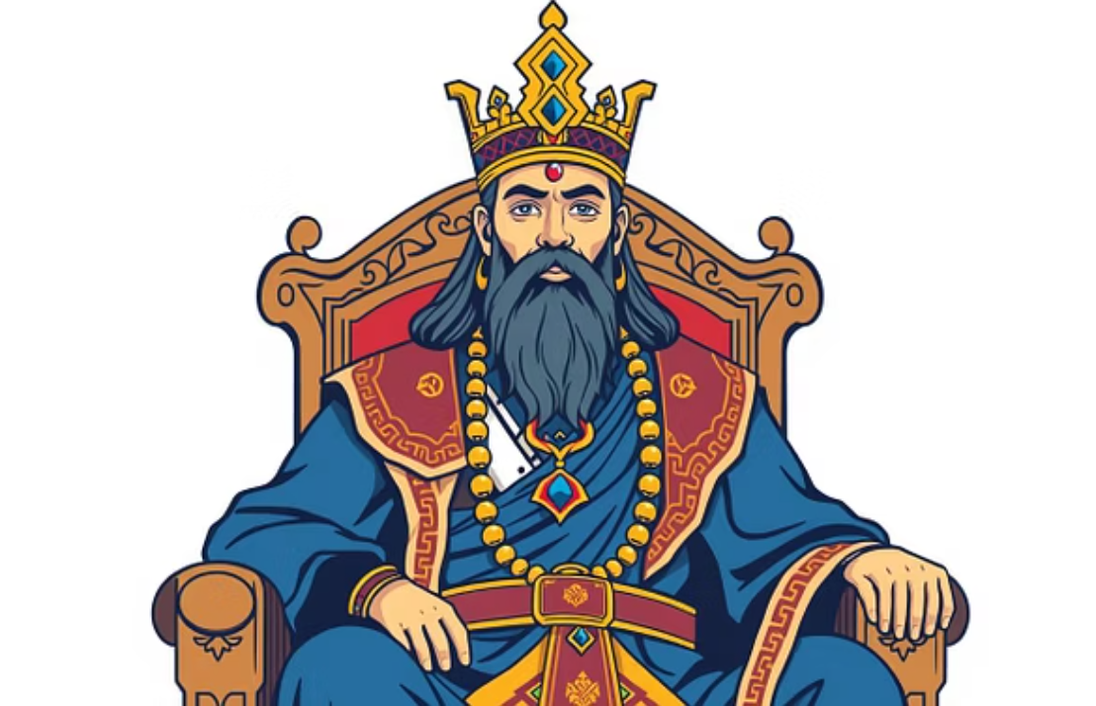
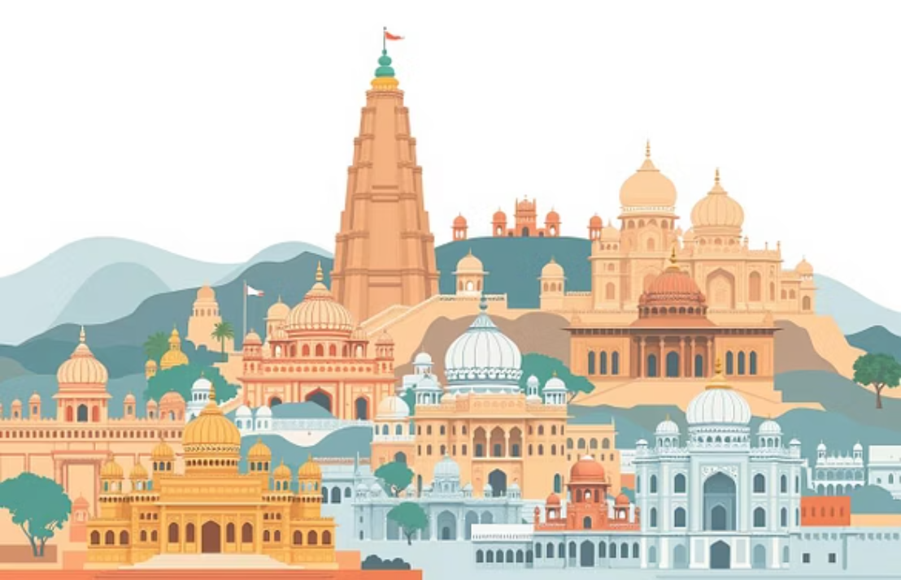
Conclusion: Legacy of Regional Kingdoms
The regional kingdoms of medieval India left an indelible mark on the subcontinent, fundamentally shaping its political structures, cultural expressions, and social norms.
Their rich legacy of art, architecture, and literature continues to inspire and resonate, offering invaluable insights into India's profound heritage.
Understanding their distinct stories and contributions is essential for appreciating the incredible diversity and richness of India's medieval past.

