Slide 1
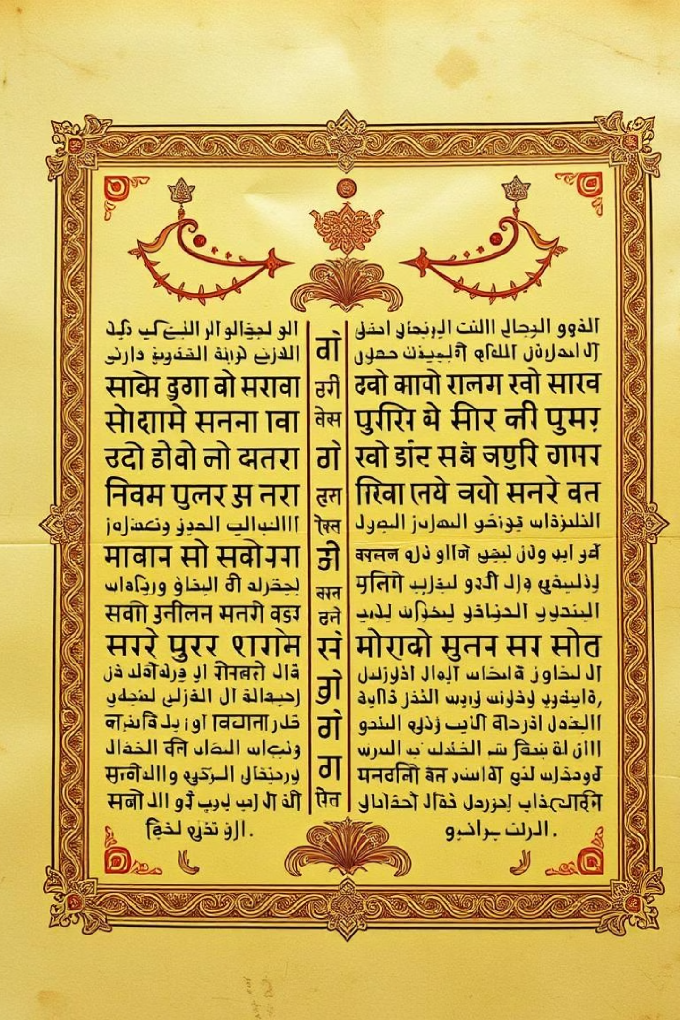
Unveiling Medieval India: A Comprehensive Overview
This presentation delves into the fascinating medieval period of Indian history, exploring its political, social, economic, and cultural facets. We will examine key developments, significant figures, and the rich legacy that continues to influence modern India.

Slide 2
Timeline and Historical Context
8th Century CE
Late 12th Century CE
The medieval period in India commences, marked by significant shifts in political and social landscapes.
Establishment of the Delhi Sultanate, signifying a new era of centralised rule and Islamic influence in northern India.
1
2
3
4
Early Medieval Kingdoms
16th-18th Century CE
Rise of prominent regional powers such as the Pratiharas, Palas, Rashtrakutas, and Cholas, shaping diverse regional identities.
Emergence and consolidation of the Mughal Empire, ushering in an era of political stability, economic prosperity, and cultural synthesis.

Slide 3
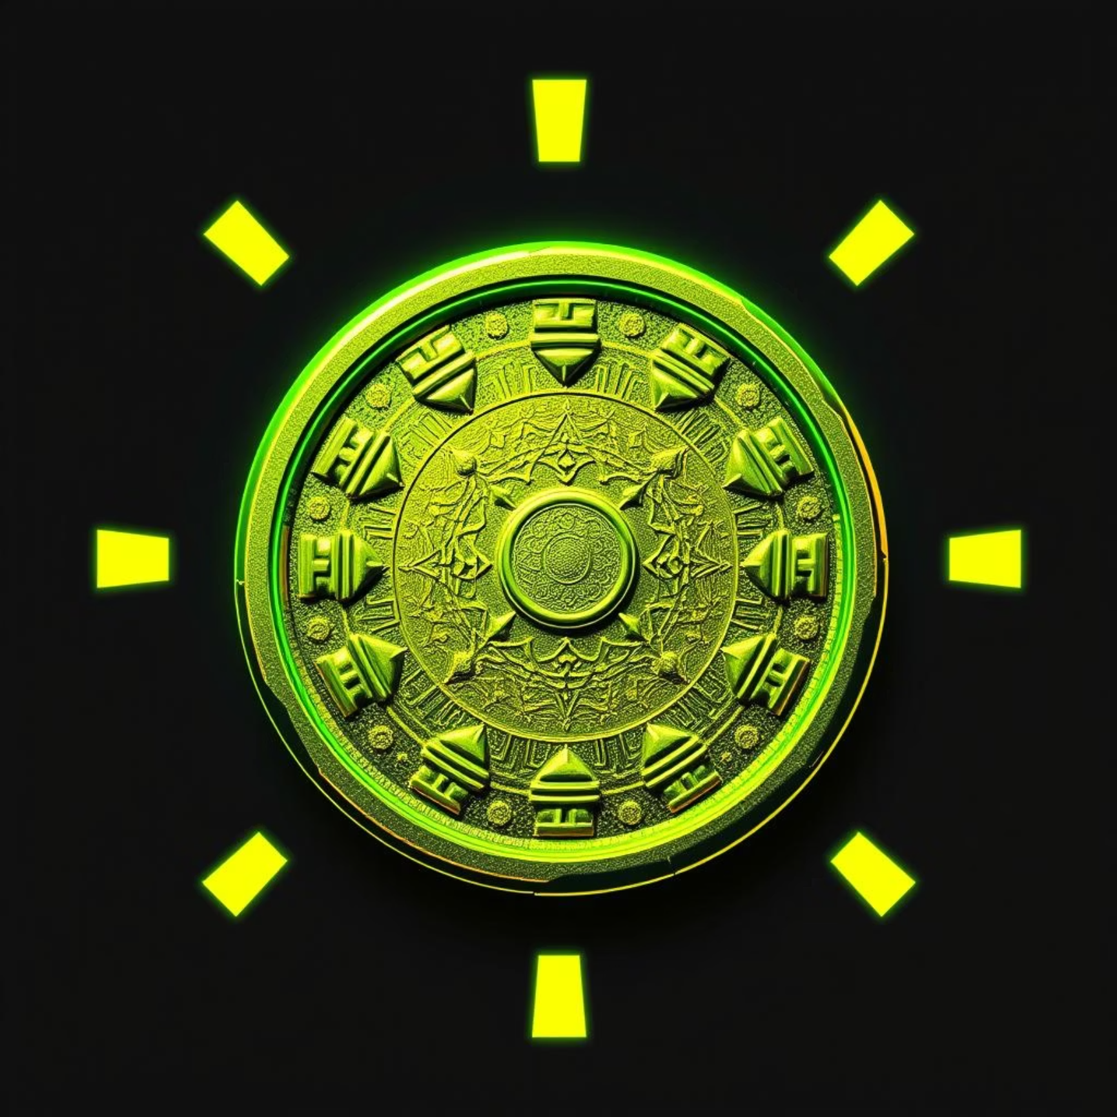
Sources of Medieval History
Archaeological Evidence
Literary Accounts
Valuable insights from forts, mosques, temples, ancient coins, intricate inscriptions, and vibrant paintings provide tangible links to the past.
Key chronicles like Rajatarangini (Kashmir's history), Baburnama (Mughal emperor Babur's memoirs), and Prithviraj Raso offer narrative perspectives.
Foreign Travellers' Narratives
First-hand accounts from visitors like Ibn Batuta, Marco Polo, Duarte Paes, and Nicolo Conti offer external perspectives on Indian society and culture.

Slide 4




Political Developments
Fragmented Kingdoms
Early medieval India witnessed a political landscape dominated by numerous independent regional kingdoms, leading to constant conflicts and shifting allegiances.
Delhi Sultanate Unification
The Sultanate brought a degree of political unification to northern India, introducing a new administrative structure and fostering a unique blend of cultures.
Rise of Regional Powers
Simultaneously, powerful regional kingdoms such as the Bahmani, Vijayanagar, and Maratha empires emerged, challenging central authority and contributing to regional distinctiveness.
Mughal Centralisation
The Mughal Empire established a highly centralised administration, expanding its territories across vast swathes of the subcontinent and ensuring political stability for centuries.

Slide 5
Society and Culture
Cultural Synthesis
Bhakti Movement
Social Hierarchy
Varied Living Standards
The interaction between Hindu and Muslim traditions led to the emergence of a rich, syncretic Indian culture, visible in art, language, and customs.
This devotional movement promoted spiritual equality, challenging rigid social hierarchies and advocating for a direct personal relationship with the divine.
Medieval society was structured with distinct classes: affluent nobles, land-owning zamindars, hardworking peasants, and, in some regions, serfs tied to the land.
Life greatly differed; nobles enjoyed opulent lifestyles in grand palaces, while peasants often faced severe hardships due to high taxation and natural calamities.

Slide 6
Economy and Trade
60%
20%
Trade Growth
Land Revenue System
Under the Delhi Sultanate and Mughal Empire, trade flourished, leading to the expansion of towns and the proliferation of various crafts.
The primary source of state income was land revenue, managed by zamindars responsible for collecting taxes from farmers and forwarding them to the central authority.
10%
10%
International Trade Links
Self-Sufficient Villages
India maintained robust trade relationships with Central Asia, Persia, and European nations, exporting textiles, spices, and precious stones, and importing luxury goods.
In certain regions, a manorial system prevailed, where villages were largely self-sufficient, producing their own food and goods, with limited external reliance.

Slide 7




Education in the Medieval Period
Islamic Education
Curriculum Focus
The predominant education system revolved around madrasas (higher learning) and maktabs (elementary schools), primarily teaching Islamic sciences and law.
Education focused on religious texts, legal principles, and practical knowledge essential for material prosperity and administrative roles.
Assessments
Limited Access
Regular examinations and structured assessments were integral to the system, ensuring academic rigour and evaluating student progress.
Access to education was largely restricted to the elite classes and religious scholars, perpetuating social disparities in learning opportunities.

Slide 8
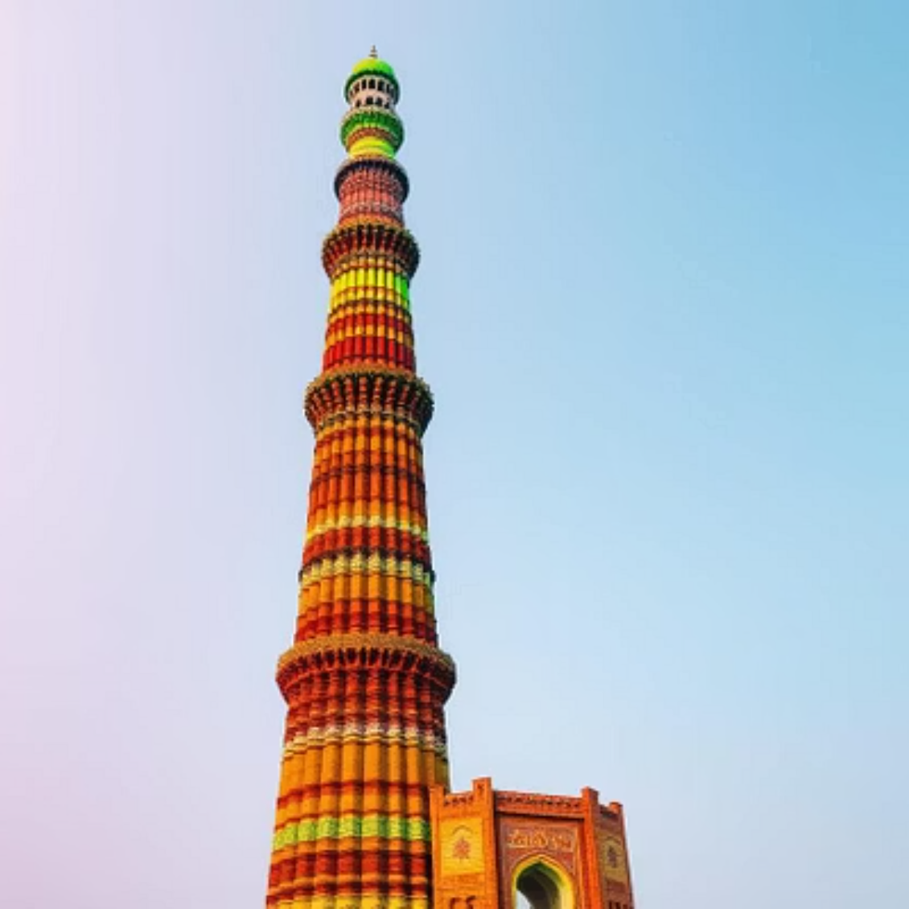
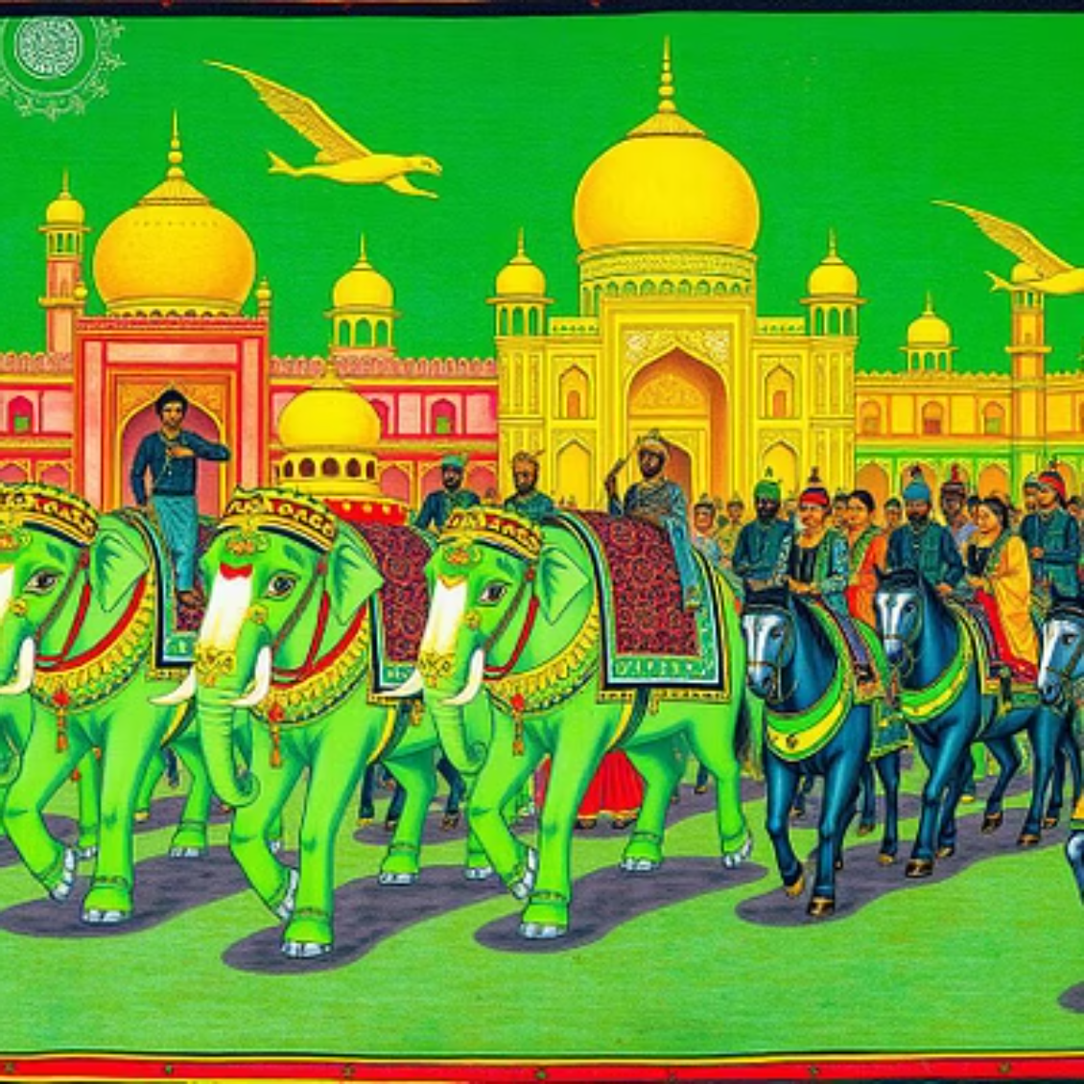
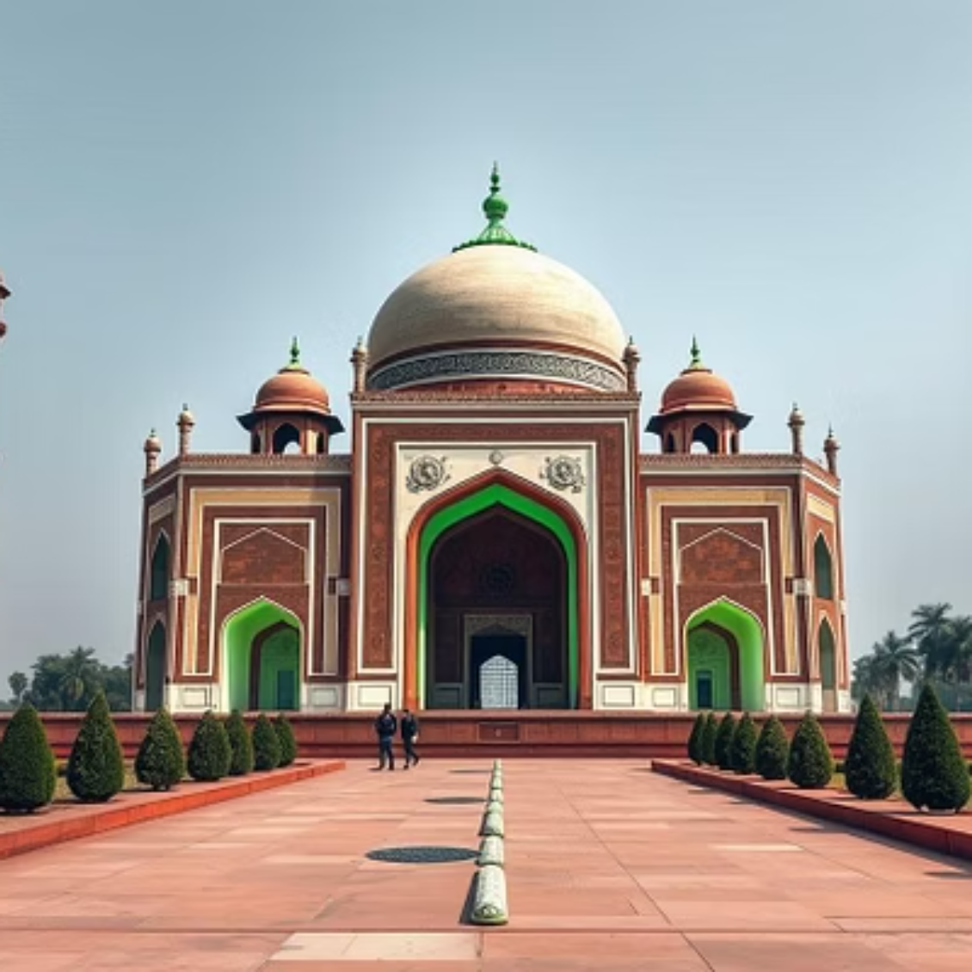
Architecture and Art
Medieval India witnessed a golden age of architectural and artistic innovation. Sultanate and Mughal rulers commissioned magnificent structures like forts, mosques, and tombs, exemplified by the iconic Qutub Minar and Humayun's Tomb. These structures showcased a remarkable blend of Persian, Central Asian, and indigenous Indian architectural styles. Mughal painting, renowned for its intricate details and vibrant colours, flourished as a distinct art form. Music also thrived, with new ragas and instruments evolving. In contrast, European medieval architecture featured grand cathedrals and formidable castles, serving as centres of power and religious life.

Slide 9
Religion and Movements
Spread of Islam
Bhakti and Sufi Movements
Religious Festivals
European Church's Role
Following invasions from the 8th century onwards, Islam gradually spread across the Indian subcontinent, leading to the establishment of Muslim dynasties and the conversion of many.
Festivals and pilgrimages, such as Diwali, Eid, and various temple fairs, served as crucial social events, fostering community bonds and cultural exchange.
For comparative context, in medieval Europe, the Church played a central role in political, social, and cultural life, influencing all aspects of society, from education to governance.
These powerful spiritual movements championed religious harmony and challenged the rigid caste system, promoting inclusivity and devotion among diverse communities.

Slide 10
Summary and Sources
Medieval India: A period of significant political change, rich cultural synthesis, and substantial economic growth, leaving an enduring legacy.
Key Sources: Our insights are drawn from the Ratna Sagar Class 7 textbook, historical chronicles like the Rajatarangini and Baburnama, and invaluable accounts from foreign travellers.
Further Reading: For deeper understanding, explore resources from Jagran Josh, History Tuition, and academic papers on ResearchGate.
Understanding Heritage: Studying the medieval world is crucial for grasping India’s diverse and complex historical heritage, and its contemporary identity.

