Slide 1
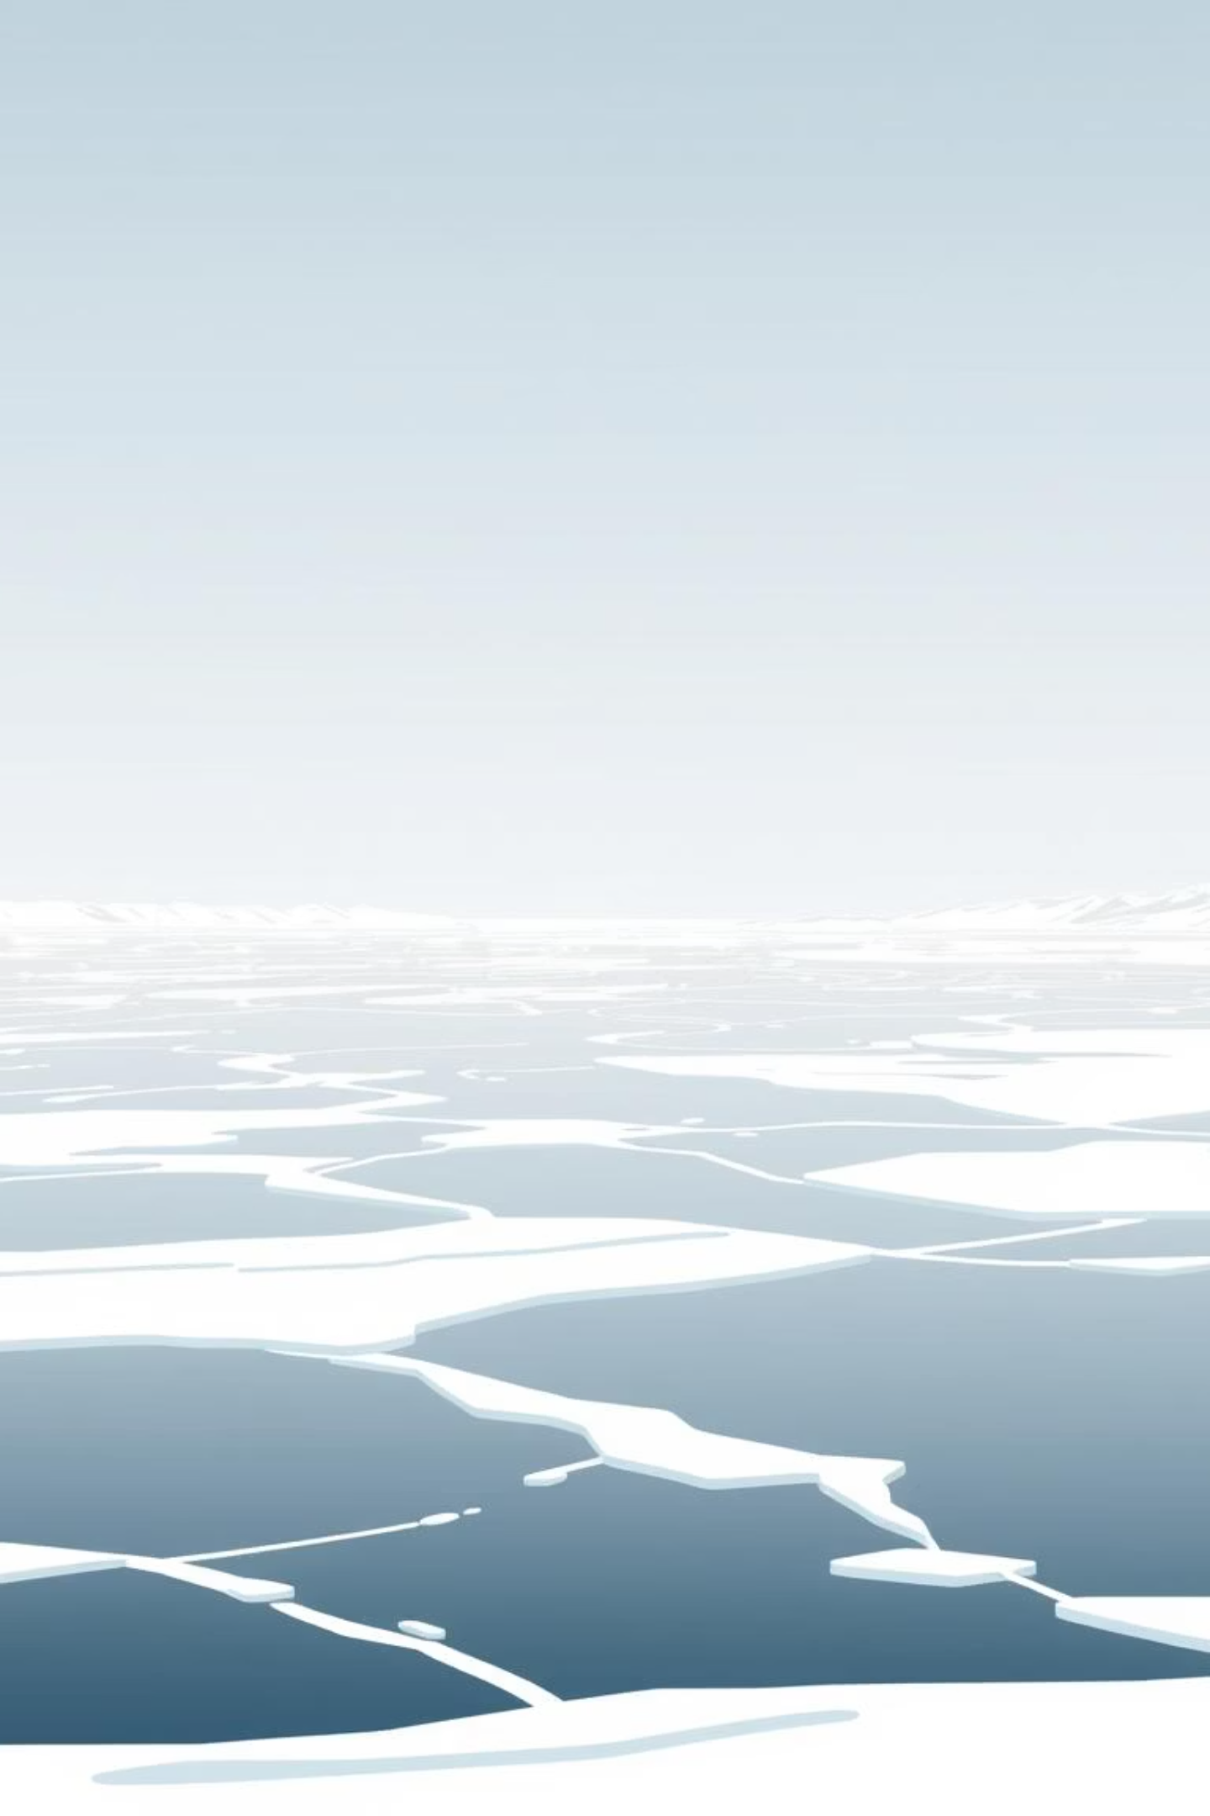
Expedition to the Magnetic North Pole
Join us on an incredible journey to the High Arctic.

Slide 2
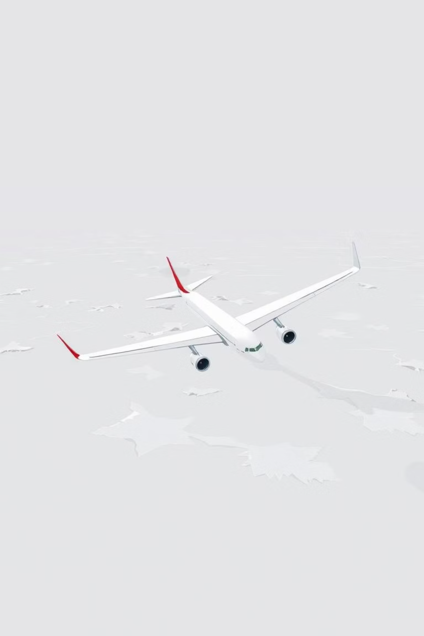
The Journey North
Our adventure began with a long trip from New York City to Montreal, then on to Resolute, a remote village in the Northwest Territories.

Slide 3
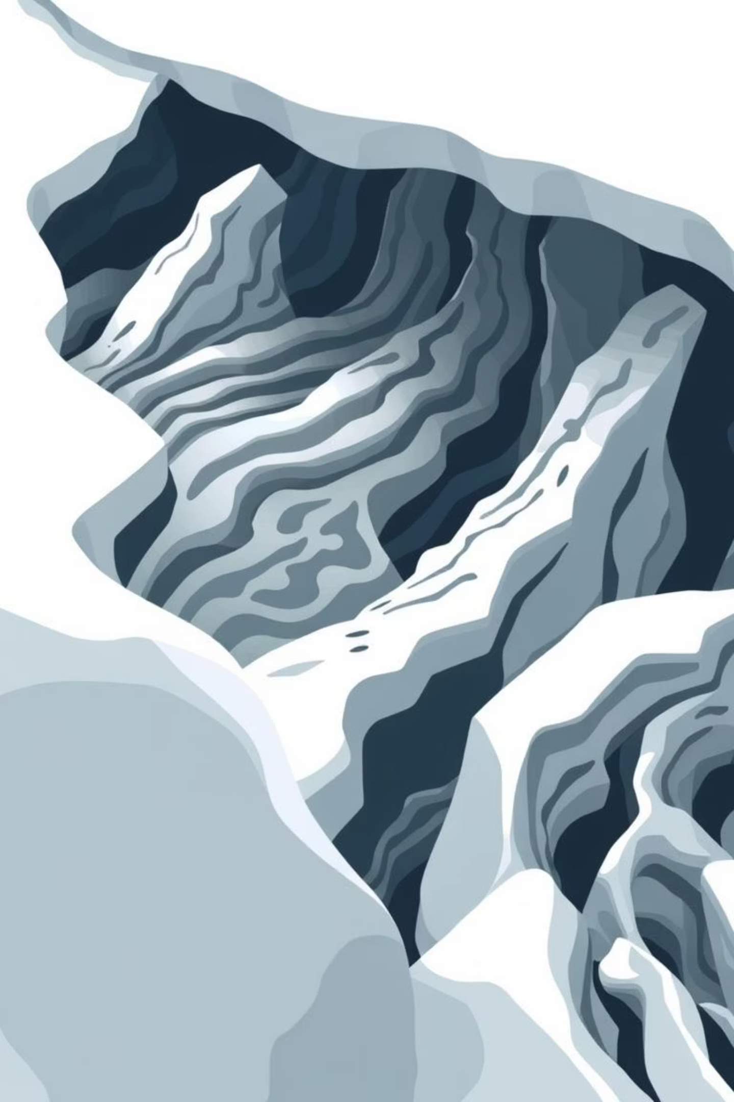
A Land of Ice
From thousands of kilometres above, the High Arctic appeared as a frozen, snowy white expanse. Land and water were unified by one colour, yet we could still see the shapes of frozen ripples, waves, and mummified canyons.

Slide 4



Poles Apart: Geographic vs. Magnetic
Geographic North Pole
Magnetic North Pole
The Earth's true top, reached by Admiral Robert Peary in 1909 after three attempts.
The "real centre" where a compass points, first reached by Captain Ross in 1831 after nearly 300 years of attempts. This is our destination.

Slide 5
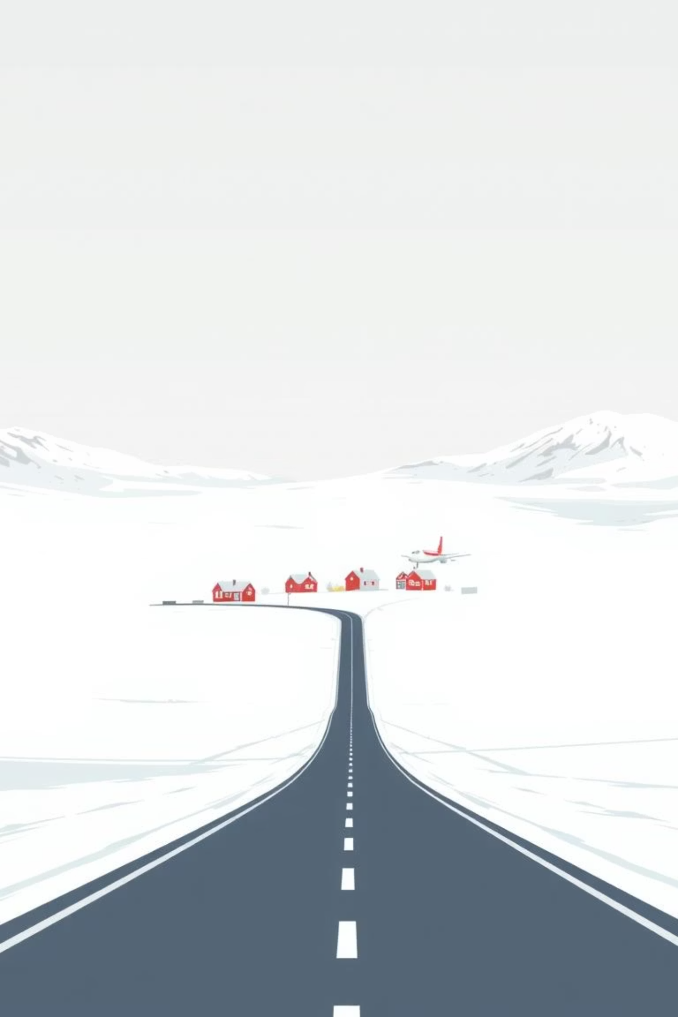
Arrival in Resolute
As we approached Resolute, a small cluster of houses emerged from the snowy whiteness. Organisers Bezal and Terry met us, and we headed to our lodge, seven kilometres away.

Slide 6





Our International Team
India
Germany
Switzerland
The author, and only woman on the expedition.
Hans, a seasoned traveller.
Pascal, part of our diverse group.
Ireland
Hong Kong/UK
Anthony, another experienced adventurer.
David, a British citizen living in London.

Slide 7
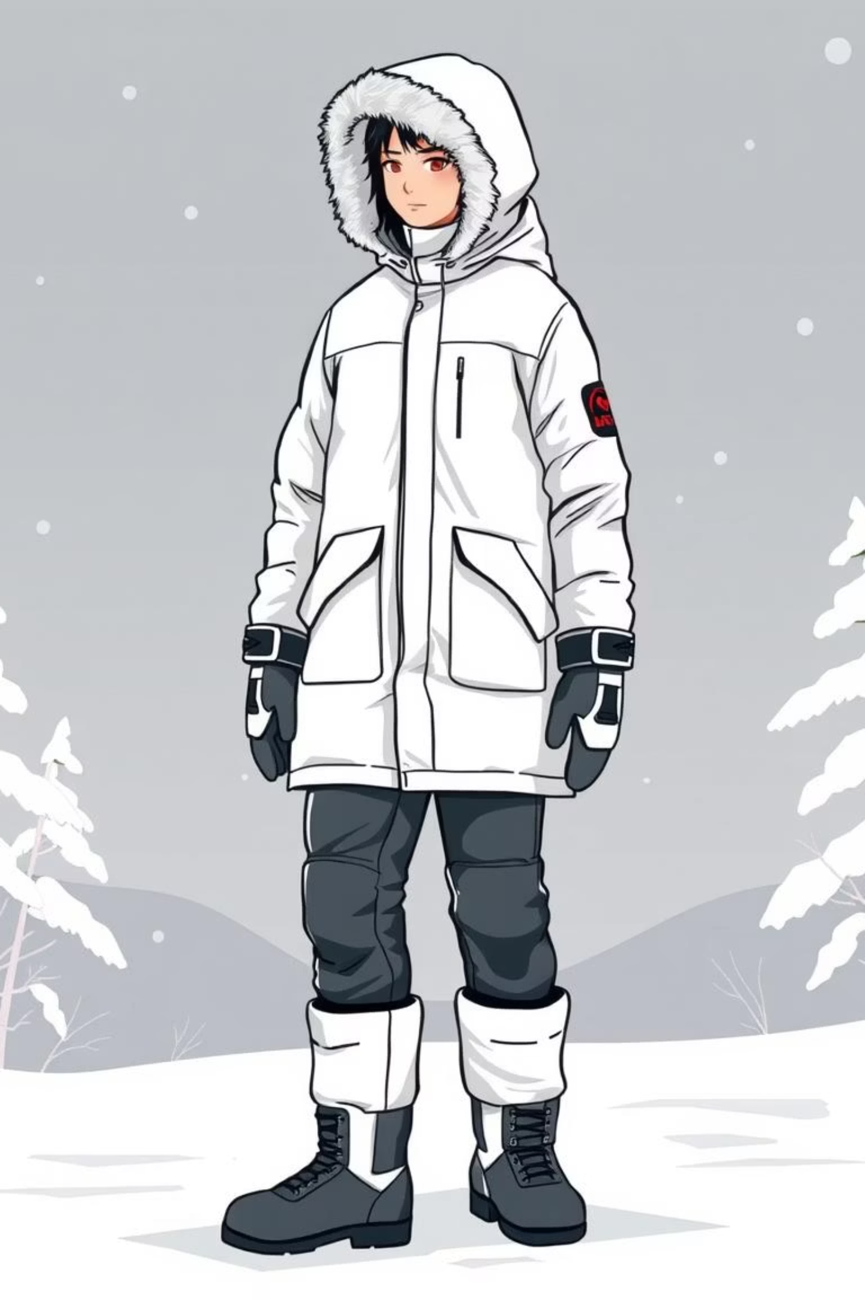
Gearing Up for the Arctic
We spent two days acclimatising and practising in our Arctic gear: heavy windproof layers, hooded parkas, knee-high horse-leather boots, and thick leather mittens.

Slide 8
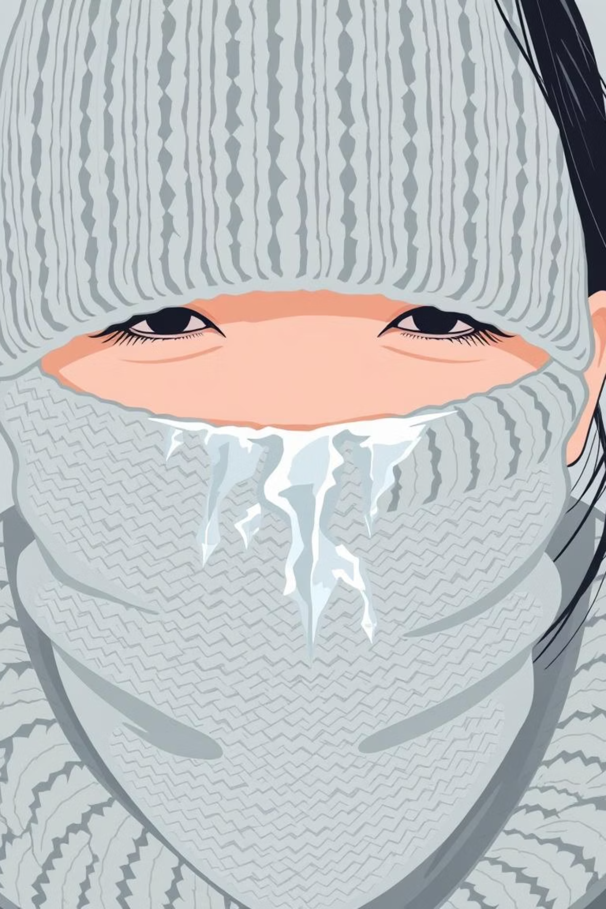
Battling the Cold
Despite multiple layers of socks and gloves, fingers still froze. A woollen tube insulated the neck, but exhaled breath froze it instantly. Proper head cover was crucial; a thin cap led to immediate discomfort.

Slide 9
Protecting Equipment and Eyes
Camera Insulation
Eye Protection
Cameras needed heavy insulation (like woollen tubes and plastic bags) to prevent batteries from freezing.
Dark glasses were essential due to blinding glare from the snow, despite constant fogging.

Slide 10
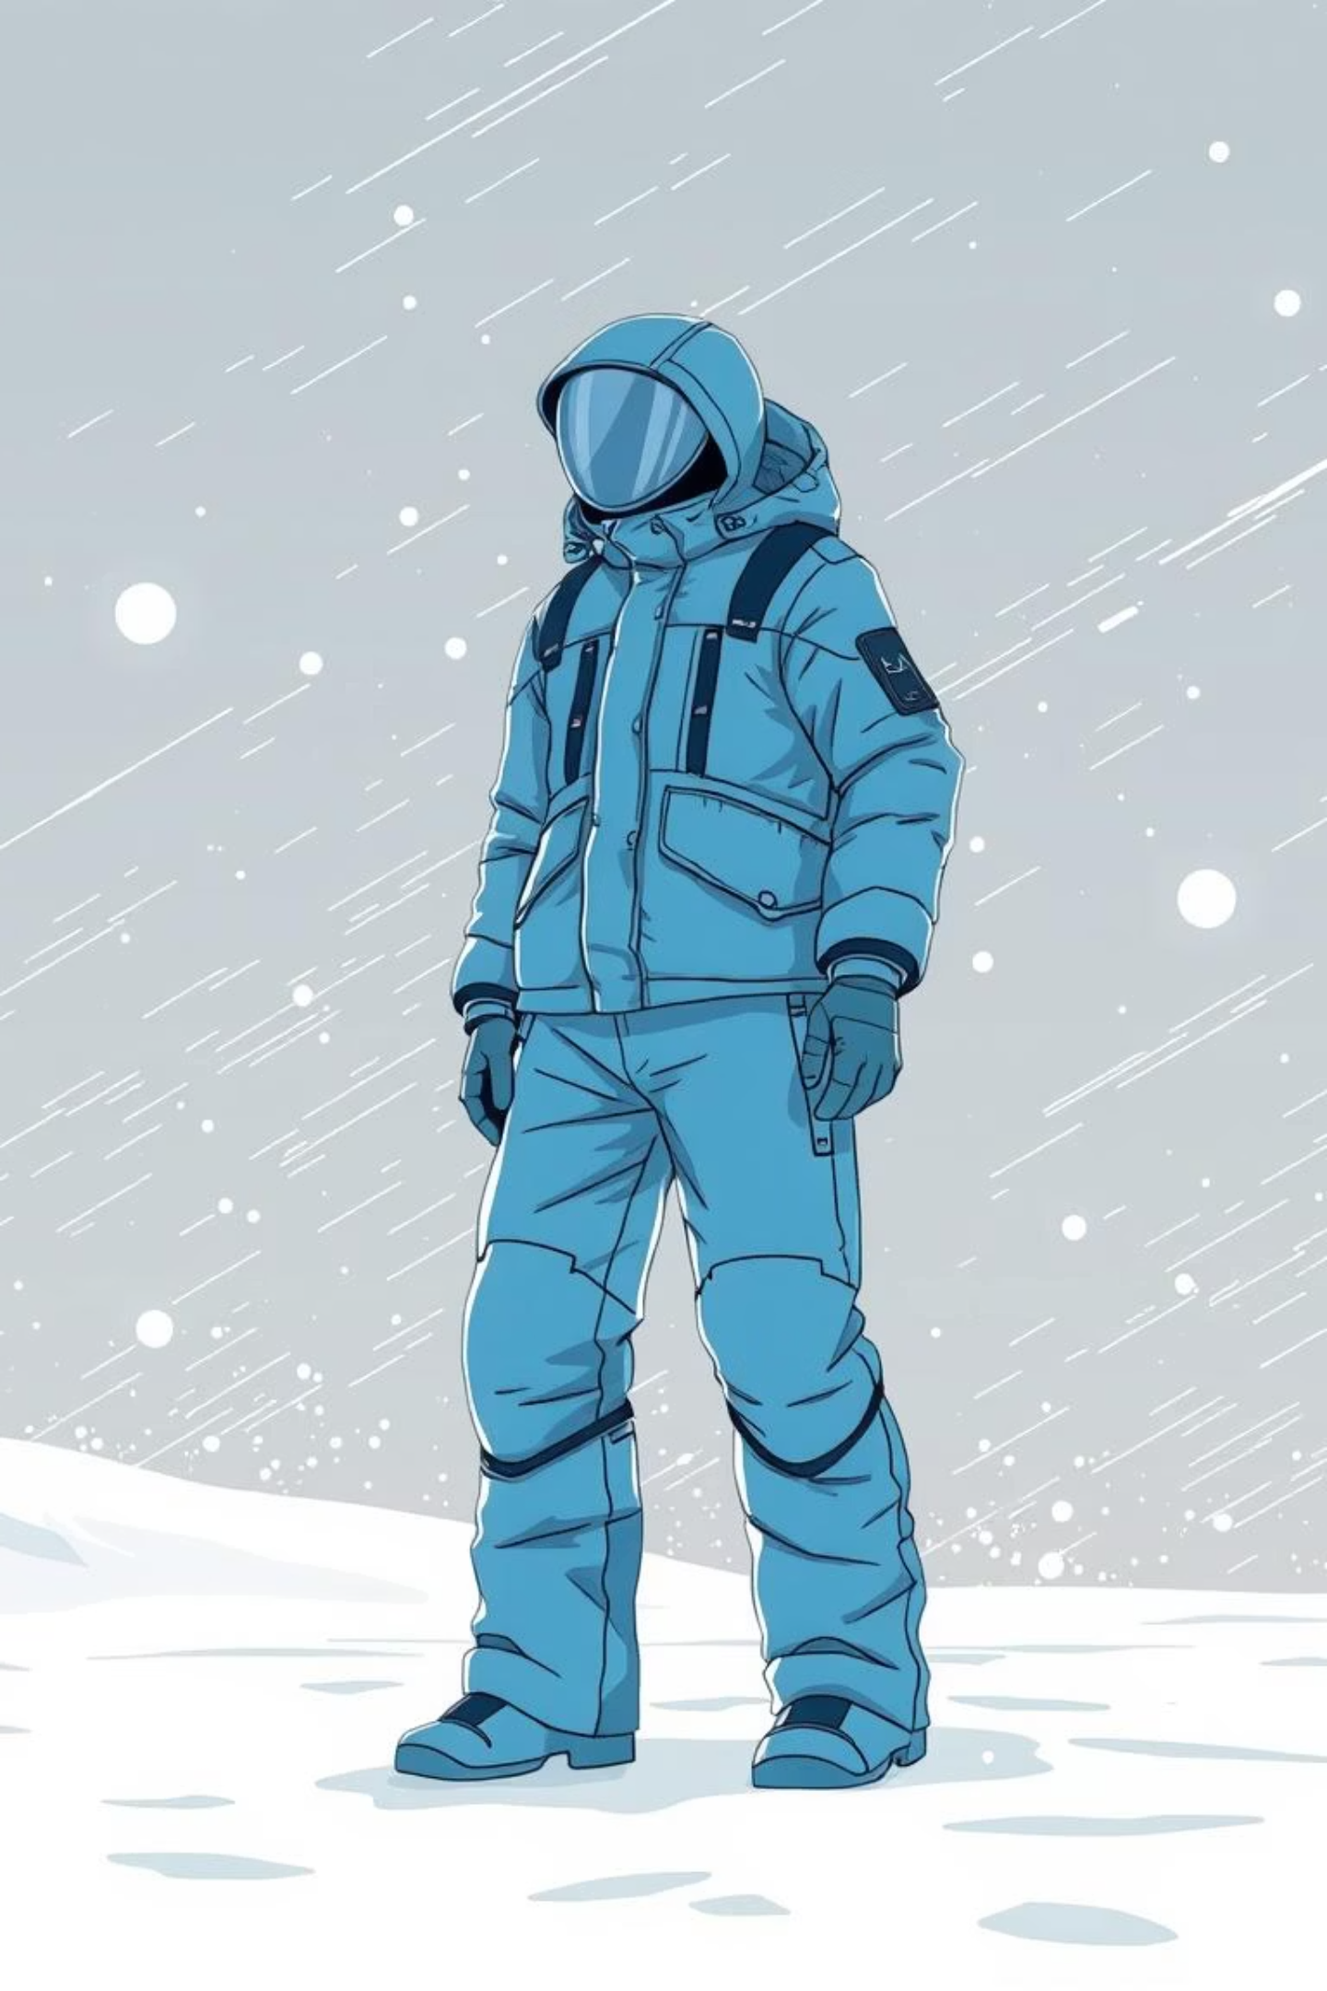
The Arctic Outfit
Our foam-filled wind pants and parka jackets made us feel enormous and robot-like. Walking was strenuous, and slipping on the snow was common. The fierce Arctic wind, below -45°F, was an aggressive welcome.

