Slide 1

World of Numbers

Slide 2
Indian Place Value System
• Groups digits into periods: Ones, Thousands, Lakhs.
• Commas after every two digits from the right.
• Example: 76,23,456
→ Seventy-six lakh twenty-three thousand
four hundred fifty-six
• Place Values: TL | L | TTh | Th | H | T | O
    → 7 | 6 | 2 | 3 | 4 | 5 | 6
💡 Let’s Try: Write the number 5,04,382 in words.

Slide 3
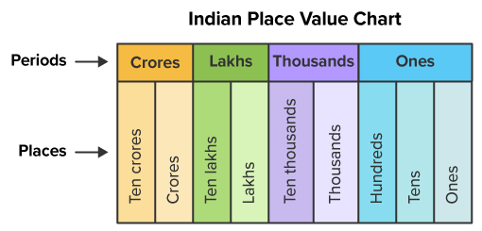

Slide 4
International Place Value System
• Groups digits into periods: Ones, Thousands, Millions.
• Commas after every three digits from the right.
• Example: 7,623,456 → Seven million six hundred
twenty-three thousand four hundred fifty-six
• Place Values: M | HTh | TTh | Th | H | T | O
7 | 6 | 2 | 3 | 4 | 5 | 6
🎯 Quick Task: Convert 5,043,821 to the Indian System.

Slide 5
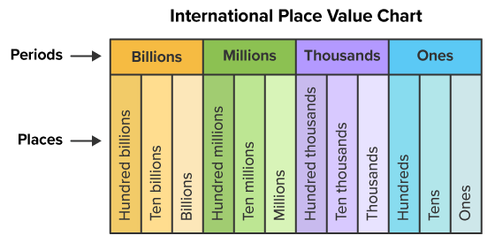

Slide 6
Writing Numbers in Words
Indian: 1,05,555 → One lakh five thousand five
              hundred fifty-five
International: 1,055,555 → One million fifty-five
          thousand five hundred fifty-five
✅ Tip: Read each period and say its name!
📝 Task: Write 9,23,014 in both systems.

Slide 7
Successor and Predecessor
• Successor = Number after → Add 1
              (e.g., 999 → 1000)
• Predecessor = Number before → Subtract 1
              (e.g., 100 → 99)
Number | Predecessor | Successor
76,84,893 | 76,84,892 | 76,84,894
10,55,556 | 10,55,555 | 10,55,557
🧠 Think: What is the predecessor of 1,00,00,000?

Slide 8
Consecutive Numbers
• Natural numbers: 1, 2, 3, 4, 5…
• Even numbers: 2, 4, 6, 8, 10…
• Odd numbers: 1, 3, 5, 7, 9…
• Multiples of 5: 5, 10, 15, 20…
🔢 Practice: Write 5 numbers after 905879.
Write 5 consecutive numbers of greatest
5 digit number.

Slide 9
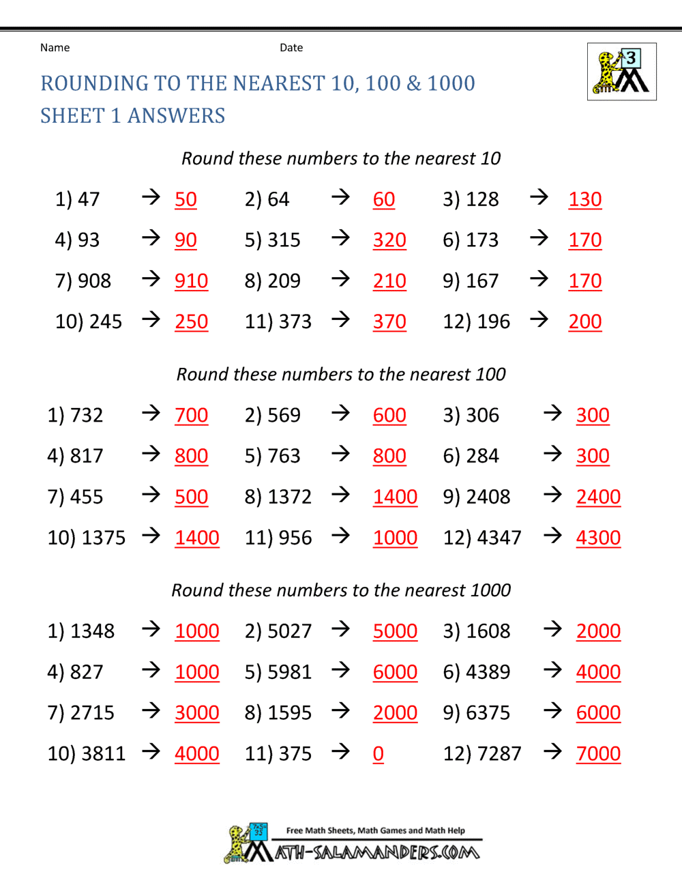
ROUNDING OFF NUMBERS

Slide 10
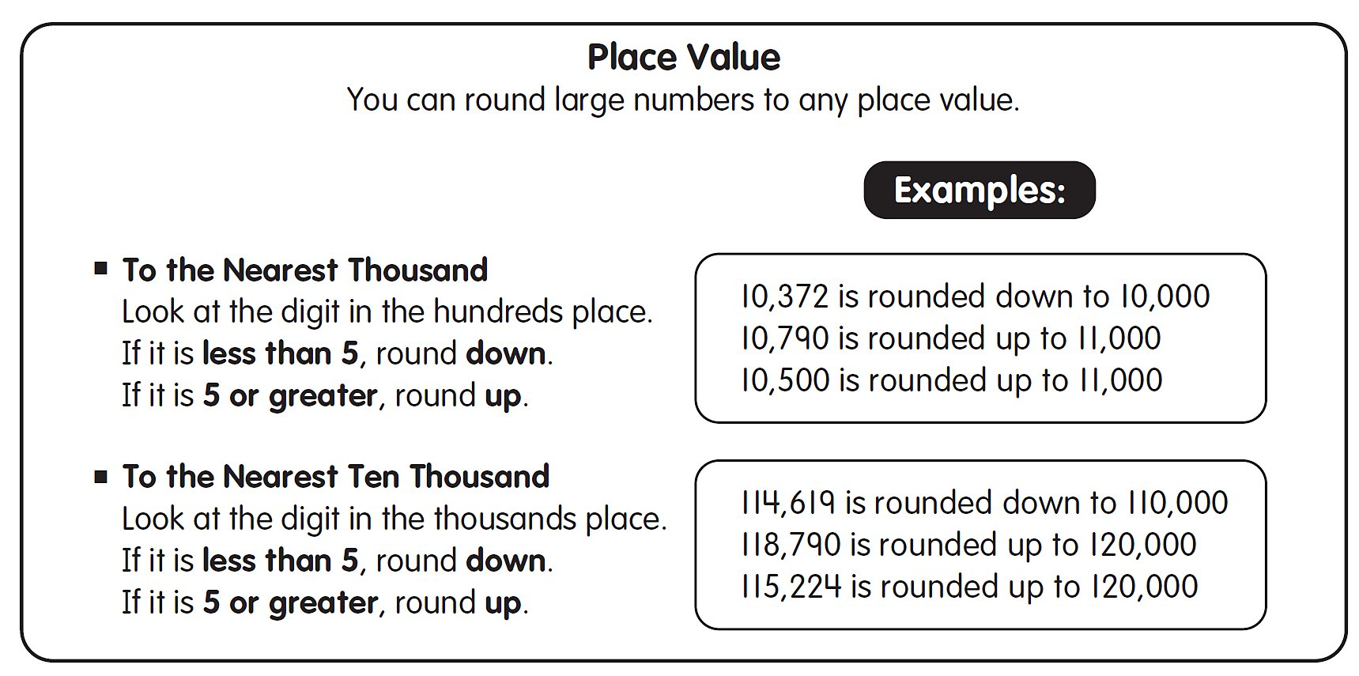
ROUNDING OFF NUMBERS

Slide 11
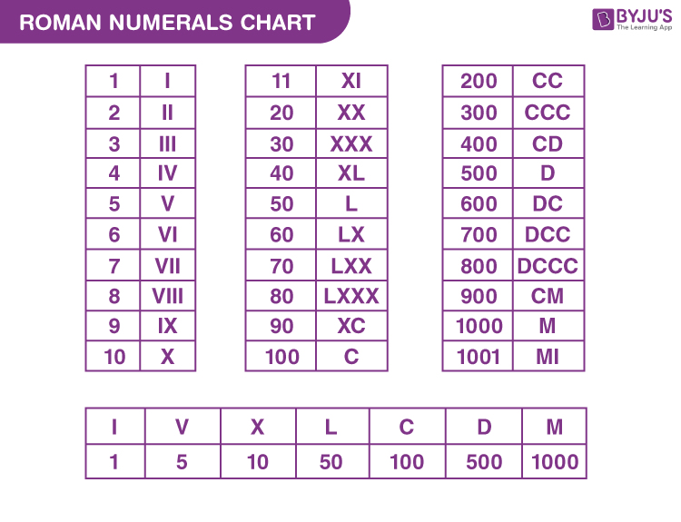
      Roman Numerals – Symbols
🧠 Memory Trick: I Value Xtra Large Cool Digital Money!

Slide 12
Roman Numerals – Rules
📘 Rules for Forming Roman Numerals
Basic Symbols:
I = 1 V = 5 X = 10 L = 50 C = 100 D = 500 M = 1000
Repetition Rule: I, X, C can be repeated up to 3 times (e.g., III = 3, XXX = 30)
      V, L, D cannot be repeated
Subtractive Rule: If a smaller numeral comes before a larger one, subtract it
      IV = 4 (5 - 1) IX = 9 (10 - 1)
Additive Rule: If a smaller numeral comes after a larger one, add it
      VI = 6 (5 + 1) XI = 11 (10 + 1)
Between two big numbers → subtract it from right (e.g., XIV = 14)

Slide 13
Roman Numerals chart

Slide 14
Quick Practice!
1. Write the Roman numeral for 6: ______
2. What comes after 999? ______
3. Write 76,23,456 in Indian words: _____________
4. Write the successor of 999: ______
5. Write 1 less than 1,00,00,000 : ________________
6. Write in Hindu-Arabic numerals:
a) XXIX = _____
b) XLIV = _____
c) XC = _____

Slide 15
“Without mathematics, there’s nothing
you can do.”
                – Shakuntala Devi
Keep exploring the world of numbers!
Thank You!

