Slide 1


Addition and Subtraction

Slide 2
Addition with Blocks
+ 534
H T O
+
7
9
8

Slide 3
Addition with Blocks
+ 2135
Th H T O
+
6
3
8
9

Slide 4
THANK YOU

Slide 5

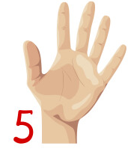
Addition without Re-Grouping
7222+ 755
Th H T O
7
2
2
2
+
7
5
5
7
9
7
7
8102+ 1437
Th H T O
8
1
0
2
+
1
4
3
7
9
5
3
9

Slide 6
THANK YOU

Slide 7

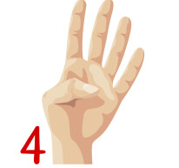

Addition with Re-Grouping
5642+9161
Th H T O
1
5
6
4
2
+
9
1
6
1
1 4
8
0
3
2947+ 3770
Th H T O
1
1
2
9
4
7
+
3
7
7
0
6
7
1
7

Slide 8
THANK YOU

Slide 9
Subtraction with Blocks
594 - 342
H T O
_
3 4 2
2
5
2

Slide 10
Subtraction with Blocks
4684 - 1453
Th H T O
_
1 4 5 3
3
2
3
1

Slide 11
THANK YOU

Slide 12
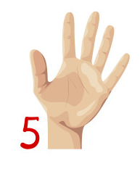





Subtraction without Re-grouping
8755 - 605
Th H T O
8
7
5
5
_
6
0
5
8
1
5
0
9846 - 5424
Th H T O
9
8
4
6
_
5
4
2
4
4
4
2
2

Slide 13
THANK YOU

Slide 14

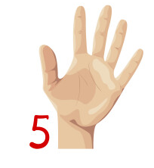
Subtraction with Re-Grouping
9220 - 6885
Th H T O
1
8
1
1
1
9
2
2
1
0
_
6
8
8
5
2
3
3
5
7172 - 1348
Th H T O
6
6
7
1
1
7
1
2
-
1
3
4
8
5
8
2
4

Slide 15
THANK YOU

Slide 16
Estimation
Estimate the sum of 1079 and 4873
Rounding off 1079 – highest place(thousands)
Number < 5
1
0
0
0
1079 –
Number >= 5 ; +1
Rounding off 4873 – highest place(hundreds)
+1
5
0
00
4873 –
Th H T O
Th H T O
1
1
1
0
0
0
1
0
7
9
+
+
5
0
0
0
4
8
7
3
6
0
0
0
5
9
5
2

Slide 17
Estimation
Estimate the difference of 3487 and 679
Rounding off 3487 – highest place(thousands)
Number < 5
3
0
0
0
3487 –
Number >= 5 ; +1
Rounding off 679 – highest place(hundreds)
+1
7
0
0
679 –
Th H T O
Th H T O
2
2
7
3
1
0
0
0
3
1
4
8
1
7
_
_
7
0
0
6
7
9
2
3
0
0
2
8
0
8

Slide 18
THANK YOU

Slide 19
Inverse Relationship
4, 9 and 5
9
4
5
+
Addition Fact : 4+5 = 9
Subtraction Fact 1: 9-4 =5
Subtraction Fact 2: 9-5=4

Slide 20
Inverse Relationship
43+ 54 = 97
Subtraction Fact 1: 97 – 43 = 54
Subtraction Fact 2: 97 – 54 = 43
59- 36 = 23
Addition Fact : 36 + 23 = 59
Subtraction Fact : 59 - 23 = 36

Slide 21
Inverse Relationship
36+ __ = 92
92
-
36
=
56
84 - __ = 16
84
-
16
=
68

Slide 22
THANK YOU

