Slide 1
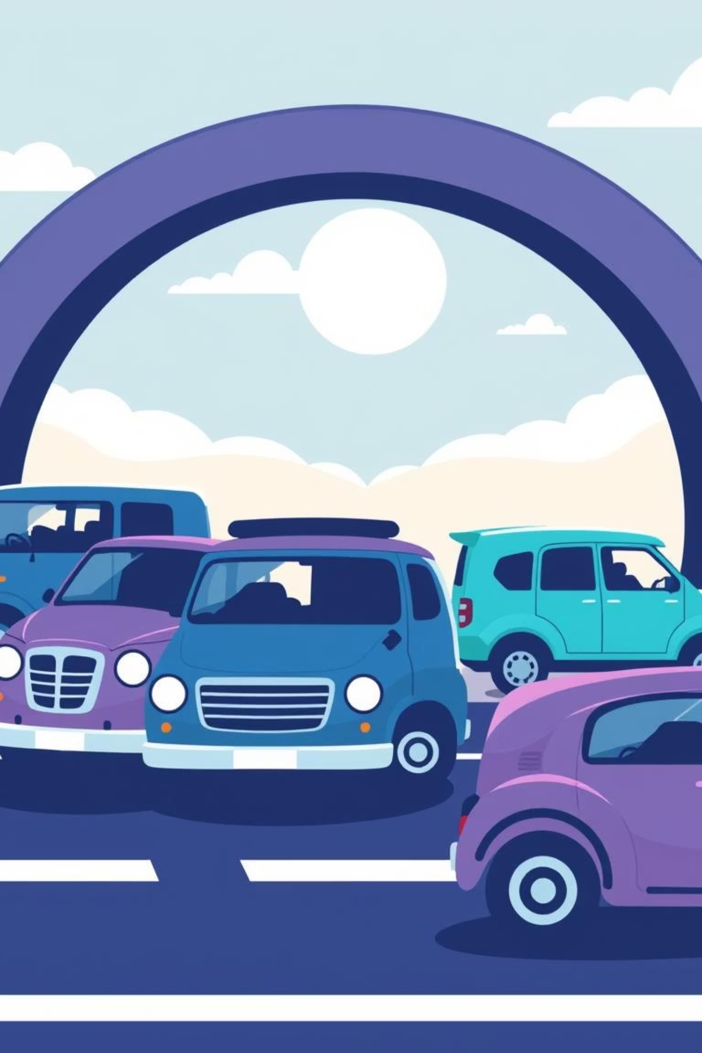
Transport: Moving Around
Have you ever wondered how we get from one place to another? It's all thanks to transport! Transport helps us move ourselves and things from one place to another. We use transport every single day, maybe even without thinking about it! There are three main types of transport: on land, on water, and in the air. Let's learn about them with some fun pictures!

Slide 2
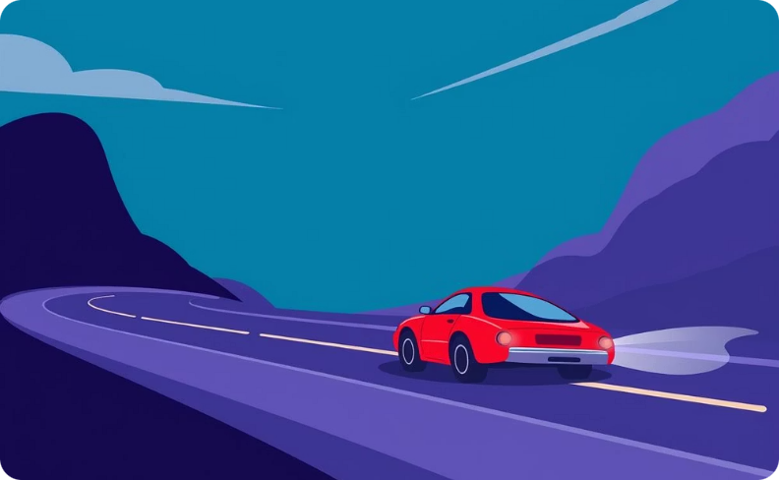
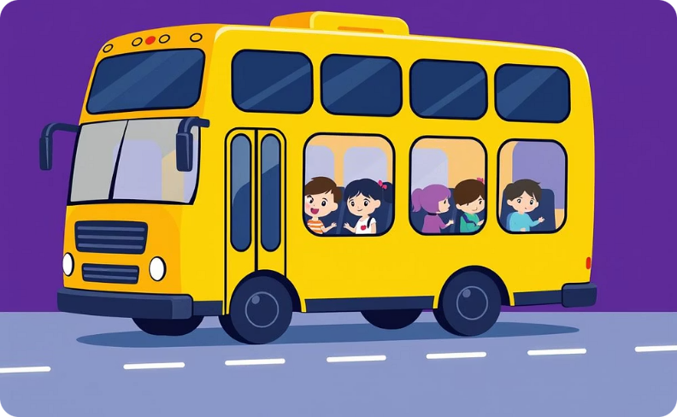
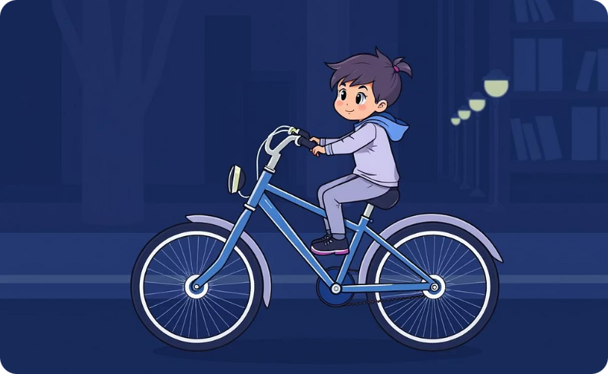
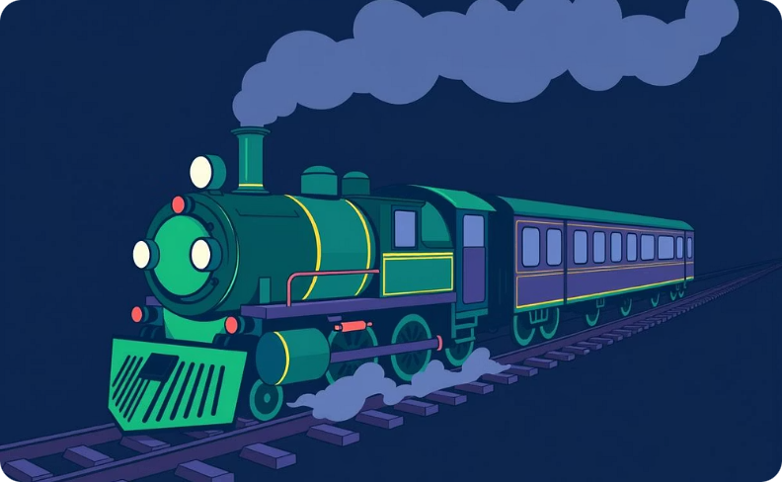
Land Transport
Car
Bus
Bicycle
Train
Car goes on the road!
Bus takes us to school!
Bicycle helps us pedal!
Train rides on tracks!

Slide 3
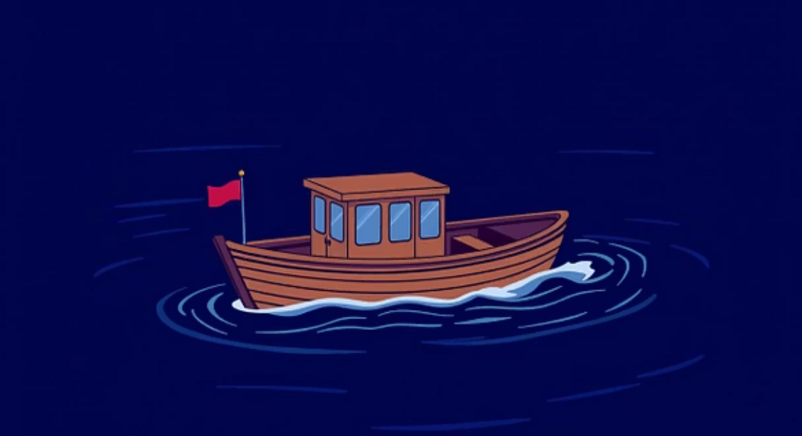
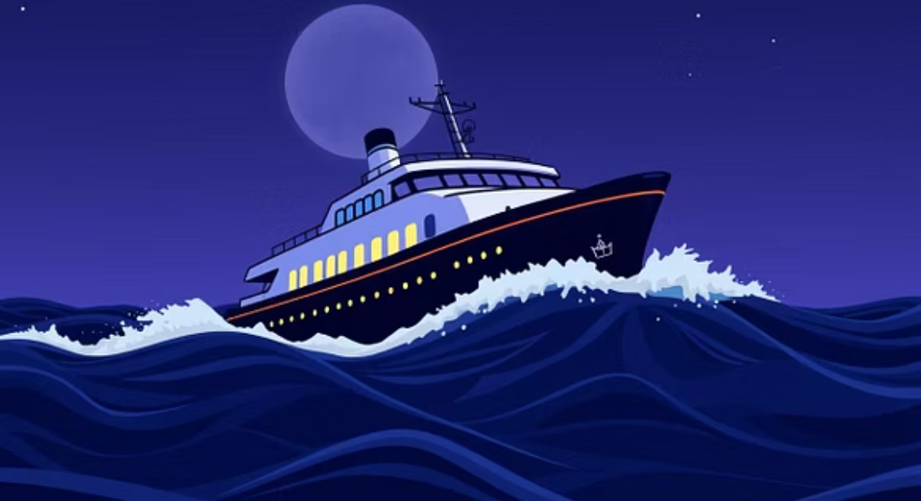
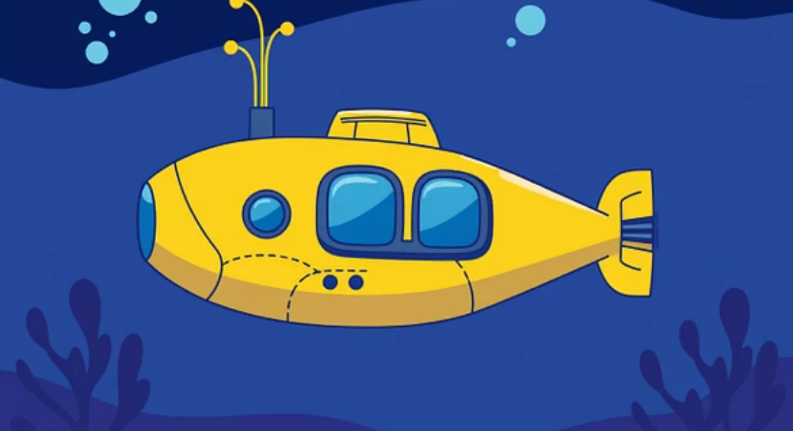
Water Transport
Water transport helps us travel across rivers, lakes, and oceans. Look at these amazing vehicles that float or go under the water!
Boat floats on water!
Ship sails the sea!
Submarine dives deep!

Slide 4

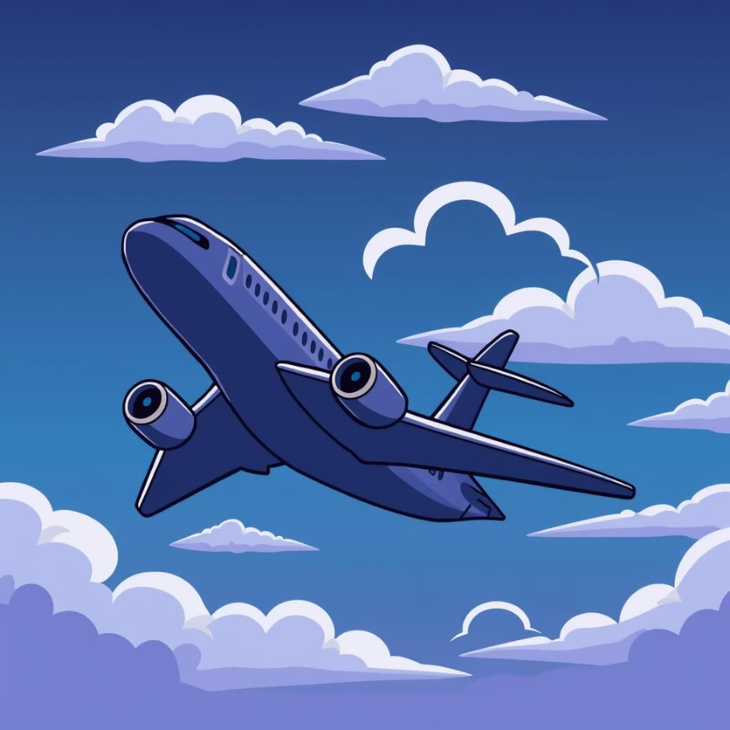
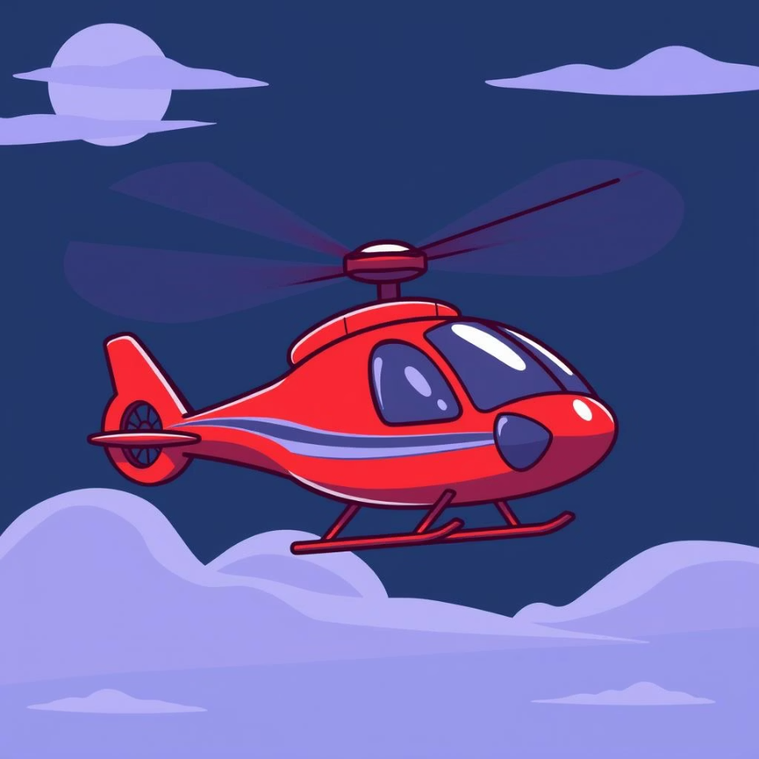
Air Transport
Air transport takes us high up into the sky! It's so much fun to imagine flying. Let's see what flies above us!
Plane flies in the sky!
Helicopter flies up high!
Look! A big, colourful hot air balloon floats in the sky!

Slide 5




Sounds of Transport
Every type of transport makes a special sound! Can you guess which vehicle makes which sound?
Beep beep!
Toot toooot!
Whoooosh!
What sound does a car make?
What sound does a big ship make?
What sound does an airplane make?
Let's play a fun guessing game! Listen carefully to the sounds.

Slide 6
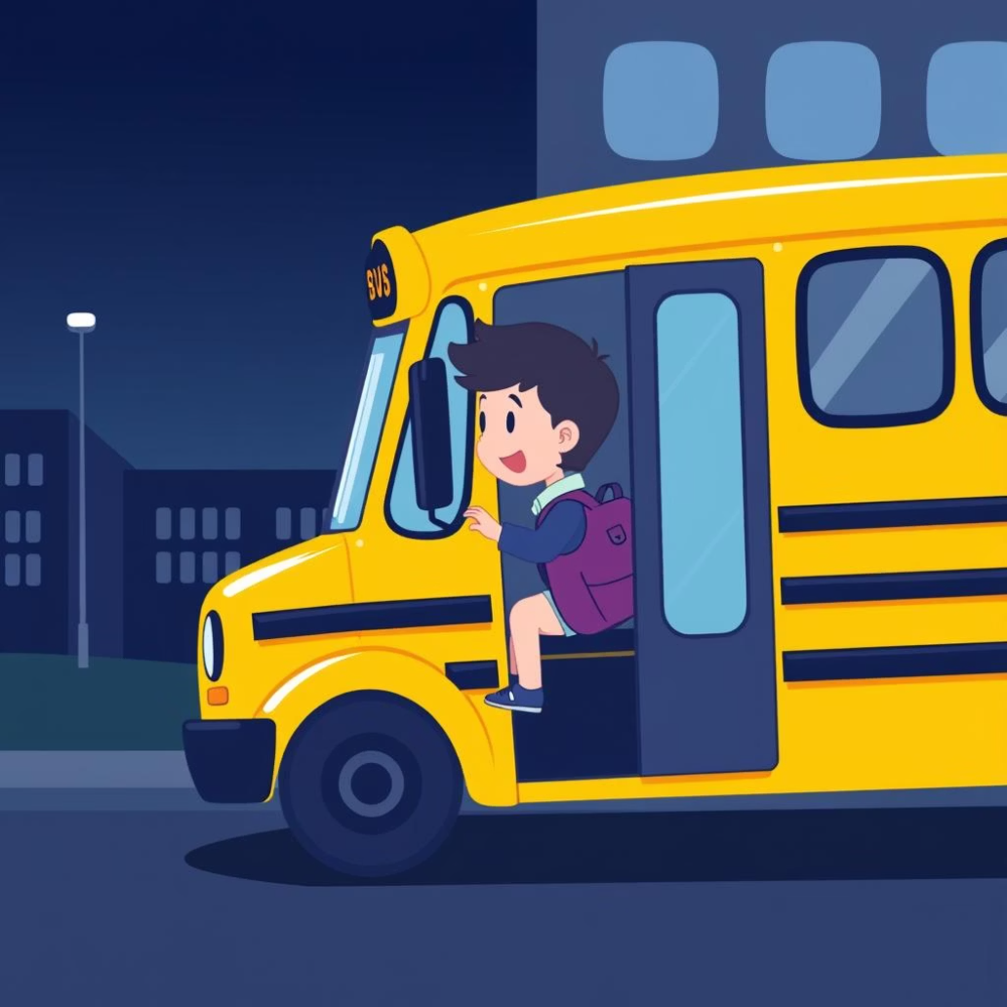
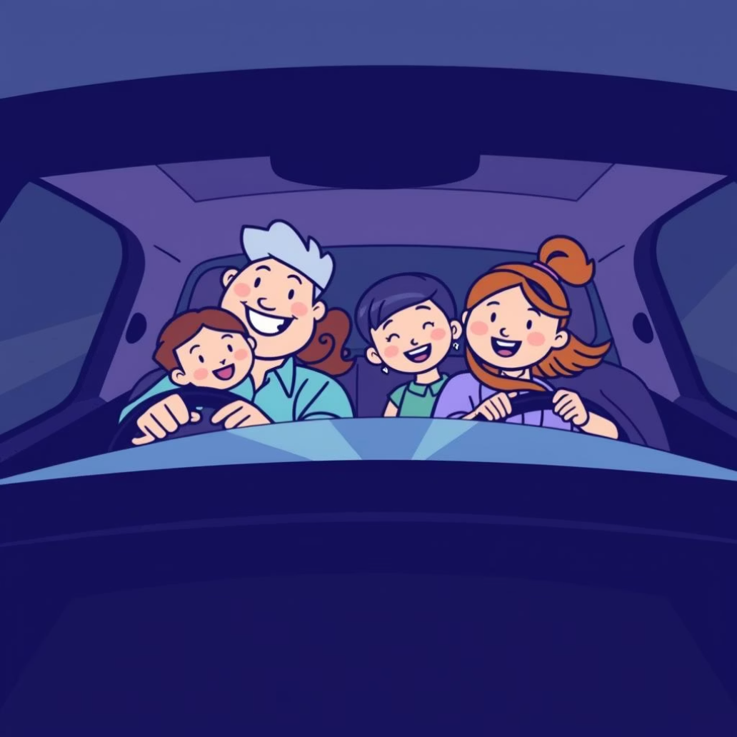
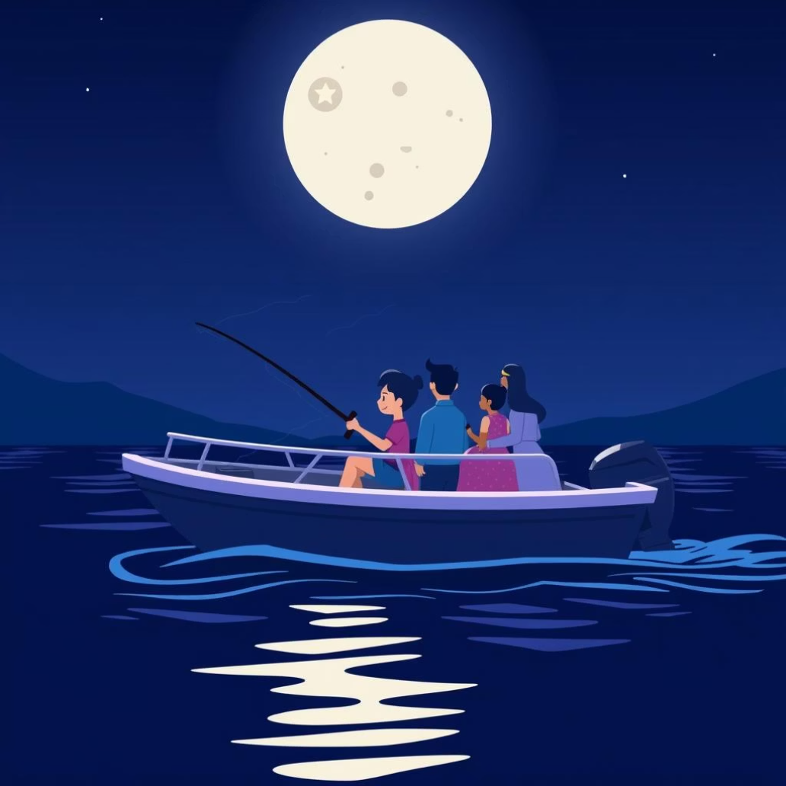
How Do We Travel?
We use transport every day for many reasons. How do you come to school? Do you ride a bus, a car, or maybe walk?
We ride the bus to school!
We drive in the car to the shop!
We take a boat for fun trips!

Slide 7
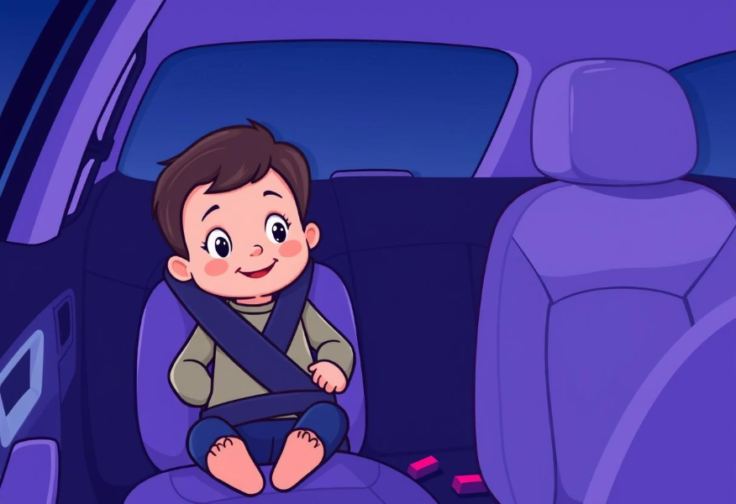
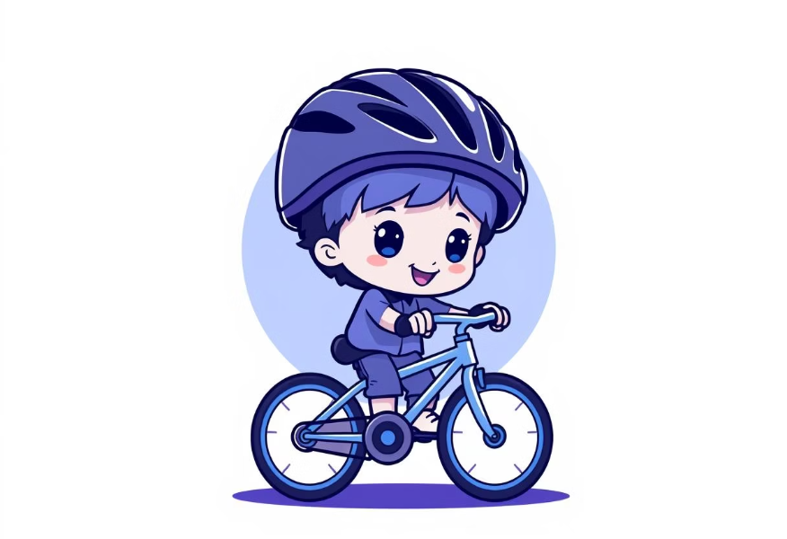
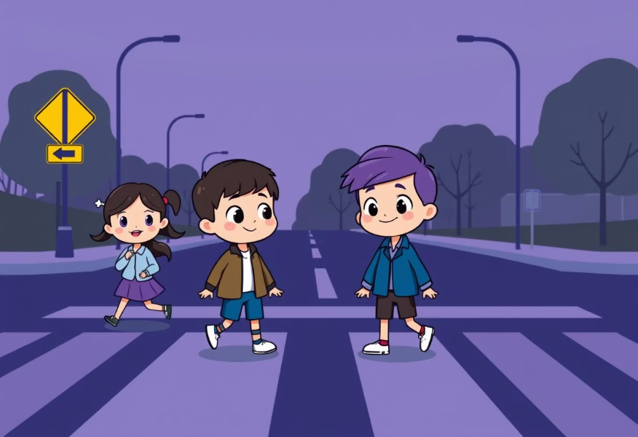
Transport Safety
When we travel, it's very important to be safe. Here are some simple rules to remember for safe travels!
Wear your seatbelt!
Wear your helmet!
Look both ways!
Always buckle up tight in the car. It keeps you safe!
When riding your bicycle, put on your helmet to protect your head.
Before crossing the road, always look left, then right, then left again.

Slide 8
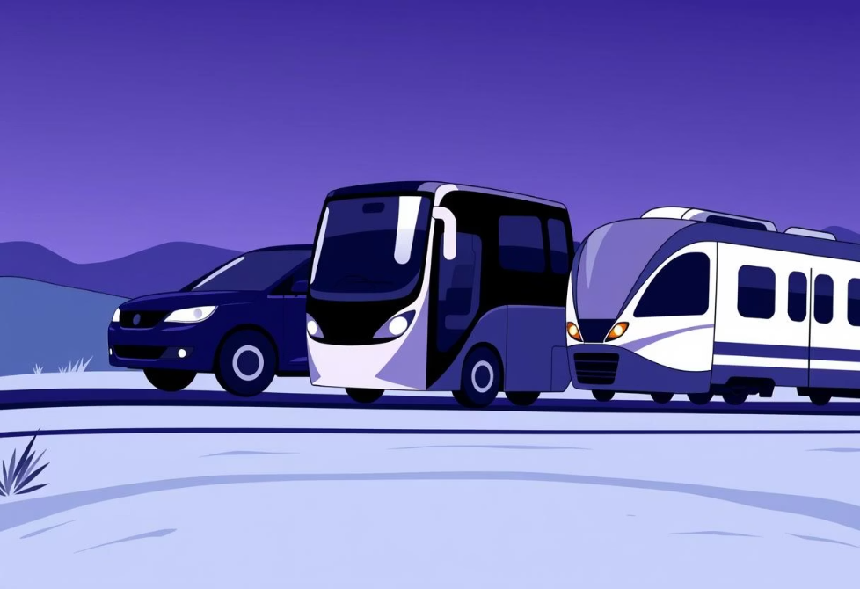
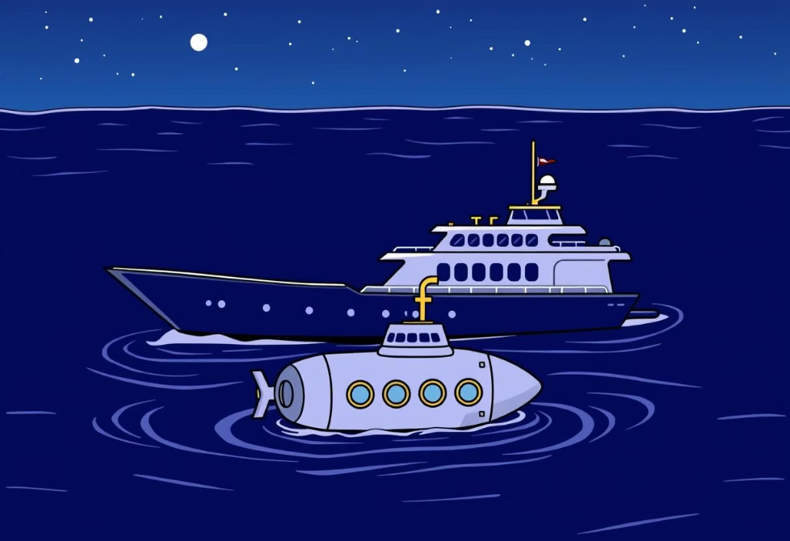
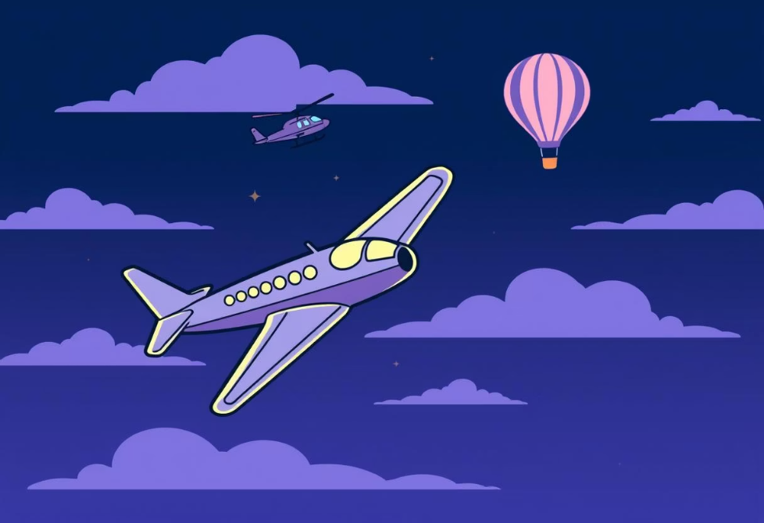
Let's Remember!
We've learned so much about transport today! Let's quickly remember the three main types.
Land Transport
Water Transport
Air Transport
Cars, buses, trains!
Boats, ships, submarines!
Airplanes, helicopters, hot air balloons!
What is your favourite transport? Thank you for learning about transport with us!

