Slide 1

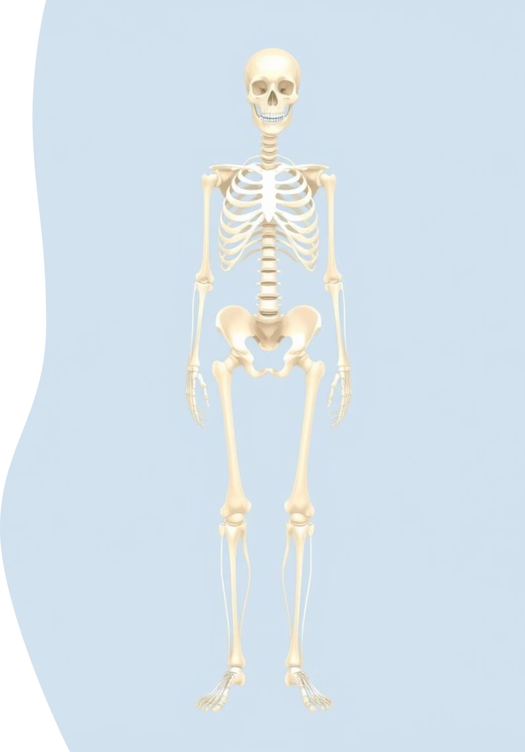


Joint Types
We will cover key joints like the shoulder, elbow, wrist, knuckle, knee, and ankle.
by Safeena B

Slide 2
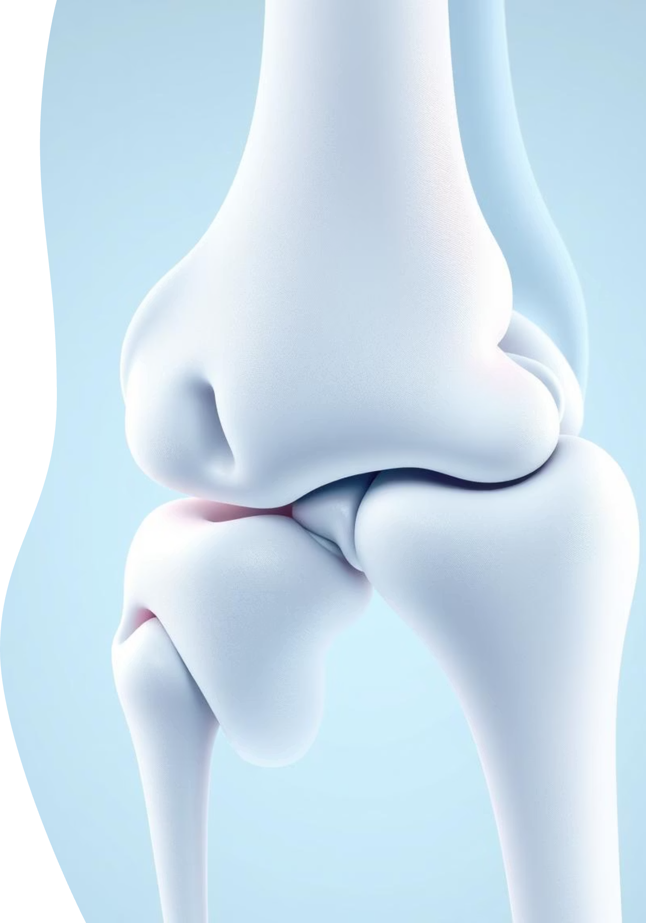
Introduction to Joints
What are Joints?
Joints are the connections between bones that allow us to move. Without them, our bodies would be rigid and unable to bend or twist. They are crucial for all physical activities, from walking to writing.

Slide 3
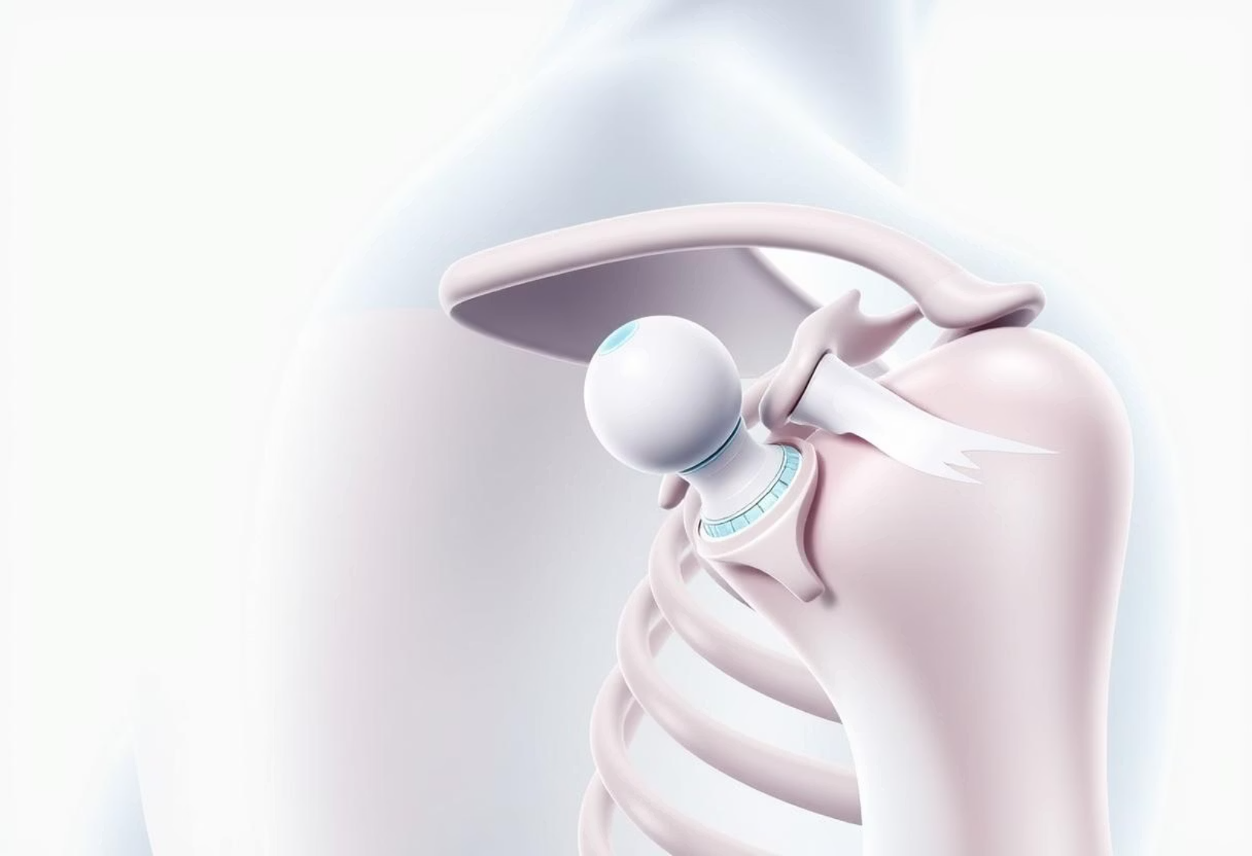
The Shoulder Joint
It allows us to lift our arms, throw, and reach in many directions. This flexibility is essential for tasks like dressing and playing sports.

Slide 4
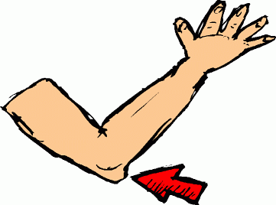
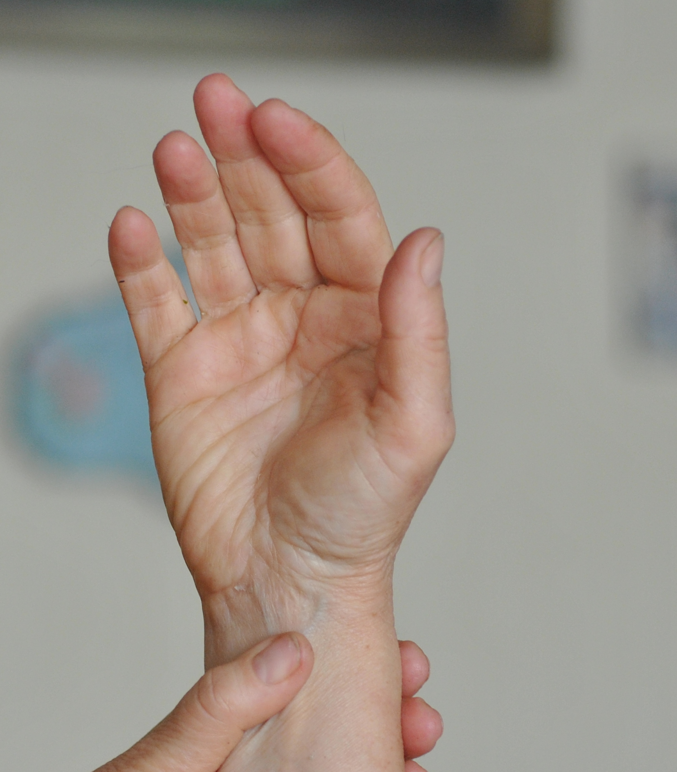


Elbow and Wrist Joints
Elbow Joint
Wrist Joint

Slide 5

Knuckle Joints

Slide 6
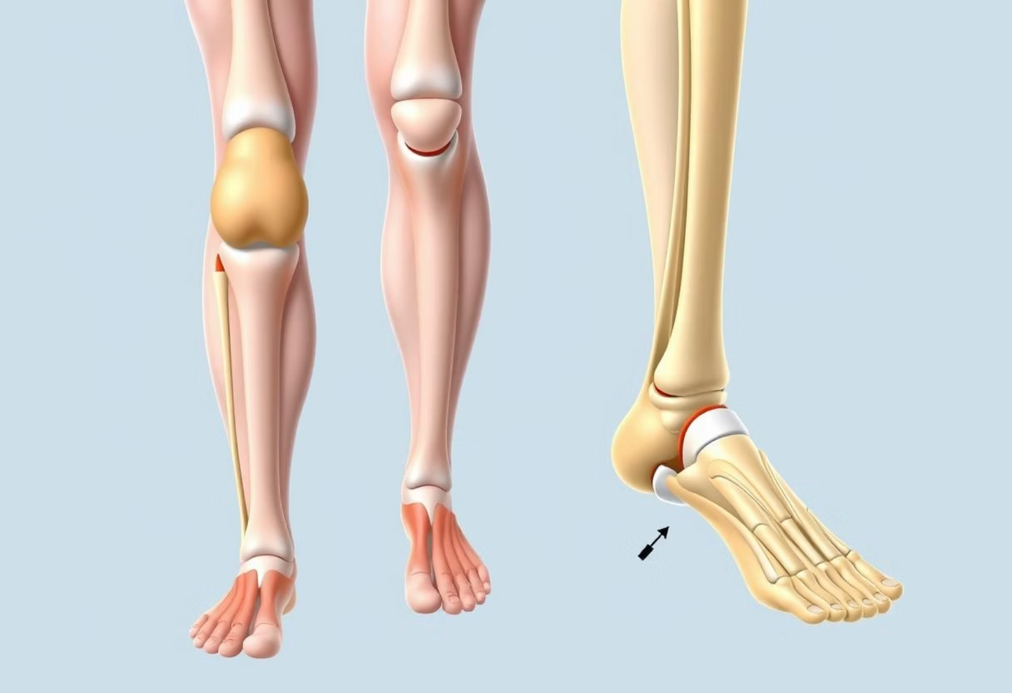
Knee and Ankle Joints

Slide 7
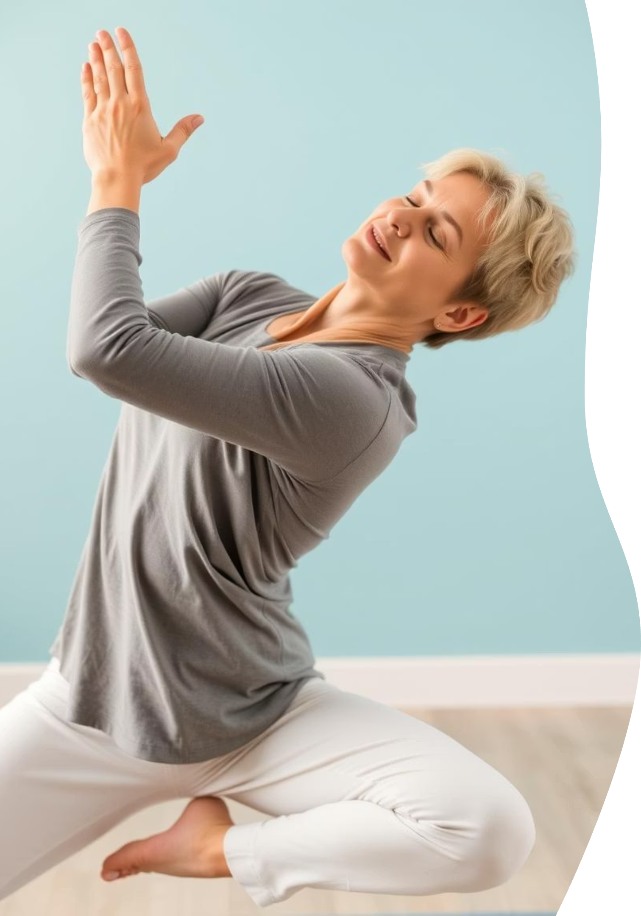
Key Takeaways and Next Steps
Joints Enable Movement
All our daily activities rely on the proper functioning of our joints.
Different Joints, Different Functions
Each joint type is specialized for specific movements, from wide rotations to simple bends.
Protect Your Joints
Understanding how joints work helps us appreciate and protect them through proper care and exercise.

