Slide 1




Welcome to My Neighborhood!
Let's explore the wonderful places near our homes!
by Safeena B

Slide 2
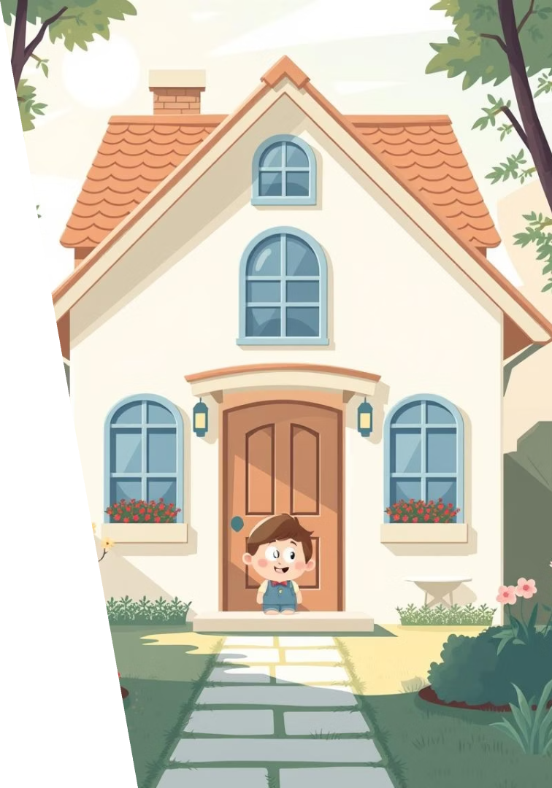
My Home
My House
Family Inside
This is where I live. It keeps me safe.
My family lives here with me.
What is Your Home?
Is it a house or an apartment?

Slide 3
The Street I Live On
Cars Drive Here
We Walk Here
Cars and buses use the street.
The sidewalk is safe for us.

Slide 4



My School
I Learn New Things
We read books and learn numbers.
I Make Friends
My friends are fun to play with.

Slide 5




The Park
Swings
I love to swing high.
Slide
Down I go!
Games
We play with balls.

Slide 6

The Store
Take Home
Buy Things
Then we go home to eat.
Find What We Need
We pay for our items.
We find food and snacks.

Slide 7




The Library
Borrow Books
We can take books home.
Learn New Things
There are books about everything.
Be Quiet
It's a calm place to read.

Slide 8








People in My Neighborhood
Postman
Police Officer
Brings our letters.
Keeps us safe.
Doctor
Teacher
Helps us feel better.
Helps us learn.

Slide 9

Keeping Our Neighborhood Clean
Pick Up Trash
Respect Nature
Put litter in the bin.
Don't pick flowers.
1
2
3
Plant Flowers
Make it pretty.

Slide 10



I Love My Neighborhood!
Friends
1
I play with them.
Fun Places
2
Parks and libraries.
My Home
3
Where I feel safe.

