Slide 1
Computer Networks and Data Communications
UNIT I

Slide 2
NETWORK TYPES
LAN
MAN
WAN

Slide 3
A Communications Model
Source
generates data to be transmitted
Transmitter
Converts data into transmittable signals
Transmission System
Carries data
Receiver
Converts received signal into data
Destination
Takes incoming data

Slide 4
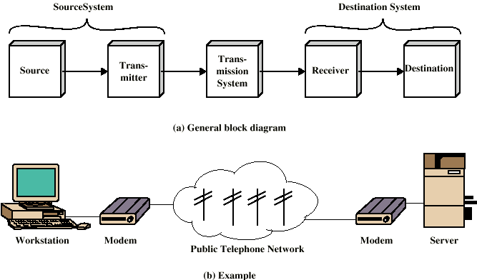
Simplified Communications Model - Diagram

Slide 5
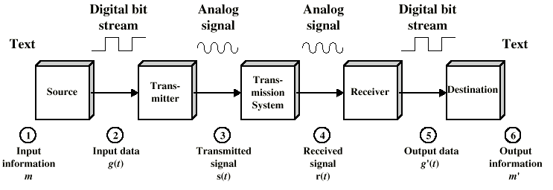
Simplified Data Communications Model

Slide 6
Networks
A network consists of two or more computers that are linked in order to share resources (such as printers and CDs), exchange files, or allow electronic communications.

Slide 7
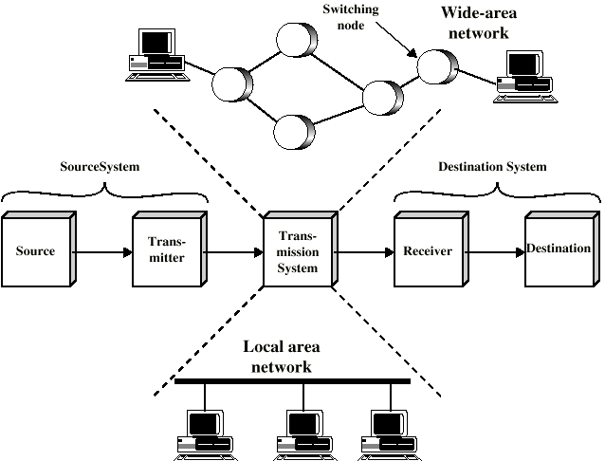
Simplified Network Model

Slide 8
Wide Area Networks
simplest form, a wide-area network (WAN) is a collection of local-area networks (LANs) or other networks that communicate with one another. A WAN is essentially a network of networks, with the Internet the world's largest WAN.
Alternative technologies/ types
Circuit switching
Packet switching
Frame relay
Asynchronous Transfer Mode (ATM)

Slide 9
Circuit Switching
It is the process of exchanging information between two communication devices.
There are two types of switching: circuit switching and packet switching.
e.g. telephone network

Slide 11
Packet Switching
Data sent out of sequence
Small chunks (packets) of data at a time
Packets passed from node to node between source and destination
Packet switching is the transfer of small pieces of data across various networks. These data chunks or “packets” allow for faster, more efficient data transfer.

Slide 12
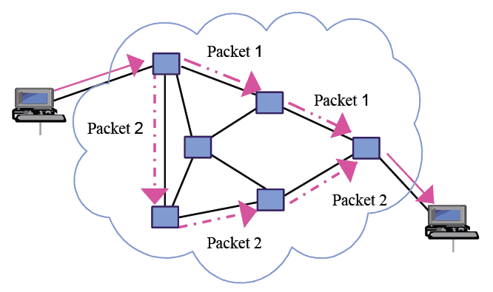

Slide 13
Frame Relay
Frame Relay (frame relay) is a packet switching technology that fragmented into transmission units called frames and sent in high-speed bursts through a digital network. Establishes an exclusive connection during the transmission period called virtual connection.

Slide 14
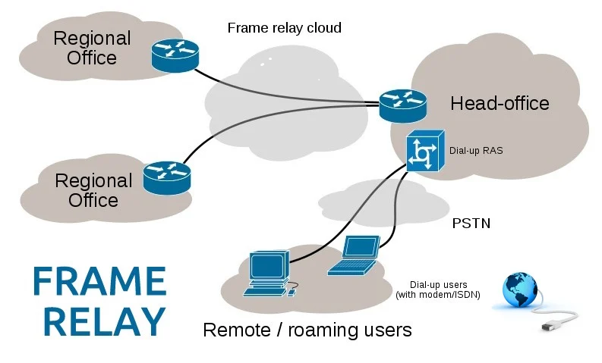

Slide 15
Asynchronous Transfer Mode
ATM stands for Asynchronous transfer mode. It is a switching technique used by telecommunication networks that uses asynchronous time-division multiplexing to encode data into small, fixed-sized cells. ATMs can be used for efficient data transfer over high speed data networks.

Slide 16
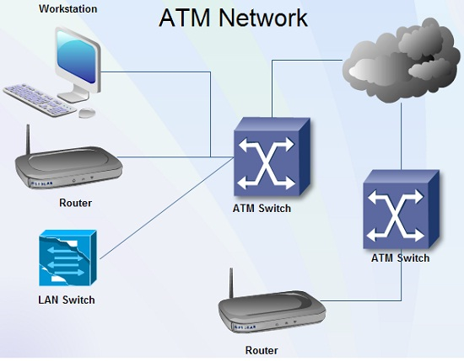

Slide 17
Protocol Architecture
Task of communication broken up into modules
For example file transfer could use three modules
File transfer application
Communication service module
Network access module

Slide 18
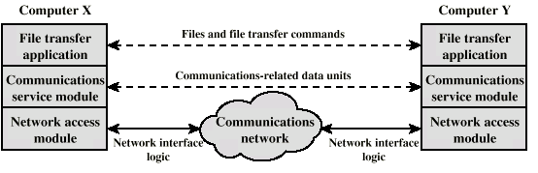
Simplified File Transfer Architecture

Slide 19
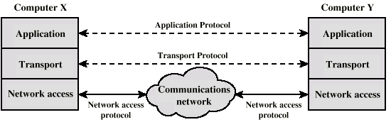
Protocols in Simplified Architecture

Slide 20
TCP/IP Protocol Architecture
Developed by the US Defense Advanced Research Project Agency (DARPA) for its packet switched network (ARPANET)
Used by the global Internet
No official model but a working one.
Application layer
Host to host or transport layer
Internet layer
Network access layer
Physical layer

Slide 21
Physical Layer
Physical interface between data transmission device (e.g. computer) and transmission medium or network
Characteristics of transmission medium
Signal levels
Data rates
etc.

Slide 22
Network Access Layer
Exchange of data between end system and network
Destination address provision
Invoking services like priority

Slide 23
Internet Layer (IP)
Systems may be attached to different networks
Routing functions across multiple networks
Implemented in end systems and routers

Slide 24
Transport Layer (TCP)
Reliable delivery of data
Ordering of delivery

Slide 25
Application Layer
Support for user applications
e.g. http, SMPT

Slide 26
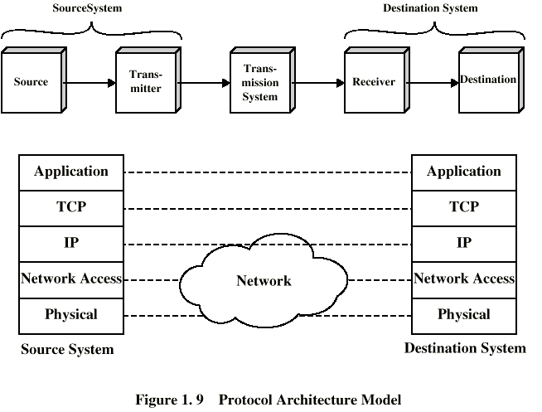
TCP/IP Protocol Architecture Model

Slide 27
OSI Model
Open Systems Interconnection
Developed by the International Organization for Standardization (ISO)
Seven layers

Slide 28
OSI Reference Model
The OSI model defines seven layers:
Layer 7: Application Layer
Layer 6: Presentation Layer
Layer 5: Session Layer
Layer 4: Transport Layer
Layer 3: Network Layer
Layer 2: Data Link Layer
Layer 1: Physical Layer

Slide 29
OSI Layers
Application
Presentation
Session
Transport
Network
Data Link
Physical

Slide 31
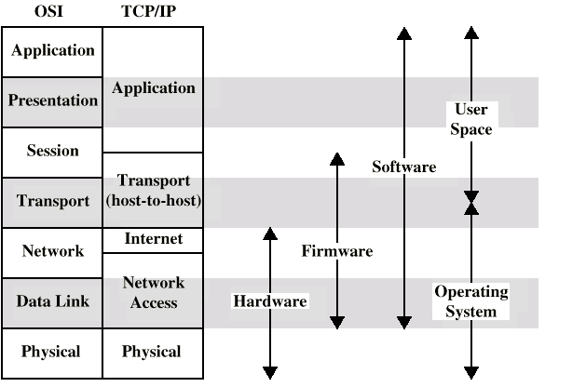
OSI v TCP/IP

Slide 32
Physical Layer (Layer 1):
At the bottom of our OSI model we have the Physical Layer, which represents the electrical and physical representation of the system. This can include everything from the cable type, radio frequency link (as in a Wi-Fi network), as well as the layout of pins, voltages, and other physical requirements.

Slide 33
Data Link Layer (Layer 2):
The Data Link Layer provides node-to-node data transfer (between two directly connected nodes), and also handles error correction from the physical layer. Two sublayers exist here as well--the Media Access Control (MAC) layer and the Logical Link Control (LLC) layer.

Slide 34
Network Layer (Layer 3):
Its most basic sense, this layer is responsible for packet forwarding, including routing through different routers.
Example: IP

Slide 35
Transport Layer (Layer 4):
The Transport Layer deals with the coordination of the data transfer between end systems and hosts. How much data to send, at what rate, where it goes, etc. The best known example of the Transport Layer is the Transmission Control Protocol

Slide 36
Session Layer (Layer 5):
When two computers or other networked devices need to speak with one another, a session needs to be created, and this is done at the Session Layer. Functions at this layer involve setup, coordination (how long should a system wait for a response, for example) and termination between the applications at each end of the session.

Slide 37
Presentation Layer (Layer 6):
The Presentation Layer represents the area that is independent of data representation at the application layer. In general, it represents the preparation or translation of application format to network format, or from network formatting to application format.
Data conversion into application format
Encryption/decryption

Slide 38
Application Layer (Layer 7):
The Application Layer in the OSI model is the layer that is the “closest to the end user”. It receives information directly from users and displays incoming data to the user.
Everything is application specific
Example: File Transfer, Electronic Mail

Slide 39
Multimedia
Multimedia is a set of more than one media element used to produce a concrete and more structured communication method. In other words, multimedia is the simultaneous use of data from different sources. These sources in multimedia are known as media elements.
Elements of Multimedia
Text, Audio, video, pictures, animations, etc.

