Slide 1
UNIT II
Concepts and Terminology
Transmission Terminology
Data transmission occurs between transmitter and receiver over some transmission medium.
Transmission media may be classified as guided or unguided.
In both cases, communication is in the form of electromagnetic waves. With guided media, the waves are guided along a physical path; examples of guided media are twisted pair, coaxial cable, and optical fiber.

Slide 2
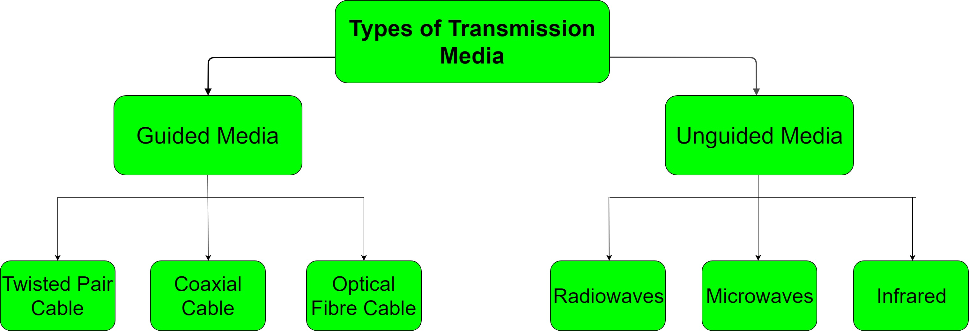

Slide 3
Unguided media, also called wireless, provide a means for transmitting electromagnetic waves but do not guide them
examples are propagation through air, vacuum, and seawater

Slide 4
Analog and Digital Data
Analog data take on continuous values in some interval. For example, voice and video are continuously varying patterns of intensity.
Analog and Digital Signals
a communications system, data are propagated from one point to another by means of electromagnetic signals.
An analog signal is a continuously varying electromagnetic wave that may be propagated over a variety of media, depending on spectrum; examples are wire media, such as twisted pair and coaxial cable.

Slide 5
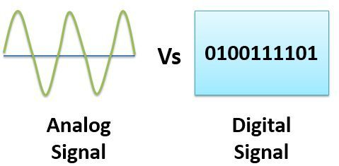

Slide 6
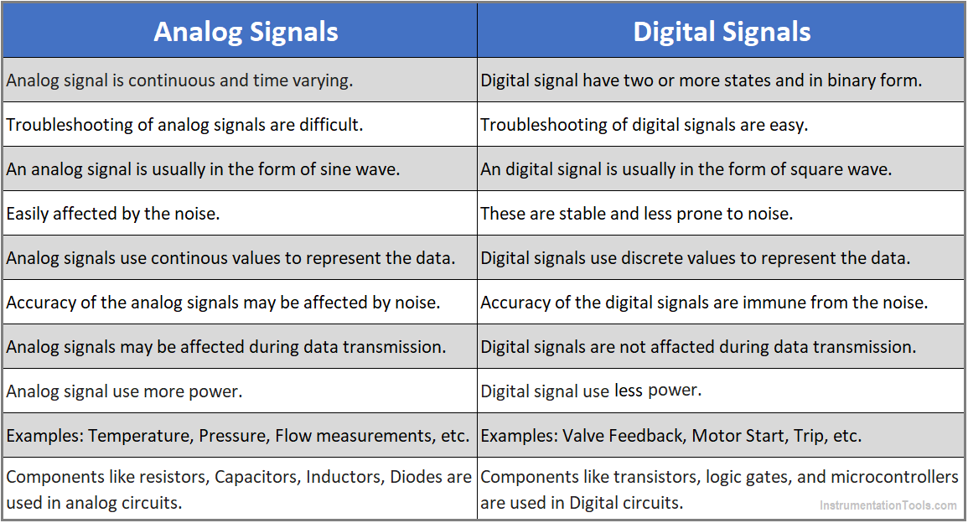

Slide 7
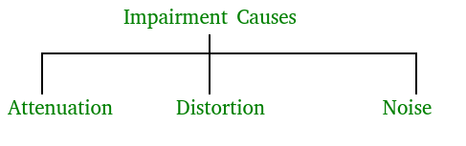
Transmission Impairments

Slide 8
Attenuation – It means loss of energy. The strength of signal decreases with increasing distance which causes loss of energy in overcoming resistance of medium. This is also known as attenuated signal. Amplifiers are used to amplify the attenuated signal which gives the original signal back and compensate for this loss.
Attenuation is measured in decibels(dB). It measures the relative strengths of two signals or one signal at two different point.

Slide 9
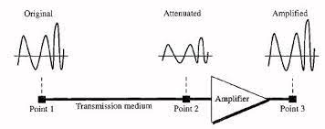

Slide 10
Distortion – It means changes in the form or shape of the signal. This is generally seen in composite signals made up with different frequencies. Each frequency component has its own propagation speed travelling through a medium.

Slide 11
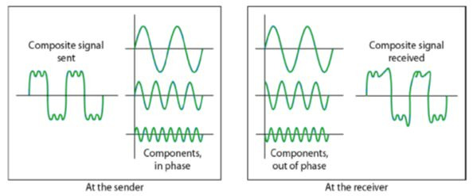

Slide 12
Noise – The random or unwanted signal that mixes up with the original signal is called noise. There are several types of noise such as induced noise, crosstalk noise, thermal noise and impulse noise which may corrupt the signal.
Induced noise comes from sources such as motors and appliances. These devices act as sending antenna and transmission medium act as receiving antenna.
Thermal noise is movement of electrons in wire which creates an extra signal.
Crosstalk noise is when one wire affects the other wire.
Impulse noise is a signal with high energy that comes from lightning or power lines

Slide 13
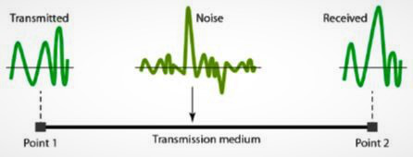

Slide 14
channel capacity
By capacity of a channel, it means the capacity of the transmission medium (wire or link). Capacity is the number of bits the transmission medium can hold. So basically there are 2 types of channels – Full duplex and half duplex.
Half duplex – the transmission can happen in one direction at a time.
Full duplex – the transmission can happen in both the direction simultaneously.

Slide 15
The capacity of the channel depends on two things:
Bandwidth
Propagation delay
Capacity = bandwidth * propagation delay
(in case of half duplex)
Capacity =2* bandwidth * propagation delay (in case of full duplex)

Slide 16
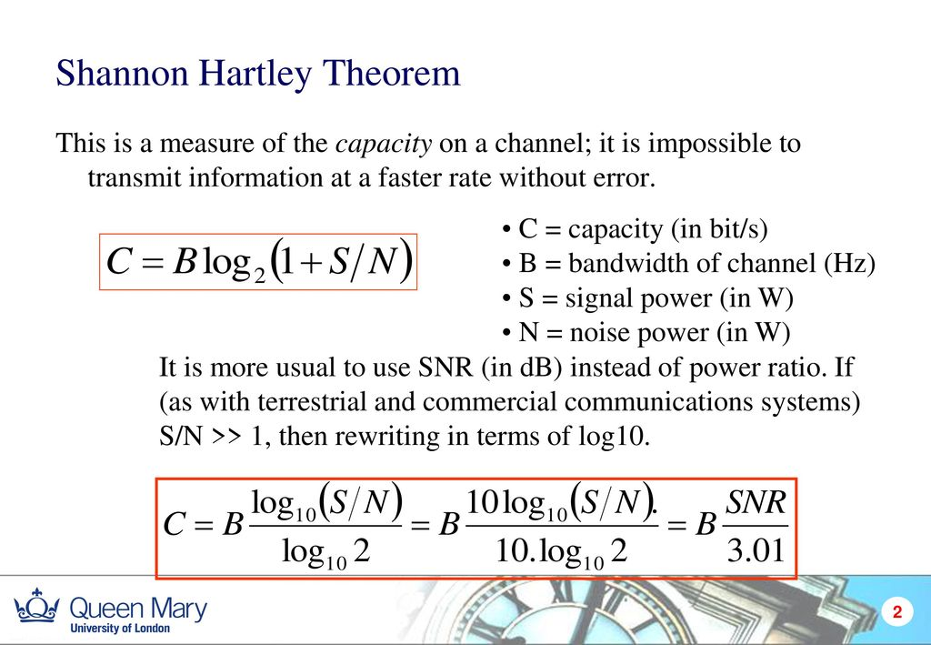

Slide 17
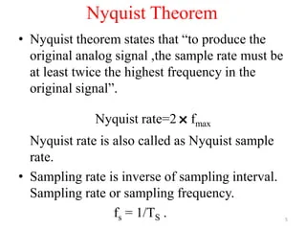

Slide 18
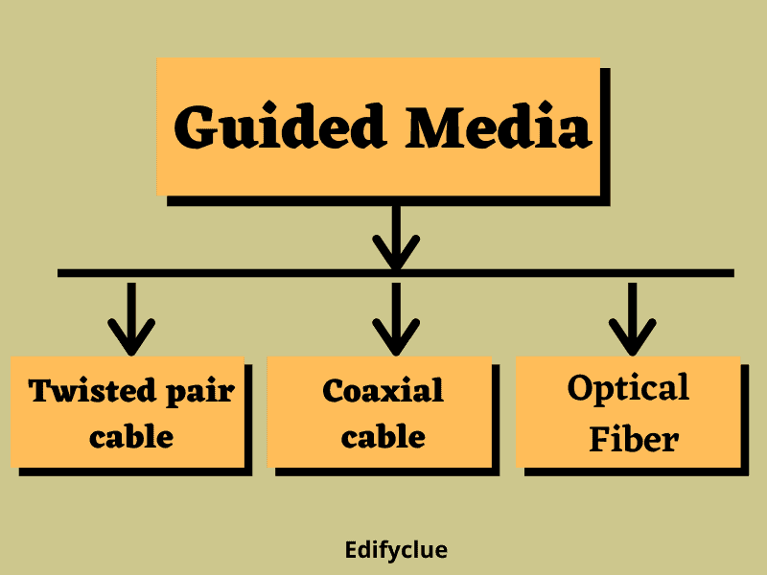
Guided Media

Slide 19
1. Guided Media: It is also referred to as Wired or Bounded transmission media. Signals being transmitted are directed and confined in a narrow pathway by using physical links.
Features:
High Speed
Secure
Used for comparatively shorter distances

Slide 20
There are 3 major types of Guided Media:
(i) Twisted Pair Cable –
It consists of 2 separately insulated conductor wires wound about each other. Generally, several such pairs are bundled together in a protective sheath. They are the most widely used Transmission Media. Twisted Pair is of two types:
Unshielded Twisted Pair (UTP):
UTP consists of two insulated copper wires twisted around one another. This type of cable has the ability to block interference and does not depend on a physical shield for this purpose. It is used for telephonic applications.
Advantages:
⇢ Least expensive
⇢ Easy to install
⇢ High-speed capacity

Slide 21
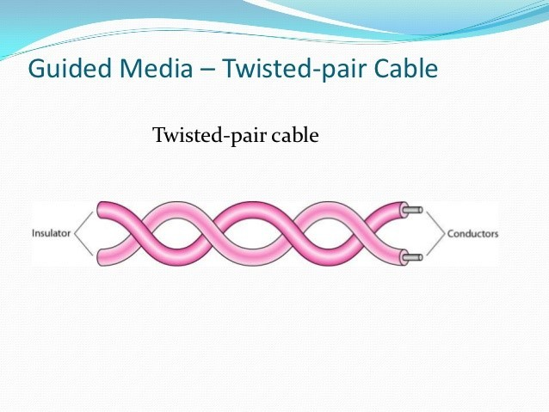

Slide 22
(ii) Coaxial Cable –
It has an outer plastic covering containing an insulation layer made of PVC or Teflon and 2 parallel conductors each having a separate insulated protection cover. The coaxial cable transmits information in two modes: Baseband mode(dedicated cable bandwidth) and Broadband mode(cable bandwidth is split into separate ranges). Cable TVs and analog television networks widely use Coaxial cables.

Slide 23
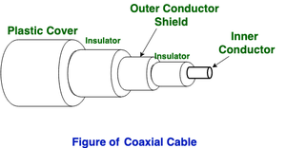

Slide 24
Advantages:
High Bandwidth
Better noise Immunity
Easy to install and expand
Inexpensive
Disadvantages:
Single cable failure can disrupt the entire network

Slide 25
(iii) Optical Fiber Cable –
It uses the concept of refraction of light through a core made up of glass or plastic. The core is surrounded by a less dense glass or plastic covering called the cladding. It is used for the transmission of large volumes of data.

Slide 26
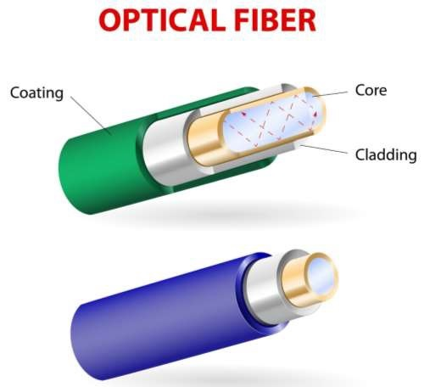

Slide 27
Wireless Transmission
Wireless communication is also referred to as Unguided Media or Unbounded transmission media. In this mode, no physical medium is required for the transmission of electromagnetic signals. In wireless communication, we can transfer our message through the air, water or vacuum i.e. Infrared, Radio wave, Microwave wave.

Slide 28
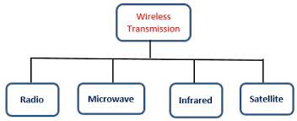

Slide 29
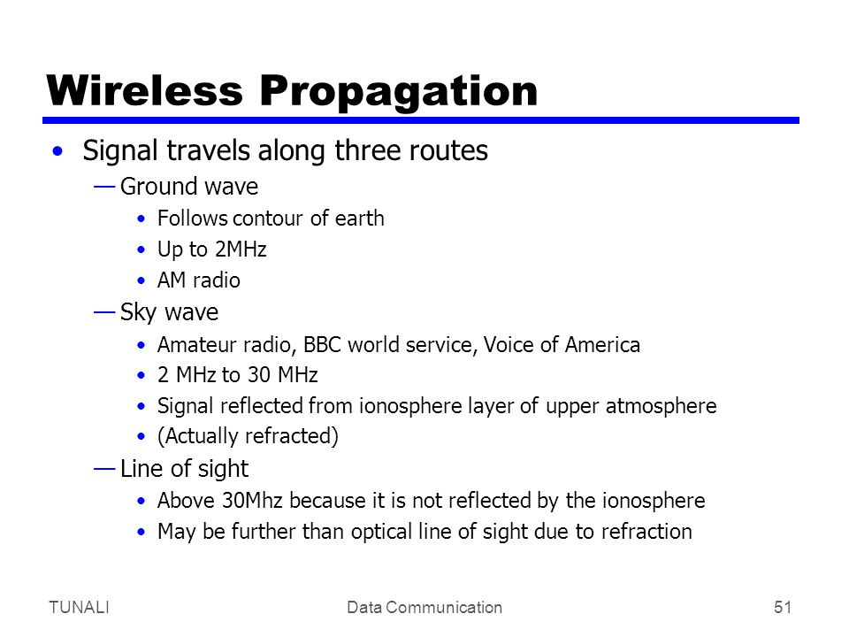
Wireless Propagation and Line of sight

Slide 30
Thank You

