Slide 1
SOFTWARE PROJECT MANAGEMENT
SYLLABUS
Unit I : Introduction SPM -What is Project-
S/w Project vs other types of Projects -
Activities Covered by SPM - The Project as
a system –Problems with software projects-
Management Control – Requirement
Specification

Slide 2
UNIT I
Introduction:
Software Project Management(SPM) is a proper way of planning and leading software projects.
It is a part of project management in which software projects are planned,
implemented, monitored, and controlled.

Slide 3
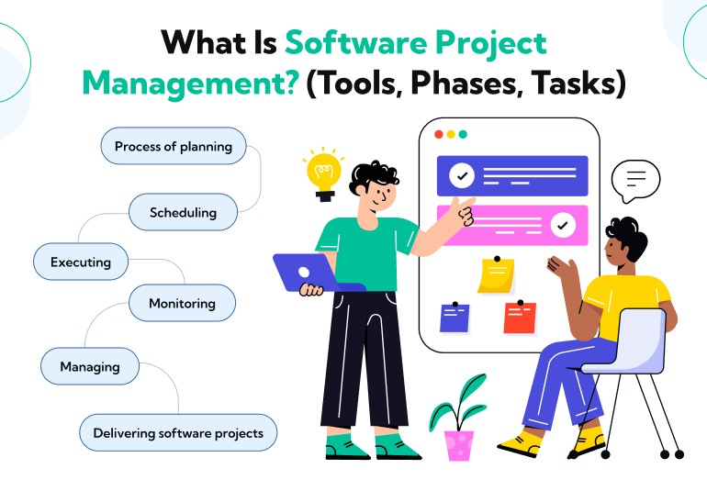

Slide 4
What is a Project?
A project is defined as a sequence of tasks that must be completed to attain a certain outcome.
According to the Project Management Institute (PMI), the term Project refers to ” to any temporary endeavor with a definite beginning and end”.
Depending on its complexity, it can be managed by a single person or hundreds.

Slide 5
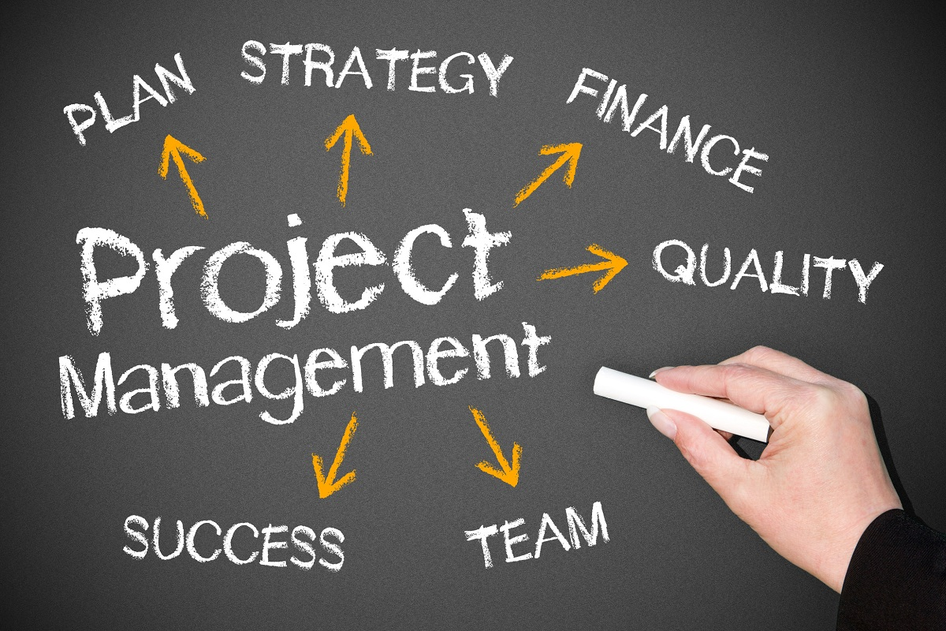

Slide 6
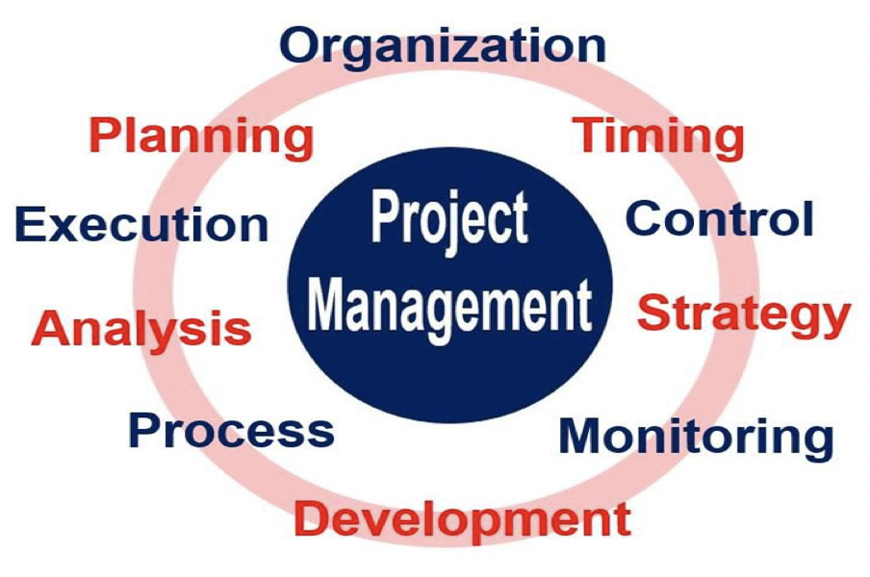

Slide 7
Software Project vs other type Project :
Invisibility
Software, progress is not immediately
visible since work is logical; however, for
Physical artifacts like bridges, work
progress can be seen from time to time.
In Software Development, there is a level of
uncertainty.

Slide 8
2. Complexity
Software projects contain more complexity
than other engineered artifacts.
For example, in a bridge, there is a clear
structural relationship Between parts, whereas
software component relationships are much
more complicated.
We can't measure the complexity of a
Software project until we work on it.

Slide 9
3. Conformity
Physical systems are governed by
Consistent physical law, while Software
developers have to conform to the requirements
of human clients.
4. Flexibility
Software systems are particularly subject to
change. A bridge has to be built in a specific
order, whereas We can make Software much
more flexibly and restructure parts quite freely.

Slide 10
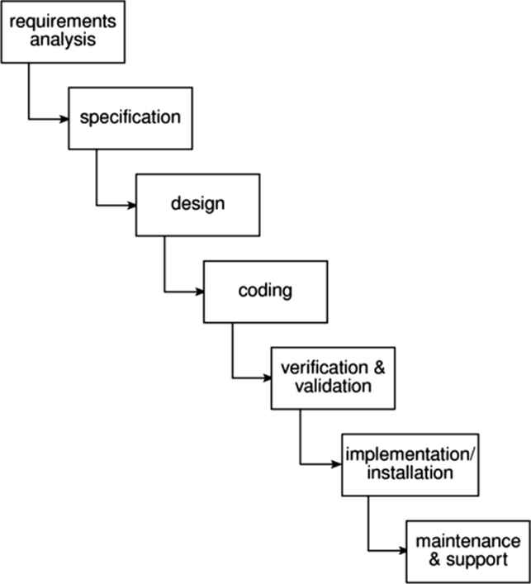
Activity Covered by Software Project Management

Slide 11
Requirements analysis This is finding out in
detail what the users require of the system that
the project is to implement.
Specification Detailed documentation of
what the proposed system is to do.
Design A design that meets the specification
has to be drawn up.
This design activity will be in two stages.
One will be the external or user design.

Slide 12
Coding This might refer to writing code in
a procedural language such as C or ada, or might
refer to the use of a high level application
builder.
Verification and validation Whether
software is developed specially for the current
application or not, careful testing will be needed
to check that the proposed system meets its
requirements.

Slide 13
Implementation/installation Some system
development practitioners refer to the whole of
the project after design as 'implementation' (that
is, the implementation of the design or user
manual) while others insist that the term refers
to the installation of the system after the
software has been developed.

Slide 14
Maintenance and support Once the system
has been implemented there will be a
continuing need for the correction of any errors
that may have crept into the system and for
extensions and improvements to the system.

Slide 15
The Project as a System
A project is concerned with
creating a new system and/or transforming
an old one and is itself a system.
A simple definition of the term
system is 'a set of interrelated parts'.

Slide 16
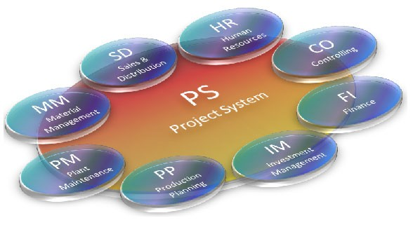

Slide 17
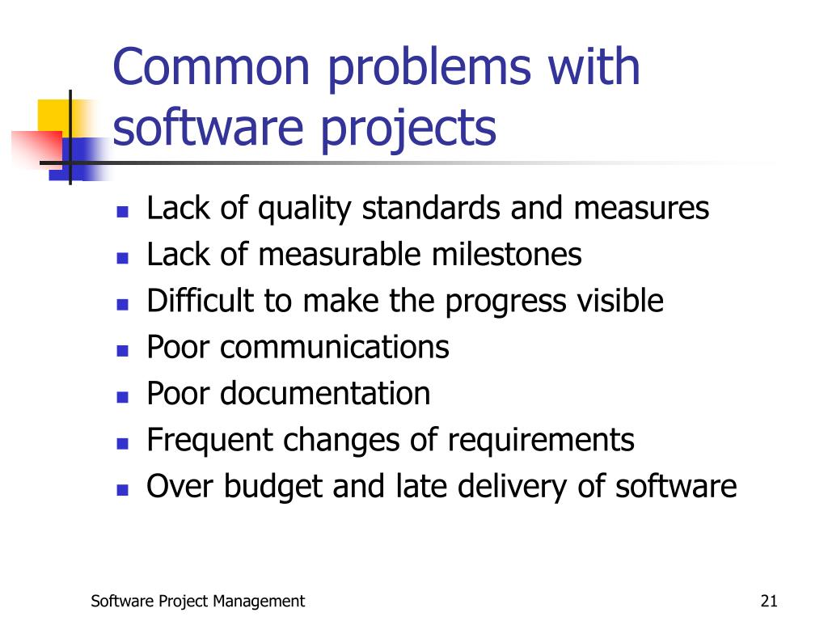

Slide 18
• Poor estimates and plans;
• Lack of quality standards and measures;
• Lack of guidance about making organizational decisions;
• Lack of techniques to make progress visible
• Poor role definition - who does what?
• Incorrect success criteria.

Slide 19
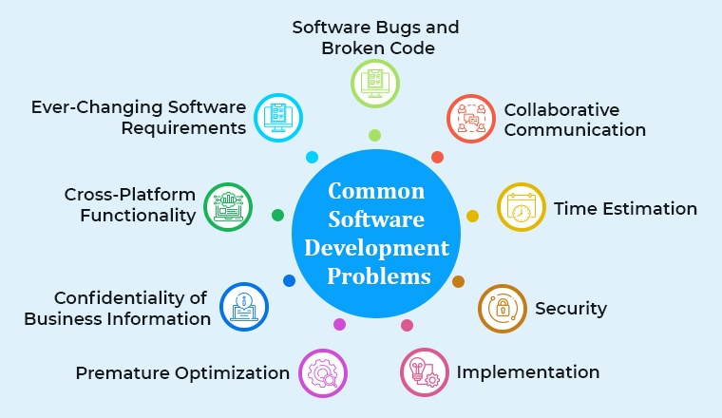

Slide 20
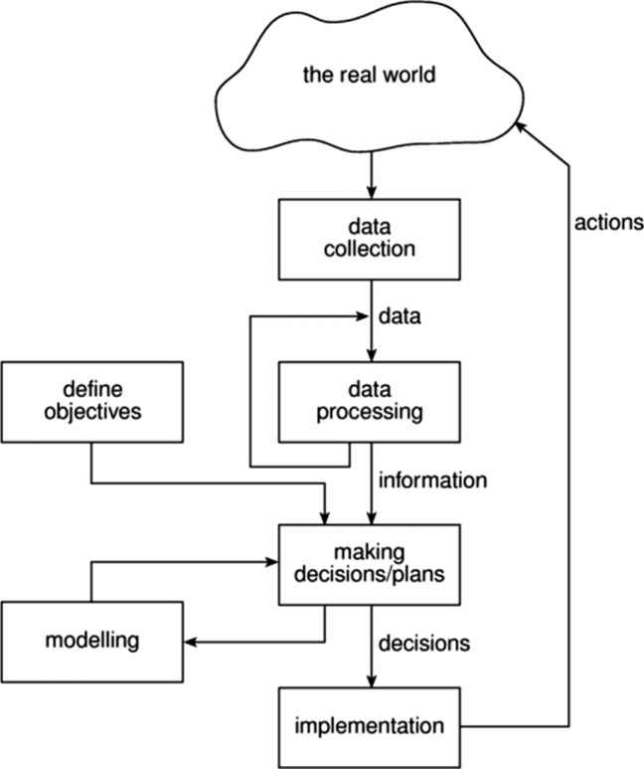
Management Control

Slide 21
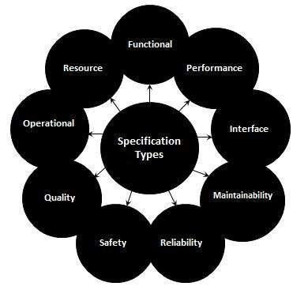
Software Requirement Specification(SRS)

