Slide 1
SNS COLLEGE OF ALLIED HEALTH SCIENCE
Affiliated to The Tamil Nadu Dr. M.G.R Medical University, Chennai
DEPARTMENT OF PHYSICIAN ASSISTANT
COURSE NAME :OBSTETRICS &GYNECOLOGY
UNIT :1
TOPIC : FETAL SKULL
FACULTY NAME : Ms. SUMATHY. R

Slide 2
CASE HISTORY ( EMPATHY )
A 28-year-old primigravida at 40 weeks gestation presents in active labor with ruptured membranes. After 2 hours in the second stage, cardiotocography shows recurrent late decelerations. Vaginal examination finds the head at +2 station with marked caput succedaneum and overlapping parietal bones; the posterior fontanelle is palpable anteriorly, confirming occipito-anterior position and moderate molding. how mastery of foetal skull anatomy prevents misdiagnosis of cephalopelvic disproportion and avoids unwarranted cesarean delivery???

Slide 3
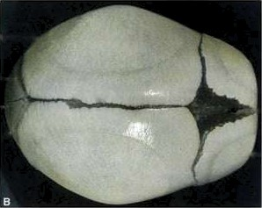
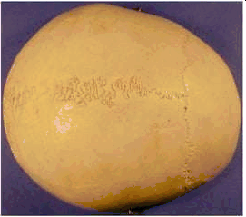
FETAL SKULL vs ADULT SKULL

Slide 4
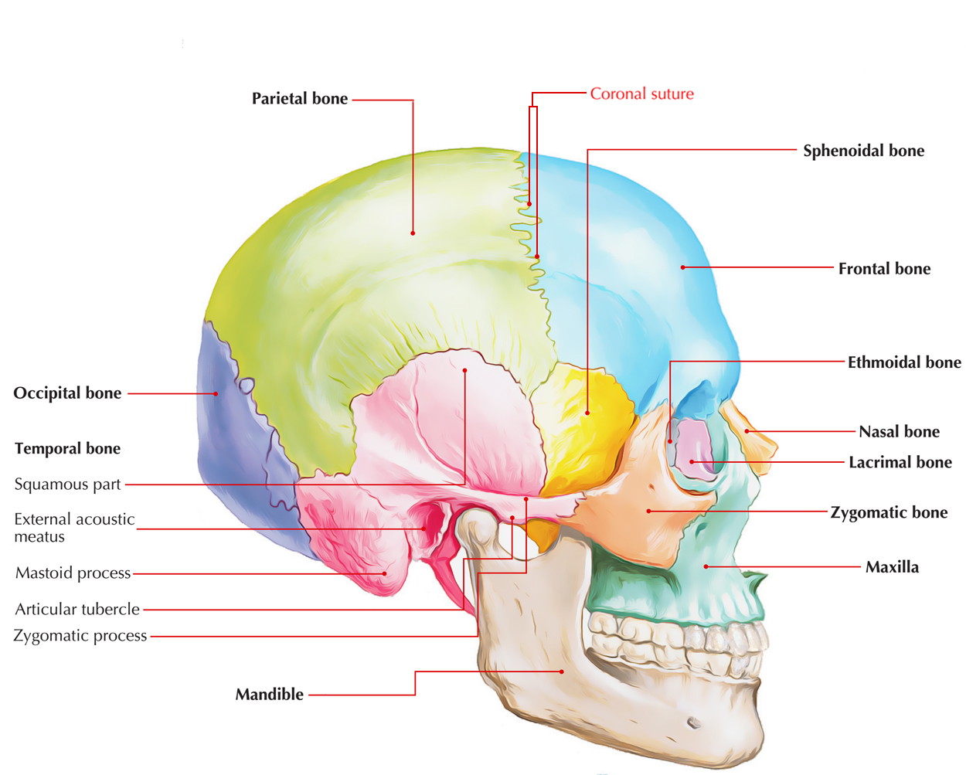
BONES OF THE FETAL SKULL-DEFINE
2 × Frontal
2 × Parietal
2 × Temporal
1 × Occipital (2 parts at birth)
1 × Sphenoid
1 × Ethmoid
→ Total: 7 main bones

Slide 5
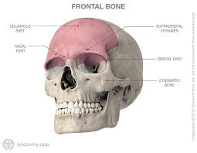
FRONTAL BONE
Forms the forehead or sinciput
* The ossification centre of each bone is the frontal eminence
*The frontal bones fuse into a single bone by age 8 years of age.

Slide 6
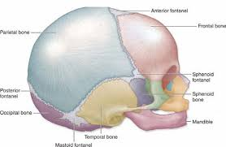
PARIETAL BONE
Which lie on either side of the skull and occupy most of the skull
The ossification centre of each of these bones is called the parietal eminence

Slide 7
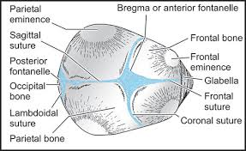
OCCIPITAL BONE
Forms the back of the skull and part of its base
The ossification centre is the occipital Protuberance
Part of it contributes to the base of the skull as it contains the foramen magnum

Slide 8
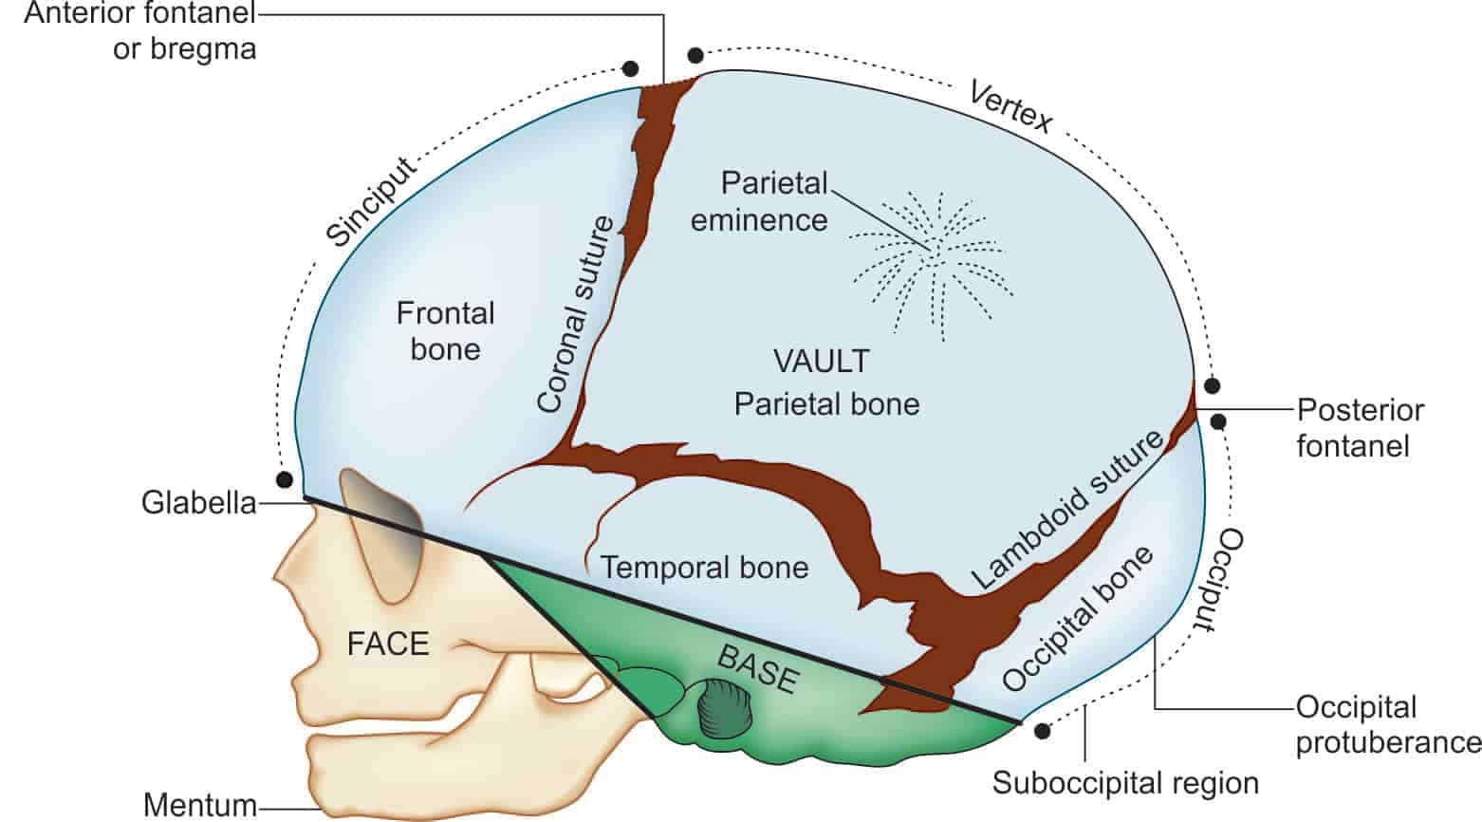
TEMPORAL BONE
On both side of head Forms part of the Vault
( Not significant in obstetrics )

Slide 9
SUTURES
Are spaces between the bones of the skull
Two or more sutures meet, a fontanelle
These sutures and fontanelle allow for molding of the fetal head during labour
04/11/2025

Slide 10
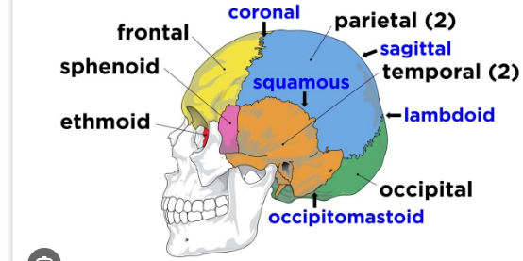
SUTURES (FIBROUS JOINTS)
Sagittal → between 2 parietals
Frontal → between 2 Frontal bones
Coronal → frontal ↔ parietals
Lambdoid → occipital ↔ parietals

Slide 11
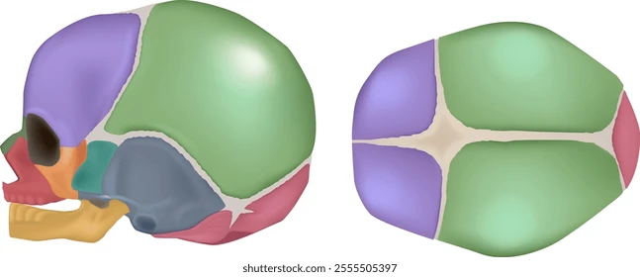
FONTANELLES
Fontanelles are soft membranous gaps or sutures between the cranial bones.
Anterior Fontanelle
located between two frontal and two parietal bones
Diamond shaped
situated between the coronal and the sagittal suture.
18 months
Also called as BREGMA

Slide 12
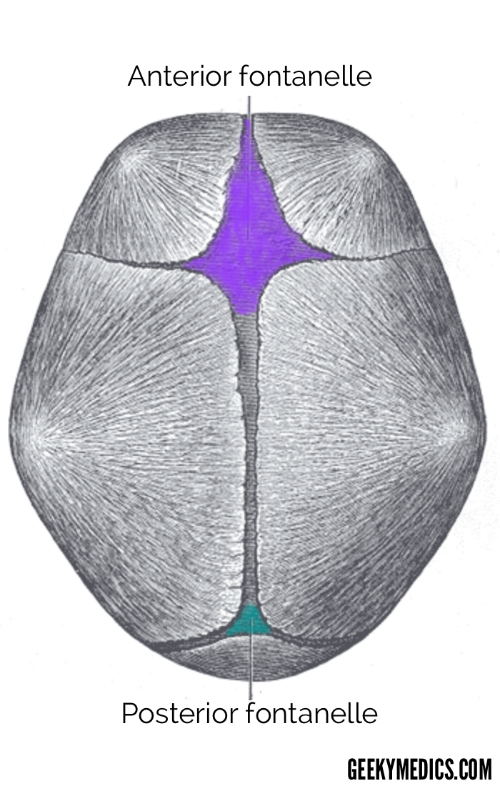
FONTANELLES
Posterior Fontanelle
located at the junction of the sagittal suture and the lambdoid suture
Triangular Shape
The posterior fontanelle ossifies (closes) within 6-8 weeks after birth.
Also called - LAMBDA

Slide 13
REGIONS OF THE FETAL SKULL
VAULT
Is the large , dome shaped part above an imaginary line drawn between the orbital ridges and the nape of the neck
BASE :
The base comprises bones that are firmly united to protect the vital centers in the medulla oblongata
FACE : Is composed of 14 small bones that are also firmly united and non-compressible

Slide 14
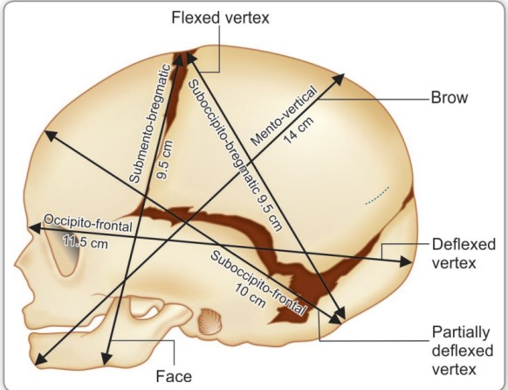
DIAMETERS OF FETAL SKULL

Slide 15
SUMMARY
It is important for midwife to learn about the fetal skull by knowing the landmarks will enable them to estimate the progress of labour.
Midwife also can evaluates the presentation and progression of the fetal skull through these structures

Slide 16
REFERENCE :
1. Marshall J.,& Raynor M. (2014) Myles TextbOOk FOR Midwives. (16th ed.). London Elsevier.
2.Verrals S. (2015) Anatomy And Physiology Applied TO Obstetrics. (3’d ed.). Singapore : Elsevier.
3.Winson N. V., & Mcdonald S. (2014) Illustrated Dictionary Of Midwifery. Edinburgh : Elsevier.

