Slide 1

Active Voice and Passive Voice
Connecting to Today's Lesson
Understanding voice in English grammar helps us communicate more effectively in both academic and professional settings.
Recap of English grammar basics covered previously
Focus on sentence structure and clarity
Connection to technical writing standards
Preparation for workplace communication
Foundation for professional documentation
1/10

Slide 2

Design Thinking Alignment
Mastering active and passive voice follows the same structured approach used in engineering design processes.
01
02
Empathize
Define
Understand communication challenges in technical contexts
Identify when to use each voice type
03
04
Ideate
Prototype
Explore sentence structure variations
Practice converting between voice types
05
Test
Apply in real-world engineering scenarios
2/10

Slide 3

EMPATHY
Why This Topic Matters ?
Not mastering voice types creates significant communication barriers in engineering careers.
Communication Issues
Interview Performance
Unclear documentation confuses team members and stakeholders
Weak grammar reduces professional credibility
Workplace Problems
Exam Impact
Ambiguous reports lead to project delays
Grammar errors cost valuable marks
Career Growth
Poor writing limits advancement opportunities
3/10

Slide 4
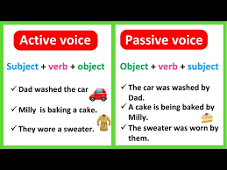
Defining Active and Passive Voice
Understanding the fundamental difference between these voice types is essential for clear technical communication.
Active Voice
Passive Voice
Subject performs the action. Clear and direct: "The engineer designed the circuit."
Subject receives the action. More formal: "The circuit was designed by the engineer."
4/10

Slide 5

Core Rules (Part 1)
Master these fundamental patterns to correctly identify and use both voice types.
Active Structure
Passive Structure
Subject + Verb + Object
Object + be-verb + past participle + by + Subject
Action Clarity
Formal Tone
Active voice shows who performs the action
Passive voice creates objective, professional tone
Verb Form
Always use past participle with be-verbs in passive
5/10

Slide 6

Rules with Examples (Part 2)
Apply these rules to technical and workplace scenarios for professional communication.
Example 1
Active: The team completed the project on time. Passive: The project was completed on time by the team.
Example 2
Active: Engineers tested the prototype. Passive: The prototype was tested by engineers.
Example 3
Active: The supervisor approved the design. Passive: The design was approved by the supervisor.
Example 4
Active: We analyzed the data. Passive: The data was analyzed by us.
6/10

Slide 7

Classroom Activity
Practice converting sentences between active and passive voice with this interactive 10-minute exercise.
01
Form Pairs
Partner with a classmate for collaborative learning
02
Receive Sentences
Get 5 technical sentences from instructor
03
Convert Voices
Transform each sentence to opposite voice type
04
Review Together
Check accuracy and discuss improvements
05
Share Findings
Present best examples to the class
7/10

Slide 8
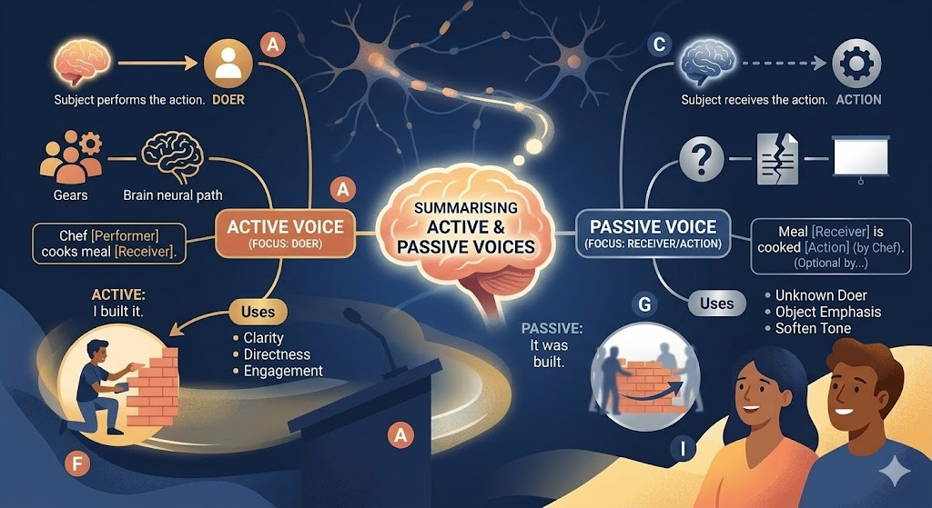
Concept Mind Map
Visual summary of active and passive voice key concepts for quick reference.
Active Voice
Subject acts
Passive Voice
Subject receives
Structure
Pattern rules
Usage
When to apply
Practice
Technical examples
8/10

Slide 9

Practice Exercises
Test your understanding with these moderate-difficulty questions combining technical and workplace scenarios.
Question 1
Question 2
Convert to passive: "The engineer fixed the software bug."
Identify voice: "The specifications were reviewed by the quality team."
Question 3
Question 4
Correct error: "The experiment was conduct by researchers."
Fill blank: "The design _____ (approve) yesterday."
Question 5
MCQ: When is passive voice preferred in technical writing?
9/10

Slide 10

Answer Key & Final Recap
Check your work and remember these key takeaways for professional success.
Key Takeaway 1
Key Takeaway 2
Active voice = clear, direct communication
Passive voice = formal, objective tone
Key Takeaway 3
Key Takeaway 4
Choose voice based on context and purpose
Practice converts knowledge to skill
Key Takeaway 5
Master grammar for career success
10/10

