Slide 1

SNS COLLEGE OF TECHNOLOGY
Coimbatore-35
An Autonomous Institution
Department of AIML
23AMO304-Introduction To Business Intelligence
Business Reporting
Concepts
Foundations of Business Intelligence & Decision Support
Dr. Angel Latha Mary S
SNS College of Technology | Coimbatore

Slide 2

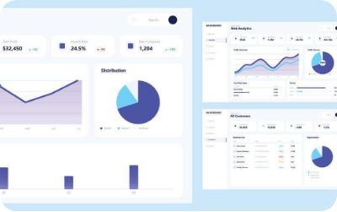

What is Business Reporting?
The Bridge from Data to Insight
Business reporting is the process of collecting and transforming data into meaningful information. It facilitates communication among stakeholders to support fact-based decision-making.
"Reporting tells you what happened, providing the foundation for Analytics to tell you why."

Slide 3





Core Purposes of Reporting
Monitor Operations
Strategic Planning
Compliance
Ensure regulatory standards are met through transparent financial and safety reporting.
Track day-to-day performance against predefined goals and operational benchmarks.
Provide historical trends and patterns to inform long-term corporate strategies.

Slide 4
Types of Business Reports
Informational Reports: Focus strictly on facts and data presentation (e.g., Attendance, Inventory).
Analytical Reports: Provide data plus interpretation, analysis, and recommendations (e.g., Feasibility studies).
Ad-Hoc Reports: Unplanned reports generated on-demand to answer specific business questions.

Slide 5
Standard Report Structure
Executive Summary: High-level overview for busy stakeholders.
Interpretation: What the findings actually mean for the business.
Methodology: How the data was collected and analyzed.
Recommendations: Concrete actions based on the analysis.
Findings: The core data visualizations and facts.
Appendix: Raw data and detailed technical proofs.

Slide 6
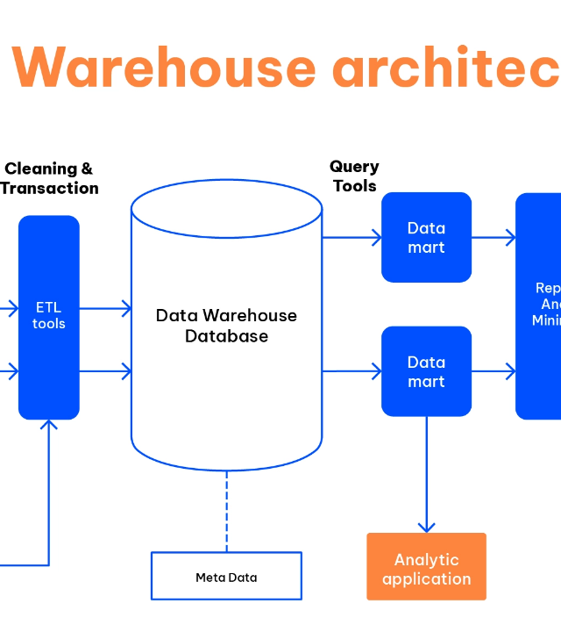
The BI Reporting Cycle
A systematic flow ensures data integrity:
Source: ERP, CRM, and Flat Files.
ETL: Extract, Transform, and Load into the Warehouse.
Presentation: Deploying to mobile or web portals.

Slide 7


Monitoring vs. Strategic Performance
Dashboards
Scorecards
Operational focus on short-term tasks.
Strategic focus on long-term goals.
•
Real-time updates
•
Balanced Scorecard (BSC)
•
High granularity
•
Strategic alignment
•
Visualized KPIs
•
Progress vs. Milestones

Slide 8






Visualizing for Clarity
Effective reporting requires choosing the correct visual aid:
Bar Charts
Line Graphs
Doughnut Charts
Comparing values across categories.
Tracking changes over time.
Displaying proportional parts of a whole.

Slide 9
Attributes of Effective Reports
Attribute | Definition | Impact
Accuracy | Data verified against source. | Builds stakeholder trust.
Timeliness | Reports delivered when needed. | Enables reactive agility.
Clarity | Clear visuals, no jargon. | Faster comprehension.
Relevance | Tied to specific KPIs. | Reduces information noise.

Slide 10




Interactive Puzzle 1: Match the Terms
Match these BI concepts to their roles:
A. Strategic performance tracker.
ETL
B. Moving data from source to target.
KPI
C. Metric used to evaluate success.
Scorecard
Answer Key: 1-B, 2-C, 3-A

Slide 11




Interactive Puzzle 2: The Logic Maze
The Manager's Dilemma:
"Our sales in the Southern region dropped by 15%. I need to know why this happened and what we should do next."
Which type of report should the BI analyst prepare?
Correct! B. Analytical Report — because it goes beyond facts to provide Interpretation and Recommendations.

