Slide 1
SNS COLLEGE OF TECHNOLOGY
Coimbatore-35
An Autonomous Institution
Department of AIML
23AMO304-Introduction To Business Intelligence
Descriptive Statistics
Summarizing Historical Data to Identify Trends & Patterns
Dr. Angel Latha Mary S
SNS College of Technology | Coimbatore

Slide 2
Foundations
The first step in any analytical journey: "What Happened?"

Slide 3
Levels of Measurement
Data types determine the statistical methods we can apply. Understanding these four levels is critical for accurate analysis.
•
Nominal: Qualitative categories with no inherent order (e.g., Department names).
•
Ordinal: Categories with a meaningful sequence (e.g., Customer satisfaction ranks).
•
Interval: Numeric scales where differences matter, but no true zero (e.g., Temperature).
•
Ratio: Numeric with a true zero, allowing for ratios (e.g., Sales Revenue).

Slide 4

Central Tendency
The Averages
Mean: The arithmetic average. Sensitive to outliers.
These measures locate the "center" of a dataset, providing a single representative value.
Median: The middle value in a sorted list. Robust to outliers.
Mode: The most frequent value. Useful for categorical data.

Slide 5






Measures of Spread
Range
Standard Deviation
IQR
The difference between maximum and minimum values. Simple but highly limited.
Interquartile Range: Measures the spread of the middle 50% of data.
The average amount values differ from the mean. Essential for risk assessment.

Slide 6
Distribution Shape
Beyond averages, we must understand the "Shape" of our data to identify biases.
Skewness
Indicates asymmetry. Positive skew shifts data to the left; negative skew shifts to the right.
Kurtosis
Measures the "peakedness" of the curve. High kurtosis indicates extreme outliers.

Slide 7
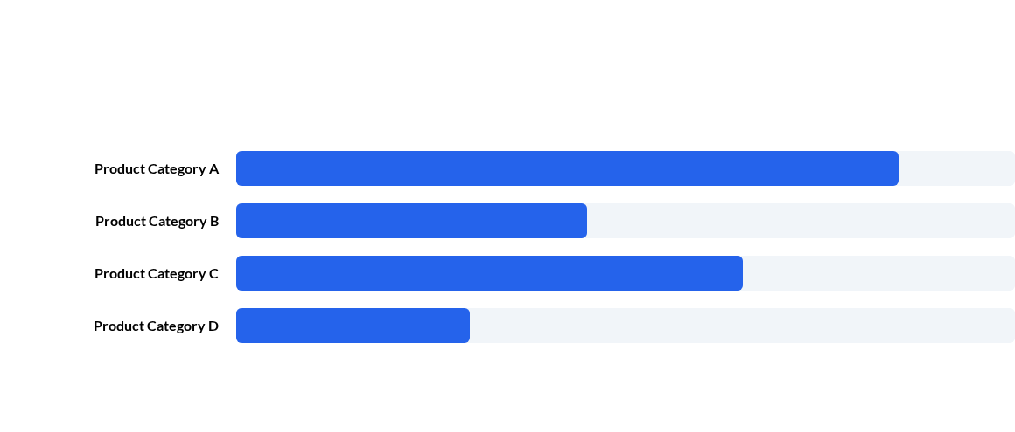
Visualizing Frequency
Frequency distributions help identify the most common occurrences in business operations.

Slide 8

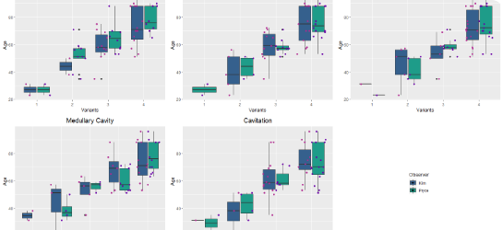
Exploratory Visuals
Box Plots: Visualizing quartiles and detecting outliers.
Dashboards: Aggregating multiple descriptive metrics.

Slide 9
Strategic Implementation
80%
The Power of "What"
Implementing descriptive statistics allows businesses to track KPIs with precision. From Inventory Management to Financial Auditing, these metrics provide the context needed for senior management to evaluate performance against yearly benchmarks.
Decision Accuracy

Slide 10
Summary of Methods
Metric Type | Standard Measure | Best Use Case
Central Tendency | Mean, Median, Mode | Summarizing total sales or typical user behavior.
Dispersion | Std. Dev, Variance | Assessing financial risk and quality control.
Relationship | Correlation | Understanding links between marketing & revenue.
Distribution | Histogram, Box Plot | Identifying seasonality and outliers.

Slide 11


Knowledge Puzzle 1
The Scenario Challenge
Your company's CEO says: "I want to know the most common price point our customers are choosing for their subscription."
Question: Which measure of central tendency should you report?
A) Mean | B) Median | C) Mode
(Answer: C. Mode identifies the 'most common' value.)

Slide 12

Knowledge Puzzle 2
The Spread Challenge
You have two sales teams. Team A has a Standard Deviation of 5, and Team B has a Standard Deviation of 50. Their Mean sales are identical.
Question: Which team has more consistent performance?
A) Team A | B) Team B
(Answer: A. A lower standard deviation indicates less variability.)

