Slide 1

SNS COLLEGE OF TECHNOLOGY
An Autonomous Institution Coimbatore-35
DEPARTMENT OF INFORMATION TECHNOLOGY
23ITT304 Information Coding Technique
Unit I
Information Theory
Information
P.Thilagarani AP/IT

Slide 2


Information from Coding
Convert messages into symbols, and the receiver converts them back to understand the meaning.
C – Come
F – Fast
T – To
C – Canteen
coded message carried the same information in shorter form
15.12.2025 INFORMATION CODING TECHNIQUE | Information | P.Thilagarani | SNSCT 1/13

Slide 3


Recap & Icebreaker
Quick Reflection
Think back: How do you send a message on your phone? What happens between typing and the recipient reading it?
Pair Share (2 min)
Discuss with a partner:
One example of a message you sent today
Did it include text, emojis, or voice? How was it 'coded'?
We’ll share one insight from each pair.
15.12.2025 INFORMATION CODING TECHNIQUE | Information | P.Thilagarani | SNSCT 1/13

Slide 4
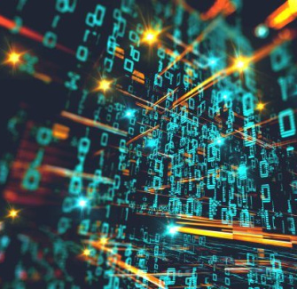
Learning Objectives
By the end of this session, you will be able to:
Explain how information is encoded and decoded in digital systems
Identify common coding techniques like ASCII, Unicode, and binary encoding
Apply coding principles to real-world data transmission scenarios
Analyze the role of error detection and correction in reliable communication
Evaluate emerging trends in information coding for future technologies
15.12.2025 INFORMATION CODING TECHNIQUE | Information | P.Thilagarani | SNSCT 1/13

Slide 5



Problem Statement: The Digital Misunderstanding
Root Cause
Poor network conditions degrade data transfer due to weak coding and error handling.
Persona
Rahul, 32, field tech, sends repair updates via mobile app in low-connectivity areas.
Challenge
Messages arrive corrupted or delayed—critical data like part numbers get garbled during transmission.
15.12.2025 INFORMATION CODING TECHNIQUE | Information | P.Thilagarani | SNSCT 1/13

Slide 6




Design Thinking Approach
Ideate
Explore compression, redundancy, checksums, and modulation techniques.
Prototype
Simulate message encoding with error detection using simple parity bits.
Empathize
Users need fast, accurate transmission even in unstable networks.
Define
How might we ensure data integrity during encoding and transmission?
15.12.2025 INFORMATION CODING TECHNIQUE | Information | P.Thilagarani | SNSCT 1/13

Slide 7

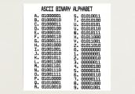

Vertical Depth: Core Coding Techniques
Parity
Simple error detection by adding even/odd bit to data blocks.
ASCII
Maps 128 characters (letters, numbers, symbols) to 7-bit codes.
Unicode
Supports global scripts
one standard code for all characters..
Eg:A=Unicode U+0041
Binary
All digital data starts as 0s and 1s—foundation of machine language.
15.12.2025 INFORMATION CODING TECHNIQUE | Information | P.Thilagarani | SNSCT 1/13

Slide 8

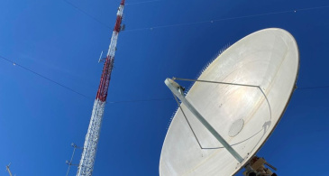
Horizontal Breadth: Applications & Links
Applications
QR codes
Wi-Fi and Bluetooth transmission
Satellite communications
Interdisciplinary Links
Computer Science (networking)
Linguistics (symbol representation)
Mathematics (probability in error correction)
15.12.2025 INFORMATION CODING TECHNIQUE | Information | P.Thilagarani | SNSCT 1/13

Slide 9
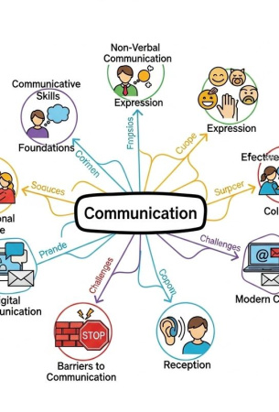
Summary
Information coding transforms human-readable data into machine-efficient formats
Core methods: Binary, ASCII, Unicode, Parity
Design thinking helps identify and solve real-world transmission issues
Cross-domain relevance in tech, language, and math
Future trends: Quantum encoding, AI-driven compression
15.12.2025 INFORMATION CODING TECHNIQUE | Information | P.Thilagarani | SNSCT 1/13

Slide 10
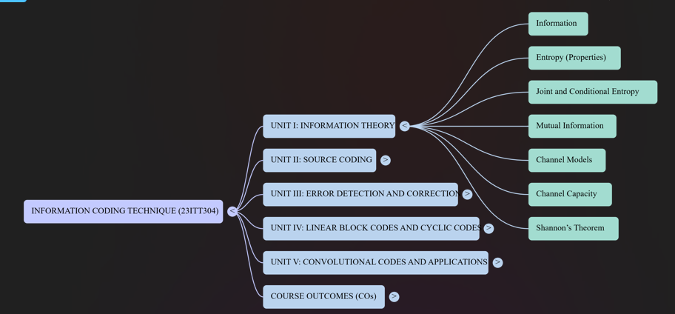
15.12.2025 INFORMATION CODING TECHNIQUE | Information | P.Thilagarani | SNSCT 1/13

Slide 11

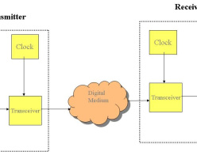
Discuss! 🤷‍♀️​ 💁‍♂️​ 💬​
Real-World Messaging: New Insights?
How has learning about information coding techniques changed the way you think about sending everyday messages, like a text or email? Think about what happens to your message before someone receives it.
15.12.2025 INFORMATION CODING TECHNIQUE | Information | P.Thilagarani | SNSCT 1/13

Slide 12
Discuss! 🤷‍♀️​ 💁‍♂️​ 💬​
✅​
You might have said...
I realize now that my messages are turned into codes the computer can understand before reaching someone else.
I never thought about error detection, but now I get why sometimes messages get garbled or need extra checks.
I see that using coding methods like ASCII or parity is what actually protects my communication from mistakes during transmission.
15.12.2025 INFORMATION CODING TECHNIQUE | Information | P.Thilagarani | SNSCT 1/13

Slide 13
Thank you
15.12.2025 INFORMATION CODING TECHNIQUE | Information | P.Thilagarani | SNSCT 1/13

