Slide 1

SNS COLLEGE OF TECHNOLOGY
An Autonomous Institution Coimbatore-35
DEPARTMENT OF INFORMATION TECHNOLOGY
23ITT304 Information Coding Technique
Unit II
Information Theory
Variable Length Codes
P.Thilagarani AP/IT

Slide 2


Variable Length Codes
Understanding Efficient Data Encoding in Information Theory
01.02.2026 INFORMATION CODING TECHNIQUE | Variable Length Codes | P.Thilagarani | SNSCT 2/12

Slide 3


Recap & Icebreaker
Let’s Warm Up!
Think about how we abbreviate words in texting:
'LOL' for 'laugh out loud'
'BRB' for 'be right back'
Why do we do this?
To save time and space—shorter messages for frequent phrases.
Connection to Coding
This is similar to how variable length codes work: common data gets shorter codes, rare data gets longer ones.
01.02.2026 INFORMATION CODING TECHNIQUE | Variable Length Codes | P.Thilagarani | SNSCT 3/12

Slide 4
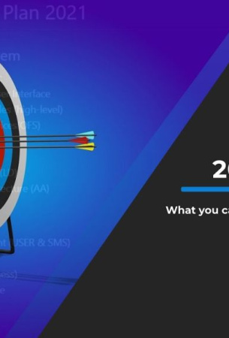
Lesson Objective
By the end of this session, you will be able to:
Explain what variable length codes are and why they matter.
Compare them with fixed-length encoding.
Apply Huffman coding principles to design efficient codes.
Recognize real-world applications in compression and communication.
01.02.2026 INFORMATION CODING TECHNIQUE | Variable Length Codes | P.Thilagarani | SNSCT 4/12

Slide 5
Design Thinking: Problem Statement
Persona: Priya, Data Analyst
Works at a telecom firm in Bangalore.
Handles massive call record files daily.
Faces high storage and transmission costs.
Needs faster, cheaper data transfer without losing information.
Core Challenge
Fixed-length codes (like ASCII) use same bits for all characters—even rare ones.
For example: 'E' and 'Z' both take 8 bits, even though 'E' appears far more often.
This wastes bandwidth and storage.
How can we encode data more efficiently?
01.02.2026 INFORMATION CODING TECHNIQUE | Variable Length Codes | P.Thilagarani | SNSCT 5/12

Slide 6

Design Thinking Process
Empathize
High costs, slow transfers, inefficient encoding plague data systems.
1
Define
Fixed-length codes waste space; they don't adapt to symbol frequency.
2
Ideate
Shorter codes for frequent symbols, longer for rare.
3
Prototype
Build Huffman coding model from character frequency in sample data.
4
01.02.2026 INFORMATION CODING TECHNIQUE | Variable Length Codes | P.Thilagarani | SNSCT 6/12

Slide 7
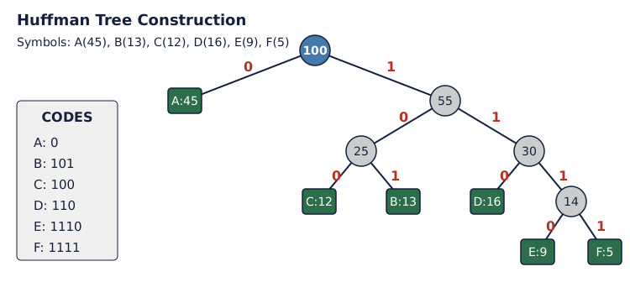
Huffman Coding Example
01.02.2026 INFORMATION CODING TECHNIQUE | Variable Length Codes | P.Thilagarani | SNSCT 7/12

Slide 8
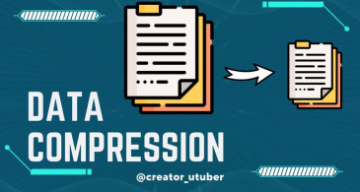
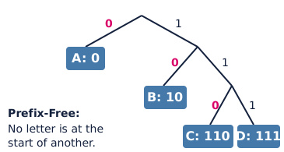
Technical Depth & Breadth
Horizontal Breadth
Used in ZIP, PNG, MP3, JPEG.
Links to AI: entropy in decision trees.
Future: adaptive coding in 6G networks.
Vertical Depth
Prefix-free. Optimal for known frequencies. Greedy algorithm for minimum weighted path length.
01.02.2026 INFORMATION CODING TECHNIQUE | Variable Length Codes | P.Thilagarani | SNSCT 8/12

Slide 9
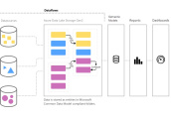


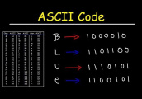
Key Takeaways
Efficiency
Shorter codes for frequent symbols reduce average bit usage.
Real Use
Used in compression standards like ZIP and multimedia formats.
Uniqueness
Prefix-free codes ensure unambiguous decoding.
Smart Design
Code length adapts to data patterns—like language usage.
01.02.2026 INFORMATION CODING TECHNIQUE | Variable Length Codes | P.Thilagarani | SNSCT 9/12

Slide 10

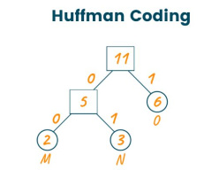
Discuss! 🤷‍♀️​ 💁‍♂️​ 💬​
When Shorter Codes Backfire
Can variable length codes ever be worse than fixed-length codes? When might this happen? Quick quiz: Which symbol should get the shortest code if it appears 70% of the time?
01.02.2026 INFORMATION CODING TECHNIQUE | Variable Length Codes | P.Thilagarani | SNSCT 10/12

Slide 11
Discuss! 🤷‍♀️​ 💁‍♂️​ 💬​
You might have said...
Variable length codes can be worse if all symbols appear with similar frequency, since the codes won't save space.
They can also be worse if error detection is important, since variable lengths can be more sensitive to mistakes in transmission.
The symbol that appears 70% of the time should get the shortest code to make the overall encoding as efficient as possible.
01.02.2026 INFORMATION CODING TECHNIQUE | Variable Length Codes | P.Thilagarani | SNSCT 11/12

Slide 12
Thank you
01.02.2026 INFORMATION CODING TECHNIQUE | Variable Length Codes | P.Thilagarani | SNSCT 12/12

