Slide 1

SNS COLLEGE OF TECHNOLOGY
An Autonomous Institution Coimbatore-45
DEPARTMENT OF INFORMATION TECHNOLOGY
23ITT304 Information Coding Technique
Unit IV
Vector Spaces
P.Thilagarani AP/IT
LINEAR BLOCK CODES AND CYCLIC CODES

Slide 2
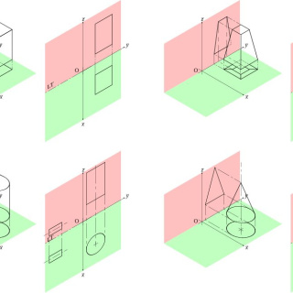
Abstract Algebra: Vector Spaces
Navigating Multidimensional Structures and Linear Combinations
12.04.2026 23ITT304-INFORMATION CODING TECHNIQUES | Vector Spaces | P.Thilagarani | SNSCT 2/13

Slide 3
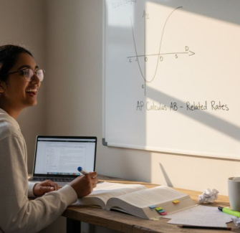
Recap & Icebreaker
Before We Start
Recall our work with Vectors in R². We used Arrows to represent direction and magnitude. Think of a Force applied to an object.
The Hook
If you have a set of 'things' (polynomials, functions, or matrices) that you can add together and scale, could they be treated just like arrows in space?
Discuss: What properties MUST remain true for a mathematical system to keep its shape?
12.04.2026 23ITT304-INFORMATION CODING TECHNIQUES | Vector Spaces | P.Thilagarani | SNSCT 3/13

Slide 4
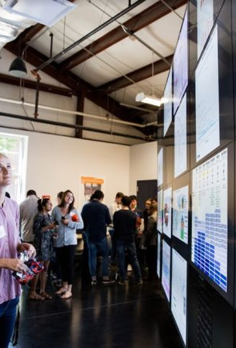
Problem Statement & Persona
Meet Rohan
Rohan is a Data Scientist in Bangalore working on Recommendation Engines. He has millions of user preferences (movies, ratings, genres).
The Challenge
How does Rohan mathematically define the 'distance' or 'similarity' between users? He needs a framework to treat these complex data points as elements in a consistent, structured space—this is where Vector Spaces come in. Without these axioms, his algorithms would collapse.
12.04.2026 23ITT304-INFORMATION CODING TECHNIQUES | Vector Spaces | P.Thilagarani | SNSCT 4/13

Slide 5
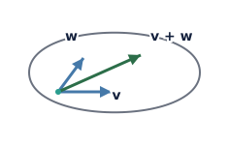
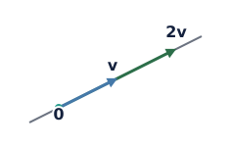
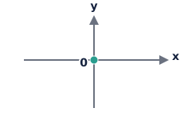
Defining the Core Challenge
Closure Property
If we add two things in our space, does the result stay inside the space? This is critical for system stability.
Scaling Consistency
If we stretch an element by a number (scalar), does it still behave predictably within the set?
The Zero Element
Every space needs an origin. Does our space have a unique zero vector that leaves elements unchanged?
12.04.2026 23ITT304-INFORMATION CODING TECHNIQUES | Vector Spaces | P.Thilagarani | SNSCT 5/13

Slide 6
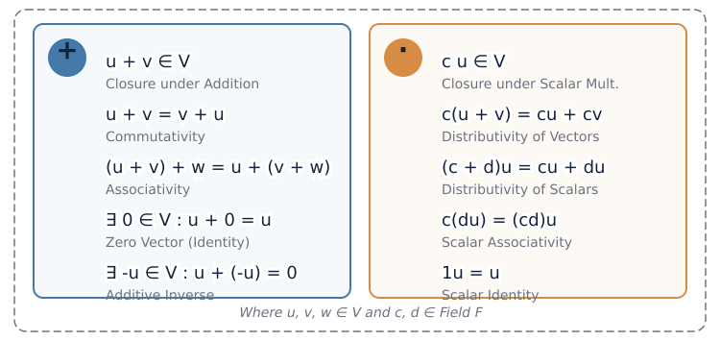
The 10 Axioms: Technical Depth
12.04.2026 23ITT304-INFORMATION CODING TECHNIQUES | Vector Spaces | P.Thilagarani | SNSCT 6/13

Slide 7

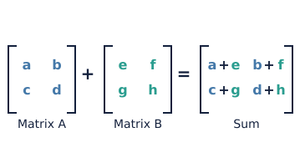
Solution: Abstracting our View
Prototype: Consider the set of all 2x2 matrices. They follow addition and scaling rules, making them a valid Vector Space.
By defining these 10 rules, we can treat Matrices and Functions as 'vectors'. This allows us to apply linear algebra to Calculus and Engineering.
12.04.2026 23ITT304-INFORMATION CODING TECHNIQUES | Vector Spaces | P.Thilagarani | SNSCT 7/13

Slide 8


Testing the Prototype: The Group Check
In groups of 4, evaluate the set of all points in the first quadrant of R² (where x > 0 and y > 0).
Does this set form a Vector Space?
Hint: Test the scalar multiplication axiom using a negative scalar like -1. Present your findings to the class.
12.04.2026 23ITT304-INFORMATION CODING TECHNIQUES | Vector Spaces | P.Thilagarani | SNSCT 8/13

Slide 9
Broad Horizons: The T-Shaped View
Modern AI
Machine Learning
Word Embeddings (NLP) use vector spacesto show 'King - Man + Woman = Queen'.
Future Physics
Quantum Mechanics
The state of a subatomic particle is represented as a vector in a Hilbert Space.
Present
Signal Processing
Representing radio waves as vectors in an infinite-dimensional space to filter noise.
12.04.2026 23ITT304-INFORMATION CODING TECHNIQUES | Vector Spaces | P.Thilagarani | SNSCT 9/13

Slide 10
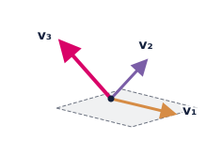
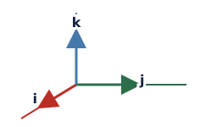
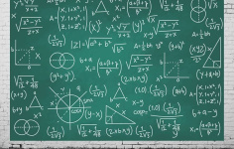
Key Takeaways: Summary Mind Map
Linear Independence
The 'building blocks' of the space—vectors that cannot be formed by others.
Basis & Dimension
The minimum number of vectors needed to span the entire space.
Formal Definition
A non-empty set V over a field F satisfying addition and scalar multiplication axioms.
12.04.2026 23ITT304-INFORMATION CODING TECHNIQUES | Vector Spaces | P.Thilagarani | SNSCT 10/13

Slide 11
Final Assessment
1.
Subspace
a)
A vector space that is contained within another larger vector space.
2.
Scalar
b)
A real number or element of a field used for stretching vectors.
4.
Span
c)
A self-evident rule or requirement that must be satisfied.
The set of all possible linear combinations of a set of vectors.
4.
Axiom
d)
12.04.2026 23ITT304-INFORMATION CODING TECHNIQUES | Vector Spaces | P.Thilagarani | SNSCT 11/13

Slide 12
Final Assessment
1.
Subspace
a)
A vector space that is contained within another larger vector space.
✅​
2.
Scalar
b)
A real number or element of a field used for stretching vectors.
4.
Span
d)
The set of all possible linear combinations of a set of vectors.
4.
Axiom
c)
A self-evident rule or requirement that must be satisfied.
12.04.2026 23ITT304-INFORMATION CODING TECHNIQUES | Vector Spaces | P.Thilagarani | SNSCT 12/13

Slide 13
THANK YOU
12.04.2026 23ITT304-INFORMATION CODING TECHNIQUES | Vector Spaces | P.Thilagarani | SNSCT 13/13

