Slide 1

Dr. SNS RAJALAKSHMI COLLEGE OF ARTS AND SCIENCE (AUTONOMOUS)
Department of Mathematics
21UCL302: RESOURCE MANAGEMENT TECHNIQUES Unit IV : Topic: CRICAL PATH METHOD (CPM) AND PROGRAMME EVALUATION REVIEW TECHNIQUES (PERT)
Dr. K.M. MANIKANDAN
Assistant Professor & Head
Dept. of Mathematics
Dr. SNSRCAS
18/02/2026 RESOURECE MANAGEMENT TECHNIQUES |CPM AND PERT
| Dr. K.M. MANIKANDAN 1/14

Slide 2
CRICAL PATH METHOD (CPM) AND PROGRAMME EVALUATION REVIEW TECHNIQUES (PERT)
Section A : Question Bank Problem No 9. Define critical path with example
Solution : Critical Path – Definition
The Critical Path is the longest path in a project network diagram from the start node to the finish node. It represents the minimum time required to complete the entire project.
Activities on the critical path have zero float (or slack). Any delay in these activities will delay the whole project.
This concept is used in Project Management under the Critical Path Method (CPM).
18/02/2026 RESOURECE MANAGEMENT TECHNIQUES |CPM AND PERT
| Dr. K.M. MANIKANDAN 2/14

Slide 3
CRICAL PATH METHOD (CPM) AND PROGRAMME EVALUATION REVIEW TECHNIQUES (PERT)
Example
Consider a simple project with the following activities:
Activity | Predecessor | Duration (Days)
A | — | 3
B | A | 4
C | A | 2
D | B | 5
E | C | 6
Step 1: Identify Possible Paths
There are two paths from Start to Finish:
Path 1: A → B → D ; Duration = 3 + 4 + 5 = 12 days
Path 2: A → C → E ; Duration = 3 + 2 + 6 = 11 days
18/02/2026 RESOURECE MANAGEMENT TECHNIQUES |CPM AND PERT
| Dr. K.M. MANIKANDAN 3/14

Slide 4
CRICAL PATH METHOD (CPM) AND PROGRAMME EVALUATION REVIEW TECHNIQUES (PERT)
Step 2: Determine the Longest Path
Path 1 = 12 days
Path 2 = 11 days . Since 12 days is longer,
Critical Path = A → B → D ; Project Duration = 12 days
Important Points
Critical Path determines minimum completion time
Activities on it have Zero Slack
Delay in any critical activity → Project delay
Non-critical activities have positive float
18/02/2026 RESOURECE MANAGEMENT TECHNIQUES |CPM AND PERT
| Dr. K.M. MANIKANDAN 4/14

Slide 5
CRICAL PATH METHOD (CPM) AND PROGRAMME EVALUATION REVIEW TECHNIQUES (PERT)
Section A : Question Bank Problem No 10. Define Event and Activity
Solution : 1. Event
An Event is a point in time that represents the start or completion of one or more activities in a project network.
It does not consume time
It does not require resources
It is represented by a circle (node) in a network diagram
👉 An event simply indicates that something has happened.
Example: If activity “Foundation Work” is completed, that completion point is an event.
18/02/2026 RESOURECE MANAGEMENT TECHNIQUES |CPM AND PERT
| Dr. K.M. MANIKANDAN 5/14

Slide 6
CRICAL PATH METHOD (CPM) AND PROGRAMME EVALUATION REVIEW TECHNIQUES (PERT)
2. Activity
An Activity is a task or work element that must be performed to complete a project.
It consumes time
It may require resources
It is represented by an arrow in a network diagram (in Activity-on-Arrow method)
An activity connects two events.
Example: “Construction of foundation” taking 5 days is an activity.
Simple Illustration
Event (1) —— Activity A (5 days) ——> Event (2)
Event (1) = Start of work
Activity A = Work being done
Event (2) = Completion of that work
18/02/2026 RESOURECE MANAGEMENT TECHNIQUES |CPM AND PERT
| Dr. K.M. MANIKANDAN 6/14

Slide 7
CRICAL PATH METHOD (CPM) AND PROGRAMME EVALUATION REVIEW TECHNIQUES (PERT)
Section A : Question Bank Problem No 12 : Write the Number of Time Estimates involved in PERT
Solution : In PERT (Program Evaluation and Review Technique), there are three time estimates involved for each activity.
They are:
Optimistic Time (to)
The minimum possible time required to complete an activity (if everything goes well).
Most Likely Time (tm)
The normal or most probable time required under usual working conditions.
Pessimistic Time (tp)
The maximum possible time required (if unfavorable conditions occur).
Therefore, the number of time estimates involved in PERT is:
Three (3)
18/02/2026 RESOURECE MANAGEMENT TECHNIQUES |CPM AND PERT
| Dr. K.M. MANIKANDAN 7/14

Slide 8
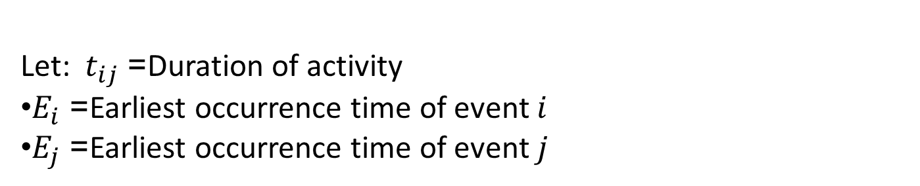
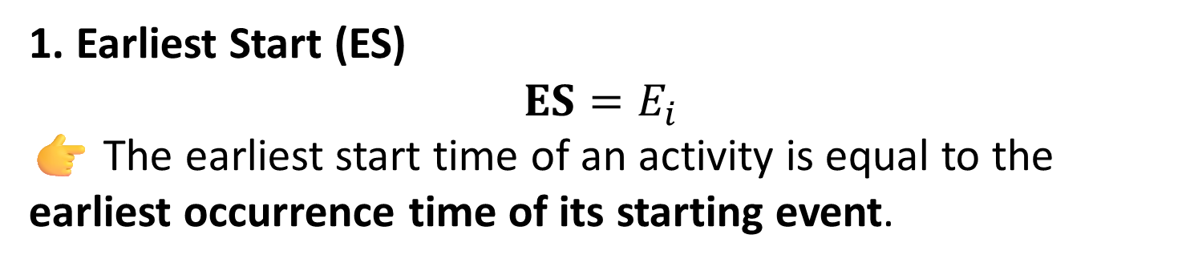
CRICAL PATH METHOD (CPM) AND PROGRAMME EVALUATION REVIEW TECHNIQUES (PERT)
Section A : Question Bank Problem No 13 : Write Formula for Earliest Start (ES) and Earliest Finish (EF)
Solution : (In CPM / PERT – Forward Pass Calculation)
Let: $t_{ij}$= Duration of activity
$E_{i}$= Earliest occurrence time of event $i$
$E_{j}$= Earliest occurrence time of event $j$
1. Earliest Start (ES)
$$\text{ES}=E_{i}$$
👉 The earliest start time of an activity is equal to the earliest occurrence time of its starting event.
18/02/2026 RESOURECE MANAGEMENT TECHNIQUES |CPM AND PERT
| Dr. K.M. MANIKANDAN 8/14

Slide 9
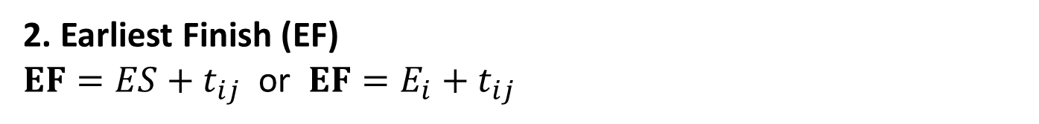
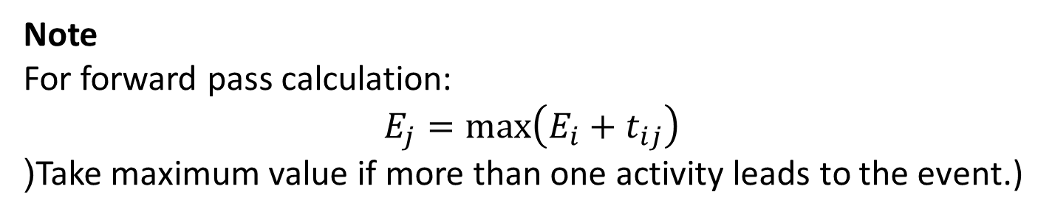
CRICAL PATH METHOD (CPM) AND PROGRAMME EVALUATION REVIEW TECHNIQUES (PERT)
2. Earliest Finish (EF)
$\text{EF}=ES+t_{ij}$ or $\text{EF}=E_{i}+t_{ij}$
👉 The earliest finish time is equal to Earliest Start + Duration of the activity.
Note
For forward pass calculation:
$$E_{j}=max⁡\left(E_{i}+t_{ij}\right)$$
(Take maximum value if more than one activity leads to the event.)
18/02/2026 RESOURECE MANAGEMENT TECHNIQUES |CPM AND PERT
| Dr. K.M. MANIKANDAN 9/14

Slide 10

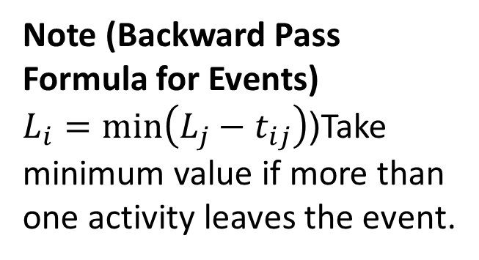

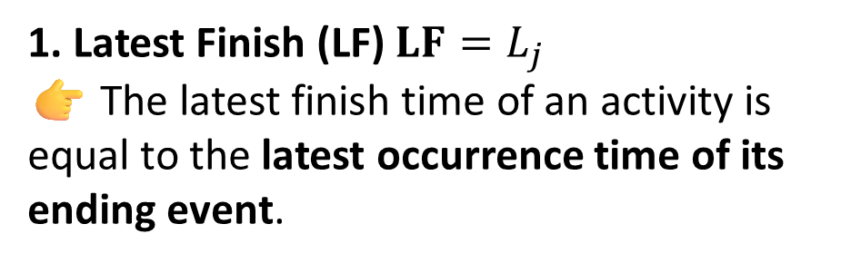
CRICAL PATH METHOD (CPM) AND PROGRAMME EVALUATION REVIEW TECHNIQUES (PERT)
Section A : Question Bank Problem No 14 : Formula for Latest Finish (LF) and Latest Start (LS)
Solution : (In CPM / PERT – Backward Pass Calculation)
Let: $t_{ij}$= Duration of activity
$L_{j}$= Latest occurrence time of ending event
$L_{i}$= Latest occurrence time of starting event
2. Latest Start (LS)
$$\text{LS}=LF−t_{ij}$$
or$\text{LS}=L_{j}−t_{ij}$
👉 The latest start time is equal to Latest Finish − Duration of the activity.
Note (Backward Pass Formula for Events)
$L_{i}=min⁡\left(L_{j}−t_{ij}\right)$(Take minimum value if more than one activity leaves the event.
1. Latest Finish (LF) $\text{LF}=L_{j}$
👉 The latest finish time of an activity is equal to the latest occurrence time of its ending event.
18/02/2026 RESOURECE MANAGEMENT TECHNIQUES |CPM AND PERT
| Dr. K.M. MANIKANDAN 10/14

Slide 11
Section B : Question Bank Problem No 4 : Write about the basic differences between PERT and CPM. Solution :
Basis | PERT | CPM
Full Form | Program Evaluation and Review Technique | Critical Path Method
Nature of Time | Probabilistic (Uncertain time estimates) | Deterministic (Fixed time estimates)
Number of Time Estimates | Three (Optimistic, Most Likely, Pessimistic) | One time estimate
Focus | Time-oriented | Time and Cost-oriented
Type of Projects | Research & Development, Non-repetitive projects | Construction, Production, Repetitive projects
Cost Consideration | Cost not directly considered | Cost optimization (Crashing) possible
Suitable For | Projects with high uncertainty | Projects with well-defined activities
Slack/Float Analysis | Less emphasis | Detailed float analysis
18/02/2026 RESOURECE MANAGEMENT TECHNIQUES |CPM AND PERT
| Dr. K.M. MANIKANDAN 11/14

Slide 12
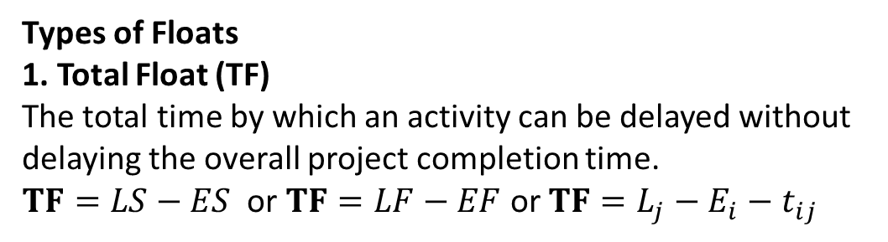
CRICAL PATH METHOD (CPM) AND PROGRAMME EVALUATION REVIEW TECHNIQUES (PERT)
Section B : Question Bank Problem No 5 : Write about the floats and its types.
Solution :
Floats in CPM / PERT
Definition of Float
Float (or Slack) is the amount of time by which an activity can be delayed without affecting the project completion time or the schedule of other activities.
Activities on the critical path have zero float.
Types of Floats
1. Total Float (TF)
The total time by which an activity can be delayed without delaying the overall project completion time.
$\text{TF}=LS−ES$ or $\text{TF}=LF−EF$ or $\text{TF}=L_{j}−E_{i}−t_{ij}$
18/02/2026 RESOURECE MANAGEMENT TECHNIQUES |CPM AND PERT
| Dr. K.M. MANIKANDAN 12/14

Slide 13
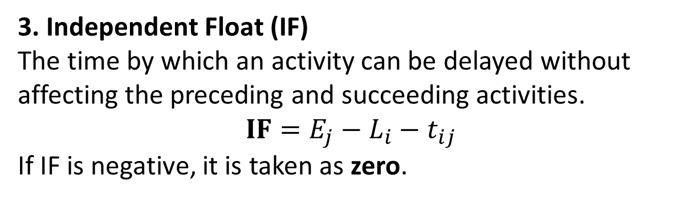
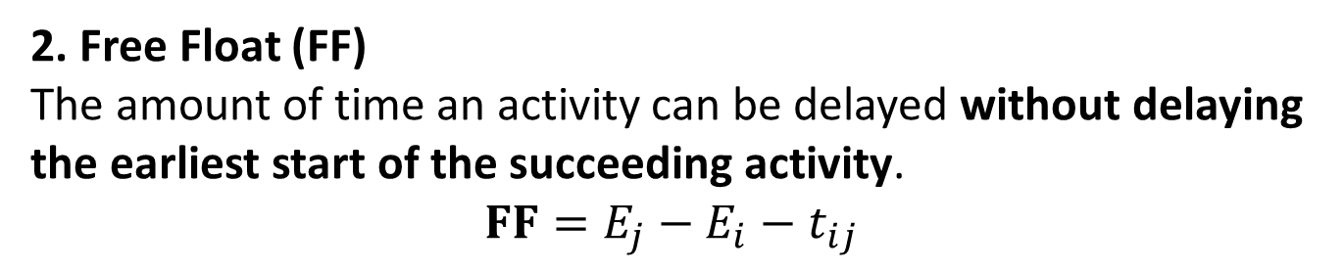
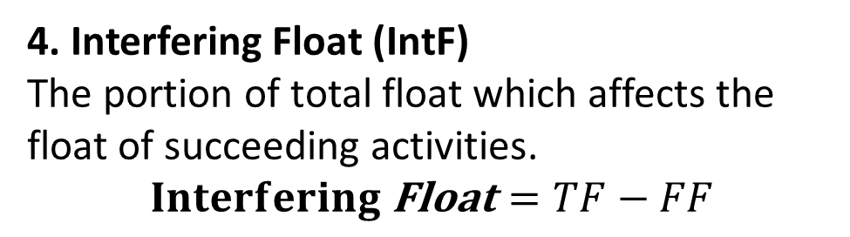
CRICAL PATH METHOD (CPM) AND PROGRAMME EVALUATION REVIEW TECHNIQUES (PERT)
2. Free Float (FF)
The amount of time an activity can be delayed without delaying the earliest start of the succeeding activity.
$$\text{FF}=E_{j}−E_{i}−t_{ij}$$
3. Independent Float (IF)
The time by which an activity can be delayed without affecting the preceding and succeeding activities.
$$\text{IF}=E_{j}−L_{i}−t_{ij}$$
If IF is negative, it is taken as zero.
4. Interfering Float (IntF)
The portion of total float which affects the float of succeeding activities.
$$\text{Interfering} \text{Float}=TF−FF$$
18/02/2026 RESOURECE MANAGEMENT TECHNIQUES |CPM AND PERT
| Dr. K.M. MANIKANDAN 13/14

Slide 14
Thank You
18/02/2026 RESOURECE MANAGEMENT TECHNIQUES |CPM AND PERT
| Dr. K.M. MANIKANDAN 14/14

