Slide 1

Dr. SNS RAJALAKSHMI COLLEGE OF ARTS AND SCIENCE
(AUTONOMOUS)
Department of Mathematics
21UCL302: RESOURCE MANAGEMENT TECHNIQUES Unit IV : Topic: CRICAL PATH METHOD (CPM) AND PROGRAMME EVALUATION REVIEW TECHNIQUES (PERT)
Dr. K.M. MANIKANDAN
Assistant Professor & Head
Dept. of Mathematics
Dr. SNSRCAS
19/02/2026 RESOURECE MANAGEMENT TECHNIQUES |CPM AND PERT
| Dr. K.M. MANIKANDAN 1/12

Slide 2
CRICAL PATH METHOD (CPM) AND PROGRAMME EVALUATION REVIEW TECHNIQUES (PERT)
Unit IV: Section B Q No. 09 .
Draw the network and determine the critical path for the given data :
Activity | 1 - 2 | 1 - 3 | 2 - 4 | 3 - 4 | 3 – 5 | 4 - 5 | 4 - 6 | 5 - 6
Duration (in days) | 6 | 5 | 10 | 3 | 4 | 6 | 2 | 9
Find the total float , free float and Independent float of each activity.
19/02/2026 RESOURECE MANAGEMENT TECHNIQUES |CPM AND PERT
| Dr. K.M. MANIKANDAN 2/12

Slide 3
CRICAL PATH METHOD (CPM) AND PROGRAMME EVALUATION REVIEW TECHNIQUES (PERT)
Solution : Given Data
Step 1: Forward Pass (Earliest Event Times)
Start event 1 at time 0
Event 1
E₁ = 0
1–2 (6) E₂ = 0 + 6 = 6
1–3 (5) , E₃ = 0 + 5 = 5
2–4 (10) Finish = 6 + 10 = 16
3–4 (3) Finish = 5 + 3 = 8
E₄ = max(16, 8) = 16 ,
3–5 (4) Finish = 5 + 4 = 9
4–5 (6) Finish = 16 + 6 = 22
E₅ = max(9, 22) = 22,
4–6 (2) Finish = 16 + 2 = 18
5–6 (9) , Finish = 22 + 9 = 31
E₆ = max(18, 31) = 31
Activity | Duration (Days)
1–2 | 6
1–3 | 5
2–4 | 10
3–4 | 3
3–5 | 4
4–5 | 6
4–6 | 2
5–6 | 9
Project Duration = 31 Days
19/02/2026 RESOURECE MANAGEMENT TECHNIQUES |CPM AND PERT
| Dr. K.M. MANIKANDAN 3/12

Slide 4
CRICAL PATH METHOD (CPM) AND PROGRAMME EVALUATION REVIEW TECHNIQUES (PERT)
Step 2: Backward Pass (Latest Event Times)
L₆ = 31
5–6 (9) , L₅ = 31 − 9 = 22
4–6 (2), Possible L₄ = 31 − 2 = 29
4–5 (6) Possible L₄ = 22 − 6 = 16
L₄ = min(29,16) = 16
3–5 (4) , Possible L₃ = 22 − 4 = 18
3–4 (3), Possible L₃ = 16 − 3 = 13
L₃ = min(18,13) = 13
2–4 (10), L₂ = 16 − 10 = 6
1–2 (6), Possible L₁ = 6 − 6 = 0
1–3 (5) , Possible L₁ = 13 − 5 = 8
L₁ = min(0,8) = 0
19/02/2026 RESOURECE MANAGEMENT TECHNIQUES |CPM AND PERT
| Dr. K.M. MANIKANDAN 4/12

Slide 5
CRICAL PATH METHOD (CPM) AND PROGRAMME EVALUATION REVIEW TECHNIQUES (PERT)
Step 3: ES, EF, LS, LF of Activities
Activity | Dur | ES | EF | LS | LF
1–2 | 6 | 0 | 6 | 0 | 6
1–3 | 5 | 0 | 5 | 8 | 13
2–4 | 10 | 6 | 16 | 6 | 16
3–4 | 3 | 5 | 8 | 13 | 16
3–5 | 4 | 5 | 9 | 18 | 22
4–5 | 6 | 16 | 22 | 16 | 22
4–6 | 2 | 16 | 18 | 29 | 31
5–6 | 9 | 22 | 31 | 22 | 31
19/02/2026 RESOURECE MANAGEMENT TECHNIQUES |CPM AND PERT
| Dr. K.M. MANIKANDAN 5/12

Slide 6
CRICAL PATH METHOD (CPM) AND PROGRAMME EVALUATION REVIEW TECHNIQUES (PERT)
Step 4: Floats
Formulas : Total Float (TF) = LS − ES = LF − EF
Free Float (FF) = Eⱼ − EF
Independent Float (IF) = Eⱼ − Lᵢ − Duration (if negative → 0)
Float Table
Activity | TF | FF | IF
1–2 | 0 | 0 | 0
1–3 | 8 | 0 | 0
2–4 | 0 | 0 | 0
3–4 | 8 | 8 | 8
3–5 | 13 | 13 | 5
4–5 | 0 | 0 | 0
4–6 | 13 | 13 | 13
5–6 | 0 | 0 | 0
19/02/2026 RESOURECE MANAGEMENT TECHNIQUES |CPM AND PERT
| Dr. K.M. MANIKANDAN 6/12

Slide 7
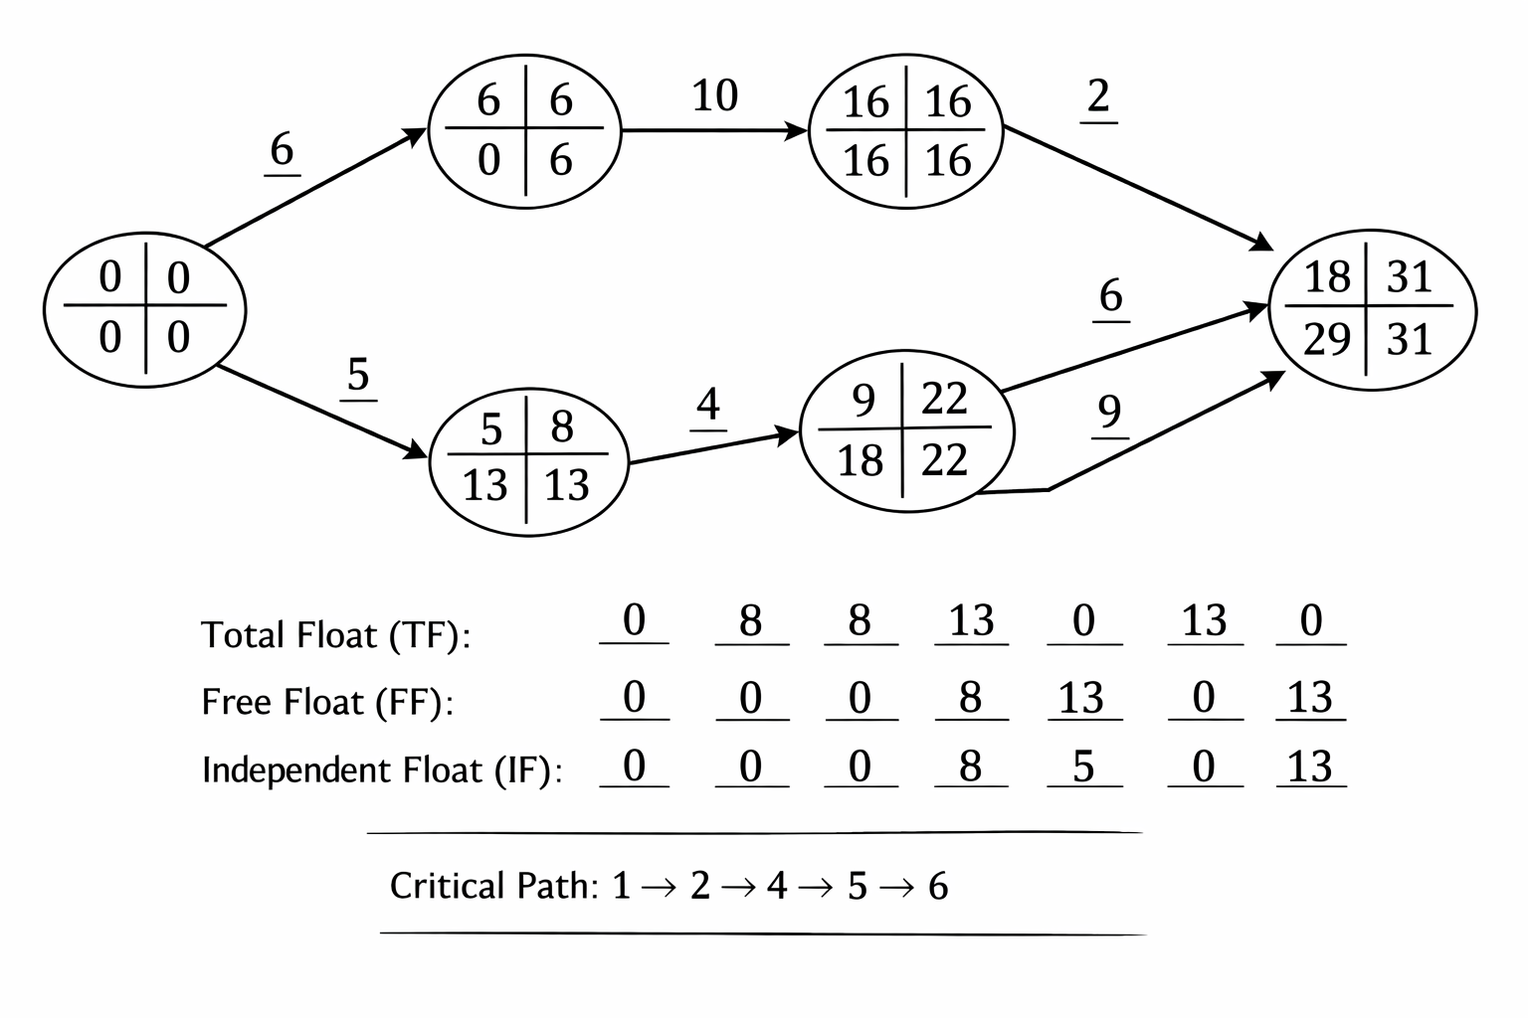
CRICAL PATH METHOD (CPM) AND PROGRAMME EVALUATION REVIEW TECHNIQUES (PERT)
Critical Path : Activities with Zero Total Float:
1–2 → 2–4 → 4–5 → 5–6
Critical Path = 1–2–4–5–6 ; Project Duration = 31 Days
19/02/2026 RESOURECE MANAGEMENT TECHNIQUES |CPM AND PERT
| Dr. K.M. MANIKANDAN 7/12

Slide 8
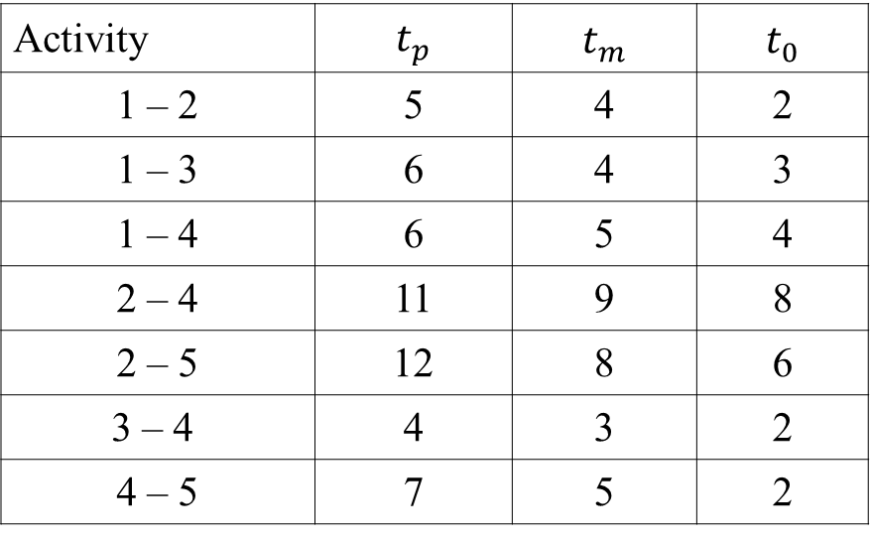
CRICAL PATH METHOD (CPM) AND PROGRAMME EVALUATION REVIEW TECHNIQUES (PERT)
Unit IV: Section B Q No. 10 .
Construct the network for the project whose activities and the three times estimates of these activities (in weeks) are given below . Compute
(a) Expected duration of each activity.
(b) Expected variance of each activity.
(c) Expected variance of the project length.
Activity | $$t_{p}$$ | $$t_{m}$$ | $$t_{0}$$
1 – 2 | 5 | 4 | 2
1 – 3 | 6 | 4 | 3
1 – 4 | 6 | 5 | 4
2 – 4 | 11 | 9 | 8
2 – 5 | 12 | 8 | 6
3 – 4 | 4 | 3 | 2
4 – 5 | 7 | 5 | 2
19/02/2026 RESOURECE MANAGEMENT TECHNIQUES |CPM AND PERT
| Dr. K.M. MANIKANDAN 8/12

Slide 9
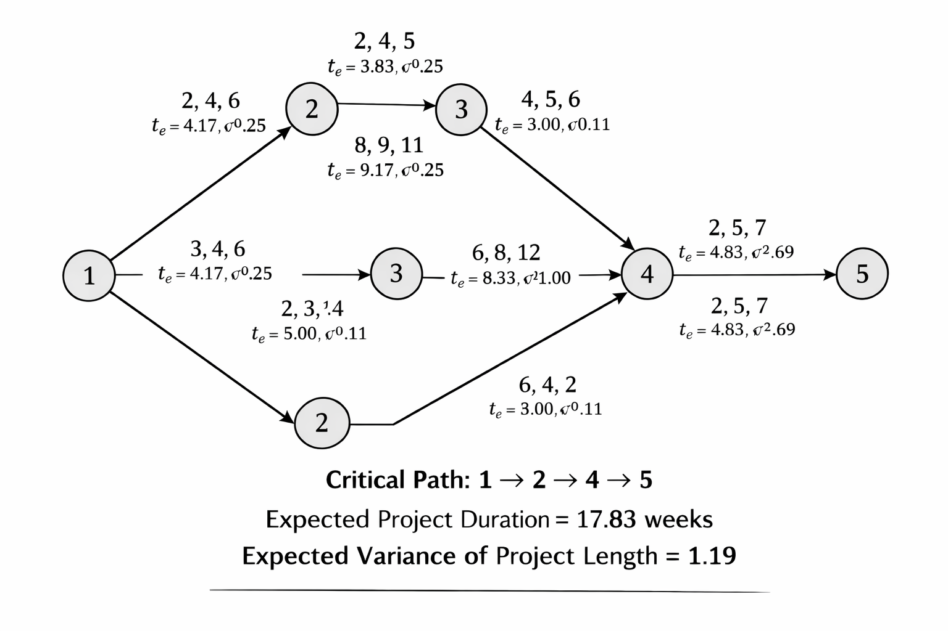
CRICAL PATH METHOD (CPM) AND PROGRAMME EVALUATION REVIEW TECHNIQUES (PERT)
Solution :
19/02/2026 RESOURECE MANAGEMENT TECHNIQUES |CPM AND PERT
| Dr. K.M. MANIKANDAN 9/12

Slide 10
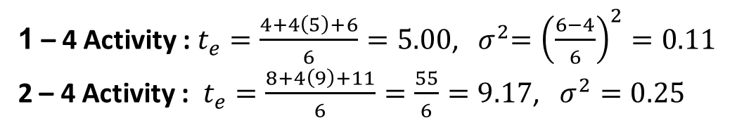
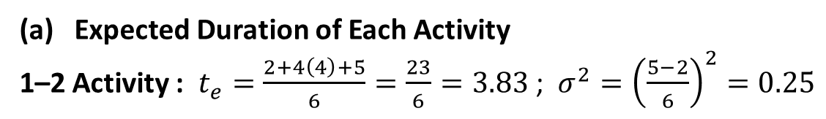
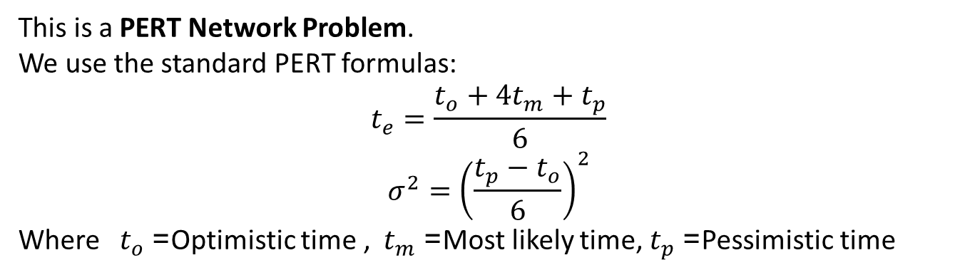
CRICAL PATH METHOD (CPM) AND PROGRAMME EVALUATION REVIEW TECHNIQUES (PERT)
This is a PERT Network Problem.
We use the standard PERT formulas:
$$t_{e}=\frac{t_{o}+4t_{m}+t_{p}}{6}$$
$$σ^{2}={\left(\frac{t_{p}−t_{o}}{6}\right)}^{2}$$
Where $t_{o}$= Optimistic time , $t_{m}$= Most likely time, $t_{p}$= Pessimistic time
Expected Duration of Each Activity
1–2 Activity : $t_{e}=\frac{2+4\left(4\right)+5}{6}=\frac{23}{6}=3.83$ ; $σ^{2}={\left(\frac{5−2}{6}\right)}^{2}=0.25$
1-3 Activity : $t_{e}=\frac{3+4\left(4\right)+6}{6}=\frac{25}{6}=4.17 , σ^{2}=0.25$
1 – 4 Activity : $t_{e}=\frac{4+4\left(5\right)+6}{6}=5.00$, ${ σ}^{2}={\left(\frac{6−4}{6}\right)}^{2}=0.11$
2 – 4 Activity : $t_{e}=\frac{8+4\left(9\right)+11}{6}=\frac{55}{6}=9.17$, $σ^{2}=0.25$
19/02/2026 RESOURECE MANAGEMENT TECHNIQUES |CPM AND PERT
| Dr. K.M. MANIKANDAN 10/12

Slide 11
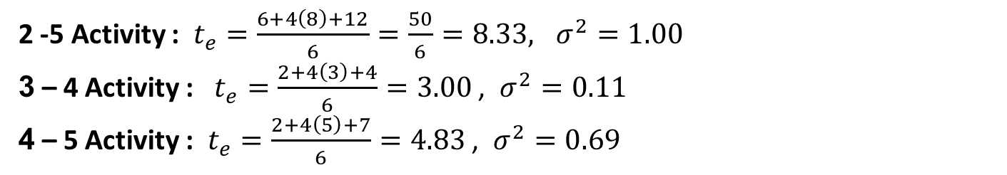
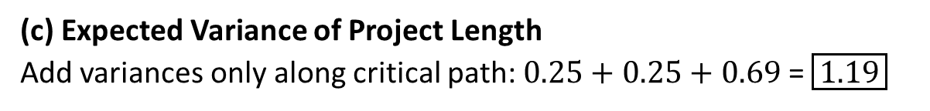
2 -5 Activity : $t_{e}=\frac{6+4\left(8\right)+12}{6}=\frac{50}{6}=8.33, σ^{2}=1.00$
3 – 4 Activity : $t_{e}=\frac{2+4\left(3\right)+4}{6}=3.00$ , $σ^{2}=0.11$
4 – 5 Activity : $t_{e}=\frac{2+4\left(5\right)+7}{6}=4.83$ , $σ^{2}=0.69$
Critical Path Calculation (Using Expected Times)
Possible paths: 1–2–4–5 , = 3.83 + 9.17 + 4.83 = 17.83
1–2–5 , = 3.83 + 8.33 = = 12.16
1–3–4–5, = 4.17 + 3.00 + 4.83 = = 12.00
Critical Path : $\boxed{1\text{–}2\text{–}4\text{–}5}$ Expected Project Duration = 17.83 weeks
(c) Expected Variance of Project Length
Add variances only along critical path: $0.25+0.25+0.69$= $\boxed{1.19}$
19/02/2026 RESOURECE MANAGEMENT TECHNIQUES |CPM AND PERT
| Dr. K.M. MANIKANDAN 11/12

Slide 12
Thank You
19/02/2026 RESOURECE MANAGEMENT TECHNIQUES |CPM AND PERT
| Dr. K.M. MANIKANDAN 12/12

