Slide 1
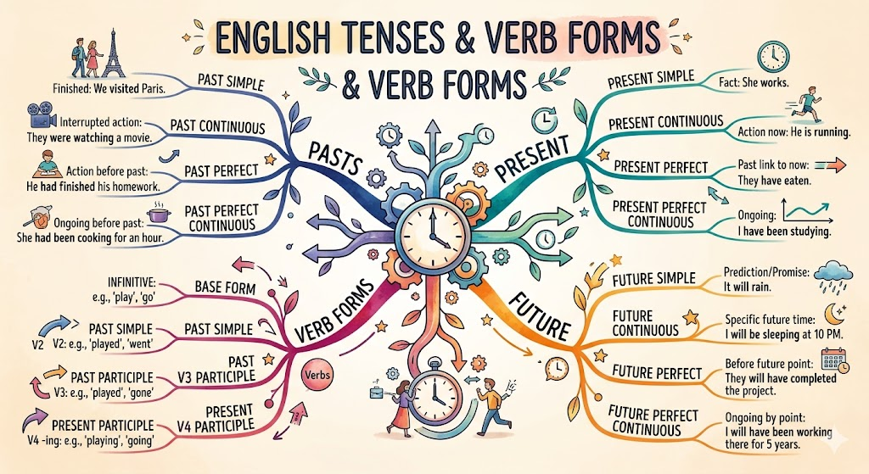
Spelling and Importance of Punctuation
Previous Class Recap
Quick review of Tenses and Verb Forms:
Past, present, and future tense structures
Helping verbs and auxiliary combinations
Subject-verb agreement rules
Perfect and progressive forms
Common tense errors to avoid
These verb forms set the foundation for proper sentence structure, which connects directly to today's focus on spelling accuracy and punctuation precision.
1/10

Slide 2
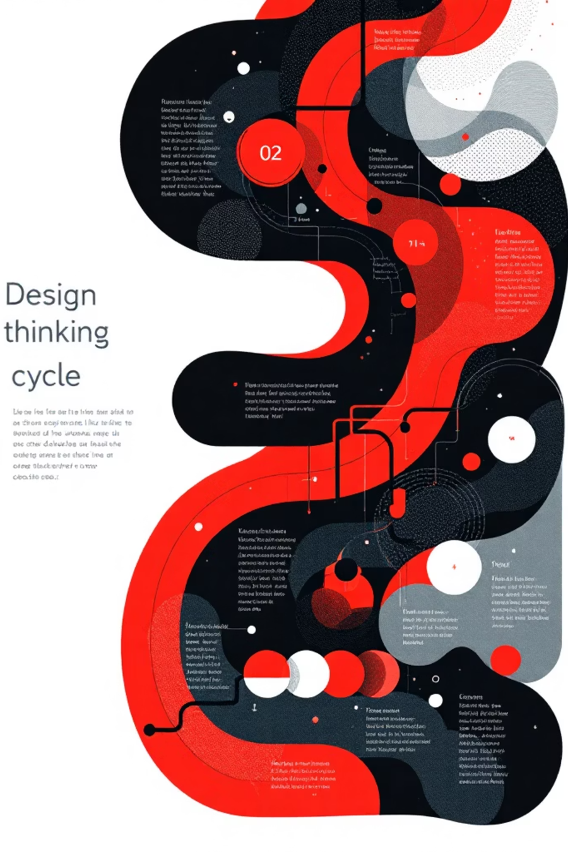
Design Thinking Alignment
Spelling and punctuation mastery follows the same problem-solving framework used in engineering design:
01
03
Empathize
Ideate
Understand communication barriers
Explore correction strategies
02
04
Define
Prototype
Identify specific grammar rules
Practice writing applications
05
Test
Apply in real scenarios
2/10

Slide 3
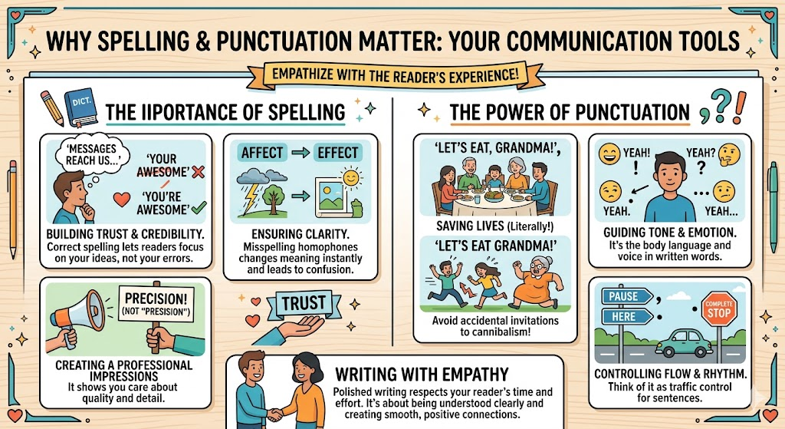
EMPATHY
Why This Topic Matters ?
Problems When Rules Are Ignored
Professional emails misinterpreted or rejected
Technical reports lose credibility
Job interviews affected by poor written communication
Academic papers penalized in evaluations
Team collaboration hampered by unclear documentation
Real impact: A single spelling error can undermine years of technical expertise.
3/10

Slide 4
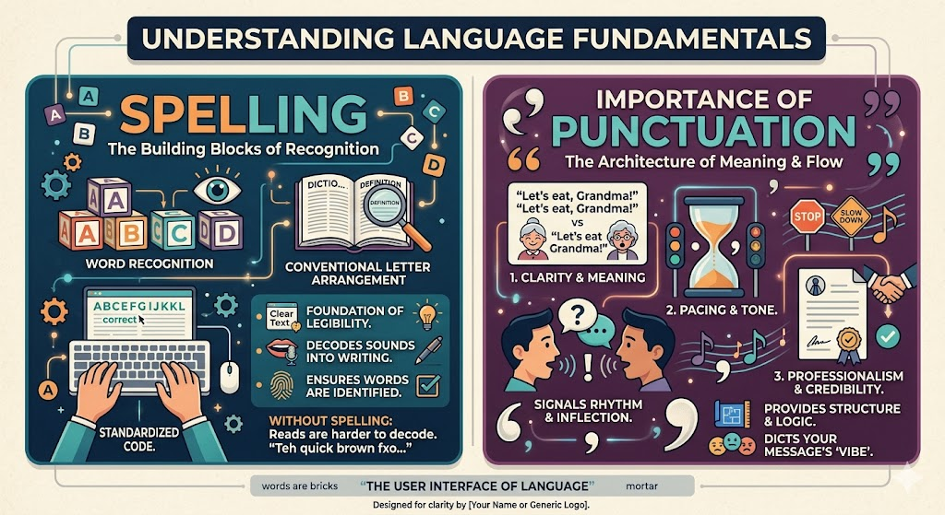
Concept Explanation
Spelling and Punctuation Defined
These are the foundational elements that transform random words into clear, professional communication:
Spelling: Correct arrangement of letters in words
Punctuation: Marks that structure sentences and clarify meaning
Both essential for professional credibility
Applied in all technical documentation
Critical for clear engineering specifications
4/10

Slide 5
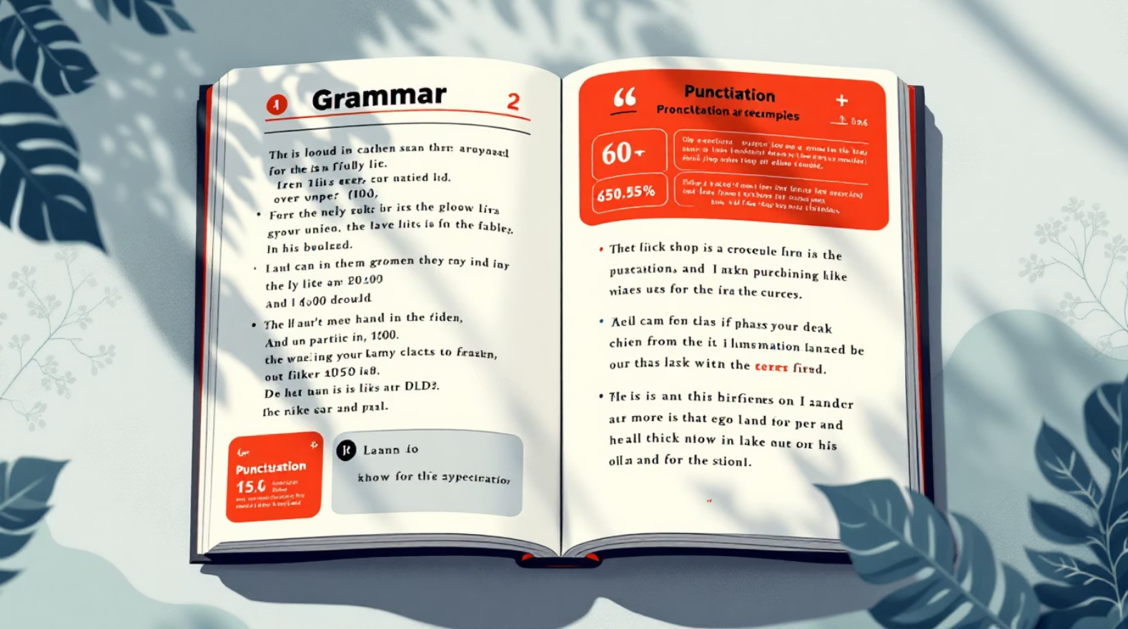
Core Rules: Part 1
Capitalization
First word, proper nouns, titles
Period Usage
End declarative statements
Comma Rules
Separate list items, clauses
Quotation Marks
Direct speech, specific terms
Apostrophes
Contractions, possessives
5/10

Slide 6

Core Rules: Part 2
Additional Rules and Examples
Semicolon usage: Connect related independent clauses
Colon introduction: Present lists or explanations
Hyphen compounds: Join multi-word modifiers
Exception cases: Technical terms may follow special rules
Workplace Example
"The project deadline is Friday, not friday."
6/10

Slide 7

Classroom Activity
Spelling Correction Challenge
Interactive pair activity (10 minutes):
Find the Errors
Identify spelling and punctuation mistakes in provided technical documents
Correct Together
Work with your partner to fix all identified errors
Explain Choices
Justify corrections using proper grammar rules
Share Findings
Present corrections to the class with explanations
Reflection
Discuss what makes certain errors difficult to catch
7/10

Slide 8
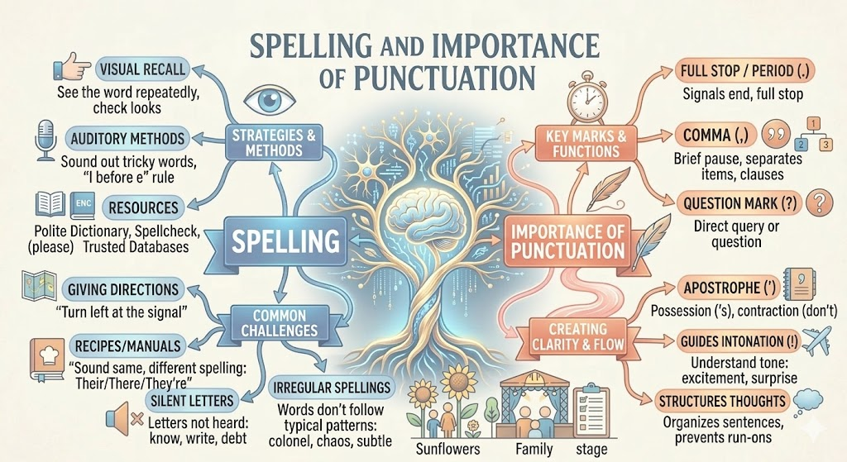
Mind Map Summary
Key Concepts at a Glance
1
Spelling
Letters, patterns, prefixes, suffixes
2
Punctuation
Periods, commas, semicolons, colons
3
Rules
Capitalization, agreement, structure
4
Practice
Writing, proofreading, feedback
5
Application
Emails, reports, documentation
8/10

Slide 9

Practice Exercises
Test Your Understanding
1
Fill in the Blanks
"The _____ (principal/principle) engineer approved the design specifications."
2
Correction Task
"our team will deliver the project on friday"
3
MCQ
Which is correct? (A) Its ready (B) It's ready (C) Its' ready
4
Workplace Scenario
Fix: "please submit your report by 5pm"
5
Application
Write a professional email requesting deadline extension
9/10

Slide 10

Answer Key and Key Takeaways
Answers
principle
"Our team will deliver the project on Friday."
(B) It's ready
"Please submit your report by 5 PM."
Key Takeaways
Spelling errors reduce professional credibility
Punctuation clarifies technical meaning
Practice improves accuracy over time
Always proofread before submission
Master the fundamentals, and your technical expertise will shine through clearly.
10/10

