Slide 1


Unit I: Foundations of BI | Part 2
Decision Making &
Computerized Support
Empowering Organizations through Rational Analytics
Dr. Angel Latha Mary S
SNS College of Technology | Coimbatore

Slide 2



Recap & Icebreaker
Connecting the Dots
In our last session, we explored the Evolution of BI from static reports to AI-driven insights.
Icebreaker: "The Crossroad Dilemma"
Think of a critical business decision (e.g., product launch). Which is riskier: Incomplete data or Human intuition bias?
Today, we dive into HOW computers bridge this gap using structured models.
Unit I: Foundations of BI

Slide 3




Session Objectives
Process
Support
Structure
Understand Herbert Simon’s 4-phase Decision Making Model.
Analyze how computerized systems assist complex choices.
Identify the core components and architecture of a DSS.
Focus: Moving from "Gut Feeling" to "Data-Driven Certainty"
Unit I: Foundations of BI

Slide 4

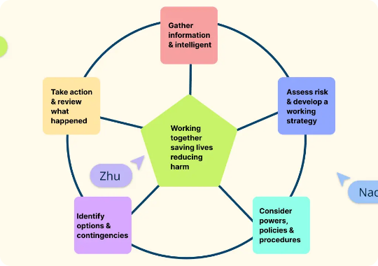
Empathize: The Persona
Meet Alex, Supply Chain Manager
The Burden: "Every hour, I must decide whether to reroute 50 trucks based on fuel, weather, and traffic. My brain is exhausted by the variables."
Problem: Decision Paralysis due to Information Overload.
Needs: A way to filter the "noise" and see clear alternatives.
Goal: Optimize delivery speed without human error.
Persona: Alex (Operations Lead)

Slide 5




Herbert Simon’s 4-Phase Model
1. Intelligence
2. Design
3. Choice
4. Implementation
Scanning environment to find conditions calling for decisions.
Developing, and analyzing possible alternative courses of action.
Selecting a course of action from those available.
Putting the chosen solution into action and monitoring.
Where do computerized systems help the most? Phase 2 (Design) and Phase 3 (Choice).

Slide 6


Design Thinking: Ideate & Prototype
Ideate: Solution Concept
Prototype: The Interface
For Alex, we conceptualize a Real-time Route Optimizer (RRO). It shouldn't just show traffic; it should suggest the top 3 routes based on profit margins.
A simple dashboard on a tablet showing "Green", "Yellow", and "Red" route statuses with a single-click reroute button.
Automated scenario building.
Testing Alex's reaction: "I don't want a manual; I want a recommendation."
Predictive impact analysis.

Slide 7
Evolution of Decision Support
Era | Primary Support Type
1960s | Model-driven: Simple math simulations.
1980s | Executive Info Systems (EIS): Static dashboards.
2000s | BI & Warehousing: Enterprise-wide reports.
2024+ | Augmented Analytics: AI-driven autonomous decisions.

Slide 8
Architecture of a DSS
The Three Pillars
Data Component: Internal and external data filtered for the decision context.
Model Component: Analytical, financial, or statistical formulas that process data.
User Interface (UI): The bridge allowing Alex to interact with models without coding.

Slide 9
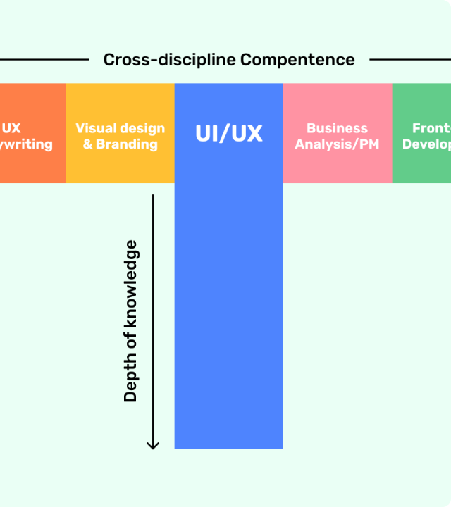
Stanford T-Shaped Model
The Modern Decision Scientist
Success in computerized support requires more than just technical skill.
Horizontal Breadth: Empathy, business strategy, ethics, and communication.
Vertical Depth: Deep expertise in Data Engineering, AI, and Simon's models.
Goal: Bridge the gap between "The Machine" and "The Boardroom".

Slide 10


Case Study: Logistics Optimization
The Scenario
Activity: Problem Solving
A global courier service implemented a "Communication-driven DSS" to manage 10,000 drivers during peak season.
Divide into groups of 4. Your task:
Map the Courier's problem to Simon's Intelligence phase.
Outcome: 22% reduction in fuel costs.
Suggest one Model (e.g., Shortest Path) to use.
Impact: Driver satisfaction increased as they followed "smart routes".
Present one potential Implementation barrier.

Slide 11
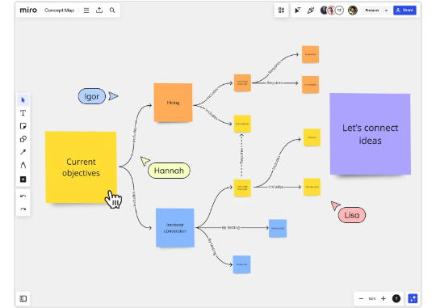
Summary & Key Takeaways
Mind Map Nodes
Foundation: Decision-making is a 4-phase process (Simon).
Tools: Computerized support targets the "Design" and "Choice" phases.
Skills: T-Shaped professionals bridge tech and business.
Architecture: Data + Model + User Interface = DSS.
Core Message: Computers don't replace the manager; they amplify the manager's capability to choose wisely.
Wrap-up

Slide 12

Questions & Reflection
Assessment Ticket:
In which phase of Simon’s model is "What-If" analysis most useful? Why?
Can a DSS be effective without a high-quality User Interface? Justify.
Reflect: Think of Alex's rerouting problem. How would your team's proposed solution handle a sudden road closure?

