Slide 1

SNS COLLEGE OF TECHNOLOGY
An Autonomous Institution Coimbatore-35
DEPARTMENT OF INFORMATION TECHNOLOGY
23ITT304 Information Coding Technique
Unit I
Entropy
Information Theory
P.Thilagarani AP/IT

Slide 2


Entropy in Information Theory
Understanding Uncertainty, Information, and Data Efficiency
15.12.2025 INFORMATION CODING TECHNIQUE | Entropy | P.Thilagarani | SNSCT 2/11

Slide 3


Learning Objectives
Explain Entropy
Define Shannon entropy and its role in measuring information uncertainty.
Analyze Data Efficiency
Relate entropy to data compression and coding efficiency.
Apply Concepts
Use entropy to evaluate and design simple coding schemes.
Connect to Real-World
Identify applications in communication, AI, and cybersecurity.
15.12.2025 INFORMATION CODING TECHNIQUE | Entropy | P.Thilagarani | SNSCT 3/11

Slide 4
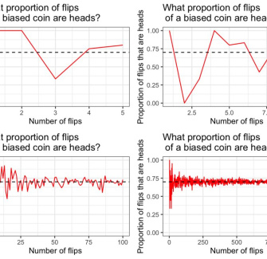
Recap & Icebreaker
Quick Review
What is information in technical terms?
How do we measure the 'surprise' in a message?
Think & Share
Flip a fair coin: Heads or Tails — how much information does the outcome carry?
Now flip a biased coin (90% heads). Is the information the same?
💡​ The amount of information depends on .
15.12.2025 INFORMATION CODING TECHNIQUE | Entropy | P.Thilagarani | SNSCT 4/11

Slide 5
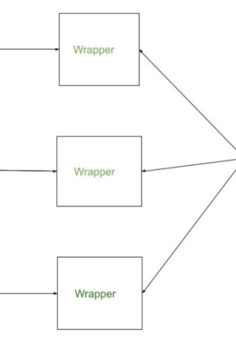
Design Thinking: The Problem
Empathize
Users need faster, cheaper, reliable data transmission despite bandwidth limits and noise.
Define
How to transmit info using fewest bits without losing meaning?
Ideate
Assign shorter codes to frequent symbols using statistical data patterns.
Prototype
Build a coding system using symbol probabilities (e.g., Huffman).
15.12.2025 INFORMATION CODING TECHNIQUE | Entropy | P.Thilagarani | SNSCT 5/11

Slide 6


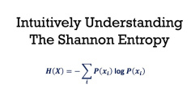
Shannon’s Entropy Formula
Probability
Each symbol has a probability p(x) of occurring in a message.
Surprise
Rare events carry more information: I(x) = -log₂(p(x)).
Average Info
Entropy H(X) = Σ p(x) log₂(1/p(x)) — the expected information per symbol.
15.12.2025 INFORMATION CODING TECHNIQUE | Entropy | P.Thilagarani | SNSCT 6/11

Slide 7

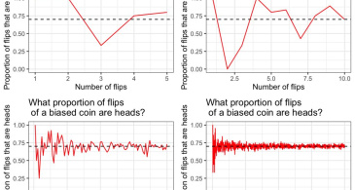
High vs Low Entropy
High Entropy
Outcomes are unpredictable
Uniform distribution
Example: Fair die roll
Maximum information per symbol
Low Entropy
Outcomes are predictable
Skewed distribution
Example: Biased coin
Redundancy allows compression
15.12.2025 INFORMATION CODING TECHNIQUE | Entropy | P.Thilagarani | SNSCT 7/11

Slide 8
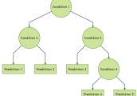
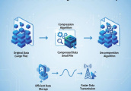
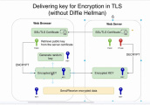
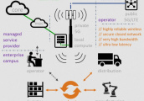
Real-World Applications
Network Efficiency
Optimizing protocols using entropy helps reduce bandwidth usage in 5G/IoT.
Data Compression
ZIP, MP3, JPEG use entropy coding to remove redundancy and shrink file size.
Cryptography
High entropy keys are more secure — harder to guess or brute-force.
AI & ML
Decision trees use entropy to split data — minimizing uncertainty at each node.
15.12.2025 INFORMATION CODING TECHNIQUE | Entropy | P.Thilagarani | SNSCT 8/11

Slide 9
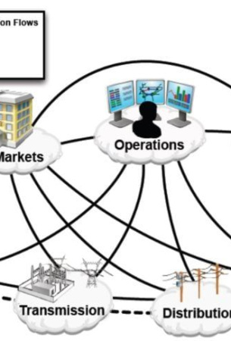
T-Shaped Learning: Big Picture
Vertical Depth
Mathematical foundation of entropy
Source coding theorem
Optimal code length ≈ entropy
Horizontal Breadth
Links to thermodynamics (analogy in disorder)
Role in quantum information
Future: entropy in AI interpretability and edge computing
💡​ Entropy is not just theory — it’s the foundation of the digital world.
15.12.2025 INFORMATION CODING TECHNIQUE | Entropy | P.Thilagarani | SNSCT 9/11

Slide 10

Summary & Mind Map
Core Concept
Entropy: Average uncertainty/information.
Key Formula
H(X) = -Σ p(x) log₂ p(x)
Applications
Compression, cryptography, AI, communications.
Design Principle
Efficient coding matches code length to symbol probability.
Big Idea
Less surprise → less info → better compression.
15.12.2025 INFORMATION CODING TECHNIQUE | Entropy | P.Thilagarani | SNSCT 10/11

Slide 11
Thank You
15.12.2025 INFORMATION CODING TECHNIQUE | Entropy | P.Thilagarani | SNSCT 11/11

