Slide 1

SNS COLLEGE OF TECHNOLOGY
An Autonomous Institution Coimbatore-45
DEPARTMENT OF INFORMATION TECHNOLOGY
23ITT304 Information Coding Techniques
Unit IV
Generator and Parity Check Matrices
P.Thilagarani AP/IT
LINEAR BLOCK CODES AND CYCLIC CODES

Slide 2
Generator and Parity Check Matrices
Reliable Communication through Linear Block Codes
14.04.2026 23ITT304-Information Coding Techniques | Generator and Parity Check Matrices | P.Thilagarani | SNSCT 2/13

Slide 3

Recap & Objective
Where we stand
We previously learned that noise in communication channels causes bit errors. To fix this, we need redundancy.
Today's Goal
Master the mathematics of Linear Block Codes (LBC). We will define how to transform raw data into codewords using Generator Matrices (G) and how to detect errors using Parity Check Matrices (H).
14.04.2026 23ITT304-Information Coding Techniques | Generator and Parity Check Matrices | P.Thilagarani | SNSCT 3/13

Slide 4
Design Thinking: The Problem-Persona
Empathize & Define
Persona: Ishaan, a Lead Systems Engineer in Bangalore, needs to ensure satellite telemetry data is 100% accurate despite solar interference.
The Challenge: Raw data bits are fragile. How do we systematically add 'checks' so Ishaan's system can identify and fix a flip from 0 to 1 automatically without re-sending the whole file?
14.04.2026 23ITT304-Information Coding Techniques | Generator and Parity Check Matrices | P.Thilagarani | SNSCT 4/13

Slide 5
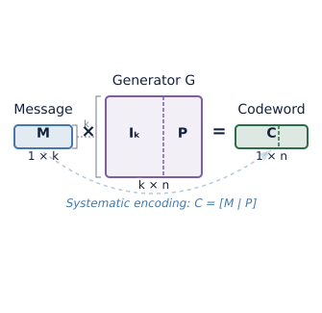
Ideate: The Generator Matrix (G)
Defining the Encoder
To create a codeword (C) from a message (M), we use a Generator Matrix. For an (n, k) code:
M: Message vector of length k bits.
G: A matrix of size k x n.
Calculation: C = M × G.
Systematic Form
A systematic G matrix looks like [Iₖ | P], where I is the identity matrix (original data) and P is the parity bit generator.
14.04.2026 23ITT304-Information Coding Techniques | Generator and Parity Check Matrices | P.Thilagarani | SNSCT 5/13

Slide 6
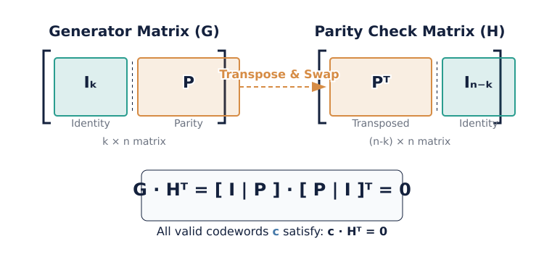
Prototype: Building the Parity Check Matrix (H)
14.04.2026 23ITT304-Information Coding Techniques | Generator and Parity Check Matrices | P.Thilagarani | SNSCT 6/13

Slide 7
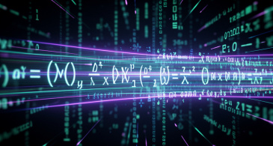
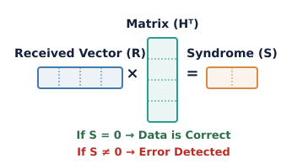
T-Shaped Depth: Error Detection
The H matrix is the 'gatekeeper'. When a codeword R is received, we calculate the Syndrome (S).
S = R × Hᵀ. If S = 0, no error. If S ≠ 0, the specific pattern tells us which bit is wrong.
14.04.2026 23ITT304-Information Coding Techniques | Generator and Parity Check Matrices | P.Thilagarani | SNSCT 7/13

Slide 8


Role-Play Activity: The Noise Channel
Divide into two groups: Encoders and Decoders.
Encoders: Use a 2x4 G-Matrix to encode '10'.
Pass to 'The Channel' (teacher) who may flip 1 bit.
Decoders: Use the H-Matrix to find the Syndrome.
Discuss: What if the channel flips 2 bits?
14.04.2026 23ITT304-Information Coding Techniques | Generator and Parity Check Matrices | P.Thilagarani | SNSCT 8/13

Slide 9
T-Shaped Breadth: Practical Apps
1
2
3
Deep Space
NASA uses high-order matrices to receive crystal clear images from Voyager from billions of miles away.
QR Codes
The boxes in QR codes use similar linear math so they still work if the sticker is scratched or dirty.
Memory RAM
ECC (Error Correction Code) RAM in servers uses parity matrices to prevent data corruption during processing.
14.04.2026 23ITT304-Information Coding Techniques | Generator and Parity Check Matrices | P.Thilagarani | SNSCT 9/13

Slide 10



Key Takeaways (Mind Map)
Syndrome (S)
The result of the check. Zero means success; non-zero identifies the error location.
The Generator (G)
Purpose: Encoding. Formula: C = M × G. Structure: [I | P].
The Parity Check (H)
Purpose: Detection. Formula: S = R × Hᵀ. Critical Rule: G × Hᵀ = 0.
14.04.2026 23ITT304-Information Coding Techniques | Generator and Parity Check Matrices | P.Thilagarani | SNSCT 10/13

Slide 11

Final Assessment & Reflection
Question 1:
If a Systematic Generator Matrix is [Iₖ | P], what is the size of the Parity Check Matrix H for an (n, k) code?
Question 2:
What is the result of the product G × Hᵀ?
Question 3:
Reflection: In a high-speed fiber optic link, would you prefer a complex G matrix with high correction or a simpler one for speed?
Answers on the next slide...
14.04.2026 23ITT304-Information Coding Techniques | Generator and Parity Check Matrices | P.Thilagarani | SNSCT 11/13

Slide 12
Final Assessment & Reflection
✅​
Answer 1:
The size is (n-k) x n.
Answer 2:
It is always a null (zero) matrix.
Answer 3:
Answers vary: Complex for high reliability over long distances, simple for low-latency short links.
14.04.2026 23ITT304-Information Coding Techniques | Generator and Parity Check Matrices | P.Thilagarani | SNSCT 12/13

Slide 13
THANK YOU
14.04.2026 23ITT304-Information Coding Techniques | Generator and Parity Check Matrices | P.Thilagarani | SNSCT 13/13

