Slide 1


Prefix Codes
Understanding Efficient and Unambiguous Data Encoding

Slide 2

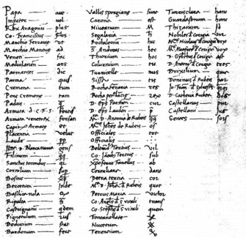
Icebreaker: Can You Decode This?
Let's Begin with a Puzzle
Here’s a secret message using code words:
Each code represents a letter:
`` = A
= B
= C
= D
What does the message say?
Answer: C B A D
This works because no code is a prefix of another — this is a prefix code.

Slide 3

Session Objectives
By the End of This Session, You Will Be Able To:
Define prefix codes and explain why they prevent ambiguity in decoding.
Compare prefix codes with non-prefix (ambiguous) codes.
Construct simple prefix codes using binary trees.
Apply prefix coding in real-world data compression techniques like Huffman coding.
Evaluate encoding efficiency using average code length.

Slide 4

Design Thinking: The Problem of Ambiguity
1
Empathize
Fast, reliable data transmission. Ambiguous codes cause errors.
2
Define
Variable-length codes are ambiguous if one code is a prefix of another.
3
Ideate
Prefix-free codes: design with trees for unique decodability.
4
Prototype
Build a binary prefix code using a full binary tree; symbols are at leaves.

Slide 5
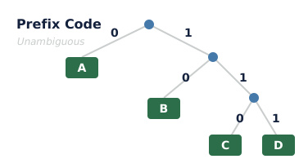
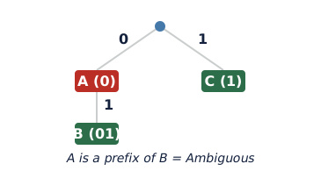
Prefix vs Non-Prefix Codes
Prefix Code Example
0=A, 10=B, 110=C, 111=D. No code starts with another. → ABC. Unambiguous!
Non-Prefix Code Example
0=A, 01=B, 11=C. '0' is prefix of '01'. Ambiguous!

Slide 6

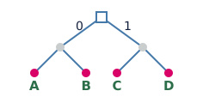
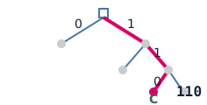
How to Build a Prefix Code
Start with Symbols
List all symbols (e.g., A, B, C) and their frequencies in the data.
Use Binary Tree
Assign each symbol to a leaf node. Internal nodes represent partial codes.
Trace Paths
The path from root to leaf defines the code: left = 0, right = 1.

Slide 7
What's the right order? 🥚​​
Answers on the next slide...
Arrange these steps in the correct sequence to build a prefix code using Huffman's method, following the algorithm from start to finish.
Build tree from bottom up
List symbols with frequencies
Combine two lowest frequency nodes
Assign 0 and 1 to branches

Slide 8
What's the right order? 🥚​​
✅​
Arrange these steps in the correct sequence to build a prefix code using Huffman's method, following the algorithm from start to finish.
List symbols with frequencies
1.
Combine two lowest frequency nodes
2.
Build tree from bottom up
3.
Assign 0 and 1 to branches
4.

Slide 9
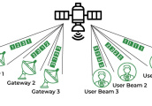


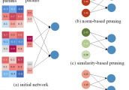
Applications & Connections
Telecom
Efficient encoding saves bandwidth in mobile and satellite communications.
Future Scope
Quantum data encoding may use generalized prefix-free structures for error-free readout.
Data Compression
Huffman coding uses prefix codes to compress files (ZIP, PNG, MP3) efficiently.
AI & ML
Model quantization uses compact codes; prefix properties ensure fast inference.

Slide 10
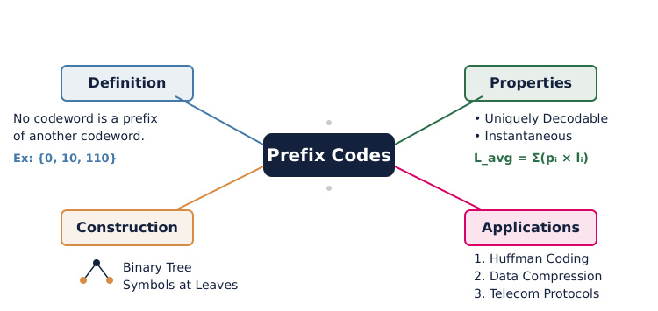
Mind Map: Prefix Codes at a Glance

Slide 11

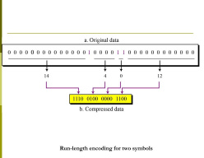
Discuss! 🤷‍♀️​ 💁‍♂️​ 💬​
Should Codes Always Be Simple?
Why can't we just use fixed-length codes for everything? Discuss trade-offs between simplicity and efficiency using real examples like text messaging or streaming.

Slide 12
Discuss! 🤷‍♀️​ 💁‍♂️​ 💬​
✅​
You might have said...
Fixed-length codes are easy to design and decode but can waste a lot of space when some symbols occur more often than others.
Variable-length prefix codes can lower the average code length, making things like text messaging and streaming faster and cheaper.
Fixed-length codes might be better for systems where speed or hardware simplicity is more important than saving space.

