Slide 1

SNS COLLEGE OF TECHNOLOGY
An Autonomous Institution Coimbatore-35
DEPARTMENT OF INFORMATION TECHNOLOGY
23ITT304 Information Coding Technique
Unit II
Types of Errors
P.Thilagarani AP/IT
ERROR DETECTION AND CORRECTION

Slide 2


Types of Errors
Mastering Error Detection in Digital Communication
29.02.2026 INFORMATION CODING TECHNIQUES | Types of Errors | P.Thilagarani | SNSCT 2/15

Slide 3



Discuss! 🤷‍♀️​ 💁‍♂️​ 💬​
Icebreaker: The Frustrated User
Think about a time a file download failed or a message was garbled. As a user, how did that error impact your trust in the system? What 'felt' wrong?
29.02.2026 INFORMATION CODING TECHNIQUES | Types of Errors | P.Thilagarani | SNSCT 3/15

Slide 4
Discuss! 🤷‍♀️​ 💁‍♂️​ 💬​
✅​
You might have said...
Loss of time
Confusion or frustration
Doubt about data integrity
Need for confirmation
29.02.2026 INFORMATION CODING TECHNIQUES | Types of Errors | P.Thilagarani | SNSCT 4/15

Slide 5
Session Objectives
Core Goals
Define different types of transmission errors.
Classify errors based on their characteristics.
Analyze the impact of errors on data integrity.
Design Thinking Focus
Empathize with end-users affected by data corruption.
Ideate coding strategies to prevent these specific errors.
Apply technical knowledge to real-world scenarios.
29.02.2026 INFORMATION CODING TECHNIQUES | Types of Errors | P.Thilagarani | SNSCT 5/15

Slide 6
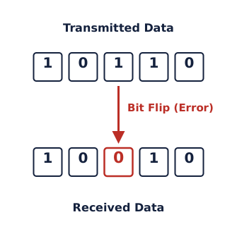
What is an Error?
The Core Problem
In digital communication, an Error occurs when a **** turns into a 1, or a 1 turns into a during transmission.
Why It Happens
Noise: Electrical interference (thermal noise, crosstalk).
Attenuation: Signal weakening over distance.
Distortion: Signal shape changes due to medium properties.
29.02.2026 INFORMATION CODING TECHNIQUES | Types of Errors | P.Thilagarani | SNSCT 6/15

Slide 7
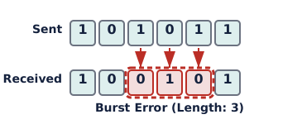
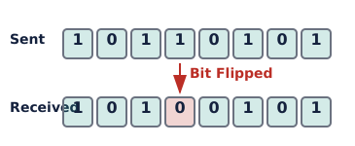
Classification of Errors
Burst Errors
Two or more consecutive bits are corrupted. Length is measured from the first to the last error.
Single-Bit Errors
Only one bit in the data unit is changed. Common in low-noise channels.
29.02.2026 INFORMATION CODING TECHNIQUES | Types of Errors | P.Thilagarani | SNSCT 7/15

Slide 8
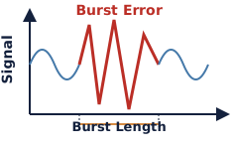
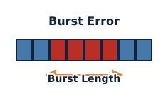
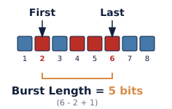
Deep Dive: Burst Errors
Mechanism
Usually caused by physical damage or strong interference affecting a duration of time.
Impact
More difficult to detect and correct than single-bit errors because they affect chunks of data.
Calculation
Burst Length = Last Error Position - First Error Position + 1.
29.02.2026 INFORMATION CODING TECHNIQUES | Types of Errors | P.Thilagarani | SNSCT 8/15

Slide 9
Check Your Understanding
Answers on the next slide...
A transmitted data unit '101010' arrives as '101110'. Which type of error occurred?
1.
Burst Error
2.
Single-Bit Error
3.
Multiple-Bit Error
4.
Random Error
29.02.2026 INFORMATION CODING TECHNIQUES | Types of Errors | P.Thilagarani | SNSCT 9/15

Slide 10
Check Your Understanding
✅​
A transmitted data unit '101010' arrives as '101110'. Which type of error occurred?
1.
Burst Error
👍​
2.
Single-Bit Error
3.
Multiple-Bit Error
4.
Random Error
29.02.2026 INFORMATION CODING TECHNIQUES | Types of Errors | P.Thilagarani | SNSCT 10/15

Slide 11

Design Thinking Activity
Prototype a Solution
Scenario: Satellite communication (high noise).
Task:
Identify likely error type.
Ideate a coding technique to handle it.
Share reasoning.
29.02.2026 INFORMATION CODING TECHNIQUES | Types of Errors | P.Thilagarani | SNSCT 11/15

Slide 12
Summary & Key Takeaways
What We Learned
Errors are bit flips (0→1 or 1→0) from noise, attenuation, or distortion.
Classification:
Single-Bit: One bit change; easier to fix.
Burst: Consecutive bits change; harder to fix.
Application:
Select error detection codes (Parity, CRC, Hamming) based on expected error types.
29.02.2026 INFORMATION CODING TECHNIQUES | Types of Errors | P.Thilagarani | SNSCT 12/15

Slide 13

Quick Assessment
Question 1:
What is the primary cause of burst errors?
Question 2:
How many bits are affected in a single-bit error?
Question 3:
Which error type is generally more difficult to correct?
Answers on the next slide...
29.02.2026 INFORMATION CODING TECHNIQUES | Types of Errors | P.Thilagarani | SNSCT 13/15

Slide 14
Quick Assessment
✅​
Answer 1:
Physical damage or strong interference lasting over time
Answer 2:
Exactly one bit
Answer 3:
Burst errors
29.02.2026 INFORMATION CODING TECHNIQUES | Types of Errors | P.Thilagarani | SNSCT 14/15

Slide 15
Thank You
29.02.2026 INFORMATION CODING TECHNIQUES | Types of Errors | P.Thilagarani | SNSCT 15/15

