Slide 1
SNS COLLEGE OF TECHNOLOGY
Coimbatore-35
An Autonomous Institution
Department of AIML
23AMO304-Introduction To Business Intelligence
Visual Analytics
Foundations of Business Intelligence & Decision Support
Dr. Angel Latha Mary S
SNS College of Technology | Coimbatore

Slide 2
01. Foundations
Core Concepts & Definitions

Slide 3


Defining Visual Analytics
What is it?
Core Goal
Visual analytics is the science of analytical reasoning facilitated by interactive visual interfaces. It combines automated analysis with human intuition.
To enable humans to perceive patterns and derive insights from massive, complex, and often conflicting datasets through active exploration.
Unlike basic charts, it focuses on Knowledge Discovery—not just showing data, but uncovering the why behind the trends.

Slide 4

Visual Analytics vs. Data Viz
Data Visualization: Primarily focuses on the "What" (e.g., Sales are up by 20%). Often static.
Visual Analytics: Focuses on the "Why" (e.g., Sales are up because of a specific region and seasonal discount combo).
Interactivity: VA allows real-time manipulation, filtering, and drilling into raw data layers.
Reasoning: Integrates statistical modeling and AI directly into the visual interface.

Slide 5
02. The VA Engine
Process, Techniques & Components

Slide 6
The Interaction Loop
The Human-in-the-Loop
The Visual Analytics process is a continuous loop where the human interacts with automated models to refine insights.
1. Data Preprocessing & Modeling
2. Visual Mapping & Interaction
3. Human Cognition & Reasoning
4. Feedback to System for Refinement

Slide 7






Essential Analytics Techniques
Drill-Down
Slice & Dice
Anomaly Spotting
Moving from a high-level summary to granular details (e.g., Year → Month → Transaction) with a single click.
Dynamic filtering across multiple dimensions (Region, Product, Segment) to compare subsets of data.
Visual highlighting of outliers or sudden changes using automated statistical thresholds.

Slide 8


Strategic Value for Business
Faster Insights: Visual processing is 60,000x faster than text analysis. Visual Analytics bridges the gap between raw data and decision-making.
Democratization: Enables non-technical managers to perform complex analysis without needing to write SQL or code.
Real-Time Reporting: Moves away from quarterly static PDFs to live, interactive "Storytelling" dashboards.

Slide 9
Reporting Evolution
Feature | Traditional Reporting | Modern Visual Analytics
Nature | Static / Retrospective | Dynamic / Predictive
Data Source | Single, Siloed Source | Multi-source Integration
User Role | Passive Observer | Active Explorer
Time to Insight | Days / Weeks | Real-time / Instant

Slide 10
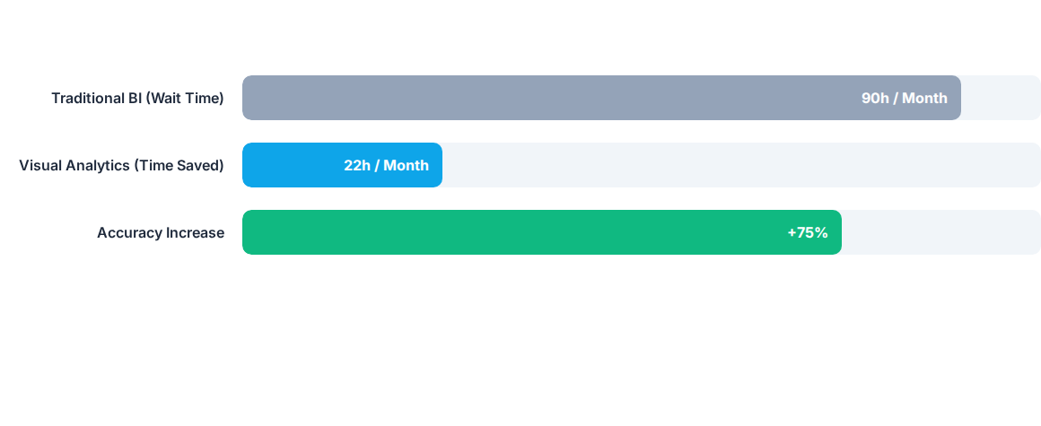
Impact on Decision Efficiency
Adopting Visual Analytics significantly reduces the dependency on technical teams for every report request.

Slide 11


Puzzle 1: The "Why" Challenge
Visual Analytics Brain Teaser
A simple bar chart shows sales are down in August. A Visual Analytics dashboard allows you to click the August bar and see that inventory was high but Footfall was low due to a Local Strike.
Q: In the Visual Analytics process, which step allowed the manager to find the "Strike" cause?
A) Preprocessing | B) Drill-Down | C) Data Mining
(Answer: B - Drill-Down allows moving from summary to specific causes.)

Slide 12

Puzzle 2: Pattern Discovery
Analytical Logic
In a scatter plot of "Marketing Spend" vs "Revenue," you see one point far away from the main cluster (top left). This indicates very high revenue with almost zero spend.
What is this point called in Visual Analytics terminology, and should you ignore it?
A) An Anomaly (Investigate for organic growth secrets)
B) A Core Point (Standard business performance)
C) A Trendline (The direction of the business)
(Answer: A - This is an Outlier/Anomaly. Visual Analytics excels at spotting these "hidden gems" or "red flags".)

