Slide 1
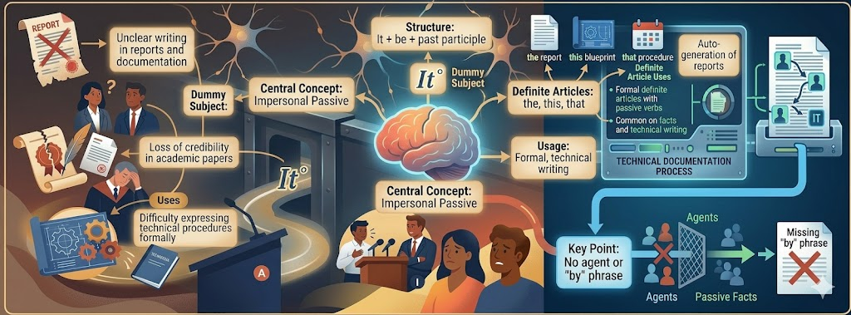
Indefinite Article and Prepositions
Recap: Impersonal Passive & Definite Article
Impersonal passive focuses on actions without specifying who performs them
Definite article "the" points to specific, known things
Passive voice is common in technical writing and formal reports
Today we'll explore how indefinite articles ("a", "an") and prepositions work together
1/10

Slide 2

Indefinite Article and Prepositions
Design Thinking Connection
Empathize: Understand communication challenges in engineering contexts
Define: Identify when to use "a", "an", and prepositions correctly
Ideate: Brainstorm examples from technical documentation
Prototype: Practice sentence construction in lab reports
Test: Apply rules in presentations and workplace emails
2/10

Slide 3

EMPATHIZE
Why This Topic Matters ?
Problems Without Proper Grammar
Confusion in technical specifications and requirements
Unclear instructions in manufacturing or lab procedures
Miscommunication in team meetings and project planning
Unprofessional appearance in academic papers and reports
3/10

Slide 4

Core Concept Definition
What Are Indefinite Articles and Prepositions ?
"A" and "an" introduce non-specific, general things
Use "a" before consonant sounds, "an" before vowel sounds
Prepositions show relationships between elements
Together they clarify spatial, temporal, and logical connections
4/10

Slide 5

Core Rules (Part 1)
Basic Guidelines
Singular countable nouns need "a" or "an" when first mentioned
Use "an" before vowel sounds: an engineer, an hour, an FPGA
Use "a" before consonant sounds: a processor, a circuit, a USB port
Prepositions link nouns to other words: in, on, at, by, with, from
5/10

Slide 6

Core Rules (Part 2)
Examples in Context
Incorrect: "We need sensor for the circuit" ✓ Correct: "We need a sensor for the circuit"
Incorrect: "The error occurred 5 PM" ✓ Correct: "The error occurred at 5 PM"
Incorrect: "Connect the wire terminal" ✓ Correct: "Connect the wire to the terminal"
Incorrect: "We tested prototype yesterday" ✓ Correct: "We tested a prototype yesterday"
6/10

Slide 7

Classroom Activity
Team Documentation Challenge
Form pairs and review a sample lab report or technical document
Identify 5 sentences that use indefinite articles or prepositions
Discuss whether each usage is correct and why
Correct any errors and explain your reasoning
Share findings with the class in 2-minute presentations
7/10

Slide 8
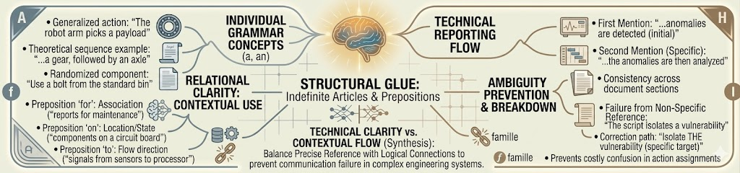
Key Concepts Mind Map
Central Idea: Indefinite Articles & Prepositions
Articles: a, an (non-specific, singular)
Prepositions: in, on, at, by, with, from
Rules: vowel/consonant sounds, singular countable nouns
Applications: reports, emails, documentation
8/10

Slide 9

Practice Exercises
Test Your Understanding
Fill in: "We need ___ oscilloscope for this measurement" (a/an)
Correct: "The component failed at 3 PM yesterday" (preposition error)
Choose: "Connect the sensor ___ the microcontroller" (a) in (b) to (c) on
Fill in: "An ___ hour delay caused production issues" (article error)
Correct: "We designed a system with an FPGA chip" (check usage)
9/10

Slide 10

Answer Key & Key Takeaways
Answers & Summary
(1) an ✓ (2) at ✓ (3) (b) to ✓ (4) hour ✓ (5) ✓ correct
Use "a" before consonant sounds, "an" before vowel sounds
Prepositions clarify relationships and timing in technical writing
Proper usage prevents ambiguity in engineering documentation
Keep practicing—clear communication is a key engineering skill!
10/10

