Slide 1

Word Formation: Prefixes and Suffixes
Recap: Previous Class
Our last session focused on spelling accuracy and punctuation mastery—essential foundations for clear professional communication.
Spelling errors reduce credibility in technical documents
Missing punctuation creates ambiguity in instructions
Proper grammar demonstrates attention to detail
These skills directly impact workplace communication
Today's topic builds on these fundamentals
1/10

Slide 2
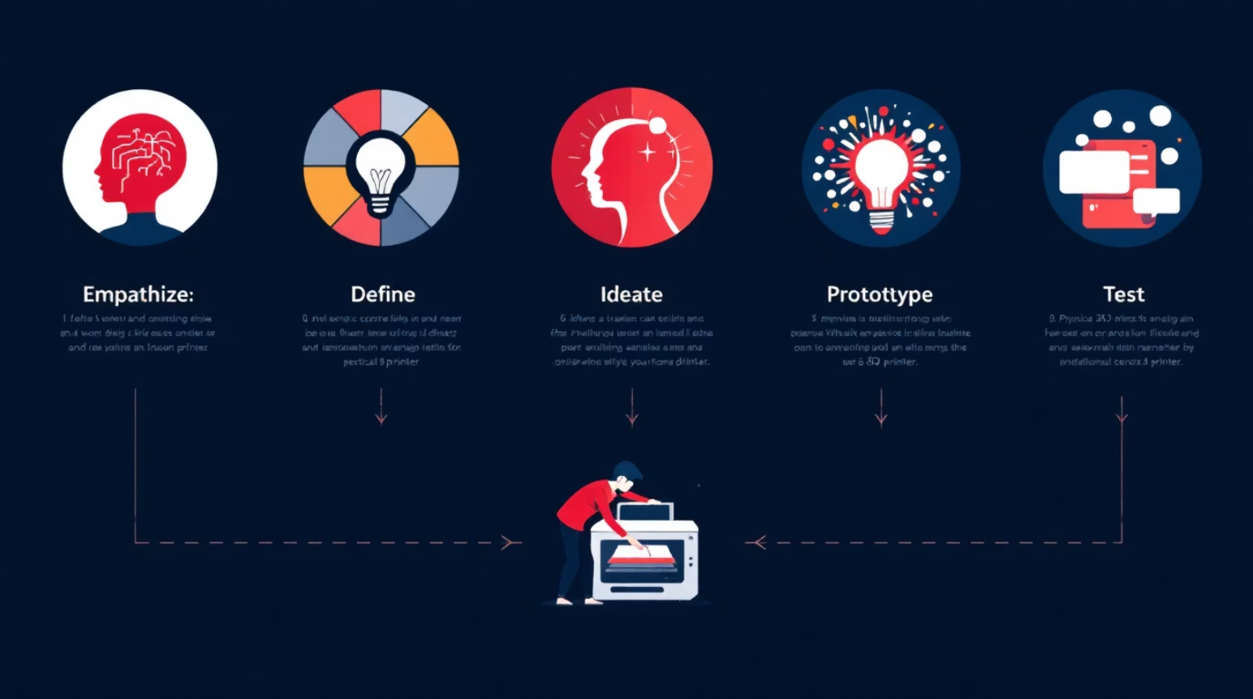
Word Formation: Prefixes and Suffixes
Aligned with Design Thinking Process
01
Empathize
Understand communication challenges engineers face with technical vocabulary
02
Define
Identify root words and their modification patterns
03
Ideate
Explore creative combinations for specialized terminology
04
Prototype
Test new word formations in technical contexts
05
Test
Validate usage through peer review and documentation
2/10

Slide 3

EMPATHY
Why This Topic Matters ?
Communication Challenges Without Mastery
Misunderstood instructions in technical documentation
Confusion during engineering team meetings and presentations
Professional credibility at stake in written reports
Difficulties during technical interviews and job applications
Errors in academic papers and research publications
Real impact: A single prefix error can reverse technical meaning entirely.
3/10

Slide 4
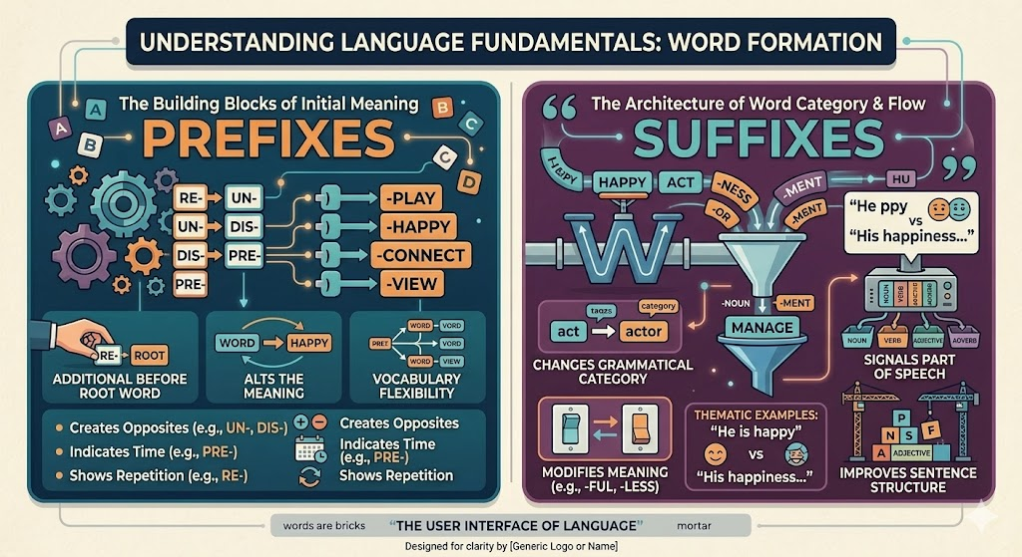
What Are Prefixes and Suffixes?
Definition & Purpose
Prefixes attach to the beginning of root words, modifying meaning (e.g., prefix, submarine).
Suffixes attach to the end, often changing word class (e.g., create → creation, engineer → engineering).
These affixes create precise technical terminology essential for engineering communication.
4/10

Slide 6

Core Rules: Part 1
Rule 1: Position Matters
Prefixes always precede root; suffixes always follow
Rule 2: Meaning Modification
Prefixes alter meaning; suffixes often change word class
Rule 3: Hyphen Usage
Use hyphens with capital letters or identical vowels
Rule 4: Double Consonants
Some suffixes require doubling final consonants
Rule 5: Spelling Adjustments
Drop silent 'e' before vowel suffixes in most cases
5/10

Slide 7

Core Rules: Part 2 with Examples
Exception: Keep 'e' in words ending 'ce' or 'ge' before '-ous' (courageous, changeable)
Example: The engineer redesigned the prototype for optimal performance
Example: The team demonstrated unethical behavior in the testing phase
Example: This technology enables automation in manufacturing systems
Example: The software requires continuous monitoring for quality assurance
6/10

Slide 8






Classroom Activity
Interactive Technical Vocabulary Challenge
Pair Formation
Form pairs and receive engineering scenario cards
Word Creation
Add prefixes/suffixes to create 3 technical terms
Scenario Presentation
Use terms in 2-minute technical explanation
Peer Review
Class evaluates accuracy and usage appropriateness
Best Practice Award
Instructor recognizes most effective technical communication
7/10

Slide 9
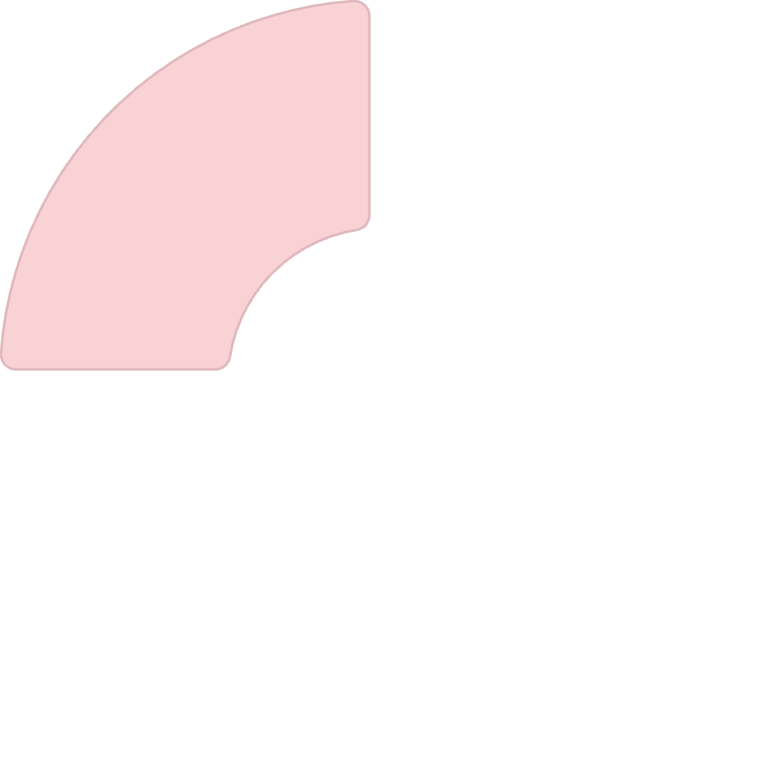
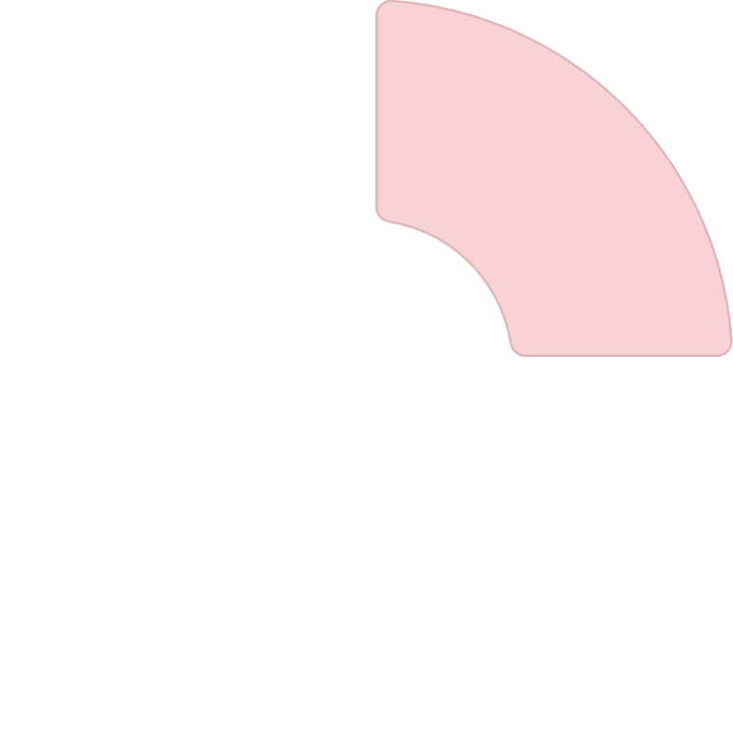
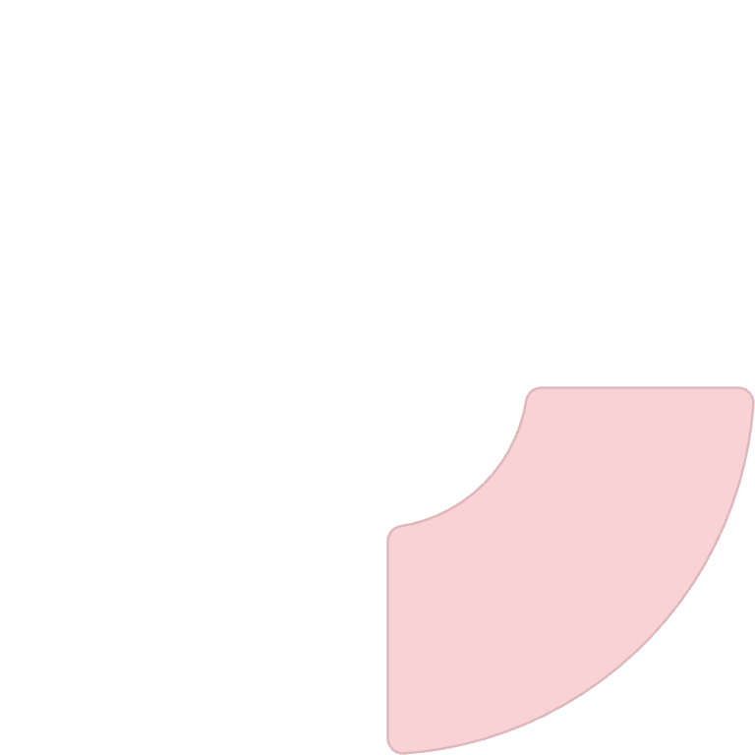
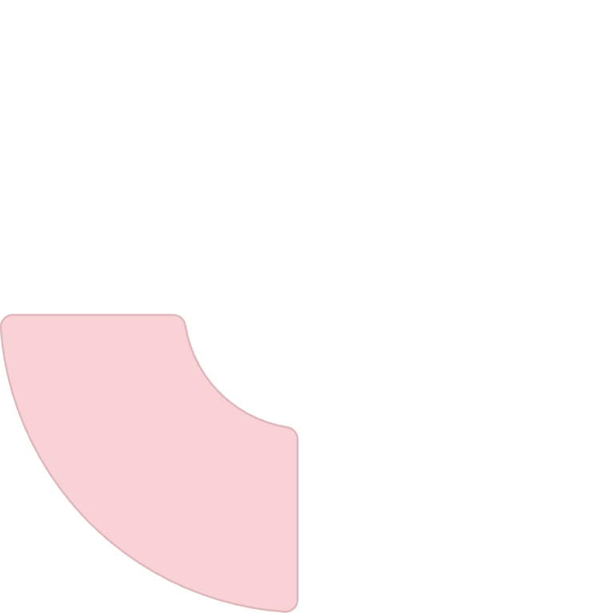


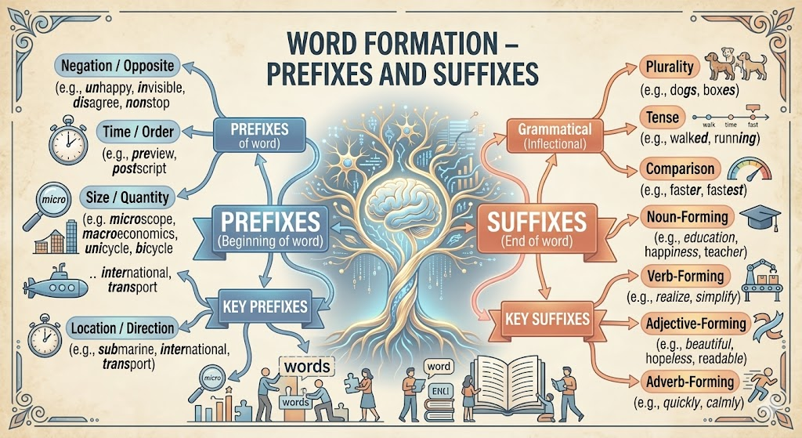

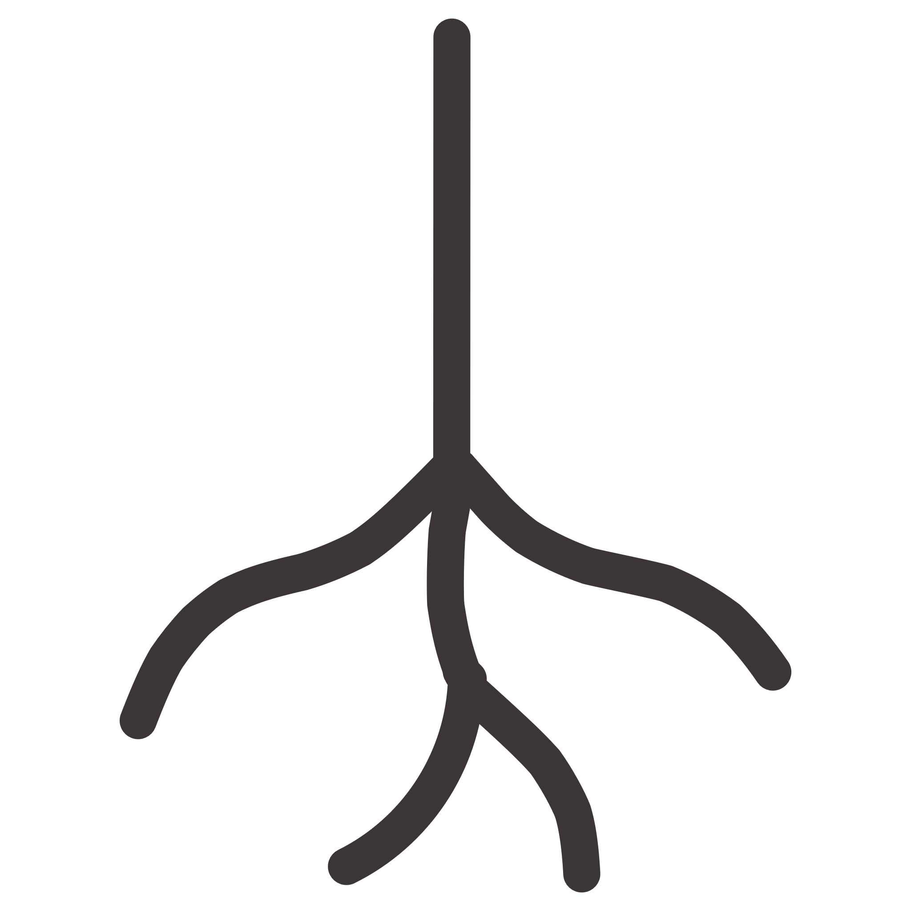
Concept Mind Map
Prefixes
anti-, pre-, sub-, trans-
Suffixes
-tion, -able, -ment, -ous
Root Words
Base meaning foundation
Applications
Technical writing, documentation
8/10

Slide 10

Practice Exercises
Add prefix to "conduct" for "not able to conduct electricity"
Correct: "The system is uncapable of processing"
Choose suffix: "The engineer provided clear ________" (instruction/instructment)
Form word: "The device automatically ________ itself" (calibrate)
Identify error: "The prototype preformed well in testing"
Workplace example: Write a brief email describing an unsuccessful test using appropriate prefixes/suffixes.
9/10

Slide 11

Answer Key & Key Takeaways
Answers
non-conductor
"The system is incapable of processing"
instruction
calibrates
"The prototype performed well"
Key Takeaways
Prefixes modify meaning at word beginnings
Suffixes change word class at endings
Position and spelling rules are critical
Technical vocabulary relies on affix mastery
Master these patterns, and technical writing becomes intuitive.
10/10

