Slide 1

SNS COLLEGE OF TECHNOLOGY
Coimbatore-35
An Autonomous Institution
Department of AIML
23AMO304-Introduction To Business Intelligence
Dashboard Design
The Art & Science of Visualizing Business Performance
Dr. Angel Latha Mary S
SNS College of Technology | Coimbatore

Slide 2
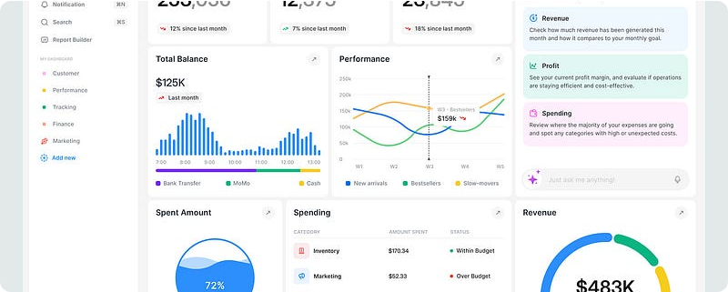
01. Foundations
Defining the Role of Dashboards in Modern BI

Slide 3

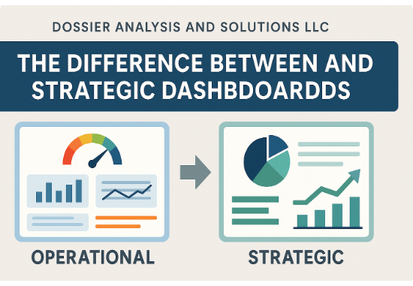
What is a Dashboard?
A Cognitive Interface
A dashboard is an information management tool that visually tracks, analyzes, and displays key performance indicators (KPIs), metrics, and key data points.
It translates complex raw data into instantly actionable insights, serving as the "nerve center" for organizational decision-making.

Slide 4






Three Keys to Great Design
Clarity
Relevance
Actionability
The user should grasp the message in less than 5 seconds. Avoid clutter and "chart junk."
Display only what matters to the specific user role. One size does not fit all.
Design to drive a decision. If a metric moves, what should the user do next?

Slide 5
02. Classification
Strategic, Operational, and Analytical Views

Slide 6

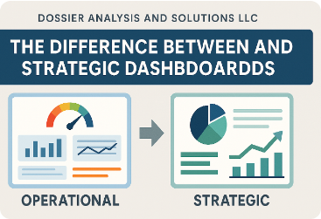

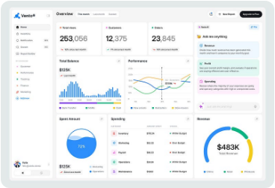


Dashboard Hierarchy
Strategic
Operational
Analytical
High-level goals for executives. Tracks monthly/yearly KPIs.
Real-time monitoring of daily tasks and processes.
Deep dives for analysts. Trend analysis and drill-downs.

Slide 7
UI Design Best Practices
Color Utility: Use color to indicate meaning (Red for Alert, Green for Success), not for decoration.
Grouping: Place related metrics in close proximity to reduce cognitive load.
Drill-Down: Provide pathways to deeper data for those who need to investigate "Why."
Simplicity: Limit a single dashboard to 5-7 visualizations to prevent information overload.

Slide 8

The Layout Strategy
Visual Information Flow
In business reporting, users typically read in an F-Pattern or Z-Pattern.
Place the most critical KPI in the Top-Left Corner. This is where the eye lands first and holds the highest psychological value.
Supportive trends go in the center, and detailed data tables reside at the bottom.

Slide 9


Common Design Pitfalls
Overcrowding
Lack of Context
Attempting to show everything to everyone results in a "cockpit of chaos" where nothing stands out.
A number like "$1.2M" is meaningless without context. Is it better or worse than last month? What is the goal?

Slide 10
Design Maturity Model
Feature | Standard Report | Professional Dashboard
Interactivity | Static / Page-based | Dynamic / Filterable
Metric Focus | Data Dump | Curated KPIs only
Visual Flow | Linear (Top to Bottom) | Priority-based (Quadrant)
Updates | Manual / Periodic | Automated / Real-time

Slide 11

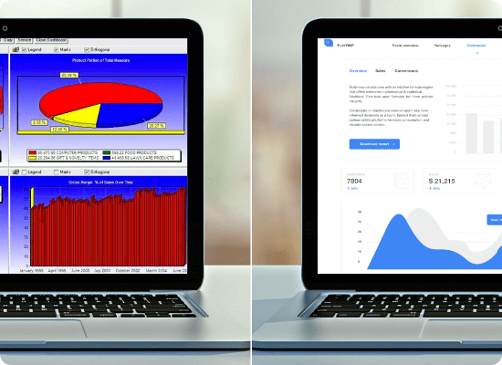





Puzzle 1: Spot the Design Error
Which principle is violated?
Hover over options to see the challenge! (Hint: Effective dashboards are flat and simple).

Slide 12



Puzzle 2: Metric Match-Up
Dashboard Types
Metrics to Match
1. Strategic Dashboard
A. Current Server Uptime (Last 5 mins)
2. Operational Dashboard
B. Market Share Trends (2020-2024)
3. Analytical Dashboard
C. Annual Net Profit vs. Forecast
The Challenge: Match 1-C, 2-A, and 3-B correctly. Why would a CEO care more about 'C' than 'A'?

