Slide 1


SNS COLLEGE OF TECHNOLOGY
Coimbatore-35
An Autonomous Institution
Department of AIML
23AMO304-Introduction To Business Intelligence
Data Warehousing
Fundamentals
Unit I: Foundations of Bi
Dr. Angel Latha Mary S
SNS College of Technology | Coimbatore

Slide 2

The Data Chaos Challenge
Recap & Icebreaker: Before we dive in, let's reflect on the current state of information.
•
Data exists in silos across departments.
•
Manual ledger keeping to digital storage.
•
The Gap: Data exists, but "Intelligence" is missing.
"Can you name a time you had the data but couldn't make a decision?"

Slide 3

Defining the Core Challenge
Persona: Alex, Operations Lead
"I spend 70% of my time manually aggregating Excel sheets and only 30% actually managing the team."
Problem: Information Blindness
How do we turn siloed, raw data into a competitive steering wheel?

Slide 4
Evolution: From DSS to AI
1970s
1990s
2010s
2020s
DSS
Rule-based models
Traditional BI
Data Warehousing
Self-Service BI
Visual Discovery
Augmented
AI-driven Insights
BI isn't new; it has transformed with computing power.

Slide 5
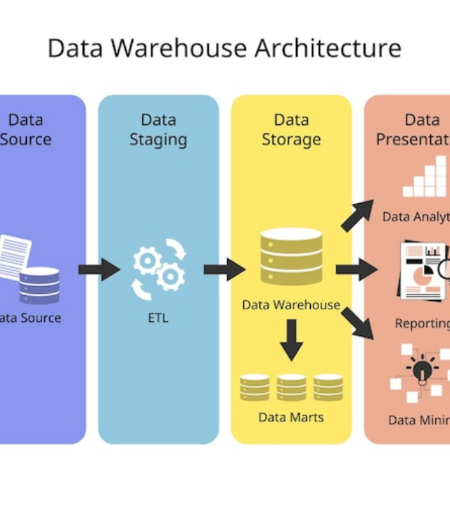
What is a Data Warehouse?
A data warehouse is a central repository of information that can be analyzed to make better informed decisions.
Data flows from transactional systems, relational databases, and other sources, typically on a regular cadence.
Hindsight to Foresight journey.

Slide 6







Warehouse Architecture Layers
Source Layer
Staging Layer
Storage Layer
Access Layer
ERP, CRM, and Flat Files speaking different "languages".
Front-end BI tools for reporting and dashboards.
Raw data landing zone before cleaning and standardization.
The core hub where data is structured into schemas.

Slide 7



The ETL/ELT Process
Pulling data from disparate sources.
Cleaning, deduplicating, and formatting.
Writing data to the target warehouse.

Slide 8


Dimensional Modeling Schemas
Star Schema
Snowflake Schema
Simplest form where one central fact table connects to several dimension tables.
Extension of star schema where dimension tables are normalized into sub-dimensions.
Denormalized, faster queries.
Normalized, storage efficient.

Slide 9
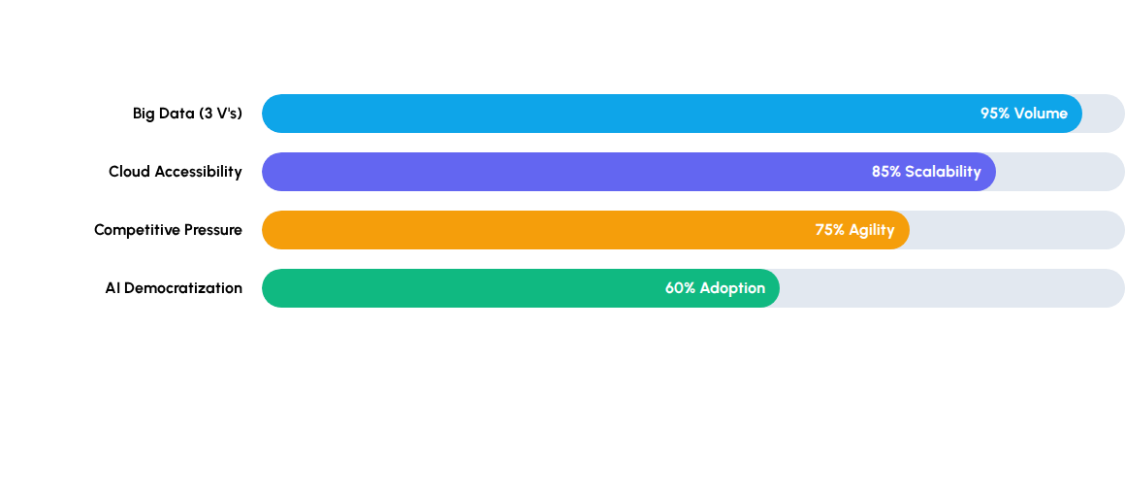
Market & Technical Drivers
These forces have converged to make BI the "New Oil" of business.

Slide 10
Database vs. Data Warehouse
Feature | Operational Database (OLTP) | Data Warehouse (OLAP)
Purpose | Run daily business operations | Analyze historical data for decisions
Data Age | Current, up-to-date data | Historical data over years
Operation | Simple transactions (Insert/Update) | Complex queries (Read/Aggregate)
Focus | Efficiency and Integrity | Performance and Insights

Slide 11

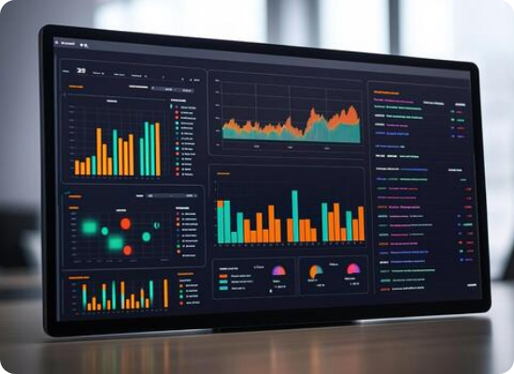
Case Study: Retail Optimization
The Scenario
A regional retailer sees high waste in fresh produce. We prototype a BI solution.
•
Input: Inventory + Weather + Footfall
•
Process: Real-time Correlation
•
Output: Smart Reordering Dashboard

Slide 12

Questions?
Identify one "Driver" and one "Evolution Stage" that led to the rise of Self-Service Analytics.
Dr. Angel Latha Mary S
Department of AI & ML | SNS Institutions

