Slide 1

SNS COLLEGE OF TECHNOLOGY
An Autonomous Institution Coimbatore-35
DEPARTMENT OF INFORMATION TECHNOLOGY
23ITT304 Information Coding Technique
Unit II
Error Detection Using Parity Checks
P.Thilagarani AP/IT
ERROR DETECTION AND CORRECTION

Slide 2


Error Detection Using Parity Checks
Ensuring Data Integrity in Digital Communication
06.03.2026 INFORMATION CODING TECHNIQUES | Error Detection Using Parity Checks | P.Thilagarani | SNSCT 2/14

Slide 3

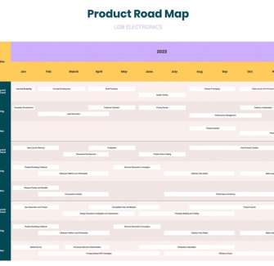
Session Flow & Objectives
Today's Roadmap
Recap: Data Transmission Basics
Define: The Problem of Noise
Ideate: The Parity Concept
Prototype: Odd vs. Even Parity
Test: Hands-on Detection
Learning Objectives
Understand the need for error detection.
Implement Even and Odd parity bits.
Analyze the limitations of parity checks.
06.03.2026 INFORMATION CODING TECHNIQUES | Error Detection Using Parity Checks | P.Thilagarani | SNSCT 3/14

Slide 4
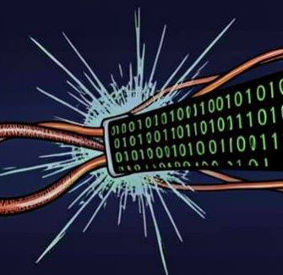
Recap: The Data Transmission Challenge
How Data Travels
Digital data travels as bits (0s and 1s) across channels like Wi-Fi, copper cables, or fiber optics.
The Reality
No channel is perfect. Noise (electrical interference, physical defects) can flip a bit:
Sent: 1
Received: 0
This is a Bit Error. How do we know it happened?
06.03.2026 INFORMATION CODING TECHNIQUES | Error Detection Using Parity Checks | P.Thilagarani | SNSCT 4/14

Slide 5
Design Thinking: Empathize & Define
Empathize: The Persona
Meet Priya, Network Engineer.
She manages banking transactions. A single flipped bit could change ₹10,000 to ₹90,000.
She needs a simple, low-cost way to know if data arrived safely without asking the sender to repeat everything.
Define: The Core Problem
The Challenge:
How can we detect if data has been corrupted during transmission using minimal computational overhead?
Constraints:
Must be fast.
Must use minimal extra bandwidth.
06.03.2026 INFORMATION CODING TECHNIQUES | Error Detection Using Parity Checks | P.Thilagarani | SNSCT 5/14

Slide 6

Ideate: The Parity Solution
The Concept
We add an extra bit to the data to make the count of '1's either Even or Odd.
The Parity Bit
This extra bit doesn't carry data; it's a 'guard' that checks the total count.
Even Parity: Total 1s = Even number
Odd Parity: Total 1s = Odd number
06.03.2026 INFORMATION CODING TECHNIQUES | Error Detection Using Parity Checks | P.Thilagarani | SNSCT 6/14

Slide 7
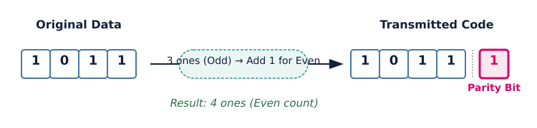
Prototype: Even Parity in Action
Data = 1011
Even parity needed. Add 1 to make total four (even).
Transmitted Code: 10111
Valid if four 1s. Three 1s trigger re-send request.
06.03.2026 INFORMATION CODING TECHNIQUES | Error Detection Using Parity Checks | P.Thilagarani | SNSCT 7/14

Slide 8
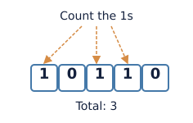
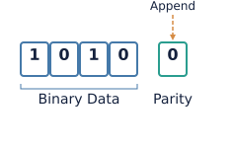
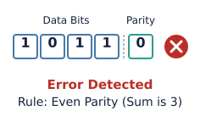
How It Works: The Algorithm
Step 1: Count
Sender counts the number of 1s in the original data block.
Step 2: Append
Sender adds a parity bit (0 or 1) to force the total to the agreed rule.
Step 3: Verify
Receiver counts the 1s. If the rule is broken, an error is flagged.
06.03.2026 INFORMATION CODING TECHNIQUES | Error Detection Using Parity Checks | P.Thilagarani | SNSCT 8/14

Slide 9
Quick Check
We are using Even Parity. The data is 10110. What is the Parity Bit?
1.
Answers on the next slide...
2.
1
3.
10
4.
Null
06.03.2026 INFORMATION CODING TECHNIQUES | Error Detection Using Parity Checks | P.Thilagarani | SNSCT 9/14

Slide 10
Quick Check
✅​
We are using Even Parity. The data is 10110. What is the Parity Bit?
1.
👍​
2.
1
3.
10
4.
Null
06.03.2026 INFORMATION CODING TECHNIQUES | Error Detection Using Parity Checks | P.Thilagarani | SNSCT 10/14

Slide 11

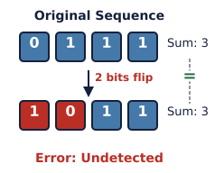
Discuss! 🤷‍♀️​ 💁‍♂️​ 💬​
Critical Thinking: Limitations
If two bits flip (e.g., 01 becomes 10), does the total number of 1s change? Can parity detect this error?
06.03.2026 INFORMATION CODING TECHNIQUES | Error Detection Using Parity Checks | P.Thilagarani | SNSCT 11/14

Slide 12
Discuss! 🤷‍♀️​ 💁‍♂️​ 💬​
✅​
You might have said...
No, the total count of 1s remains the same.
Parity checks can only detect an odd number of bit errors (1, 3, 5...). They fail to detect an even number of errors.
06.03.2026 INFORMATION CODING TECHNIQUES | Error Detection Using Parity Checks | P.Thilagarani | SNSCT 12/14

Slide 13



Summary: Key Takeaways
Types
Can be Even Parity (total 1s is even) or Odd Parity (total 1s is odd).
Purpose
Parity is a simple method to detect single-bit errors during transmission.
Limitation
Cannot detect double-bit errors (where two bits flip simultaneously).
06.03.2026 INFORMATION CODING TECHNIQUES | Error Detection Using Parity Checks | P.Thilagarani | SNSCT 13/14

Slide 14
Thank You
06.03.2026 INFORMATION CODING TECHNIQUES | Error Detection Using Parity Checks | P.Thilagarani | SNSCT 14/14

