Slide 1


Kraft’s Inequality
Understanding Prefix Codes and Their Limits in Information Coding

Slide 2


Recap & Icebreaker
Quick Review
What is a binary code? A sequence of 0s and 1s representing data.
What makes a code prefix-free? No codeword is a prefix of another.
Think: Why can’t we assign short codes to everything?
Imagine labeling items in a warehouse — if labels overlap, scanning causes errors.
Let’s explore the mathematical limit behind efficient, unambiguous coding.

Slide 3
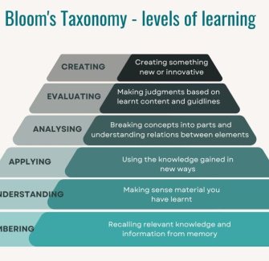
Session Objectives
By the end of this session, you will be able to:
Explain the significance of Kraft’s Inequality in coding theory.
Apply the inequality to determine if a set of codeword lengths can form a valid prefix code.
Connect Kraft’s Inequality to real-world compression systems like ZIP or MP3.
Use the Design Thinking framework to analyze coding challenges.
Reflect on how theoretical limits shape practical engineering decisions.

Slide 4
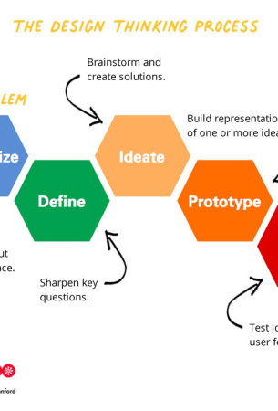
Design Thinking Approach
1
Empathize
Engineers need reliable, fast, unambiguous data transmission decoding.
2
Define
Kraft's inequality: sum of 2^(-length) <= 1 for prefix-free codes.
3
Ideate
Kraft’s Inequality: a mathematical test condition.
4
Prototype
Binary tree visualization & example code assignments.

Slide 5
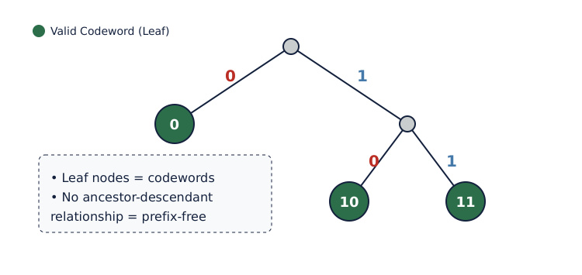
Binary Tree Representation of Prefix Codes

Slide 6
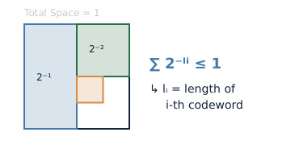
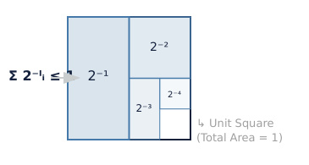
Kraft’s Inequality: The Rule
The Inequality
For a prefix-free binary code with codeword lengths l₁, ..., lₙ: ∑ᵢ 2⁻ˡⁱ ≤ 1. If > 1, impossible.
Why It Works
Each length-l codeword blocks 2⁻ˡ of the binary tree 'space'. Total reserved area (like land plots) cannot exceed 1.

Slide 7

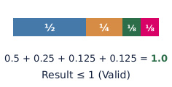

Applying Kraft’s Inequality
List Lengths
Given codeword lengths: e.g., [1, 2, 3, 3]
Compute Sum
Calculate: 2⁻¹ + 2⁻² + 2⁻³ + 2⁻³ = 0.5 + 0.25 + 0.125 + 0.125 = 1.0
Check Bound
Sum = 1.0 ≤ 1 → Valid prefix code exists.

Slide 8


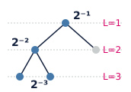

T-Shaped Learning: Breadth & Depth
Horizontal
Links to Huffman coding, data compression, and error-free communication.
Cross-Discipline
Connects math (inequalities), CS (algorithms), and engineering (systems).
Vertical
Deep dive: Proof sketch using binary trees and geometric series.
Future
Used in AI model quantization, IoT device coding, and space communication.

Slide 9

Summary & Reflection
Key Takeaways
Kraft's Inequality (∑ 2⁻ˡⁱ ≤ 1) is a necessary and sufficient condition for prefix-free codes, ensuring no codeword conflicts in binary coding. This principle underpins systems like ZIP, JPEG, and MP3.
Share & Reflect
What did you learn?
What questions remain?
Quick Assessment
Can a prefix code have lengths [1, 1, 2]? Compute the sum and justify.

