Slide 1

SNS COLLEGE OF TECHNOLOGY
An Autonomous Institution Coimbatore-45
DEPARTMENT OF INFORMATION TECHNOLOGY
23ITT304 Information Coding Techniques
Unit IV
Mastering Linear Block Codes
P.Thilagarani AP/IT
LINEAR BLOCK CODES AND CYCLIC CODES

Slide 2

Mastering Linear Block Codes
Engineering Reliable Communication in a Noisy World
17.04.2026 23ITT304-Information Coding Techniques | Mastering Linear Block Codes | P.Thilagarani | SNSCT 2/15

Slide 3
Icebreaker: The Reliability Challenge
Question 1:
What happens to a digital signal when it travels through a noisy atmosphere?
Question 2:
If you send '101' and receive '111', how do you know an error occurred?
Question 3:
What is the simplest way to check for a single-bit error?
Answers on the next slide...
17.04.2026 23ITT304-Information Coding Techniques | Mastering Linear Block Codes | P.Thilagarani | SNSCT 3/15

Slide 4
Icebreaker: The Reliability Challenge
​
Answer 1:
Bits can flip from 0 to 1 or vice versa, causing data corruption.
Answer 2:
Without redundancy or parity rules, you cannot know for certain.
Answer 3:
Adding a single parity bit to make the total number of 1s even or odd.
17.04.2026 23ITT304-Information Coding Techniques | Mastering Linear Block Codes | P.Thilagarani | SNSCT 4/15

Slide 5
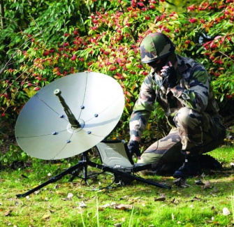
Empathize & Define: The Engineer’s Dilemma
The Persona: Arjun, Network Engineer
Arjun is designing a satellite link for rural India. High atmospheric interference causes frequent data drops.
The Challenge
How can we transmit data so the receiver can detect and correct errors without asking for a retransmission?
The Solution
Linear Block Codes (LBCs). We group bits into blocks and add structured redundancy, allowing the receiver to 'math' its way back to the original message.
17.04.2026 23ITT304-Information Coding Techniques | Mastering Linear Block Codes | P.Thilagarani | SNSCT 5/15

Slide 6
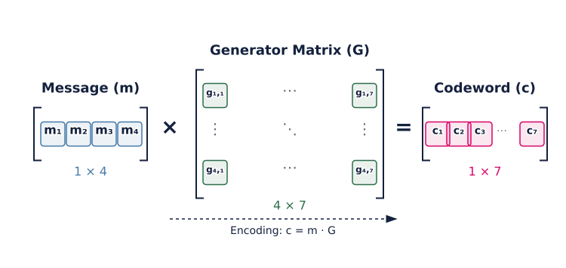
Encoding: The Generator Matrix (G)
17.04.2026 23ITT304-Information Coding Techniques | Mastering Linear Block Codes | P.Thilagarani | SNSCT 6/15

Slide 7

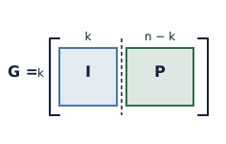

Ideate: The Encoding Process
Codeword Result
The result is a systematic codeword where the first bits are the message and the last bits are parity check bits.
Message Vector
Identify the data bits (k) you want to send.
Generator Matrix
Multiply the message by G = [I | P], where I is the identity matrix and P is the parity matrix.
17.04.2026 23ITT304-Information Coding Techniques | Mastering Linear Block Codes | P.Thilagarani | SNSCT 7/15

Slide 8
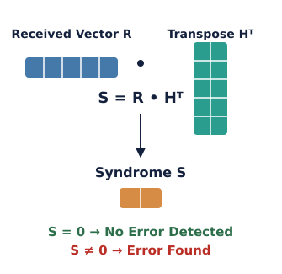
Decoding: Syndrome Testing
The Parity Check Matrix (H)
When the codeword 'R' arrives, we multiply it by the transpose of H (Hᵀ).
The Syndrome (S)
S = R • Hᵀ
If S = 0: No detectable error occurred.
If S ≠ 0: An error is present. The unique syndrome pattern points directly to the bit that flipped.
Error Correction
By identifying the error location, we simply flip the bit back to its original state.
17.04.2026 23ITT304-Information Coding Techniques | Mastering Linear Block Codes | P.Thilagarani | SNSCT 8/15

Slide 9
Test: The Decoding Workflow
Arrange the steps for a receiver processing an incoming block of data:
Answers on the next slide...
Calculate the Syndrome S using the Parity Check Matrix.
Receive the noisy vector R from the channel.
Locate and flip the erroneous bit based on S.
Extract the original k message bits from the corrected codeword.
17.04.2026 23ITT304-Information Coding Techniques | Mastering Linear Block Codes | P.Thilagarani | SNSCT 9/15

Slide 10
Test: The Decoding Workflow
✅​
Arrange the steps for a receiver processing an incoming block of data:
1.
Receive the noisy vector R from the channel.
2.
Calculate the Syndrome S using the Parity Check Matrix.
3.
Locate and flip the erroneous bit based on S.
4.
Extract the original k message bits from the corrected codeword.
17.04.2026 23ITT304-Information Coding Techniques | Mastering Linear Block Codes | P.Thilagarani | SNSCT 10/15

Slide 11
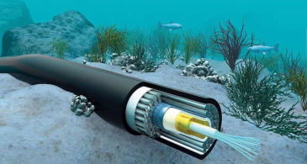

Horizontal Breadth: Real-World T-Shape
Deep Sea Cables: LBCs ensure data integrity across thousands of miles of underwater cabling where signal decay is rampant.
QR Codes: Ever wonder why a scratched QR code still works? It uses advanced block coding to reconstruct missing information.
17.04.2026 23ITT304-Information Coding Techniques | Mastering Linear Block Codes | P.Thilagarani | SNSCT 11/15

Slide 12


Group Activity: The Efficiency Trade-off
In a group, discuss: If we add more parity bits, we can correct more errors. However, what is the 'cost' of doing this in a real-world network like a 5G system in India?
17.04.2026 23ITT304-Information Coding Techniques | Mastering Linear Block Codes | P.Thilagarani | SNSCT 12/15

Slide 13
Group Activity: The Efficiency Trade-off
✅​
You might have said...
Reduced Bandwidth Efficiency: More overhead means fewer actual data bits per second.
Latency: Complex decoding math takes more time/power for the processor.
Energy Consumption: Mobile devices drain battery faster when performing heavy error-correction algorithms.
17.04.2026 23ITT304-Information Coding Techniques | Mastering Linear Block Codes | P.Thilagarani | SNSCT 1315

Slide 14

Summary & Key Takeaways
Linearity
Summing any two valid codewords yields another, aiding efficient encoding.
1
2
Hamming Distance
Error-correcting capability depends on minimum codeword distance.
Syndrome Decoding
Syndrome S: A diagnostic tool to detect and locate errors.
3
4
Systematic Form
Separating message and parity bits simplifies data extraction.
17.04.2026 23ITT304-Information Coding Techniques | Mastering Linear Block Codes | P.Thilagarani | SNSCT 14/15

Slide 15
THANK YOU
17.04.2026 23ITT304-Information Coding Techniques | Mastering Linear Block Codes | P.Thilagarani | SNSCT 2/15

