Slide 1
SNS COLLEGE OF TECHNOLOGY
Coimbatore-35
An Autonomous Institution
Department of AIML
23AMO304-Introduction To Business Intelligence
Predictive Analytics & Data Visualization
Turning Historical Patterns into Future Strategic Insights
Dr. Angel Latha Mary S
SNS College of Technology | Coimbatore

Slide 2
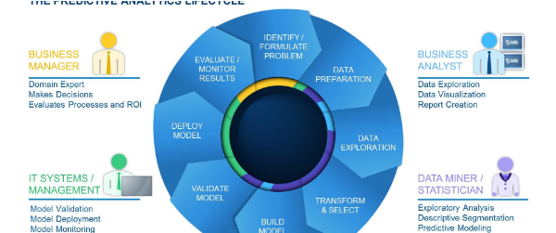
PART 01
Predictive Analytics Basics
Methods for Forecasting and Future Probabilities

Slide 3


Defining Predictive Analytics
What is it?
Strategic Importance
Predictive analytics focuses on predicting future outcomes using historical data, statistical techniques, and machine learning models.
By moving from "What happened?" to "What will happen?", organizations can optimize pricing, improve customer retention, and manage supply chains with greater precision.
It helps businesses answer the critical question: "What is likely to happen next?" by identifying risks and opportunities before they occur.

Slide 4
The Predictive Modeling Lifecycle
2. Data Plan
4. Evaluate
Collect historical data and identify key variables.
Test the model for accuracy and deployment.
1. Define Issue
3. Pick Model
Select the specific business question or problem to solve.
Choose the forecasting technique (e.g., Regression).
This iterative process ensures that models remain relevant as market dynamics shift.

Slide 5

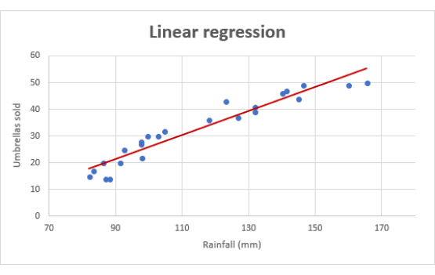
Essential Technique: Regression
Linear & Logistic Analysis
Regression analysis models the relationship between a dependent variable and one or more independent variables.
•
Linear Regression: Used for predicting continuous values (e.g., Sales revenue).
•
Logistic Regression: Used for categorical outcomes (e.g., Churn vs. Stay).
It is the cornerstone of forecasting in marketing, finance, and operations.

Slide 6






Business Applications
Marketing
Finance
Supply Chain
Segmenting leads and calculating "Expect to Purchase" scores for personalized ads.
Fraud detection by indicating unusual transactions and credit scoring for loans.
Demand forecasting and predicting equipment maintenance to avoid raw material waste.

Slide 7
PART 02
Data Visualization Methods
Graphical Representation of Data for Clear Communication

Slide 8

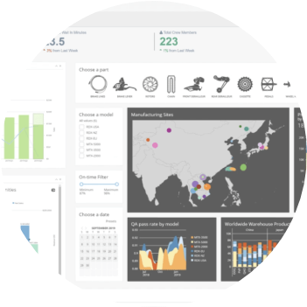
The Role of Visualization
Storytelling with Purpose
Data visualization highlights trends, patterns, and correlations that might go unnoticed in a massive spreadsheet.
Benefits:
•
Speeds up the decision-making process.
•
Communicates insights universally.
•
Makes patterns and outliers easy to internalize.

Slide 9
Classification of Visual Systems
Criteria | Classification Type | Common Examples
Dimensionality | 1D, 2D, 3D, n-D | Line Graphs, Scatter Plots, Heatmaps
Data Type | Scalar, Vector, Tensor | Temperature gradients, Wind flow maps
User Interaction | Static vs. Interactive | Printed reports vs. Tableau Dashboards
Domain | Scientific, BI, Geospatial | CT Scans, KPI Dashboards, World Maps

Slide 10
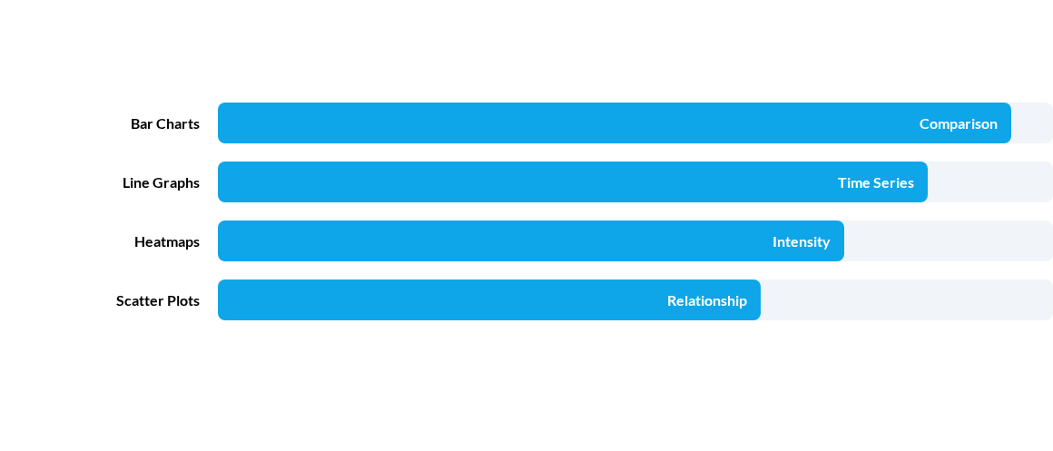
Common Visualization Techniques
Selecting the right method depends on whether you want to show comparison, composition, or trends.
Note: Effective design must avoid "Chart Junk" and distorted scales.

Slide 11



Puzzle 1: The Predictive Logic
Scenario Challenge
"A retailer analyzes historical sales data and notices that every time the temperature drops below 10°C, sales of hot cocoa increase by 40%."
Q: If the forecast predicts 8°C tomorrow, what is the 'Independent Variable' and what is the 'Dependent Variable' in this predictive model?
Answer: Independent = Temperature | Dependent = Sales volume.

Slide 12


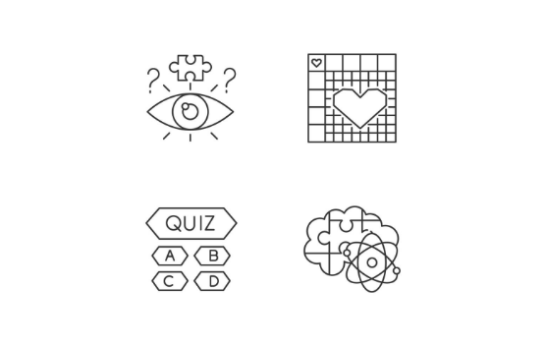

Puzzle 2: The Visualization Diagnostic
Spot the Bias
A graph shows Sales Growth. The Y-axis starts at 1,000 instead of 0. The bar for Year 2 looks five times larger than Year 1, even though growth was only 5%.
Q: What is this misleading visualization technique called?
Answer: Truncated Y-Axis (or Manipulated Scale).

