Slide 1

SNS COLLEGE OF TECHNOLOGY
An Autonomous Institution Coimbatore-35
DEPARTMENT OF INFORMATION TECHNOLOGY
23ITT304 Information Coding Technique
Unit I
Information Theory
Properties of Entropy
P.Thilagarani AP/IT

Slide 2


Properties of Entropy
Entropy (H) is a measure of uncertainty or average information contained in a random variable.
The properties of entropy describe how this uncertainty behaves under different conditions.
15.12.2025 INFORMATION CODING TECHNIQUE | Properties of Entropy | P.Thilagarani | SNSCT 2/11

Slide 3


Recap & Icebreaker
Let’s Reflect
What do you recall about information theory?
Can you name a real-world system where data must be compressed efficiently?
Quick Thought Experiment
Imagine texting without compression—how much longer would it take to send a photo? Why does it matter?
15.12.2025 INFORMATION CODING TECHNIQUE | Entropy | P.Thilagarani | SNSCT 3/11

Slide 4
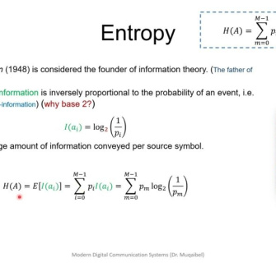
Lesson Objective
By the End of This Session, You Will:
Define entropy in the context of information theory.
Explain the key mathematical properties of entropy.
Apply entropy concepts to evaluate coding efficiency.
Connect entropy to real-world applications in data compression and communication.
15.12.2025 INFORMATION CODING TECHNIQUE | Entropy | P.Thilagarani | SNSCT 4/11

Slide 5

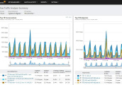


Design Thinking: Persona & Problem
Empathize
Arjun, a Mumbai telecom engineer, faces peak-hour bandwidth limits and slow data complaints.
Define
Transmit more info with less bandwidth, without losing data integrity?
Ideate
Entropy coding: Huffman, Shannon-Fano. Compress data by modeling message unpredictability.
Prototype
Simulate message source, apply variable-length coding based on symbol probabilities.
15.12.2025 INFORMATION CODING TECHNIQUE | Entropy | P.Thilagarani | SNSCT 5/11

Slide 6
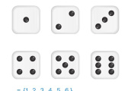


Core Properties of Entropy
Non-Negativity
Entropy is always ≥ 0. It reaches zero only when one outcome is certain—no uncertainty.
Symmetry
The entropy of a distribution doesn’t depend on the order of outcomes—only their probabilities.
Maximum Entropy
When all outcomes are equally likely, entropy is maximized—maximum uncertainty.
Additivity
For independent sources, total entropy equals the sum of individual entropies.
15.12.2025 INFORMATION CODING TECHNIQUE | Entropy | P.Thilagarani | SNSCT 6/11

Slide 7


Entropy: Mathematical & Conceptual View
Formula
H(X) = -Σ p(x) log₂ p(x)
Measures average uncertainty in bits. Higher H(X) = more unpredictable.
Analogy
Entropy is a message's 'surprise factor.' Predictable cricket match = low entropy;
close contest = high entropy.
15.12.2025 INFORMATION CODING TECHNIQUE | Entropy | P.Thilagarani | SNSCT 7/11

Slide 8
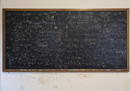
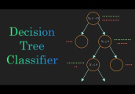


T-Shaped Learning: Depth & Breadth
Future Scope
Quantum information theory uses entropy to measure quantum entanglement and data security.
Vertical (Depth)
Explore joint entropy, conditional entropy, and the chain rule in information theory.
Horizontal (Breadth)
Link to AI: Entropy used in decision trees to split data based on information gain.
Applications
Used in ZIP files, MP3s, JPEGs, and 5G data transmission for optimal encoding.
15.12.2025 INFORMATION CODING TECHNIQUE | Entropy | P.Thilagarani | SNSCT 8/11

Slide 9

Summary Mind Map
Entropy
Measure of uncertainty and information content in a message source.
Key Properties
Non-negativity, symmetry, maximum for uniform distributions, additivity.
Coding Linkopy means more bits needed—drives efficient coding strategies.
Real-World Use
Data compression, cryptography, machine learning, and communication systems.
15.12.2025 INFORMATION CODING TECHNIQUE | Entropy | P.Thilagarani | SNSCT 9/11

Slide 10

Reflection & Assessment
Reflect & Share
What surprised you about entropy?
How might you apply this in your work or studies?
Peer Sharing
Discuss in pairs: 'Can a message be too predictable?'
Quick Assessment
Question: If a source emits two symbols with probabilities 0.9 and 0.1, is its entropy higher or lower than a source with 0.5 and 0.5? Why?
15.12.2025 INFORMATION CODING TECHNIQUE | Entropy | P.Thilagarani | SNSCT 10/11

Slide 11
Thank You
15.12.2025 INFORMATION CODING TECHNIQUE | Entropy | P.Thilagarani | SNSCT 11/11

