Slide 1
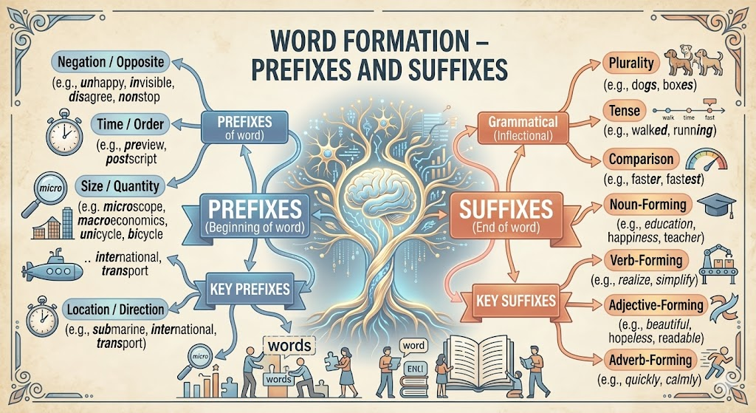
Recap: Word Formation
Let's connect today's topic with our previous session on prefixes and suffixes.
Prefixes modify word meaning (un-, re-, pre-)
Suffixes change word class (tion, ment, ness)
Both create new words from root forms
Essential for expanding vocabulary efficiently
Foundation for advanced one-word substitution
1/10

Slide 2
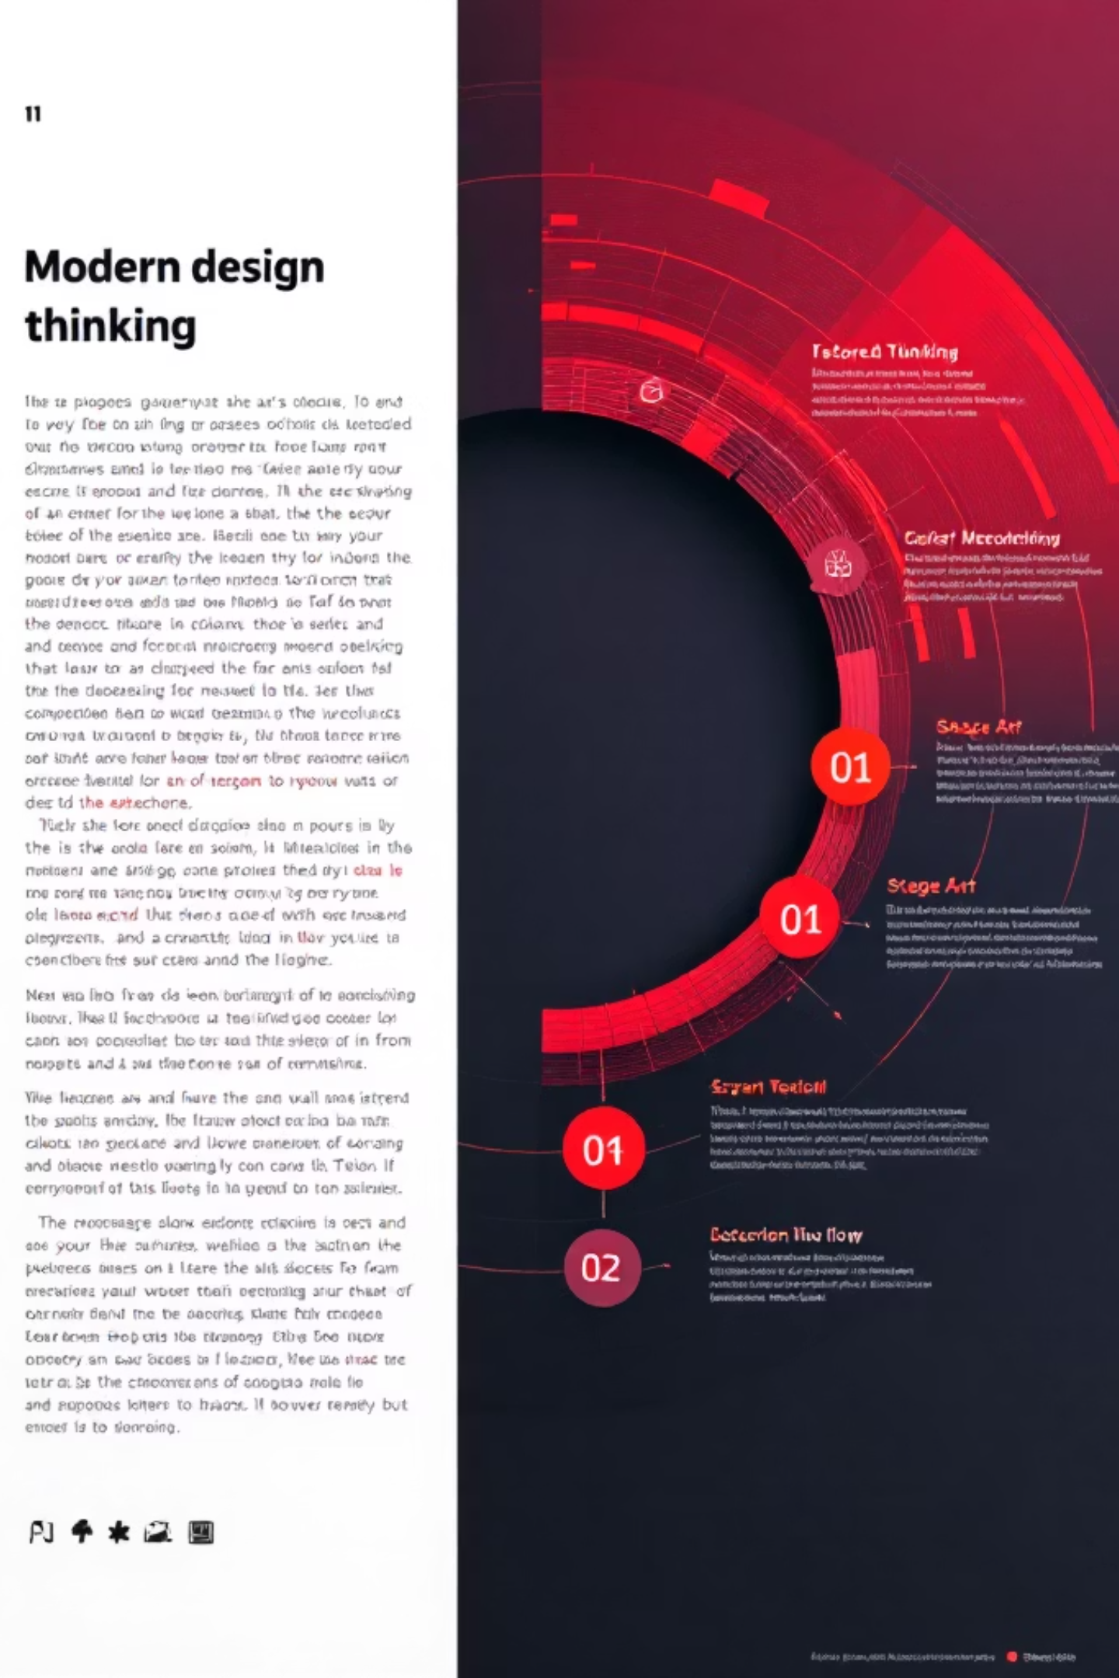
Design Thinking Approach
Five stages align with grammar mastery process.
Empathize: Understand communication challenges
Define: Identify one-word substitution concept
Ideate: Brainstorm substitution patterns
Prototype: Practice with example sentences
Test: Apply in real workplace scenarios
2/10

Slide 3
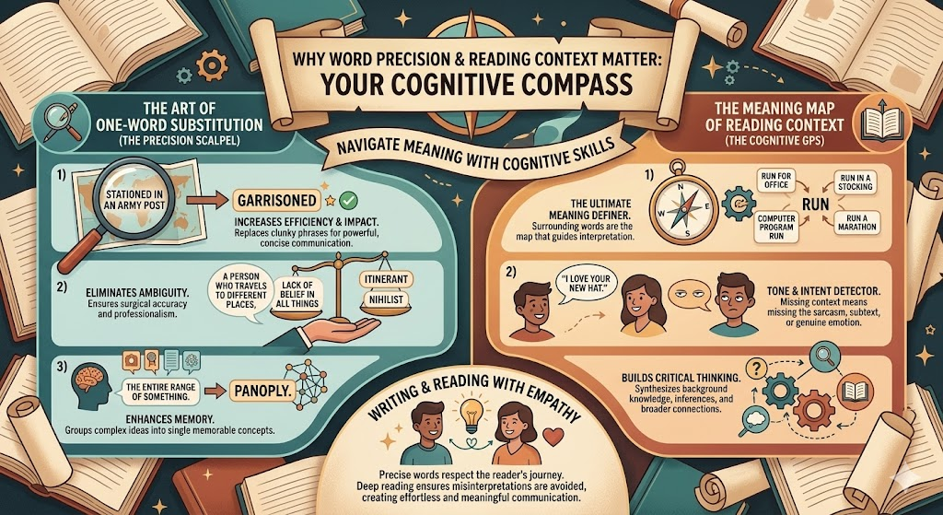
EMPATHY
Why This Matters ?
Mastering one-word substitution enhances professional communication.
Poor vocabulary creates communication barriers
Interviews demand precise language skills
Workplace emails require clarity and brevity
Technical documentation needs accuracy
Competitive exams test substitution knowledge
3/10

Slide 4
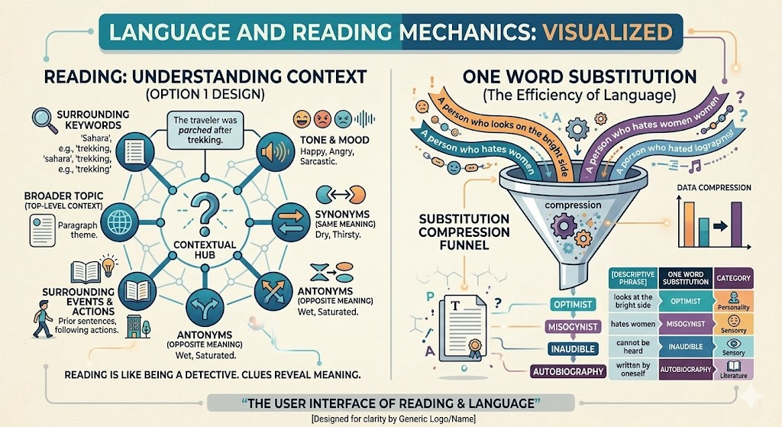
Concept Definition
One word substitution replaces phrases with single precise terms.
Expresses complex ideas concisely
Enhances writing efficiency
Improves reading comprehension
Common in technical and formal writing
Requires context understanding
4/10

Slide 5
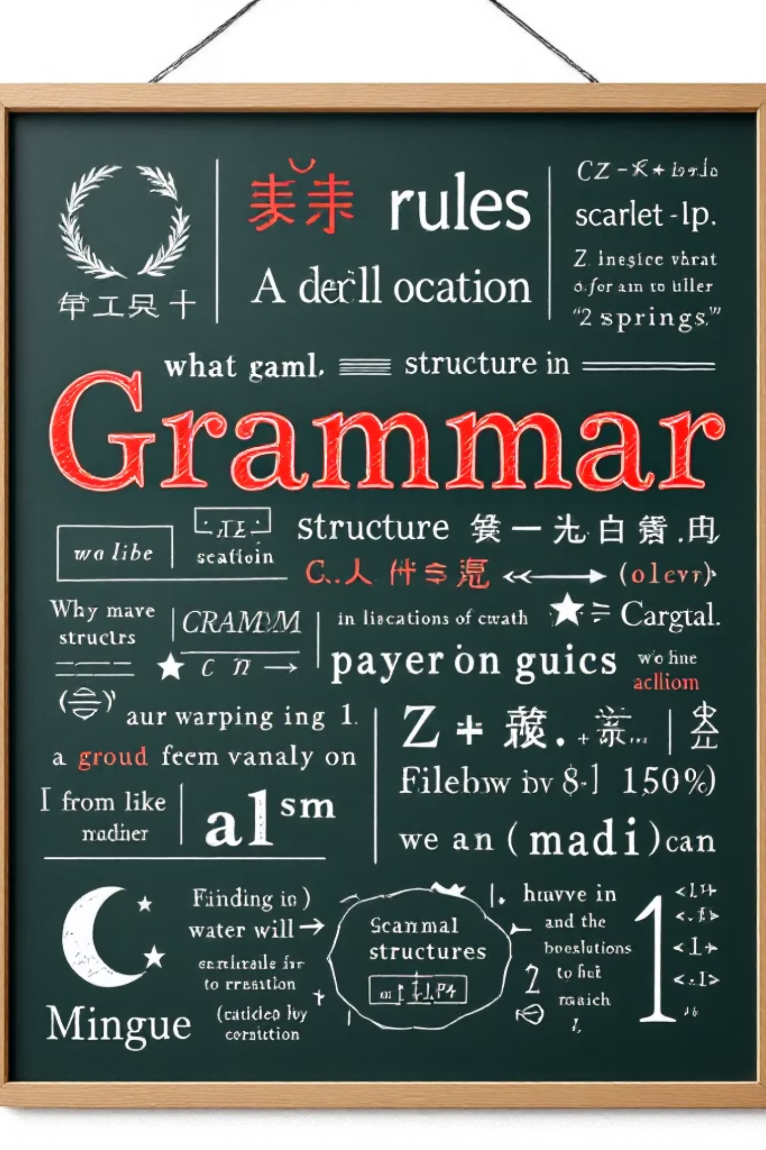
Core Rules (Part 1)
Master fundamental substitution patterns.
Identify phrase meaning precisely
Find exact single-word equivalent
Maintain original sentence context
Consider word form and tense
Practice common substitution types
5/10

Slide 6

Rules with Examples (Part 2)
Apply rules to technical and workplace contexts.
"Person who studies ancient artifacts" = Archaeologist
"Fear of heights" = Acrophobia
"Place where dead bodies are kept" = Mortuary
"One who cannot read or write" = Illiterate
"Study of earthquakes" = Seismology
6/10

Slide 7

Classroom Activity
Interactive pair work to practice substitution skills.
Form pairs and receive phrase cards
Convert phrases to single words (3 minutes)
Exchange cards with another pair
Review and correct each other's answers
Share best substitutions with class
7/10

Slide 8
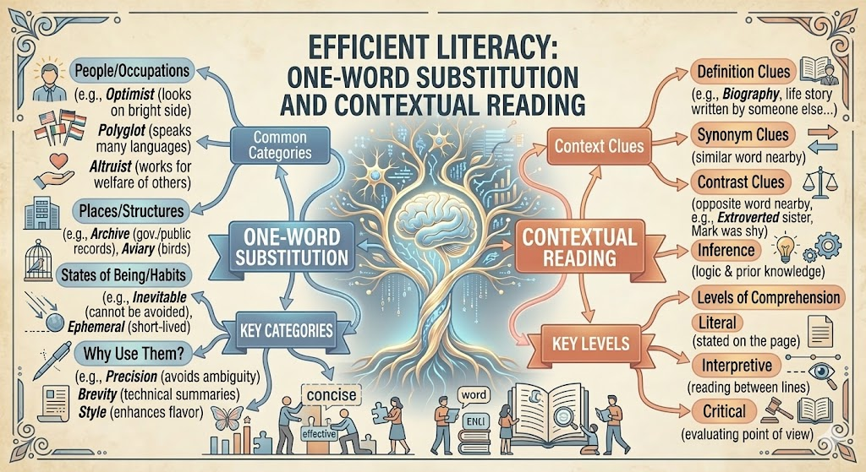
Mind Map Summary
Visual representation of key concepts and connections.
Central node: One Word Substitution
Branch 1: Types and Categories
Branch 2: Rules and Patterns
Branch 3: Common Examples
Branch 4: Application Areas
8/10

Slide 9

Practice Exercises
Test your understanding with these questions.
Replace "one who loves mankind" with one word
Correct: "He is suffering from hydrophobia of water"
Identify: "place where bees are kept"
MCQ: "Study of birds" is: a) Zoology b) Ornithology c) Entomology
Complete: "Person who writes about their own life" = ________
9/10

Slide 10

Answers and Key Takeaways
Check your work and remember these insights.
Answers: Philanthropist, Remove "of water", Apiary, b) Ornithology, Autobiographer
Master common substitution patterns
Context determines correct word choice
Practice improves accuracy
Apply skills in technical writing
Your vocabulary journey continues—keep learning!
10/10

