Slide 1
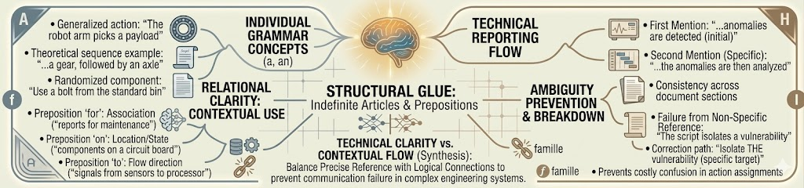
Technical Vocabulary and Synonyms
Recap: Indefinite Articles and Prepositions
Indefinite articles (a, an) introduce non-specific nouns
Prepositions show relationships between words
Common errors include wrong article selection
Preposition choice affects meaning clarity
Today's topic builds on precise word choice
1/10

Slide 2

Design Thinking Alignment
Connecting grammar mastery to the design thinking process
Empathize: Understand communication barriers engineers face
Define: Identify technical vocabulary gaps in your skillset
Ideate: Brainstorm synonym alternatives for precision
Prototype: Practice using technical terms in context
Test: Apply vocabulary in real engineering scenarios
2/10

Slide 3
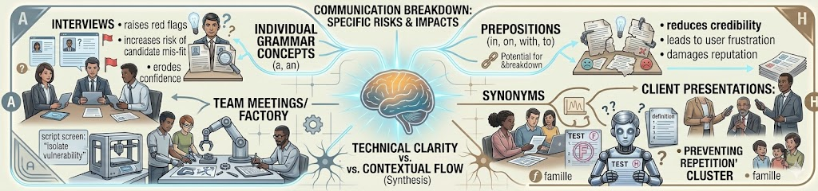
EMPATHY Why This Matters ?
Without strong technical vocabulary, communication breaks down in critical moments
Interviews: Imprecise language raises red flags
Team meetings: Ambiguity causes costly errors
Documentation: Poor word choice reduces credibility
Exams: Vague answers lose points unnecessarily
Client presentations: Unclear terms erode trust
3/10

Slide 4
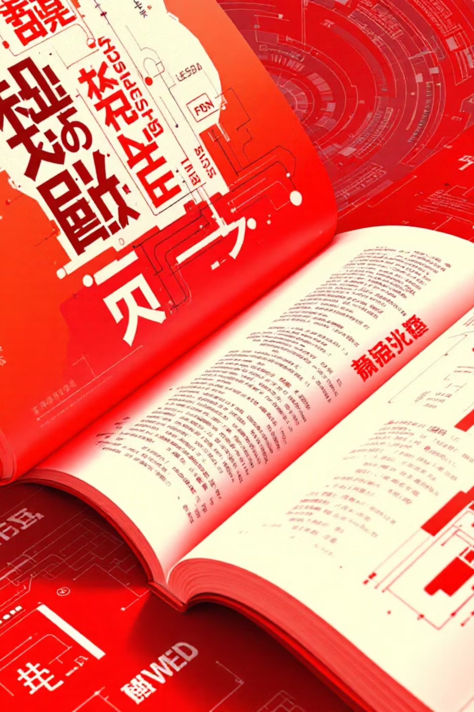
What Are Technical Vocabulary and Synonyms?
Specialized words and their alternatives that convey precise meaning in engineering contexts
Technical vocabulary: Field-specific terminology with exact meanings
Synonyms: Alternative words that maintain technical precision
Used when standard words lack specificity
Essential for clear technical communication
Builds professional credibility
4/10

Slide 5
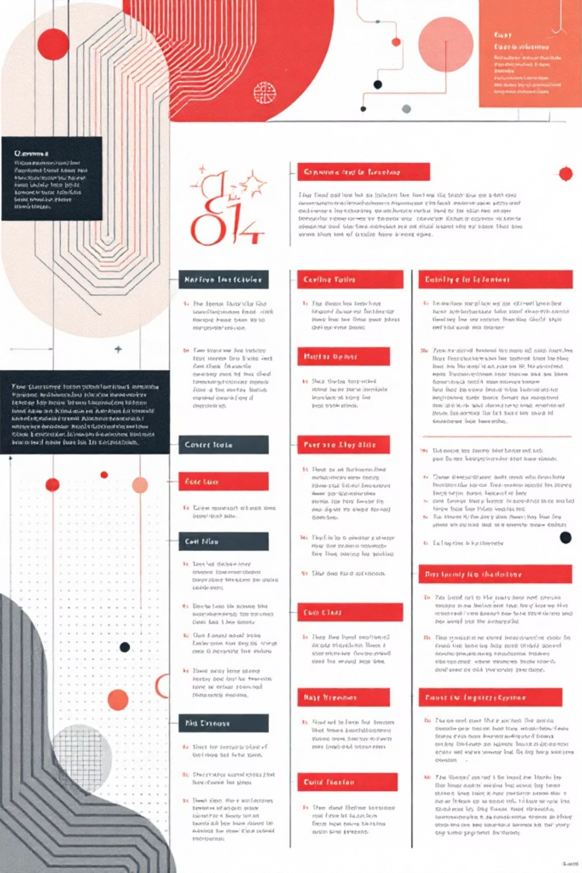
Core Rules: Part 1
Choose the most specific term available for your field
Verify synonyms maintain technical accuracy
Avoid generic replacements that lose precision
Match formality level to audience expectations
Consult field-specific references for verification
5/10

Slide 6

Core Rules: Part 2 with Examples
Example: "The semiconductor malfunctioned" (specific) vs. "The part broke" (vague)
Example: "Calculate stress distribution" (technical) vs. "Figure out pressure" (generic)
Industry jargon varies—know your audience's terminology
Technical writing demands formal register
6/10

Slide 7

Classroom Activity: Precision Challenge
Pair up and transform vague sentences into technical precision
Step 1: Form pairs and receive sentence cards
Step 2: Identify vague terms needing replacement
Step 3: Research precise technical vocabulary
Step 4: Rewrite sentences with accurate terminology
Step 5: Present to class and explain your choices
7/10

Slide 8
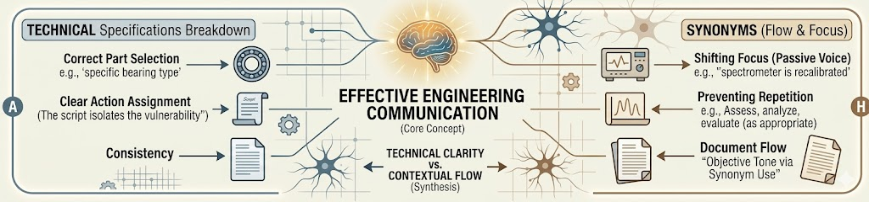
Mind Map: Key Concepts
Technical Vocabulary connects to: specificity, precision, jargon, formal register, field-specific
Synonyms connects to: alternatives, precision, context, accuracy, variety
Application connects to: documentation, presentations, emails, reports, meetings
Resources connects to: glossaries, manuals, journals, textbooks, databases
Practice connects to: writing, speaking, reading, listening, feedback
8/10

Slide 9

Practice Exercises
Test your understanding with these moderate difficulty questions
Fill blank: The _____ measured voltage dropped (device/instrument)
Correct error: "The machine broke" → [technical precision]
MCQ: Which term is most precise? (a) tool (b) torque wrench (c) device
Replace vague: "The system has a problem" with technical vocabulary
Workplace scenario: Write email describing component failure using precise terms
9/10

Slide 10

Answer Key & Key Takeaways
Check your work and remember these essential lessons
Answers: 1-instrument, 2-"component failed," 3-(b), 4-technical term, 5-varies
Technical vocabulary demonstrates engineering competence
Synonyms must preserve precision and meaning
Context determines appropriate terminology
Practice transforms vocabulary into natural skill
Your precise communication shapes your engineering future.
10/10

