Slide 1

SNS COLLEGE OF TECHNOLOGY
An Autonomous Institution Coimbatore-35
DEPARTMENT OF INFORMATION TECHNOLOGY
23ITT304 Information Coding Technique
Unit II
CRC Codes
P.Thilagarani AP/IT
ERROR DETECTION AND CORRECTION

Slide 2


CRC Codes
Ensuring Data Integrity in Digital Communication
12.03.2026 23ITT304-INFORMATION CODING TECHNIQUES | CRC Codes | P.Thilagarani | SNSCT 2/16

Slide 3



Discuss! 🤷‍♀️​ 💁‍♂️​ 💬​
Session Opener
Think about downloading a large file (like a software update or game). If even a single bit of data flips from 0 to 1 during transmission, the file becomes corrupted. How can the receiver possibly know that an error occurred without seeing the original file?
12.03.2026 23ITT304-INFORMATION CODING TECHNIQUES | CRC Codes | P.Thilagarani | SNSCT 3/16

Slide 4
Discuss! 🤷‍♀️​ 💁‍♂️​ 💬​
✅​
You might have said...
Comparison with a known checksum
Redundancy bits added by sender
Mathematical verification
12.03.2026 23ITT304-INFORMATION CODING TECHNIQUES | CRC Codes | P.Thilagarani | SNSCT 4/16

Slide 5
Design Thinking: The Challenge
Empathize
The Persona: Alex, a Network Engineer.
The Need: Alex manages high-speed financial transactions. A single corrupted byte could mean a loss of millions. He needs a way to detect errors instantly without slowing down the network.
Define
The Core Problem:
How do we transmit data efficiently while ensuring 100% detection of common transmission errors?
We need a method that is mathematically rigorous yet computationally fast.
12.03.2026 23ITT304-INFORMATION CODING TECHNIQUES | CRC Codes | P.Thilagarani | SNSCT 5/16

Slide 6
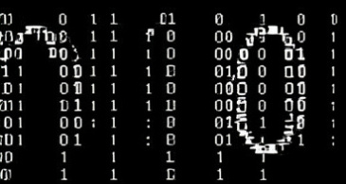

Ideate: The Solution Space
Parity Check
Simple but weak. Only detects odd numbers of bit flips.
CRC (Cyclic Redundancy Check)
Powerful, efficient, and detects burst errors. Uses polynomial division.
12.03.2026 23ITT304-INFORMATION CODING TECHNIQUES | CRC Codes | P.Thilagarani | SNSCT 6/16

Slide 7
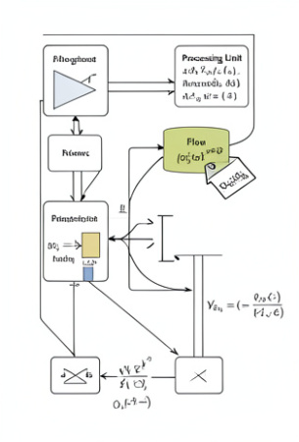
Prototype: How CRC Works
CRC Explained
CRC treats data as a binary number, dividing it by a fixed Generator Polynomial using modulo-2 division (XOR, no carries).
Process:
Append 'n' zeros to data (n = generator degree).
Perform XOR division.
The remainder is the CRC Code (or FCS).
Transmit original data + CRC.
12.03.2026 23ITT304-INFORMATION CODING TECHNIQUES | CRC Codes | P.Thilagarani | SNSCT 7/16

Slide 8
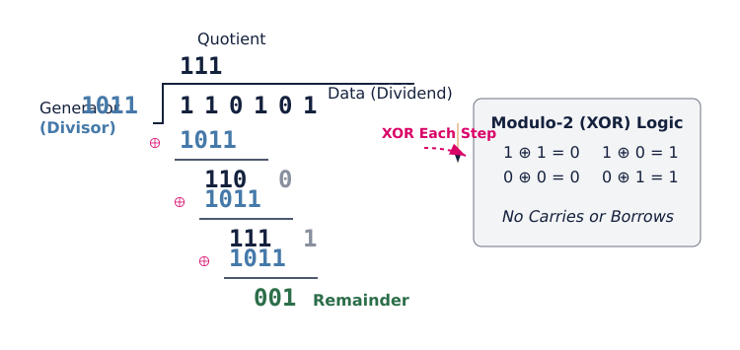
Modulo-2 Division Visualized
12.03.2026 23ITT304-INFORMATION CODING TECHNIQUES | CRC Codes | P.Thilagarani | SNSCT 8/16

Slide 9
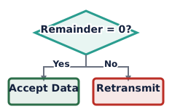
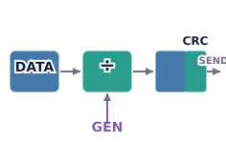
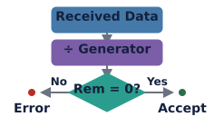
Vertical Depth: Sender & Receiver
Sender Side
Data is divided by the Generator. The remainder is appended to the data and sent.
Receiver Side
The received data (code + data) is divided by the SAME Generator.
Verification
If the remainder is zero, data is accepted. If non-zero, an error is detected.
12.03.2026 23ITT304-INFORMATION CODING TECHNIQUES | CRC Codes | P.Thilagarani | SNSCT 9/16

Slide 10
What's the right order? 🥚​​
Drag the steps to put the CRC generation process in the correct order.
Answers on the next slide...
Start with the original Data message.
Perform Modulo-2 division with the Generator.
Append the remainder to the original data.
Add 'n' zero bits to the end of the data.
12.03.2026 23ITT304-INFORMATION CODING TECHNIQUES | CRC Codes | P.Thilagarani | SNSCT 10/16

Slide 11
What's the right order? 🥚​​
✅​
Drag the steps to put the CRC generation process in the correct order.
Append the remainder to the original data.
1.
Perform Modulo-2 division with the Generator.
2.
Add 'n' zero bits to the end of the data.
3.
Start with the original Data message.
4.
12.03.2026 23ITT304-INFORMATION CODING TECHNIQUES | CRC Codes | P.Thilagarani | SNSCT 11/16

Slide 12
Horizontal Breadth: Applications & Scope
Where is CRC used?
Ethernet & Wi-Fi: Ensures packet integrity at the data link layer.
Storage Devices: Hard drives and SSDs use it to verify data writes.
Zip Files: Verifying that extracted files aren't corrupted.
USB Protocols: Detects errors in high-speed transfers.
Future Scope
As data rates move to 5G and 6G, the complexity of CRC polynomials increases to handle higher noise levels. While newer codes (like LDPC) are used for correction, CRC remains the standard for detection due to its speed.
12.03.2026 23ITT304-INFORMATION CODING TECHNIQUES | CRC Codes | P.Thilagarani | SNSCT 12/16

Slide 13

Summary & Key Takeaways
Mind Map Recap
Empathize: Need for error-free transmission.
Define: Detecting errors efficiently.
Prototype: Binary polynomial division.
Test: Zero remainder = Success.
Key Concepts
CRC is based on Modulo-2 Arithmetic.
It is highly effective at detecting burst errors.
Used widely in Networks (Ethernet) and Storage.
12.03.2026 23ITT304-INFORMATION CODING TECHNIQUES | CRC Codes | P.Thilagarani | SNSCT 13/16

Slide 14
Assessment
Answers on the next slide...
At the receiver end, if the division of the received data by the Generator Polynomial yields a remainder of 0, it means:
1.
The data has errors that need correction.
2.
The data is error-free and accepted.
3.
The Generator polynomial is wrong.
4.
The sender needs to retransmit.
12.03.2026 23ITT304-INFORMATION CODING TECHNIQUES | CRC Codes | P.Thilagarani | SNSCT 14/16

Slide 15
Assessment
✅​
At the receiver end, if the division of the received data by the Generator Polynomial yields a remainder of 0, it means:
1.
The data has errors that need correction.
2.
The data is error-free and accepted.
👍​
3.
The Generator polynomial is wrong.
4.
The sender needs to retransmit.
12.03.2026 23ITT304-INFORMATION CODING TECHNIQUES | CRC Codes | P.Thilagarani | SNSCT 15/16

Slide 16
THANK YOU
12.03.2026 23ITT304-INFORMATION CODING TECHNIQUES | CRC Codes | P.Thilagarani | SNSCT 16/16

