Slide 1


SNS COLLEGE OF TECHNOLOGY
Coimbatore-35
An Autonomous Institution
Department of AIML
23AMO304-Introduction To Business Intelligence
Data Marts &
Analytical Data
Foundations of Business Intelligence & Decision Support
Dr. Angel Latha Mary S
SNS College of Technology | Coimbatore

Slide 2
Strategic Overview
Moving from centralized chaos to departmental intelligence through structured Data Marts.
Analytical Data
Slide 2

Slide 3


What is a Data Mart?
Subject-Oriented
Efficient & Focused
A Data Mart is a subset of a Data Warehouse focused on a specific department, line of business, or subject area like Finance, Marketing, or HR.
Designed for analytical speed, it contains highly curated, structured data optimized for the specific queries of departmental analysts.
"The primary goal is to provide business units with the data they need, when they need it, without the clutter of enterprise-wide tables."
Slide 3

Slide 4
Three Pillars of Mart Architecture
Type | Approach | Source of Data | Best For
Dependent | Top-Down | Enterprise Data Warehouse (EDW) | Large organizations with established EDWs.
Independent | Bottom-Up | Direct from External Sources | Small companies or urgent standalone projects.
Hybrid | Mixed | EDW + External Feeds | Testing new products or ad-hoc data integration.
Data Management
Analytical Data
Slide 4

Slide 5
The Hub-and-Spoke Model
Architecture Layers
Effective data mart deployment follows a logical flow to ensure data integrity across the organization.
Source Layer: Raw data from CRM/ERP systems.
Transformation: Cleaning and subject-tagging.
Storage: Optimized schema deployment.
Architecture Layout
Slide 5

Slide 6






Essential Attributes of Analytical Data
Time-Variant
Integrated
Granularity
Contains a historical flow of data points, allowing for trend analysis over months or years.
Data from disparate sources is unified into a consistent format and naming convention.
Balances high-level summaries with detailed records to support "drill-down" capabilities.
Data Attributes
Slide 6

Slide 7
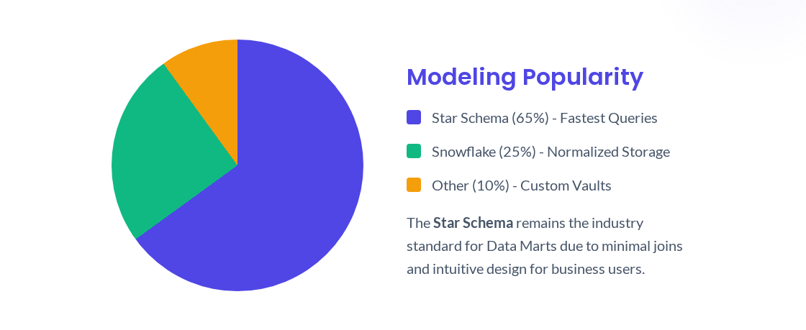
Schema Selection Trends
Modeling & Design
Slide 7

Slide 8
The Analytical Pipeline
Extract
Transform
Load
Analyze
Capturing data from operational databases (OLTP).
Cleaning, de-duplication, and business logic mapping.
Bulk insertion into the subject-specific storage.
End-user discovery via BI tools like PowerBI or Tableau.
ETL Process Flow
Slide 8

Slide 9

Why Deploy Data Marts?
Performance: Queries run up to 10x faster than in cluttered warehouses.
Security: Granular control over who sees sensitive departmental data.
Cost: Implementation is significantly cheaper than an enterprise-wide project.
Agility: Faster response to changing departmental business requirements.
Business Value
Slide 9

Slide 10
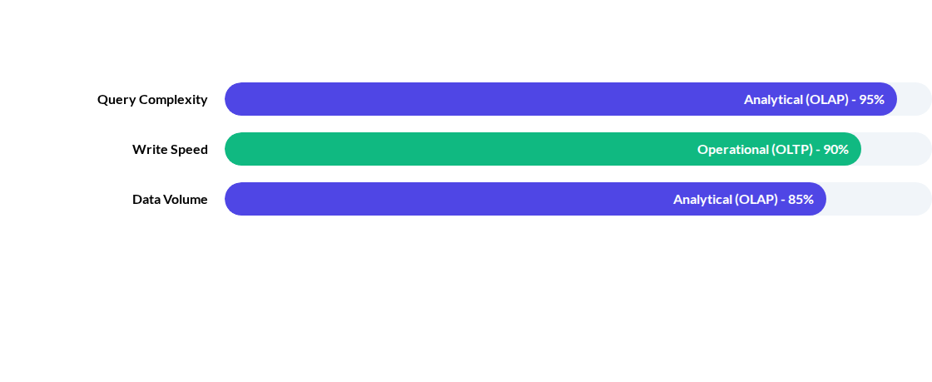
OLTP vs. Analytical OLAP
While OLTP focuses on "running" the business (seconds), OLAP focuses on "analyzing" the business (trends).
System Comparison
Slide 10

Slide 11

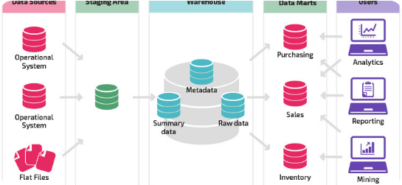

Data Marts in Action
Finance
Marketing
Analyzing quarterly performance and risk management silos.
Tracking customer behavior and campaign ROI in real-time.
Practical Application
Slide 11

Slide 12


Conclusion & Q&A
Any Questions?
Reflect on how your department could benefit from a subject-specific Data Mart.
Thank You
Slide 12

