Slide 1

SNS COLLEGE OF TECHNOLOGY
An Autonomous Institution Coimbatore-35
DEPARTMENT OF INFORMATION TECHNOLOGY
23ITT304 Information Coding Technique
Unit I
Information Theory
Joint and Conditional Entropy
P.Thilagarani AP/IT

Slide 2


Joint and Conditional Entropy
Understanding Information in Combined and Dependent Events
10.01.2026 INFORMATION CODING TECHNIQUE | Joint and Conditional Entropy | P.Thilagarani | SNSCT 2/11

Slide 3


Icebreaker: How Much Do You Know?
Let’s Reflect
Have you ever compressed a file and wondered how much data was truly 'removed'?
Can knowing one event help predict another in communication systems?
Think of a real-life example where two events are linked—like rain and traffic delays.
We’ll build on these ideas to explore how information theory quantifies uncertainty in connected events.
10.01.2026 INFORMATION CODING TECHNIQUE | Joint and Conditional Entropy | P.Thilagarani | SNSCT 3/11

Slide 4

Session Objectives
By the end of this session, you will:
Define joint entropy and conditional entropy in information theory.
Compute both using probability distributions.
Understand their role in data compression and communication.
Apply concepts through real-world examples and group problem-solving.
Connect entropy to broader applications in AI, cryptography, and machine learning.
10.01.2026 INFORMATION CODING TECHNIQUE | Joint and Conditional Entropy | P.Thilagarani | SNSCT 4/11

Slide 5
Design Thinking: Persona & Problem
1
Empathize
Arjun, a data engineer, needs efficient data compression without losing critical variable relationships.
Define
Measuring total uncertainty of two random variables & how one reduces the other's.
2
3
Ideate
Joint/conditional entropy models dependencies, optimizes encoding via variable relationships.
4
Prototype
Predict user behavior from login patterns and device usage.
10.01.2026 INFORMATION CODING TECHNIQUE | Joint and Conditional Entropy | P.Thilagarani | SNSCT 5/11

Slide 6
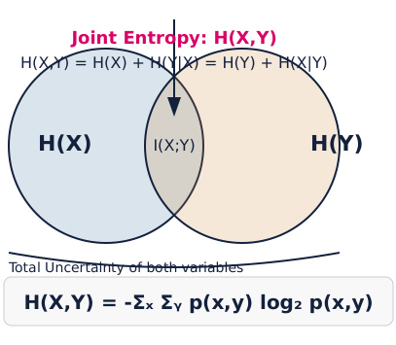
Joint Entropy: Total Uncertainty
10.01.2026 INFORMATION CODING TECHNIQUE | Joint and Conditional Entropy | P.Thilagarani | SNSCT 6/11

Slide 7

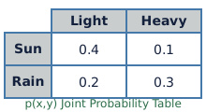
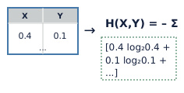
Computing Joint Entropy
Step 1
List all possible outcomes of two variables, like (Weather, Traffic).
Step 2
Build a joint probability table with p(x,y) for each pair.
Step 3
Apply formula: H(X,Y) = – Σ p(x,y) log₂ p(x,y) over all pairs.
10.01.2026 INFORMATION CODING TECHNIQUE | Joint and Conditional Entropy | P.Thilagarani | SNSCT 7/11

Slide 8
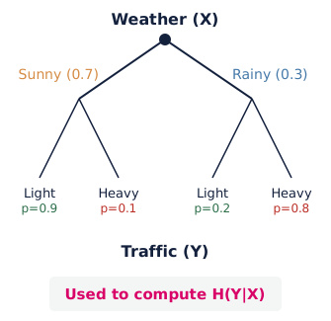
Conditional Entropy: Knowing One, Predicting Another
What Is H(Y|X)?
It measures the average uncertainty in Y when X is known.
Formula: H(Y|X) = Σ p(x) H(Y|X=x)
Real-World Insight
If knowing the weather reduces uncertainty about traffic, then H(Traffic|Weather) < H(Traffic).
This is key in efficient coding—why send full traffic data if weather already tells part of the story?
10.01.2026 INFORMATION CODING TECHNIQUE | Joint and Conditional Entropy | P.Thilagarani | SNSCT 8/11

Slide 9
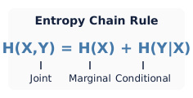


T-Shaped Learning: Depth & Breadth
Vertical Depth
Master entropy formulas, chain rules, and their derivations in information coding.
Interdisciplinary Links
Apply to machine learning (feature selection), cryptography (key entropy), and neuroscience (neural coding).
Future Scope
Quantum information theory uses entropy to measure qubit uncertainty and entanglement.
10.01.2026 INFORMATION CODING TECHNIQUE | Joint and Conditional Entropy | P.Thilagarani | SNSCT 9/11

Slide 10
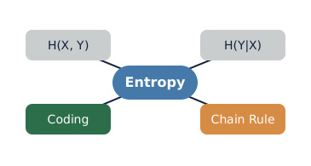

Summary & Takeaways
Reflect & Share
Discuss: Where have you seen dependent events in your work? How could entropy optimize such systems?
Answer: Can conditional entropy be greater than joint entropy? Why/why not?
Key Concepts
Joint Entropy: Total uncertainty of two variables.
Conditional Entropy: Remaining uncertainty when one is known.
Chain Rule: H(X,Y) = H(X) + H(Y|X)
These help design smarter, more efficient codes.
10.01.2026 INFORMATION CODING TECHNIQUE | Joint and Conditional Entropy | P.Thilagarani | SNSCT 10/11

Slide 11
Thank you
10.01.2026 INFORMATION CODING TECHNIQUE | Joint and Conditional Entropy | P.Thilagarani | SNSCT 2/11

