Slide 1
SNS COLLEGE OF TECHNOLOGY
Coimbatore-35
An Autonomous Institution
Department of AIML
23AMO304-Introduction To Business Intelligence
OLAP Fundamentals
Empowering Multidimensional Data Analysis for Strategic Insights
Dr. Angel Latha Mary S
SNS College of Technology | Coimbatore

Slide 2
PART 1
Concepts & Comparisons

Slide 3

Understanding OLAP
The Analytical Engine
OLAP (Online Analytical Processing) is a category of software technology that enables analysts, managers, and executives to gain insight into data through fast, consistent, interactive access to a wide variety of possible views of information.
It provides a multidimensional view of business data, allowing users to analyze it from different perspectives simultaneously.

Slide 4
OLTP vs. OLAP: The Key Differences
Feature | OLTP (Operational) | OLAP (Analytical)
Primary Purpose | Day-to-day transactions | Strategic Decision Making
Data Source | Relational (Single Source) | Data Warehouse (Multiple)
Data Format | Highly Normalized | Multidimensional (Cubes)
Update Frequency | Continuous / Real-time | Periodic (Batch)
Operations | Insert, Update, Delete | Complex Read-only Queries

Slide 5

The OLAP Cube
Multidimensional Reality
The core of OLAP is the Cube, a data structure that allows for fast analysis of data across multiple dimensions.
•
Measures: Numerical values (e.g., Sales, Profit).
•
Dimensions: Categorical attributes (e.g., Time, Location, Product).
•
Cells: The intersection of dimensions containing the measure.

Slide 6
PART 2
Operations & Architecture

Slide 7




Navigating Hierarchy: Roll-Up & Drill-Down
Roll-Up
Drill-Down
Summarizes data by climbing up a hierarchy or reducing dimensions. (e.g., viewing sales by Country instead of by City).
Navigates from less detailed data to more detailed data. (e.g., moving from Year to Month view).

Slide 8



Focusing the View: Slice, Dice & Pivot
Slice
Dice
Pivot
Pick a single value for one dimension to create a 2D view. (e.g., Sales for "Q1" only).
Select sub-cubes by picking specific values from multiple dimensions. (e.g., "Mobiles" in "Delhi" during "Q1").
Rotating the data axes to view information from a new perspective. (e.g., swapping Rows and Columns).

Slide 9
OLAP Architecture Variants
Architecture | Storage Mode | Performance | Ideal For...
MOLAP | Multidimensional (Cube) | Very Fast (Precalculated) | Predictable, small-to-mid data
ROLAP | Relational (Tables) | Standard (Calculated live) | Huge volumes of detailed data
HOLAP | Hybrid (Mixed) | Optimized / Balanced | Flexible business requirements

Slide 10
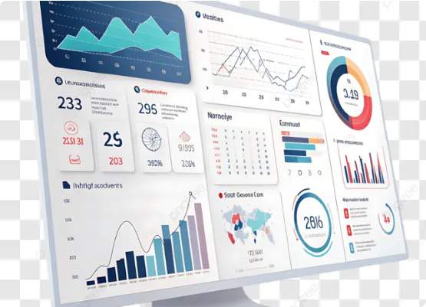
The Business Value of OLAP
Why Businesses Invest?
Consistency of Logic
Self-Service BI
Rapid Query Response
Advanced Modeling (What-if analysis)

Slide 11


Puzzle 1: The Operation Challenge
Mystery Scenario:
"A Manager is looking at total global sales. She clicks on 'India' to see sales broken down by 'New Delhi', 'Mumbai', and 'Bangalore'."
Q: Which OLAP operation did she just perform?
1.
Roll-Up
2.
Pivot
3.
Drill-Down
4.
Slice
(Answer: Drill-Down — navigating from summary to more detailed data!)

Slide 12




Puzzle 2: The "Cube" Logic
True or False?
"In a Slice operation, the resulting data structure has the same number of dimensions as the original cube."
Is this statement True or False?
(Answer: False! Slicing reduces the dimensionality by selecting a single value for one dimension.)

