Slide 1


Shannon–Fano Coding
Understanding Data Compression Through Information Theory

Slide 2


Recap & Icebreaker
Quick Recall
What is binary encoding?
Why do we compress data?
Have you ever seen a .ZIP or .MP3 file?
Think-Pair-Share
Discuss: 'Can you send a 1GB video in just 100MB without losing quality?'
Explore how information theory makes this possible.

Slide 3

Session Objectives
By the end of this session, you will be able to:
Explain the principles of Shannon–Fano coding
Apply the algorithm to encode simple messages
Compare it with other compression techniques
Understand its role in modern data transmission
Reflect on its real-world limitations and uses

Slide 4
Design Thinking: Empathize & Define
Empathize: Meet Riya
Riya is a telecom engineer in Bangalore. She handles large volumes of customer call data daily. Network bandwidth is limited, costs are high, and delays affect service.
Her pain point: Transmitting raw data is slow and expensive.
Define: The Core Problem
How can we reduce the size of digital messages efficiently—without losing information—so they can be transmitted faster and cheaper?
This is the challenge Shannon–Fano coding helps solve: efficient, lossless data compression.

Slide 5
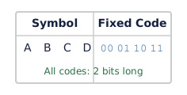
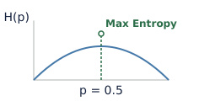
Ideate: Approaches to Compression
Variable-Length Codes
Frequent symbols get shorter codes. Saves space. Basis of Huffman and Shannon–Fano coding.
Fixed-Length Codes
Each symbol uses same number of bits (e.g., ASCII). Simple but inefficient for frequent symbols.
Entropy-Based Coding
Uses probability of symbols. Optimal when code length matches information content (log₂(1/p)).

Slide 6
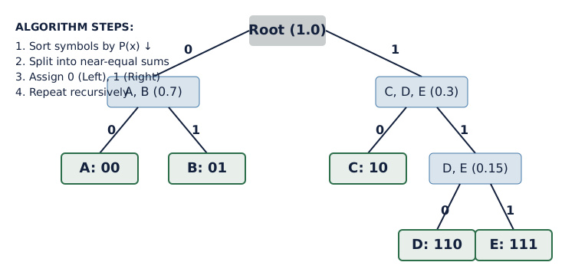
Prototype: Shannon–Fano Algorithm

Slide 7
T-Shaped Learning: Depth & Breadth
Vertical Depth
Based on information entropy (H = Σ pᵢ log₂(1/pᵢ))
Prefix-free codes ensure unambiguous decoding
Suboptimal compared to Huffman but foundational
Average code length close to entropy
Horizontal Breadth
Used in early fax compression and telemetry
Link to ZIP, MP3, JPEG (conceptual foundation)
Applications in IoT, satellite communication
Foundation for AI data preprocessing pipelines

Slide 8




Real-World Connections
Space Data
NASA uses similar methods to transmit images from Mars.
Archives
Preserves historical records efficiently in digital libraries.
Telecom
Reduces call log size for faster transfer between towers.
Streaming
Helps compress metadata for faster video loading.

Slide 9
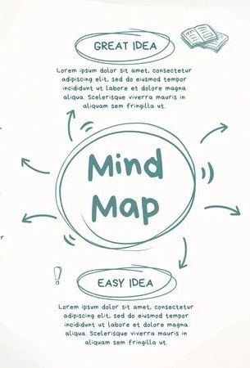
Summary Mind Map
1
Core Idea
Assign shorter codes to more frequent symbols using probability splits.
2
Key Steps
Sort, split, assign 0/1, recurse—build prefix codes top-down.
3
Efficiency
Average length near entropy; less optimal than Huffman coding.
4
Legacy
Paved way for modern compression used in files, audio, and networks.

Slide 10

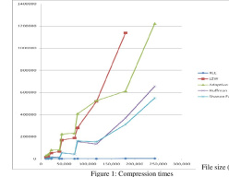
Discuss! 🤷‍♀️​ 💁‍♂️​ 💬​
Why Would You Choose One Code Over Another?
Why do you think Shannon–Fano coding is less widely used today compared to Huffman coding? Can you think of situations where it might still be a good choice?

Slide 11
Discuss! 🤷‍♀️​ 💁‍♂️​ 💬​
✅​
You might have said...
Huffman coding usually gives a more efficient code, so it's better for saving space.
Shannon–Fano is simpler to implement, so it might be useful for quick prototypes or in systems with very limited resources.
It's good in educational settings to teach basic ideas of compression and entropy.

Slide 12
Shannon–Fano Facts
Answers on the next slide...
Which of the following statements accurately describe Shannon–Fano coding? Select all that apply.
1.
It uses fixed-length codes for all symbols to ensure uniformity.
2.
It assigns shorter codes to more frequent symbols using a top-down approach based on probabilities.
3.
It recursively splits the symbol list into two parts with approximately equal total probabilities.
4.
It creates prefix-free codes, meaning no code is a prefix of another, enabling unambiguous decoding.

Slide 13
Shannon–Fano Facts
✅​
Which of the following statements accurately describe Shannon–Fano coding? Select all that apply.
1.
It uses fixed-length codes for all symbols to ensure uniformity.
2.
It assigns shorter codes to more frequent symbols using a top-down approach based on probabilities.
👍​
3.
It recursively splits the symbol list into two parts with approximately equal total probabilities.
👍​
4.
It creates prefix-free codes, meaning no code is a prefix of another, enabling unambiguous decoding.
👍​

