Slide 1

SNS COLLEGE OF TECHNOLOGY
An Autonomous Institution Coimbatore-45
DEPARTMENT OF INFORMATION TECHNOLOGY
23ITT304 Information Coding Technique
Unit IV
SYNDROME DECODING
P.Thilagarani AP/IT
LINEAR BLOCK CODES AND CYCLIC CODES

Slide 2

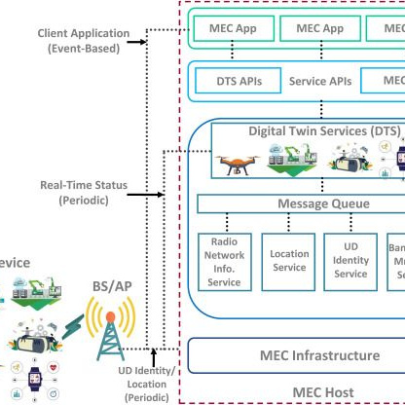
SYNDROME DECODING
Efficient Error Correction for Data Transmission
12.05.2026 23ITT304-INFORMATION CODING TECHNIQUES | SYNDROME DECODING | P.Thilagarani | SNSCT 2/14

Slide 3


RECALL & CONNECTION
STARTER
Before we dive in, let us recall: Linear Block Codes use parity check bits to ensure data integrity.
Icebreaker: If you were sending a vital bank transfer and one bit flipped from '0' to '1', how would the receiver know it wasn't valid?
🔑
Key point
The objective today is to master the 'Syndrome'— the fingerprint that identifies exactly where an error occurred.
12.05.2026 23ITT304-INFORMATION CODING TECHNIQUES | SYNDROME DECODING | P.Thilagarani | SNSCT 3/14

Slide 4

EMPATHIZE: THE PERSONA
Meet Rohan, Network Engineer
Rohan works at a 5G infrastructure firm in Bangalore. His system receives millions of packets per second.
The Pain Point: Comparing received vectors to every single valid codeword (Minimum Distance Decoding) is too slow. He needs a shortcut to find errors without exhaustive searching.
Example
The 'Define' phase: How can we identify errors instantly using only the Parity Check Matrix (H)?
12.05.2026 23ITT304-INFORMATION CODING TECHNIQUES | SYNDROME DECODING | P.Thilagarani | SNSCT 4/14

Slide 5
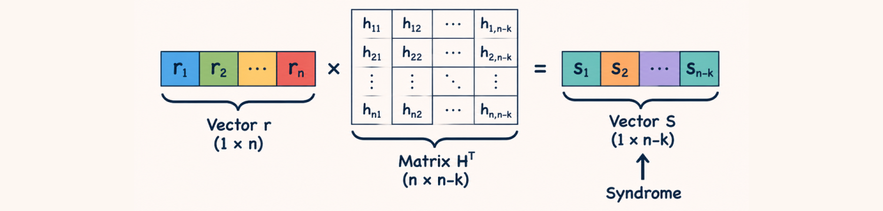
THE IDEATE PHASE: THE SYNDROME
Instead of checking every codeword, we calculate the Syndrome (S) using the received vector r and the transpose of the Parity Check Matrix H.
Why it works:
If S = 0, the received vector is a valid codeword. If S ≠ 0, an error has occurred!
12.05.2026 23ITT304-INFORMATION CODING TECHNIQUES | SYNDROME DECODING | P.Thilagarani | SNSCT 5/14

Slide 6
PROTOTYPE: DECODING STEPS
12.05.2026 23ITT304-INFORMATION CODING TECHNIQUES | SYNDROME DECODING | P.Thilagarani | SNSCT 6/14

Slide 7
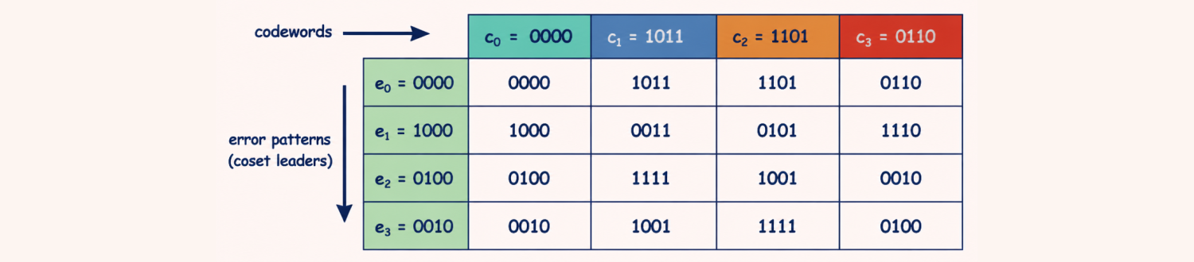
VERTICAL DEPTH: MATHEMATICAL RIGOR
The Properties
The syndrome depends only on the error pattern, not the sent codeword.
For a single error in position i, the syndrome will be identical to the i-th column of H.
🧠
Remember
If two different error patterns yield the same syndrome, they belong to the same 'Coset'. We always choose the 'Coset Leader' with the minimum weight.
12.05.2026 23ITT304-INFORMATION CODING TECHNIQUES | SYNDROME DECODING | P.Thilagarani | SNSCT 7/14

Slide 8

HORIZONTAL BREADTH: APPLICATIONS
Where is it used?
Deep Space: Voyager 1 uses variations of this to send photos across the solar system.
QR Codes: Error correction allows you to scan a damaged or partially covered code.
RAM: ECC (Error Correction Code) memory in servers uses syndrome-style checks to prevent crashes.
FUTURE SCOPE
Quantum Error Correction uses 'Stabilizer Codes', which are quantum versions of syndrome decoding.
12.05.2026 23ITT304-INFORMATION CODING TECHNIQUES | SYNDROME DECODING | P.Thilagarani | SNSCT 8/14

Slide 9
TEST: THE DECODING SEQUENCE
Answers on the next slide...
Arrange the steps of the Syndrome Decoding process in the correct order for a received vector 'r'.
Extract data bits from the corrected codeword v
Compute Syndrome S = r · Hᵀ
Subtract/XOR the Error Pattern from r (v = r - e)
Identify the Error Pattern (e) corresponding to S
12.05.2026 23ITT304-INFORMATION CODING TECHNIQUES | SYNDROME DECODING | P.Thilagarani | SNSCT 9/14

Slide 10
TEST: THE DECODING SEQUENCE
✅​
Arrange the steps of the Syndrome Decoding process in the correct order for a received vector 'r'.
Compute Syndrome S = r · Hᵀ
1.
Identify the Error Pattern (e) corresponding to S
2.
Subtract/XOR the Error Pattern from r (v = r - e)
3.
Extract data bits from the corrected codeword v
4.
12.05.2026 23ITT304-INFORMATION CODING TECHNIQUES | SYNDROME DECODING | P.Thilagarani | SNSCT 10/14

Slide 11

SUMMARY MIND MAP
12.05.2026 23ITT304-INFORMATION CODING TECHNIQUES | SYNDROME DECODING | P.Thilagarani | SNSCT 11/14

Slide 12


REFLECT & APPLY
Imagine you are designing a communication system for a high-interference industrial plant in Pune. If the noise is so high that two bits flip simultaneously, but your Syndrome Decoding only targets single-bit errors, what happens to the data? How would you solve this?
12.05.2026 23ITT304-INFORMATION CODING TECHNIQUES | SYNDROME DECODING | P.Thilagarani | SNSCT 12/14

Slide 13
REFLECT & APPLY
✅​
You might have said...
The syndrome points to a 'false' single-bit error, causing a corrupted message.
We must increase the 'minimum distance' by adding more parity bits.
We must expand the Syndrome Table to include two-bit error patterns.
12.05.2026 23ITT304-INFORMATION CODING TECHNIQUES | SYNDROME DECODING | P.Thilagarani | SNSCT 13/14

Slide 14
Thank You
12.05.2026 23ITT304-INFORMATION CODING TECHNIQUES | SYNDROME DECODING | P.Thilagarani | SNSCT 2/14

