Slide 1


SNS COLLEGE OF TECHNOLOGY
An Autonomous Institution
Coimbatore-35
Department of Computer Science & Engineering
23ITT202 – Object Oriented Programming
II B.E CSE/ III SEMESTER
UNIT V : IO STREAMS AND JAVASCRIPT
Topic 4 : Object Serialization & Deserialization

Slide 2
Topics for Discussion
Serialization
Deserialization
Serialization Interface
Example
Importance
OOPS\ Object Oriented Programming \ Dr.A.Sumithra \ SNSCT
02/13

Slide 3
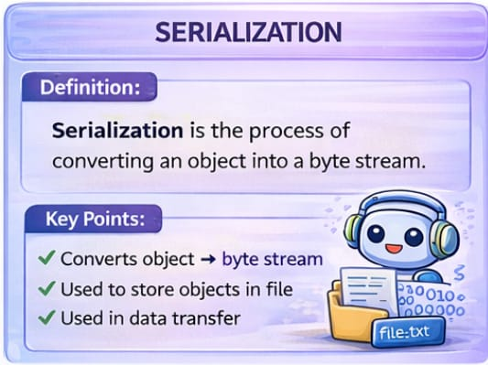
OOPS\ Object Oriented Programming \ Dr.A.Sumithra \ SNSCT
03/13

Slide 4
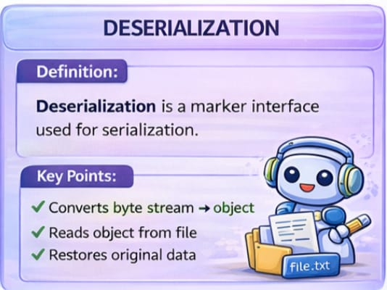
OOPS\ Object Oriented Programming \ Dr.A.Sumithra \ SNSCT
04/13

Slide 5
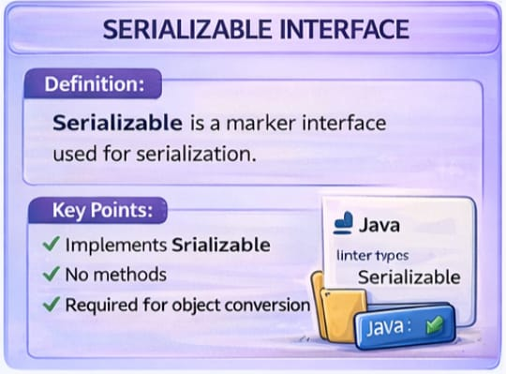
OOPS\ Object Oriented Programming \ Dr.A.Sumithra \ SNSCT
05/13

Slide 6
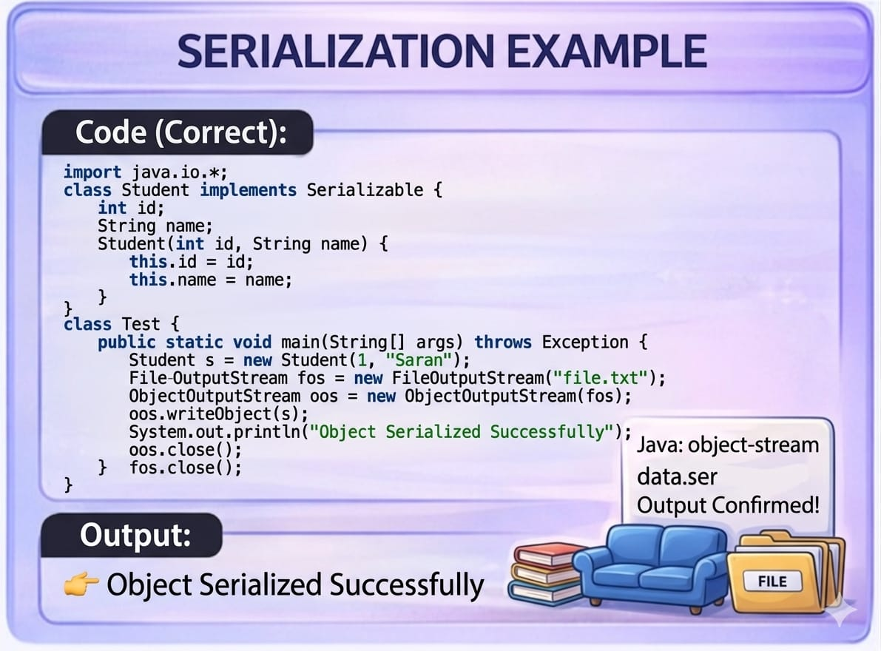
OOPS\ Object Oriented Programming \ Dr.A.Sumithra \ SNSCT
06/13

Slide 7
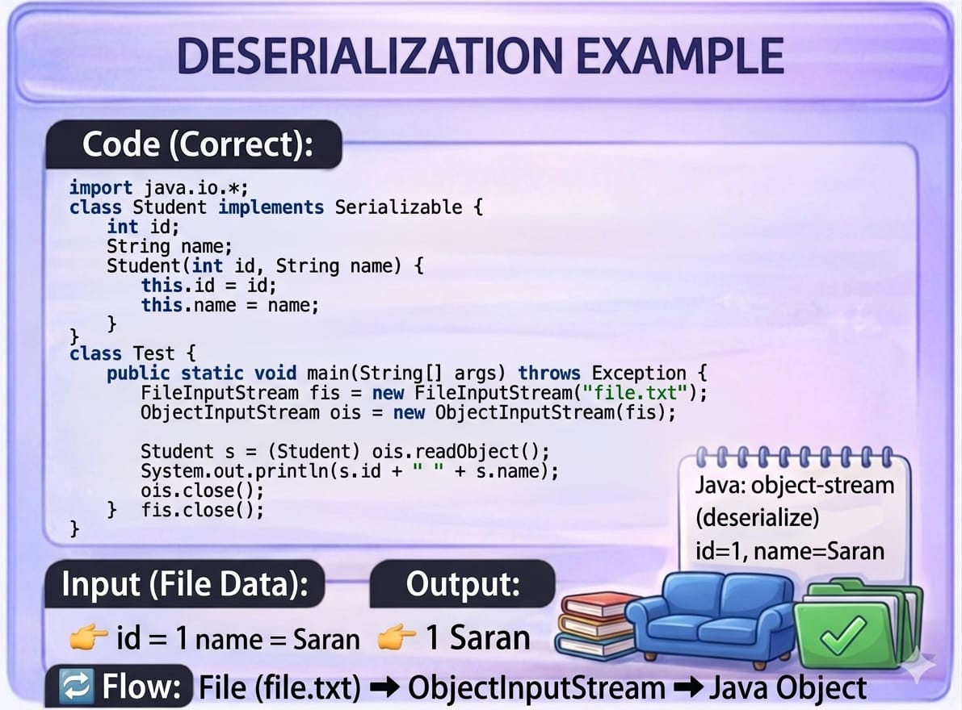
Output:
OOPS\ Object Oriented Programming \ Dr.A.Sumithra \ SNSCT
07/13

Slide 8
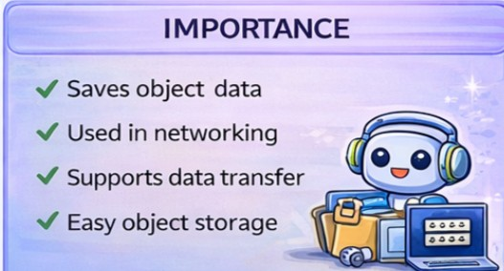
OOPS\ Object Oriented Programming \ Dr.A.Sumithra \ SNSCT
08/13

Slide 9
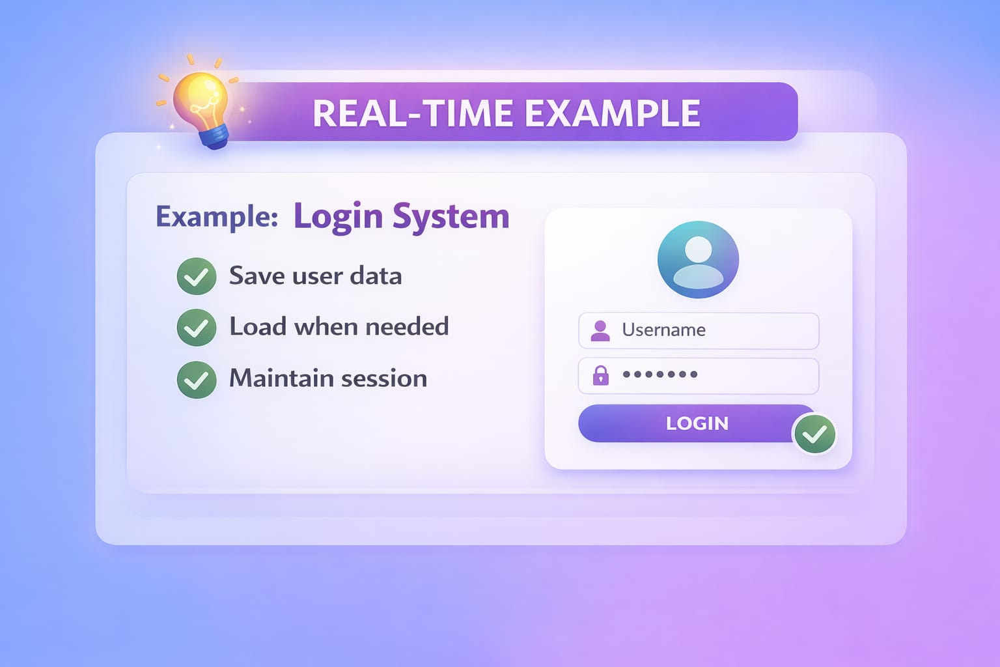
OOPS\ Object Oriented Programming \ Dr.A.Sumithra \ SNSCT
09/13

Slide 10
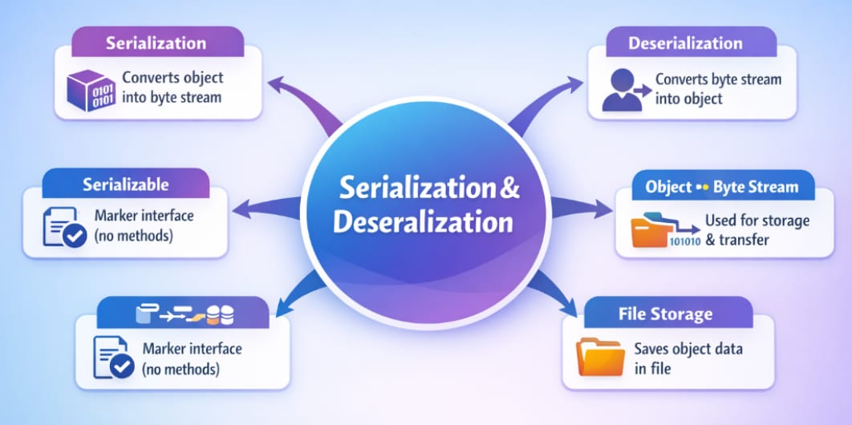
Mind Map
OOPS\ Object Oriented Programming \ Dr.A.Sumithra \ SNSCT
10/13

Slide 11
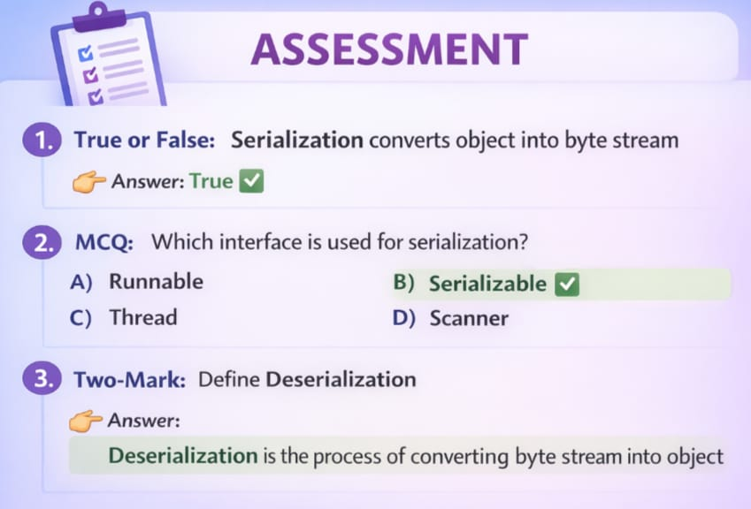

OOPS\ Object Oriented Programming \ Dr.A.Sumithra \ SNSCT
11/13

Slide 12
References
https://www.javatpoint.com/serialization-in-java
https://docs.oracle.com/javase/tutorial/jndi/objects/serial.html
https://www.w3schools.com/java/java_io.asp
OOPS\ Object Oriented Programming \ Dr.A.Sumithra \ SNSCT
12/13

Slide 13

OOPS\ Object Oriented Programming \ Dr.A.Sumithra \ SNSCT
13/13

