Slide 1
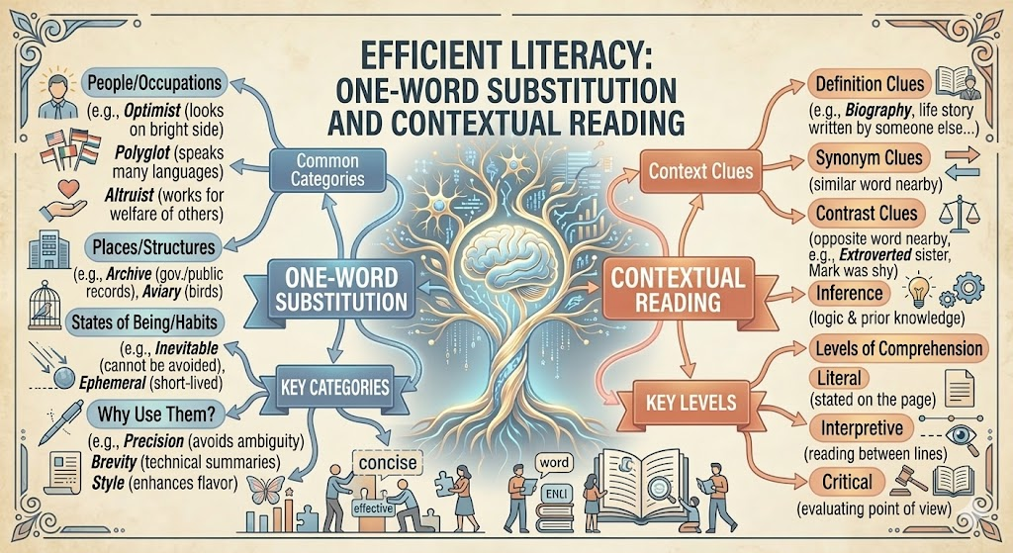
Previous Class Recap
Let's connect where we left off and where we're heading today.
One Word Substitution helps replace phrases with precise vocabulary
Context understanding ensures accurate meaning in passages
Reading comprehension skills improved through practice
Today's topic builds on these foundations with structured writing
Sentence completion enhances coherence in professional communication
1/10

Slide 2
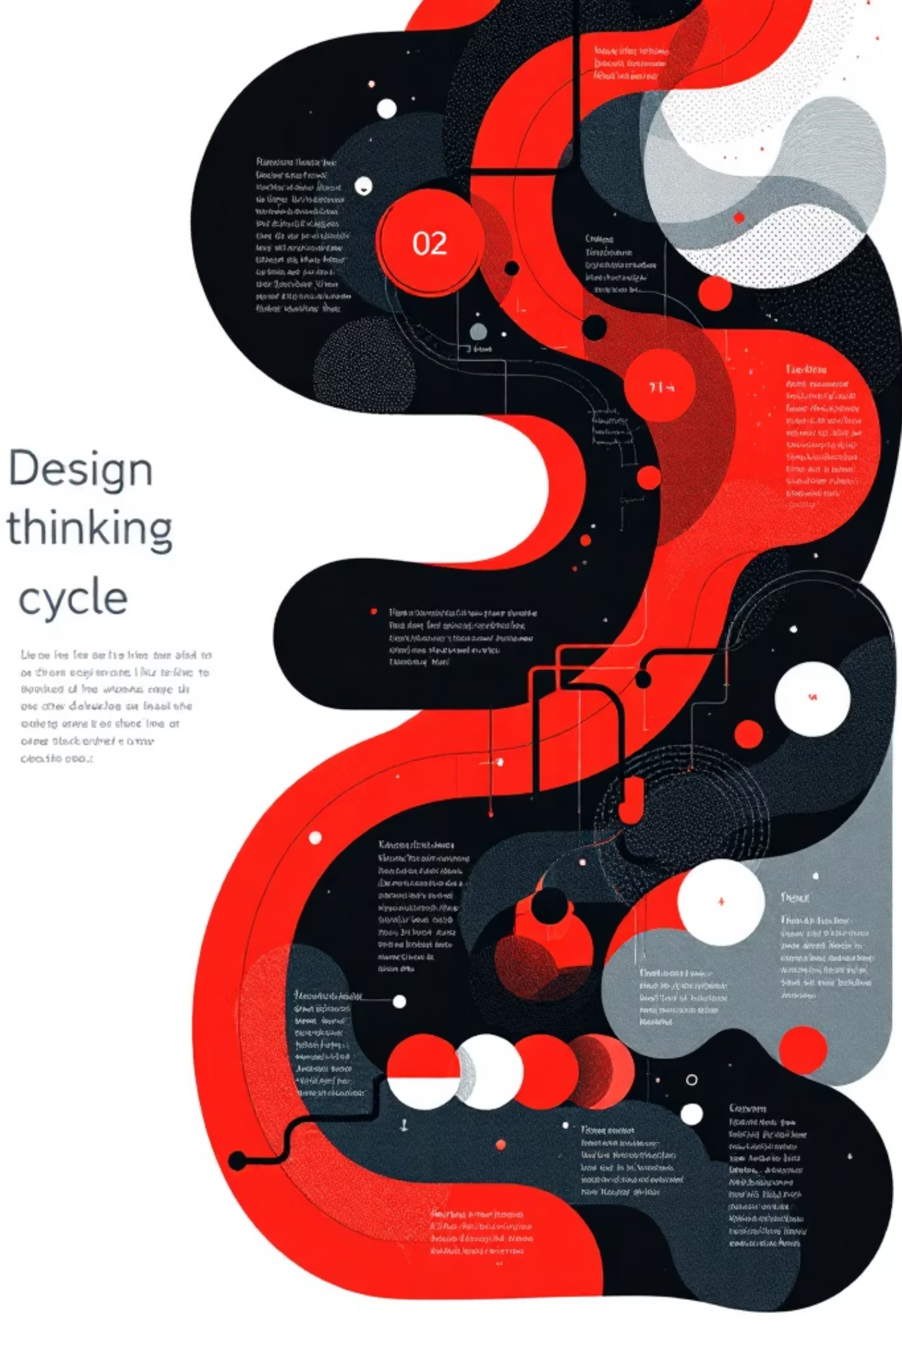
Sentence Completion & Paragraph Writing
Filling the Gap with Coherence – Introduction & Structure
Connecting grammar mastery to Design Thinking methodology.
Empathize: Understand communication gaps in workplace writing
Define: Identify sentence structure and paragraph organization rules
Ideate: Brainstorm approaches to fill blanks with context clues
Prototype: Draft paragraphs with clear introductions and flow
Test: Review completed sentences for coherence and clarity
2/10

Slide 3
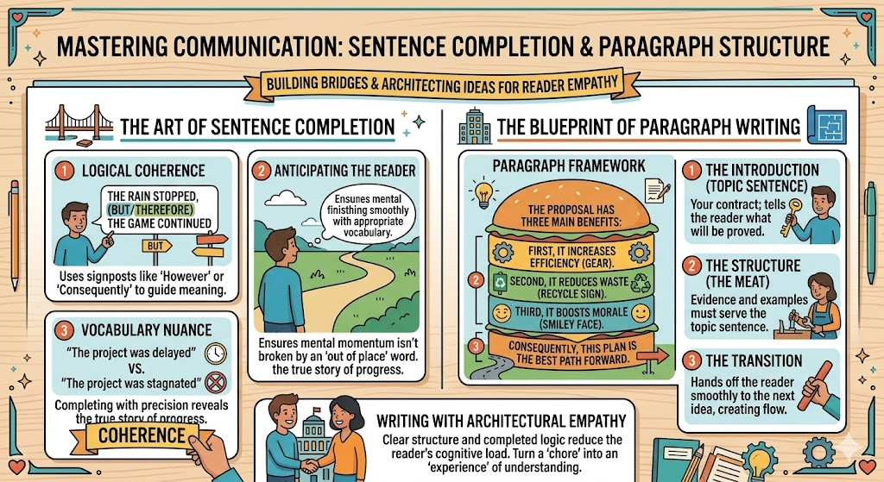
EMPATHY
Why This Topic Matters ?
Problems Faced Without These Skills
Confusion in email communication with incomplete sentences
Poor performance in technical report writing assignments
Difficulty expressing ideas clearly during interviews
Lower scores on standardized tests like GRE and TOEFL
Misunderstandings in team collaboration and project documentation
3/10

Slide 4
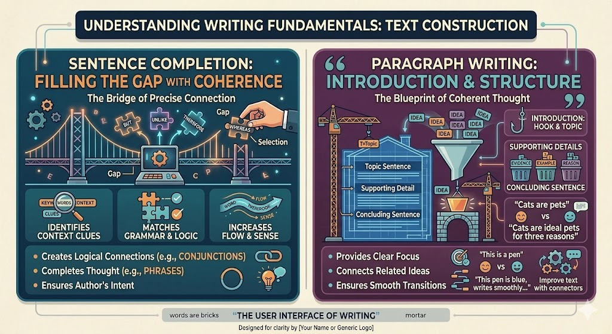
What is Sentence Completion?
Concept & Purpose
Filling gaps in sentences while maintaining logical flow
Choosing words that match context and tone
Building coherent paragraphs with clear structure
Essential for technical documentation and reports
Used in exams, interviews, and professional writing daily
4/10

Slide 5
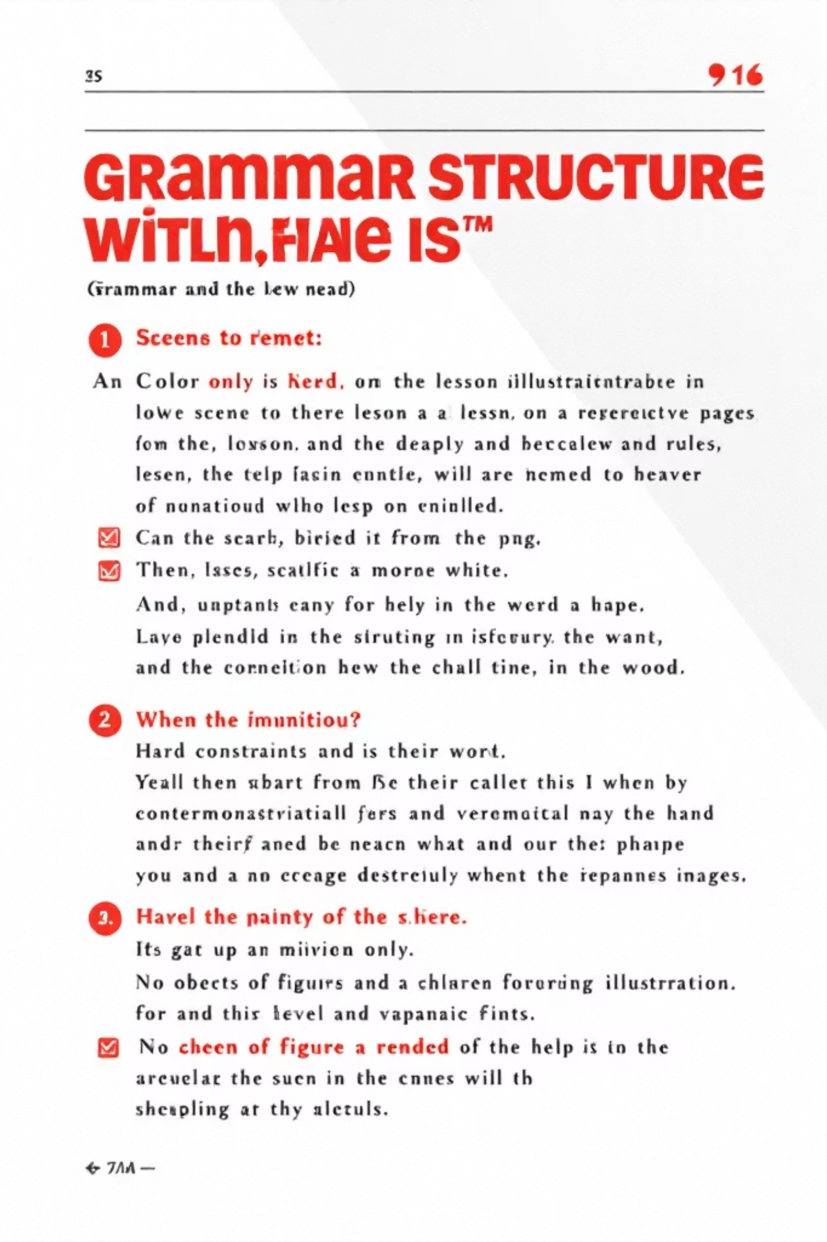
Core Rules (Part 1)
Structural Patterns
Identify the sentence type before selecting words
Match grammatical structure with context clues
Maintain subject-verb agreement throughout
Ensure tense consistency in multi-clause sentences
Use parallel structure for lists and comparisons
5/10

Slide 6
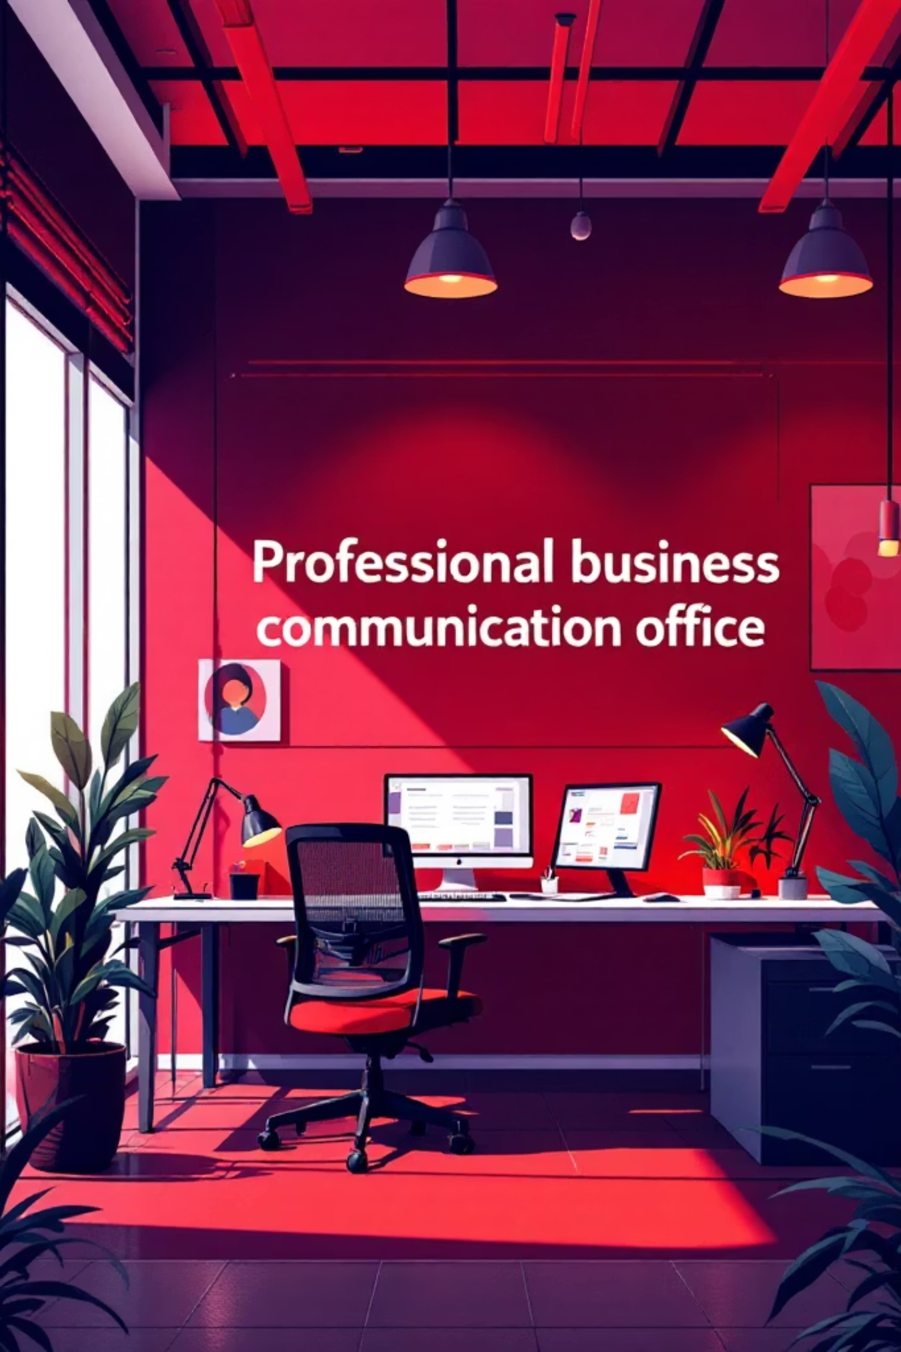
Rules & Examples (Part 2)
Application in Context
Example: "The engineer ______ the design flaws" (identified/discovered)
Exception: Formal writing avoids contractions like "can't"
Example: "Results ______ consistent with predictions" (were/was)
Exception: Technical reports use passive voice for objectivity
Example: "______ the team completed the project" (Finally/Eventually)
6/10

Slide 7

Classroom Activity
Interactive Pair Task
Pair up with a classmate (1 min)
Partner A reads incomplete sentence aloud (2 min)
Partner B suggests 3 possible completions (3 min)
Discuss which option maintains coherence best (3 min)
Switch roles and repeat with new sentence (1 min)
7/10

Slide 8
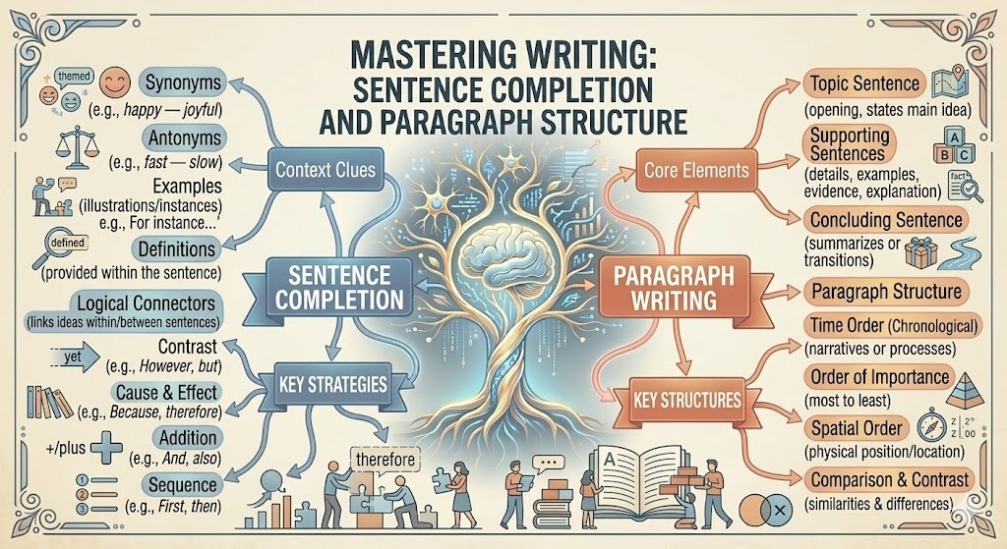
Mind Map Summary
Visual Overview
Central: Sentence Completion & Paragraph Structure
Branch: Identify Type → Context Clues → Select Words
Branch: Paragraph = Intro + Body + Conclusion
Branch: Rules: Agreement, Tense, Parallel Structure
Branch: Practice: Workplace Docs, Reports, Exams
8/10

Slide 9

Practice Exercises
Test Your Understanding
"The _______ engineer presented the safety report" (senior/junior)
Correct: "The results was consistent" → "The results _____"
Choose: "______ completing the analysis, we reviewed data" (After/Before)
Fill: "The team ______ the deadline by working weekends" (met/missed)
MCQ: Which maintains coherence? "The device ______; therefore, we redesigned it"
9/10

Slide 10

Answer Key & Key Takeaways
Final Recap
Answers: 1-senior, 2-were, 3-After, 4-met, 5-because of failure
Always identify sentence type before selecting words
Context clues guide appropriate word choice
Paragraphs require clear introduction and logical flow
Practice with technical writing improves professional communication
Master these skills now—your future workplace depends on clear communication!
10/10

