Slide 1


Unlocking Insights: A Journey into 3D Plotting
From flat charts to immersive visualizations — explore the tools and techniques that bring data to life in three dimensions.

Slide 2

Why 3D Plotting? Beyond the Flat World
Complex Relationships
Patterns & Outliers
3D plots expose clusters, trends, and anomalies that flat charts simply cannot capture.
Visualize interactions between three variables — x, y, and z — simultaneously, revealing structure hidden in 2D projections.
Real-World Impact
Essential in scientific research, engineering simulations, medical imaging, and modern data analysis workflows.

Slide 3
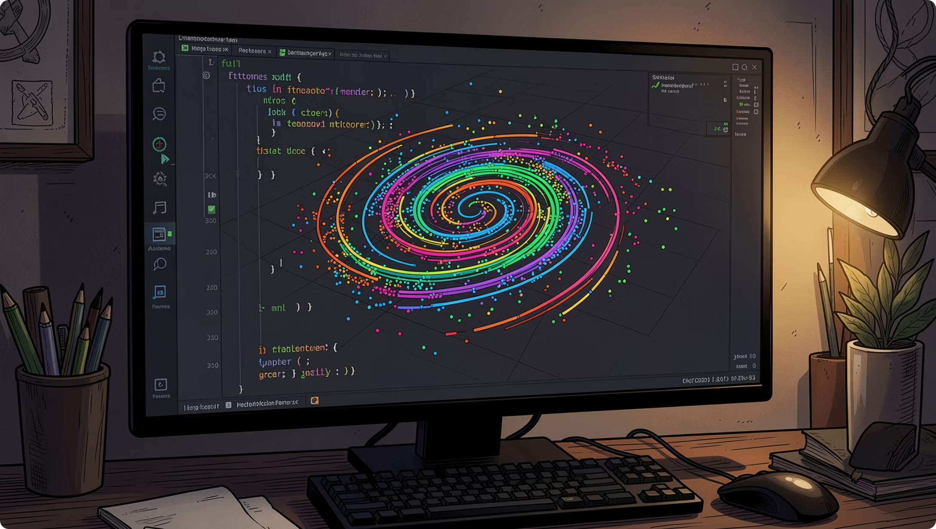
Matplotlib: The Foundation of 3D Visualization
Getting Started with mplot3d
Matplotlib's mpl_toolkits.mplot3d module is the entry point for 3D graphics in Python. Import it, create a 3D axis, and start plotting.
ax.plot3D() — Draw 3D line plots, such as spirals and parametric curves
ax.scatter() — Render 3D scatter plots with customizable markers
ax.set_xlabel(), set_ylabel(), set_zlabel() — Label each axis

Slide 4
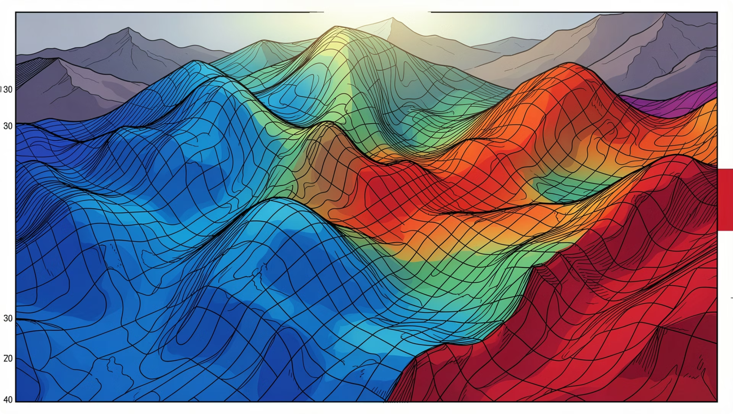
Matplotlib: Surfaces and Contours in 3D
Going Beyond Points and Lines
Surface plots model continuous functions across a 2D domain, while contour plots reveal level sets — both critical for terrain modeling and optimization.
plot_surface()
plot_wireframe()
Hillshading
Renders a smooth colored surface from a 2D grid of z-values.
Draws a mesh grid outlining the surface geometry.
Simulates lighting on surfaces for a realistic, topographic effect.

Slide 5
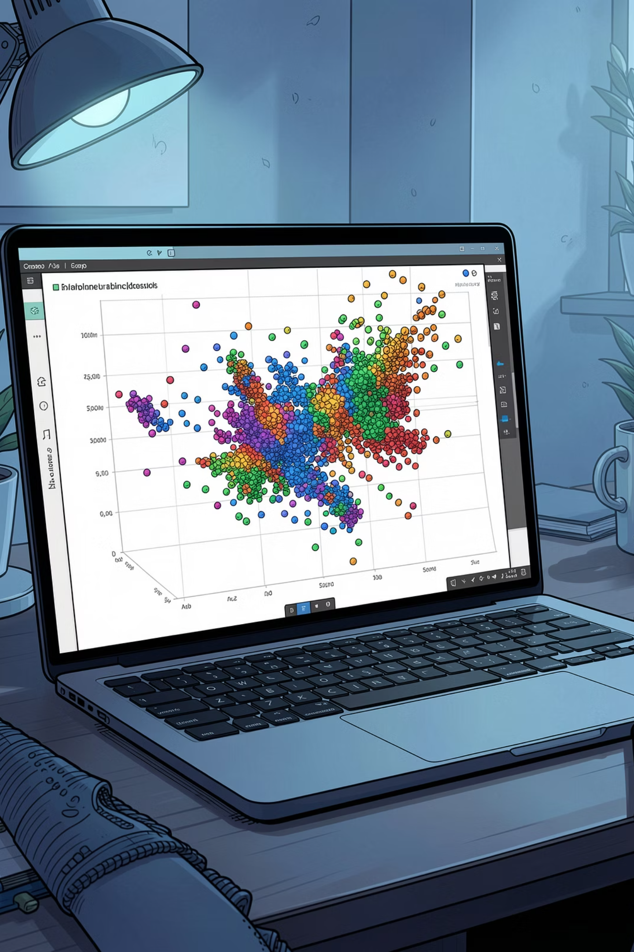

Plotly: Interactive and Dynamic 3D Charts
Plotly Express
One-line 3D scatter plots with px.scatter_3d() — minimal code, maximum interactivity. Zoom, pan, and rotate directly in the browser.
Fourth Dimension Mapping
Encode a fourth variable through color and symbol mapping — for example, visualizing Iris species alongside petal length and width.
Web-Ready Output
Plotly figures render natively in Jupyter, HTML, and web applications — no extra setup required.

Slide 6
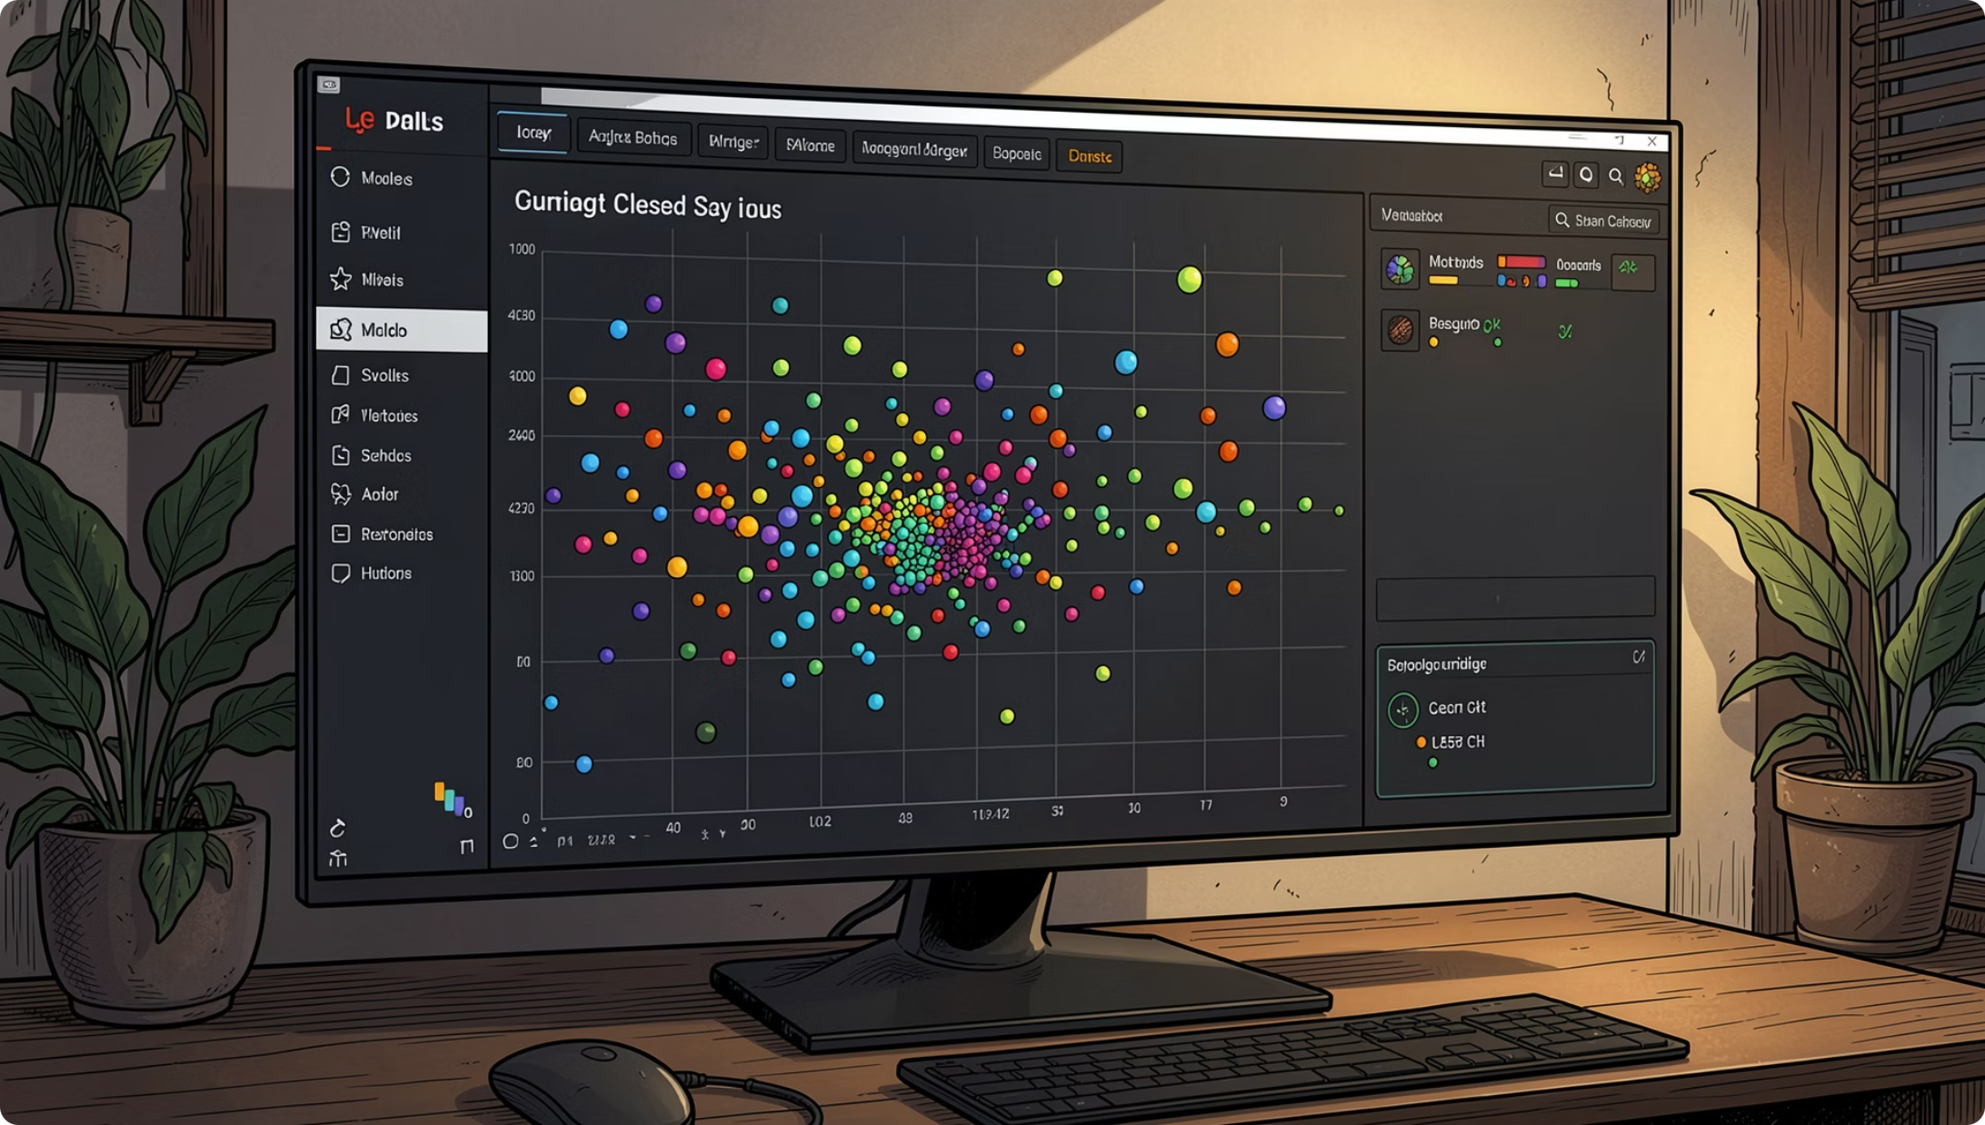
Plotly: Advanced Styling and Dash Integration
From Static to Fully Interactive
Plotly's advanced API gives you fine-grained control over every visual element — and Dash turns those plots into full analytical applications.
Marker sizing — Scale markers by a data variable for emphasis
Opacity & color — Control transparency and color scales per trace
Dash integration — Embed 3D plots in reactive web apps with callbacks
Hover templates — Customize tooltip content for richer context

Slide 7
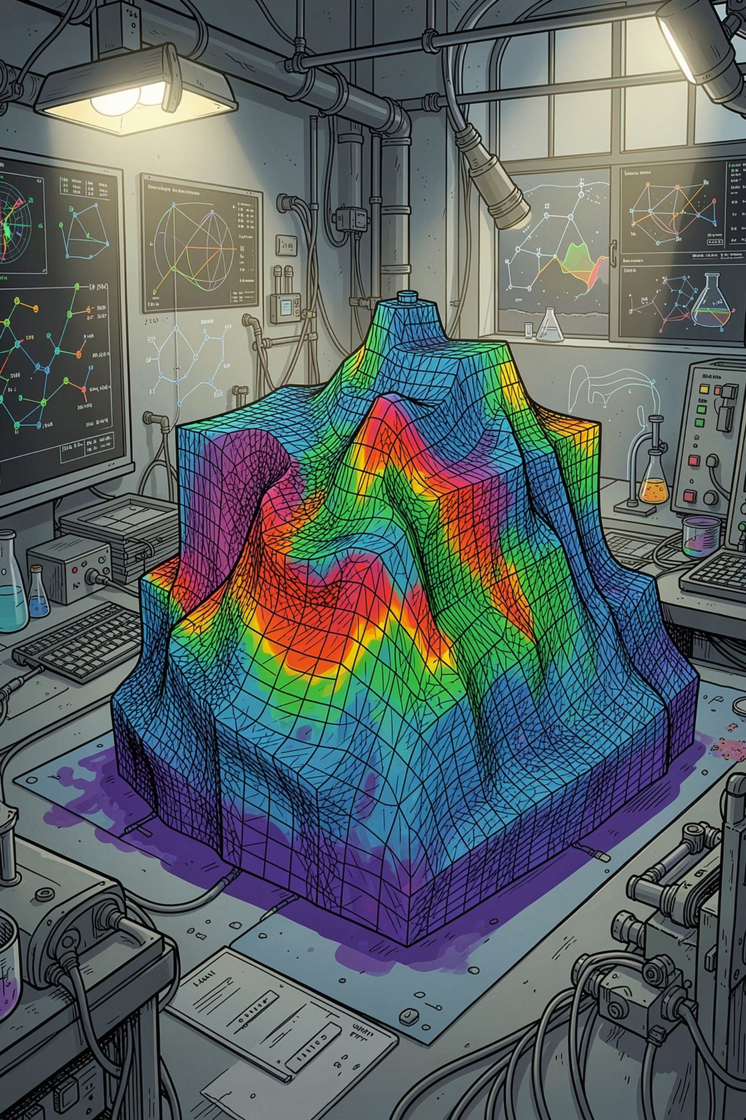
PyVista: Powerful 3D Visualization for Complex Data
Built on VTK
Plotter API
PyVista wraps the Visualization Toolkit (VTK), providing a Pythonic interface for meshes, grids, and volumetric datasets.
The pyvista.Plotter() object manages scenes, cameras, lighting, and rendering — all in a clean, intuitive API.
Mesh Styling
Add meshes, apply colormaps, toggle edge visibility, and adjust shading — ideal for engineering and geoscience data.

Slide 8
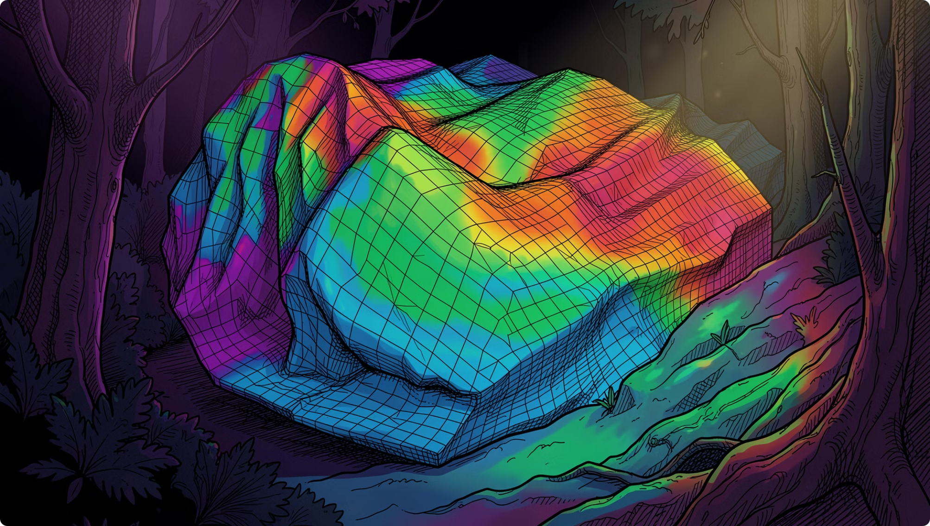
PyVista: Enhancing Visualizations with Advanced Features
Professional-Grade Rendering
PyVista supports advanced techniques that transform raw data into publication-quality visualizations.
1
Scalar Color Mapping
2
Opacity & Edges
3
Texture & Lighting
Map scalar values to Matplotlib colormaps for intuitive data encoding across surfaces.
Adjust mesh transparency and overlay edge lines to reveal internal structure.
Apply texture maps and configure PBR-style lighting for photorealistic rendering.

Slide 9
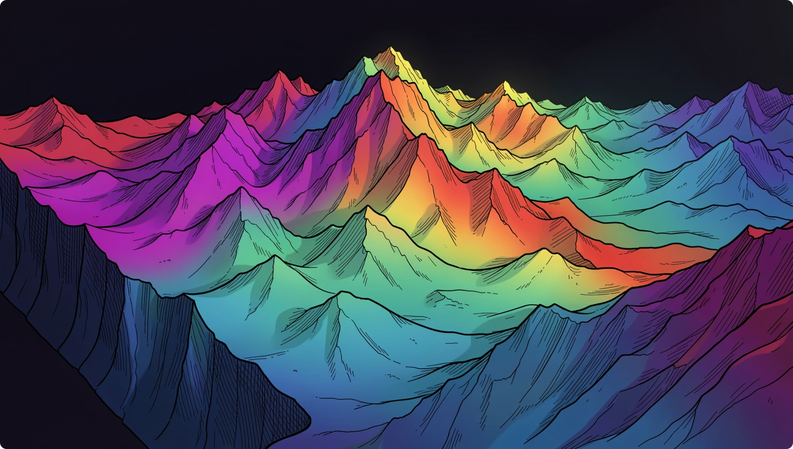

Mayavi: Interactive 3D Plotting for Scientific Data
The mayavi.mlab Interface
Mayavi offers a MATLAB-like scripting interface for rapid 3D exploration. Its mlab module is familiar to Matplotlib users but built for heavy scientific workloads.
mlab.points3d() — Plot 3D point clouds
mlab.plot3d() — Draw 3D lines and trajectories
mlab.surf() — Render elevation surfaces from 2D arrays
mlab.contour3d() — Visualize volumetric isosurfaces
Mayavi integrates with VTK under the hood, making it ideal for large-scale scientific datasets.

Slide 10

The Future of 3D Plotting: Interactivity and Beyond
1
Web-Native 3D
Libraries like JSXGraph and Three.js bring 3D plotting directly to browsers with no plugins.
2
Real-Time Rendering
GPU-accelerated pipelines enable live updates for streaming data, simulations, and dashboards.
3
Choosing Your Tool
Matplotlib for basics · Plotly for interactivity · PyVista for meshes · Mayavi for science

