Slide 1


SNS COLLEGE OF TECHNOLOGY
Coimbatore-35
An Autonomous Institution
Department of AIML
23AMO304-Introduction To Business Intelligence
Data Warehousing
Architecture
Foundations of BI & Data Marts
Dr. Angel Latha Mary S
SNS College of Technology | Coimbatore

Slide 2
STRATEGIC OVERVIEW
Transitioning to Intelligence
Moving from centralized chaos to departmental efficiency through structured Data Marts and Analytical Data management.

Slide 3


Defining the Data Mart
Subject-Oriented Subset
A Data Mart is a subset of a Data Warehouse focused on a specific department or line of business like Finance, Marketing, or HR.
Designed for analytical speed, it contains highly curated, structured data optimized for departmental analysts, removing enterprise clutter.

Slide 4
Three Pillars of Mart Architecture
Type | Approach | Data Source | Best For
Dependent | Top-Down | Enterprise DW (EDW) | Large Orgs with existing EDW
Independent | Bottom-Up | External Sources | Standalone/Urgent projects
Hybrid | Mixed | EDW + External Feeds | Testing or ad-hoc integration

Slide 5





Hub-and-Spoke Model Layers
Source Layer
Transformation
Storage Layer
Captures raw data from CRM, ERP, and flat files to serve as the initial feed for the warehouse ecosystem.
The cleaning, de-duplication, and subject-tagging layer that prepares raw data for high-quality analysis.
Optimized schema deployment (Star/Snowflake) in focused Data Marts for direct business unit access.

Slide 6
Attributes of Analytical Data
Time-Variant: Contains a historical flow of data points, allowing for trend analysis over months or years rather than just "current" state.
Integrated: Data from disparate sources is unified into a consistent format and naming convention across all departments.
Granularity: Balances high-level summaries with detailed records to support powerful "drill-down" capabilities for deeper insights.

Slide 7
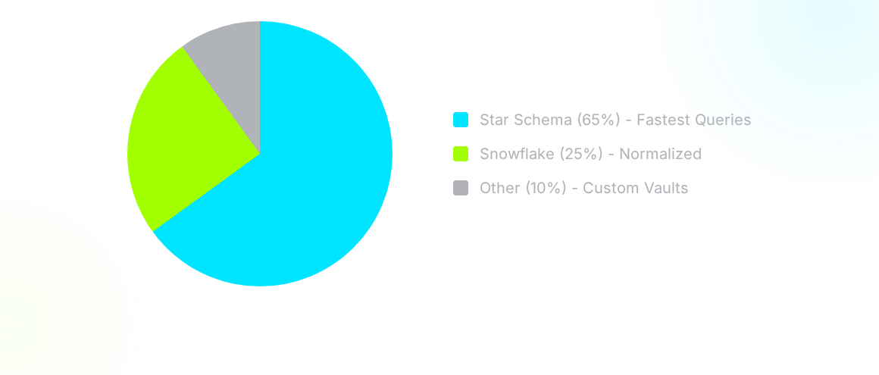
Schema Selection Trends
The Star Schema remains the industry standard due to minimal joins and intuitive design.

Slide 8
The Analytical Pipeline (ETL)
Extract
Transform
Load
Analyze
Capturing data from operational databases (OLTP).
Cleaning, de-duplication, and logic mapping.
Bulk insertion into subject-specific storage.
Discovery via tools like PowerBI or Tableau.

Slide 9

Why Deploy Marts?
Performance: Queries run up to 10x faster than in cluttered warehouses.
Security: Granular control over sensitive departmental data.
Cost: Significantly cheaper implementation than enterprise projects.
Agility: Faster response to departmental business requirements.

Slide 10
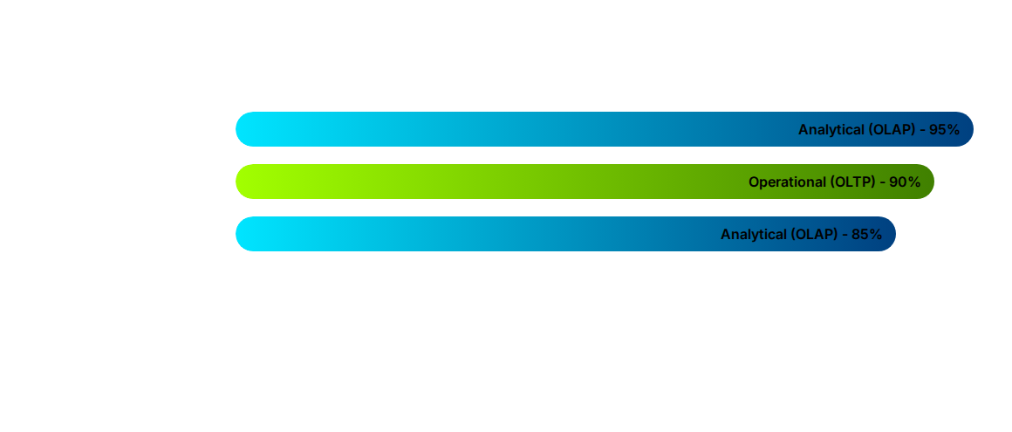
OLTP vs. Analytical OLAP
While OLTP focuses on running the business (transactions), OLAP focuses on analyzing the business (trends).

Slide 11

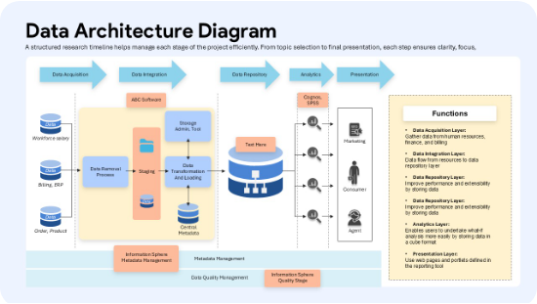
Data Marts in Action
Practical Applications
Finance: Analyzing quarterly performance and risk management silos with high precision.
Marketing: Tracking customer behavior and campaign ROI in real-time for adaptive strategies.
Operations: Monitoring supply chain latency and fulfillment efficiency.

Slide 12
Questions?
Thank you for your time!
Data Warehousing Architecture | Dr. Angel Latha Mary S

