Slide 1

SNS COLLEGE OF TECHNOLOGY
An Autonomous Institution Coimbatore-35
DEPARTMENT OF INFORMATION TECHNOLOGY
23ITT304 Information Coding Techniques
Unit II
Error Correction with Hamming Codes
P.Thilagarani AP/IT
ERROR DETECTION AND CORRECTION

Slide 2


Error Correction with Hamming Codes
Reliable Data Transmission in Digital Systems
12.03.2026 23ITT304-INFORMATION CODING TECHNIQUES | Error Correction with Hamming Codes | P.Thilagarani | SNSCT 2/12

Slide 3


Recap & The Digital Persona
Recap: Basic Parity
We use parity bits to detect if a single bit flipped during transmission.
The Persona: 'Priya the Network Engineer'
Priya manages critical data for a bank. A single corrupted bit in a transaction could mean the loss of millions.
The Challenge: Simple parity tells her something is wrong, but not where or how to fix it automatically.
12.03.2026 23ITT304-INFORMATION CODING TECHNIQUES | Error Correction with Hamming Codes | P.Thilagarani | SNSCT 3/12

Slide 4

Empathize & Define: The Problem
Empathize
In high-speed communication (satellite, banking), re-sending data isn't always an option. We need self-healing data.
Define the Core Problem
How can we detect AND correct a single-bit error without needing the sender to re-transmit the data?
We need a code that gives us location information, not just a 'yes/no' error flag.
12.03.2026 23ITT304-INFORMATION CODING TECHNIQUES | Error Correction with Hamming Codes | P.Thilagarani | SNSCT 4/12

Slide 5
Ideate: The Hamming Solution
The Solution: Redundancy at Powers of 2
Richard Hamming proposed placing check bits at specific positions (indices that are powers of 2: 1, 2, 4, 8...).
Why this works
Each check bit 'watches over' a specific group of data bits.
By checking which parity groups fail, we can calculate the exact index of the error—like a coordinate system for bits!
12.03.2026 23ITT304-INFORMATION CODING TECHNIQUES | Error Correction with Hamming Codes | P.Thilagarani | SNSCT 5/12

Slide 6
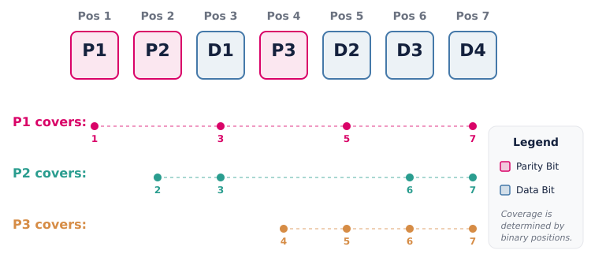
Prototype: Bit Placement Logic
12.03.2026 23ITT304-INFORMATION CODING TECHNIQUES | Error Correction with Hamming Codes | P.Thilagarani | SNSCT 6/12

Slide 7
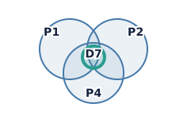
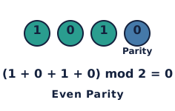
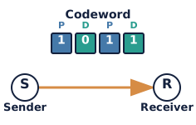
Prototype: Calculating Parity Bits
Step 1: Identify Coverage
Determine which data bits fall under each parity bit's 'watch zone' based on binary representation.
Step 2: Set Even Parity
Count the 1s in each group. Set the parity bit to 0 or 1 so the total number of 1s is even.
Step 3: Transmit Codeword
Send the combined sequence of parity bits and data bits to the receiver.
12.03.2026 23ITT304-INFORMATION CODING TECHNIQUES | Error Correction with Hamming Codes | P.Thilagarani | SNSCT 7/12

Slide 8
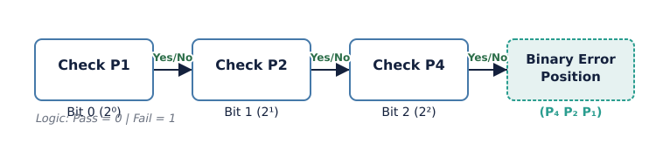
Prototype: Error Detection Logic
At the Receiver
The receiver recalculates the parity checks for all groups (P1, P2, P4...).
The Result
All pass → No Error. Some fail → Failure pattern (e.g., P1, P4) is a binary number indicating the corrupted bit.
12.03.2026 23ITT304-INFORMATION CODING TECHNIQUES | Error Correction with Hamming Codes | P.Thilagarani | SNSCT 8/12

Slide 9
Test: Quick Check
Answers on the next slide...
In a (7,4) Hamming code, if the parity checks for P1 and P4 fail, but P2 passes, what is the binary error position?
1.
011 (Bit 3)
2.
101 (Bit 5)
3.
110 (Bit 6)
4.
111 (Bit 7)
12.03.2026 23ITT304-INFORMATION CODING TECHNIQUES | Error Correction with Hamming Codes | P.Thilagarani | SNSCT 9/12

Slide 10
Test: Quick Check
✅​
In a (7,4) Hamming code, if the parity checks for P1 and P4 fail, but P2 passes, what is the binary error position?
1.
011 (Bit 3)
2.
101 (Bit 5)
👍​
3.
110 (Bit 6)
4.
111 (Bit 7)
12.03.2026 23ITT304-INFORMATION CODING TECHNIQUES | Error Correction with Hamming Codes | P.Thilagarani | SNSCT 10/12

Slide 11
Stanford T-Shaped Model
Vertical Depth (Technical)
Redundancy: Adding extra bits specifically for error control.
Syndrome Decoding: Using the pattern of parity failures to pinpoint errors.
Hamming Distance: The mathematical property ensuring single-bit error correction capability.
Formula: 2ʳ ≥ m + r + 1
Horizontal Breadth (Application)
Computer Memory (RAM): ECC memory uses Hamming codes to prevent crashes.
Satellite Comms: Corrects noise-induced errors without re-transmission delay.
Future Scope: Basis for more advanced codes like Reed-Solomon used in CDs and QR codes.
12.03.2026 23ITT304-INFORMATION CODING TECHNIQUES | Error Correction with Hamming Codes | P.Thilagarani | SNSCT 11/12

Slide 12
THANK YOU
12.03.2026 23ITT304-INFORMATION CODING TECHNIQUES | Error Correction with Hamming Codes | P.Thilagarani | SNSCT 12/12

