Slide 1

SNS COLLEGE OF TECHNOLOGY
An Autonomous Institution Coimbatore-45
DEPARTMENT OF INFORMATION TECHNOLOGY
23ITT304 Information Coding Technique
Unit IV
Mastering the Standard Array
P.Thilagarani AP/IT
LINEAR BLOCK CODES AND CYCLIC CODES

Slide 2

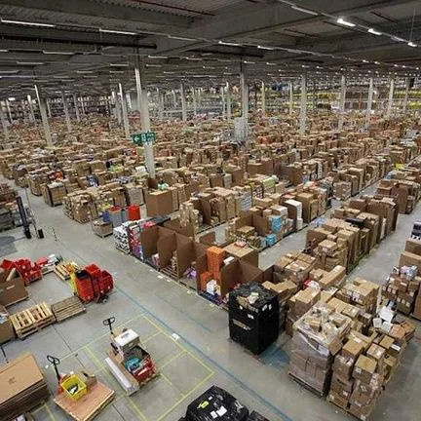
Mastering the Standard Array
Efficient Data Management in Programmatic Architectures
13.05.2026 23ITT304-INFORMATION CODING TECHNIQUES |Mastering the Standard Array | P.Thilagarani | SNSCT 2/14

Slide 3


Memory Check & Icebreaker
STARTER
Think Fast!
If you had to store 1,000 student IDs in separate variables (, , etc.), how long would it take to calculate the average?
Objective: Today we move from individual variables to indexed collections, focusing on memory efficiency and speed.
13.05.2026 23ITT304-INFORMATION CODING TECHNIQUES |Mastering the Standard Array | P.Thilagarani | SNSCT 3/14

Slide 4

Empathize: The Developer's Pain
Meet Arjun
Arjun, a Junior Dev in Bengaluru, manually updates bank logs.
Conflict: Scattered data creates 'Spaghetti Code'.
Need: Group related data for efficient loop processing.
🔑
Key point
Arrays solve manual handling by grouping values under one identifier.
13.05.2026 23ITT304-INFORMATION CODING TECHNIQUES |Mastering the Standard Array | P.Thilagarani | SNSCT 4/14

Slide 5
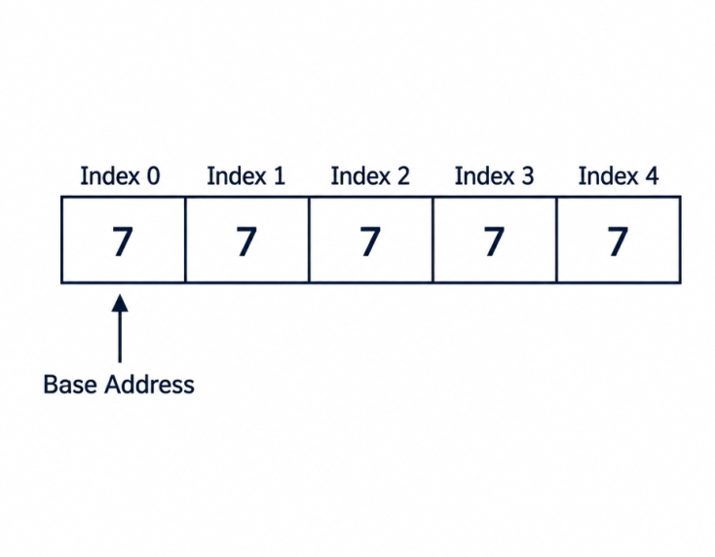
Define & Ideate: The Standard Array
The core challenge is Contiguous Memory Allocation. We need a structure that stores elements of the same type in adjacent memory locations.
The Solution: Arrays
Fixed Size: Allocated at compile/init.
Homogeneity: Only one data type allowed.
O(1) Access: Instant access via index.
13.05.2026 23ITT304-INFORMATION CODING TECHNIQUES |Mastering the Standard Array | P.Thilagarani | SNSCT 5/14

Slide 6
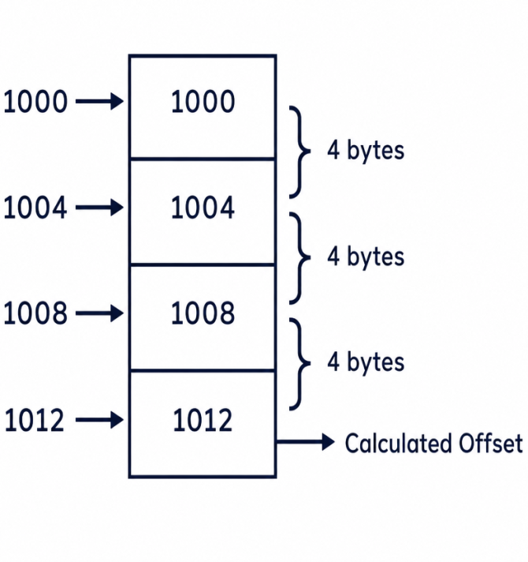
Prototype: Practical Implementation
TECHNICAL DEPTH
Calculation of memory address for :
Address = Base + (index × size)
Contiguous: No gaps in memory.
Static: Size cannot be changed after creation.
🔍
Example
If an Integer is 4 bytes and Base is 1000, then index 3 is at: 1000 + (3 × 4) = 1012.
13.05.2026 23ITT304-INFORMATION CODING TECHNIQUES |Mastering the Standard Array | P.Thilagarani | SNSCT 6/14

Slide 7
Test Your Logic
Answers on the next slide...
Arrange the steps for accessing an element in an array by its memory location:
Retrieve the value from the calculated address
Multiply the target index by the data type size
Identify the Base Address of the array
Add the result to the Base Address
13.05.2026 23ITT304-INFORMATION CODING TECHNIQUES |Mastering the Standard Array | P.Thilagarani | SNSCT 7/14

Slide 8
Test Your Logic
✅​
Arrange the steps for accessing an element in an array by its memory location:
Identify the Base Address of the array
1.
Multiply the target index by the data type size
2.
Add the result to the Base Address
3.
Retrieve the value from the calculated address
4.
13.05.2026 23ITT304-INFORMATION CODING TECHNIQUES |Mastering the Standard Array | P.Thilagarani | SNSCT 8/14

Slide 9

Horizontal Breadth: Applications
Arrays are the DNA of complex structures.
Images: 2D arrays of pixels.
OS: Process scheduling queues.
AI: Matrices for neural networks are essentially multidimensional arrays.
An array is a collection of variables of the same type. — Bjarne Stroustrup
13.05.2026 23ITT304-INFORMATION CODING TECHNIQUES |Mastering the Standard Array | P.Thilagarani | SNSCT 9/14

Slide 10
The Summary Mind Map
13.05.2026 23ITT304-INFORMATION CODING TECHNIQUES |Mastering the Standard Array | P.Thilagarani | SNSCT 10/14

Slide 11


The 'T-Shaped' Challenge
If your program requires adding thousands of new items every second, is a standard array still your best choice? Why or why not?
13.05.2026 23ITT304-INFORMATION CODING TECHNIQUES |Mastering the Standard Array | P.Thilagarani | SNSCT 11/14

Slide 12
The 'T-Shaped' Challenge
✅​
You might have said...
Static arrays have fixed sizes, hindering scaling.
Inserting at the start requires costly element shifting.
Dynamic arrays or linked lists suit frequent insertions.
Trade-off: You lose static arrays' instant address calculation.
13.05.2026 23ITT304-INFORMATION CODING TECHNIQUES |Mastering the Standard Array | P.Thilagarani | SNSCT 12/14

Slide 13

Reflect & Connect
Peer Inquiry
Turn to your neighbor and identify one real-world dataset in a banking app that must be an array and one that should not be.
Next Session: Linked Lists and the end of Contiguous Memory.
🧠
Remember
In programming, memory choice is always a trade-off between speed and flexibility.
13.05.2026 23ITT304-INFORMATION CODING TECHNIQUES |Mastering the Standard Array | P.Thilagarani | SNSCT 13/14

Slide 14
13.05.2026 23ITT304-INFORMATION CODING TECHNIQUES |Mastering the Standard Array | P.Thilagarani | SNSCT 14/14

